Slide 1
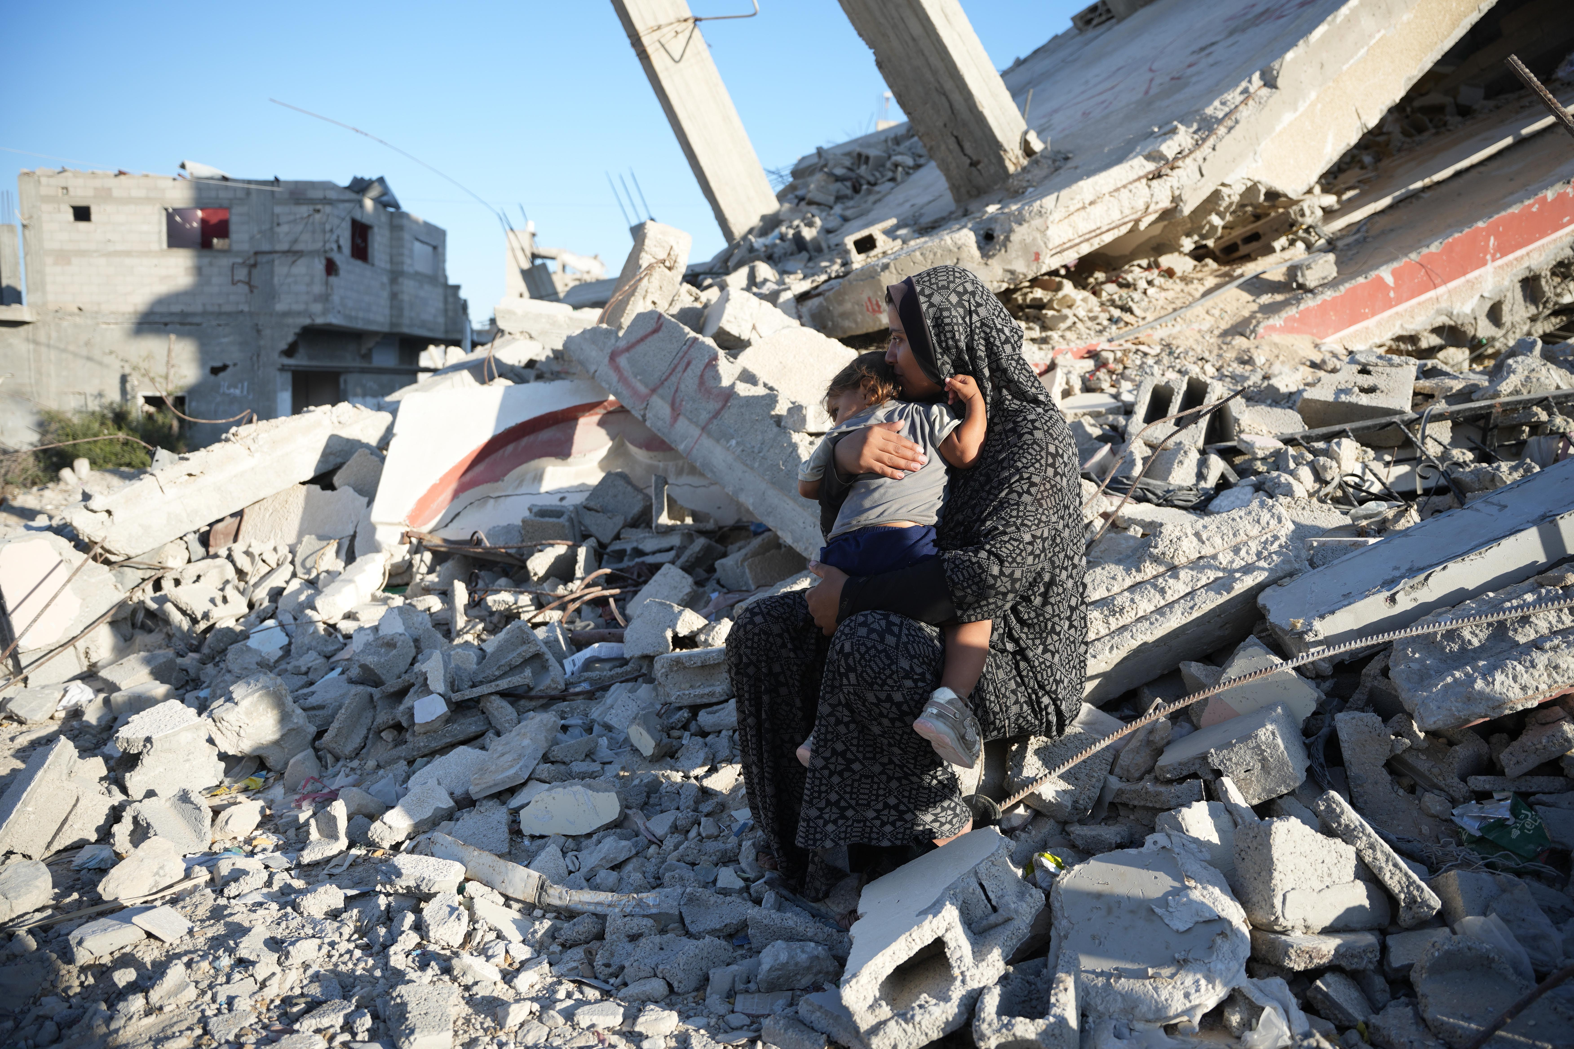
DEC
Middle East Humanitarian Appeal
A guide for young people
Notes:
Please find the most current updates about the situation, and the link to make any donations to our appeal, at: https://cafod.org.uk/News/Emergencies-news
Thank you for your prayerful and generous support. As part of the CAFOD and Caritas family, you are already there in this emergency.
Image credit: Withheld for security reasons

Slide 2
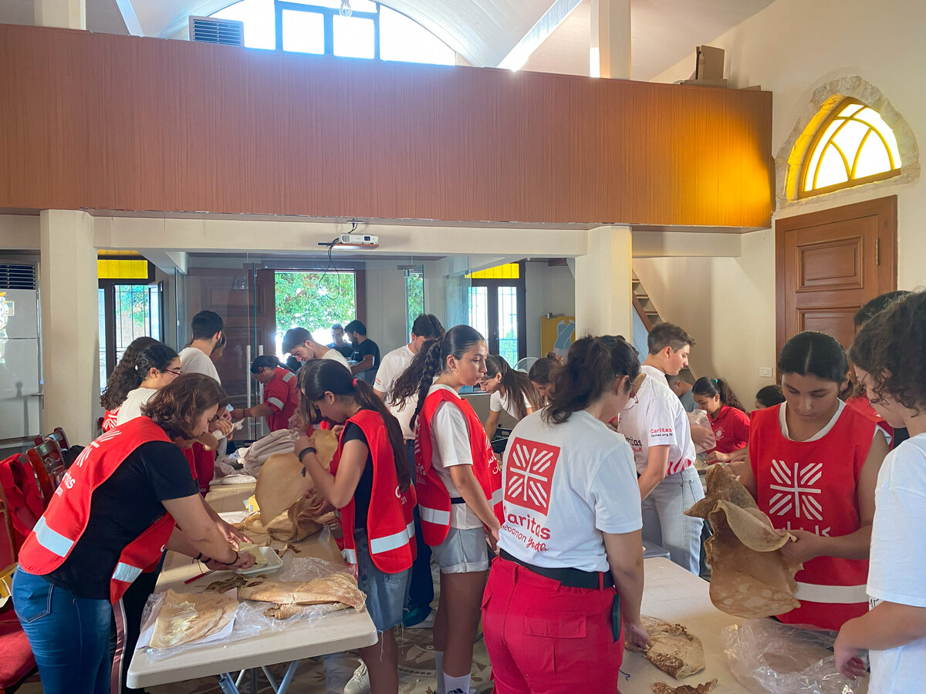
With the launch of the DEC appeal we have put together a new powerpoint which explains recent developments, the role of the DEC and the work of CAFOD.
Caritas Lebanon providing food parcels
DEC Middle East Humanitarian Appeal

Slide 3
To discuss the situation in the Middle East we need to…
Learn about the situation from multiple different sources. CAFOD listens carefully to our partners in the Middle East.
Pray for all the people involved in this situation.
Respond sensitively as this is a fast-changing situation. Make sure you think carefully before you speak or act.
DEC Middle East Humanitarian Appeal

Slide 4
What has happened?
The Disasters Emergency Committee has announced a humanitarian appeal for Middle East.
There are 15 members of the DEC and CAFOD is one of them.
DEC Middle East Humanitarian Appeal
Notes:
Image credit: Caritas Jerusalem

Slide 5
In 2023 the DEC marked 60 years of DEC Appeals. In total they have responded to 77 different world crisis’.
DEC Middle East Humanitarian Appeal
Notes:
Video length: 3 minutes 17

Slide 6
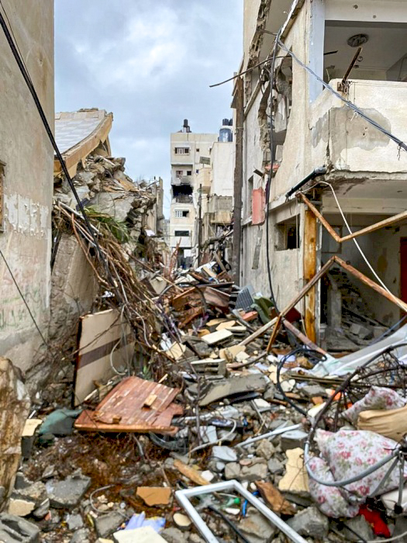
What has happened?
Conflict across the Middle East region is escalating rapidly, following a year of conflict which has caused an ever-worsening humanitarian crisis in Gaza.
Communities in Gaza, the West Bank, Lebanon, Syria and Israel are increasingly caught up in the violence.
The recent escalation of hostilities between Hezbollah and Israel, and the humanitarian and displacement crisis it causes, is putting populations at risk and further threatening regional security and stability.
A street in Gaza near a CAFOD partners’ health clinic, shortly after shelling
DEC Middle East Humanitarian Appeal
Notes:
Image credit: Caritas Jerusalem

Slide 7
Aaliyah* sits on the remains of a damaged building with her daughter in their neighbourhood in southern Gaza, in October 2024. Aaliyah depends entirely on aid to feed her family as she has been unable to earn an income since October 2023.
DEC Middle East Humanitarian Appeal
Notes:
Aaliyah* is a pseudonym

Slide 8
Aaliyah said “My family consists of eight members - me, my husband, five daughters, and a son.
I had a house that was demolished in February. We live in a tent near the rubble of our home. I always find my daughter sitting by the rubble, crying, and she only calms down when she sits there. My daughter is the main reason we live near the rubble of our house. She only stops crying and calms down when she sits there. We are suffering a lot, especially in winter. We have nothing to protect us from the rain or a shelter like other people, and my little daughter freezes from the cold.”
DEC Middle East Humanitarian Appeal
Notes:
Aaliyah* is a pseudonym

Slide 9
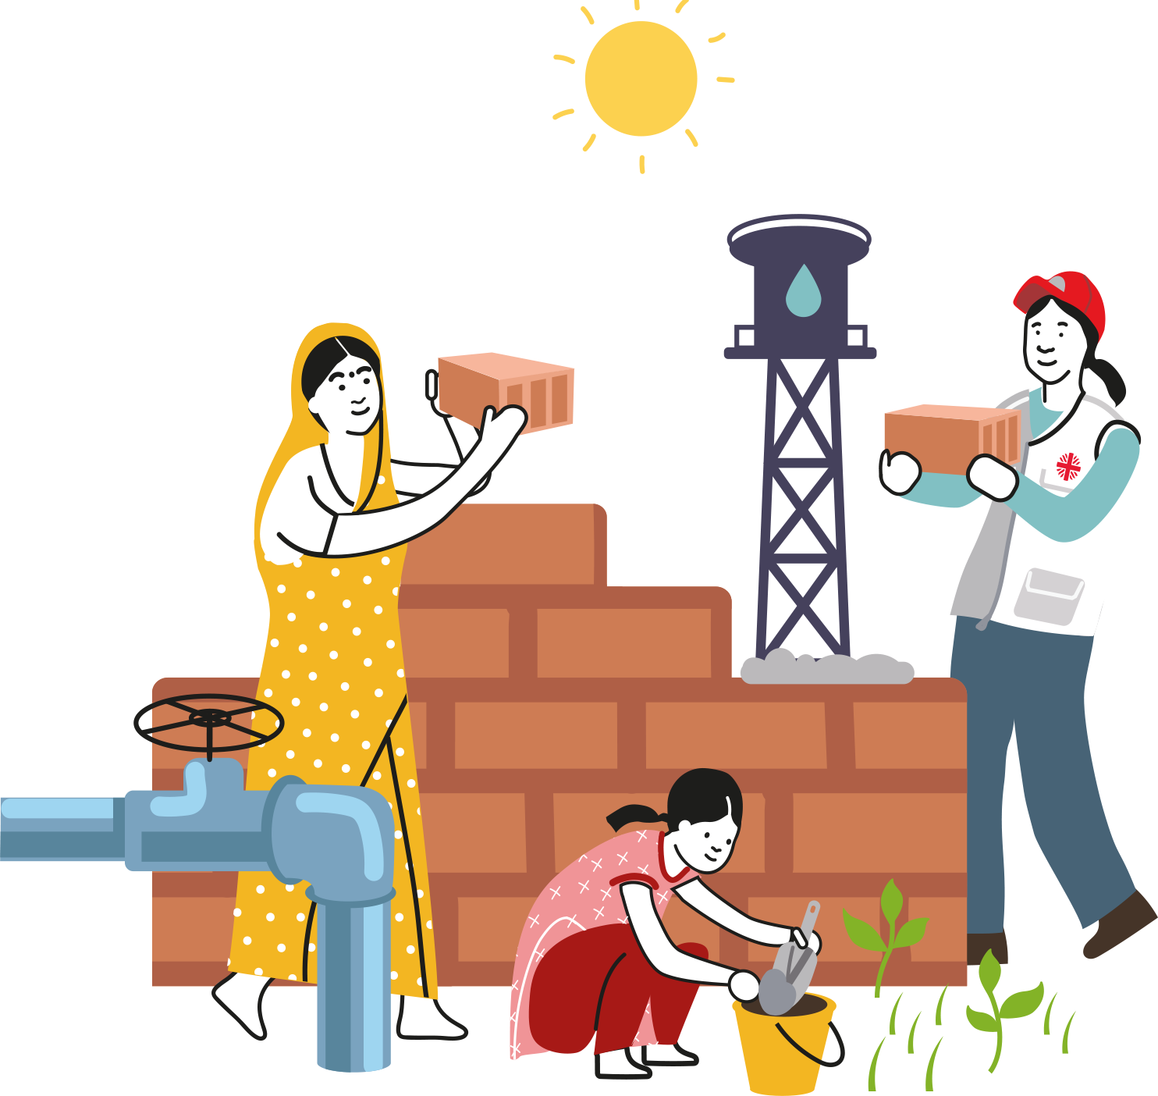
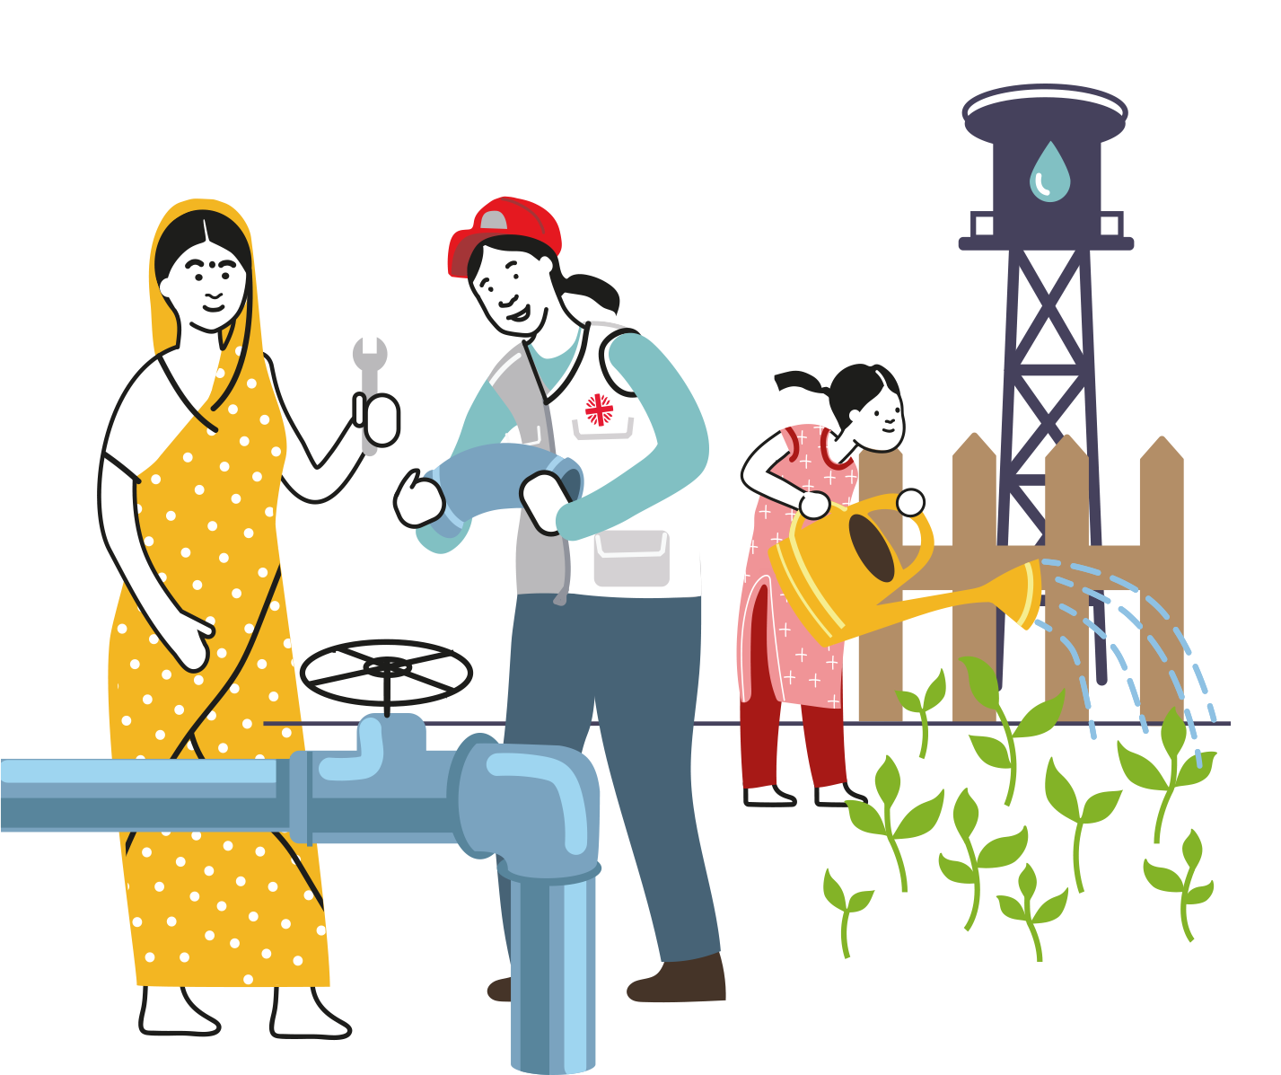
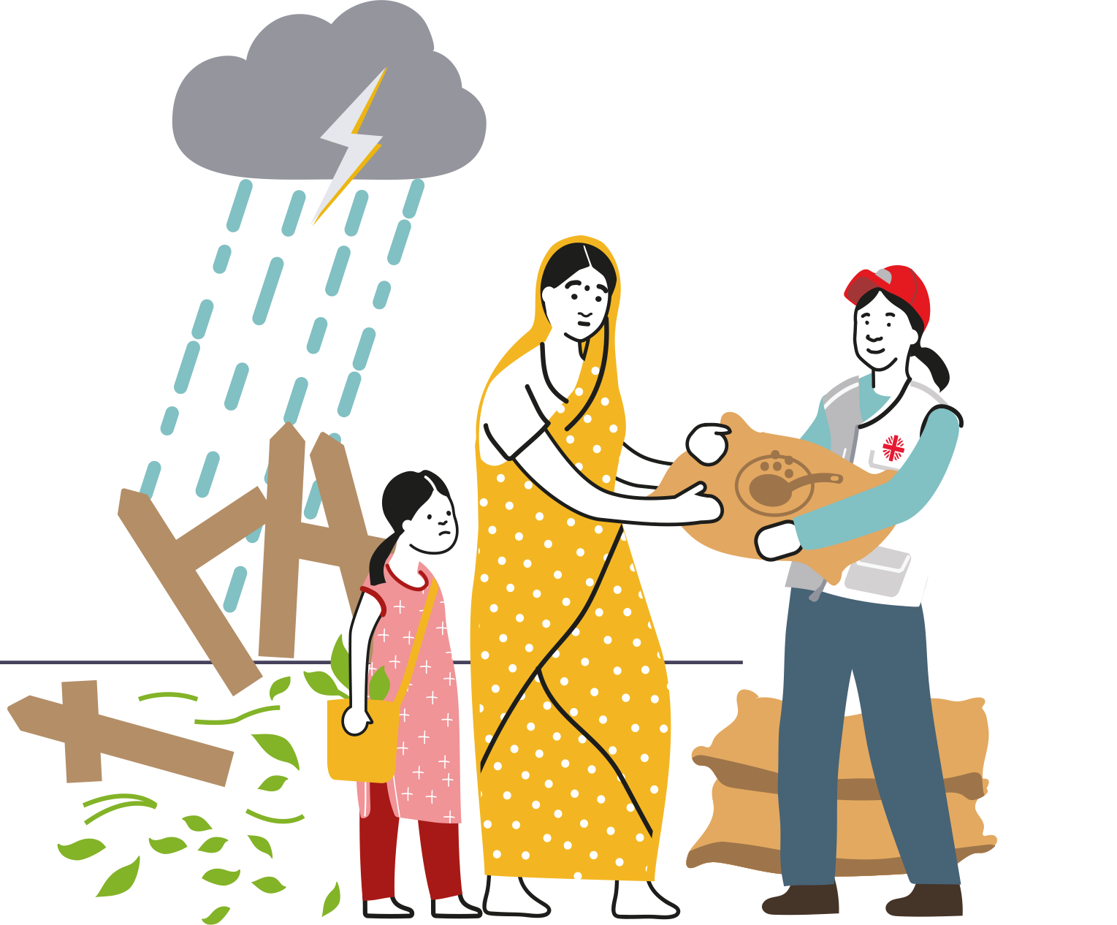
CAFOD is there…
BEFORE
>
DURING
>
AFTER
…any emergency
DEC Middle East Humanitarian Appeal

Slide 10
Caritas Internationalis
We are part of one of the largest aid agencies in the world, Caritas Internationalis. You’ll notice the Caritas flame in our logo. Through Caritas Internationalis we can reach more people.
CAFOD works with partners in Lebanon, Syria, Israel and the occupied Palestinian territory supporting those most impacted by conflict and crisis.
DEC Middle East Humanitarian Appeal
Notes:
Picture credit: Save the Children

Slide 11
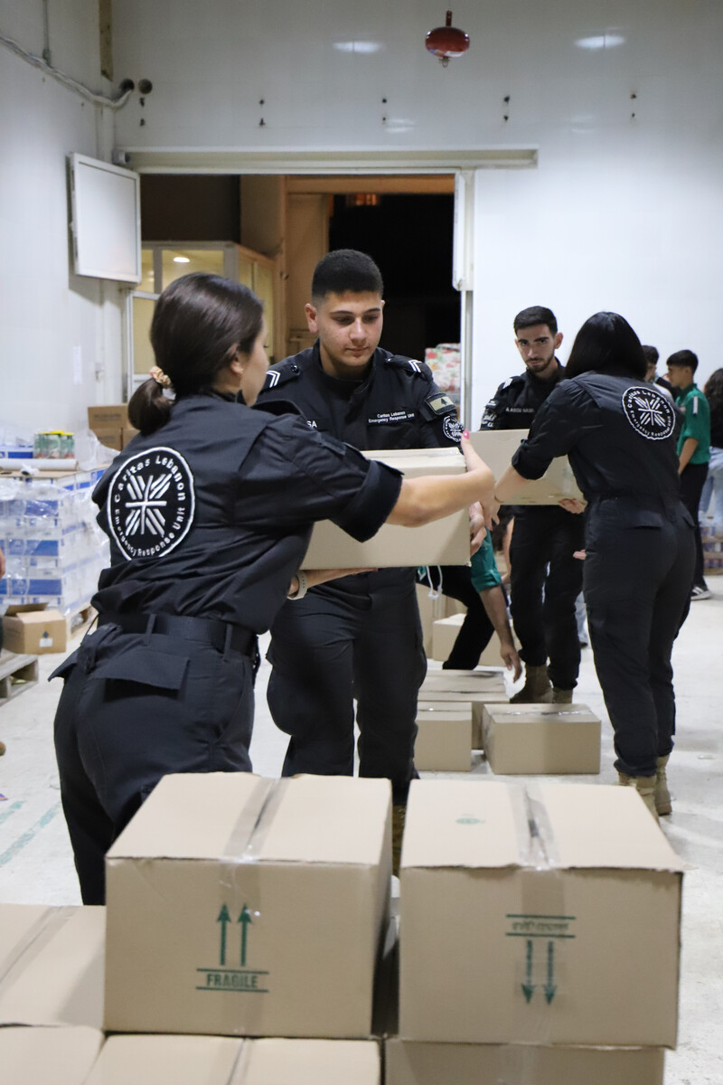
What has CAFOD been doing?
CAFOD has been working in the Middle East since the mid-1980s and works with Christian, Jewish, Muslim and secular partner organisations ‘with the aim of protecting human rights and contributing towards building more peaceful communities.’
Caritas Lebanon providing emergency supplies
DEC Middle East Humanitarian Appeal
Notes:
Picture credit: Save the Children

Slide 12
In Lebanon we support processes which enable dialogue between different groups of people. This includes bringing together families who have been impacted by decades of intra-community fighting to talk about the impact of war.
CAFOD’s long term work in the Middle East
In the occupied Palestinian territory, we provide urgent humanitarian support during crises, seek to provide protection for those at risk, to counter violence, to uphold people’s rights and dignity and to support those working for peace and justice.
In Israel we aim to nurture a culture of encounter between Palestinian and Jewish citizens, to explore questions around identity and belonging and to imagine a shared future with justice and peace for all.
DEC Middle East Humanitarian Appeal
Notes:
Picture credit:

Slide 13
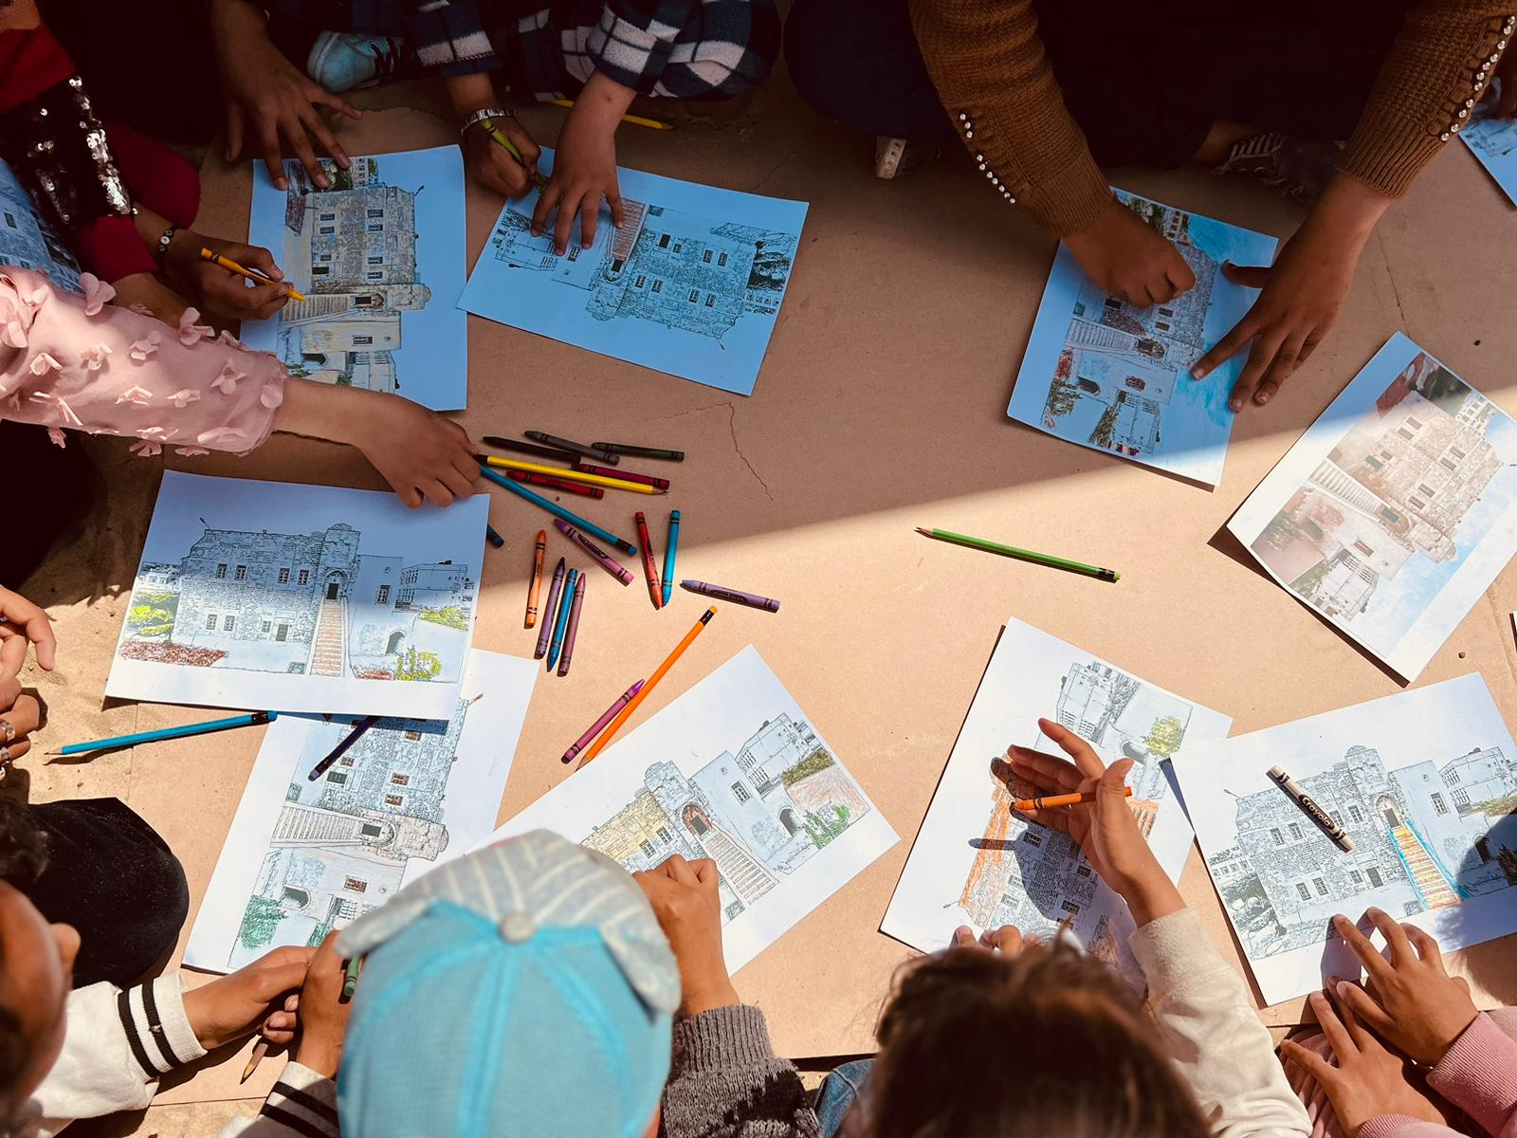
‘‘Enough war, enough attacks, enough violence. Yes to dialogue, yes to peace.’’
Pope Francis
“Every day I wait until 9 am to participate in activities, especially drawing. I love to draw and colour, and I also meet my new friends that I have found.” Hala aged 12

Slide 14
What is CAFOD currently doing?
FOOD, WATER, SHELTER
In Gaza, levels of hunger continue to rise. In Lebanon, airstrikes are damaging critical infrastructure, homes and hospitals and forcing people to flee.
Many people have sought safety in collective shelters, but these are now nearly at capacity and people are being forced to sleep on the streets.
Your donation will help local aid workers to give urgent, practical help to families in Lebanon and Gaza, the West Bank and Israel and quickly respond to other emergencies around the world.
DEC Middle East Humanitarian Appeal
Notes:
Picture credit:

Slide 15
“It’s been a year of asking ourselves difficult questions, of wondering how we continue to fight for justice in a world that often feels so broken. But it is in these moments of despair that our collective hope and resilience are most important.”
CAFOD’s partner in Israel
DEC Middle East Humanitarian Appeal

Slide 16
What can we do to help?
PRAY – pray for our brothers and sisters in the Middle East and the members of the DEC
GIVE – fundraise for the appeal
DEC Middle East Humanitarian Appeal

Slide 17
What can we do to help?
£10 gives displaced families emergency water
£120 gets emergency shelter to three households
DEC Middle East Humanitarian Appeal

Slide 18
Let’s pray
God of peace, bearer of hope, we seek your help for the peoples of the Middle East.
Quiet the clamour of war and guide us towards peace.
Where there is hatred and division sow seeds of calm and openness.
Where there is destruction help us to rebuild.
Where children are crying bring an end to tears.
Shelter your peoples and protect them Guide them and keep them from harm.
Show us how to break down the barriers of history and fear and breathe whispers of hope.
Amen.
DEC Middle East Humanitarian Appeal
Notes:
Linda Jones / CAFOD

