Slide 1
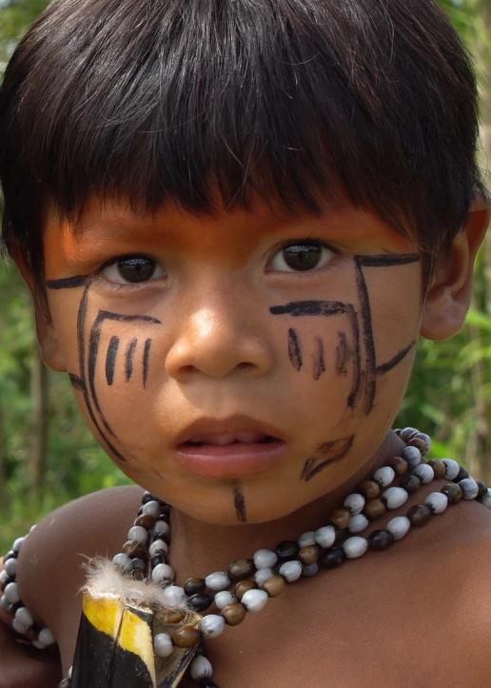
A prayer for the poor and the earth
God of the poor, help us to rescue the abandoned and forgotten of this earth. Touch the hearts of those who look only for gain at the expense of the poor and the earth. Teach us to discover the worth of each thing, to be filled with awe and contemplation, to recognise that we are profoundly united with every creature as we journey towards your infinite light. Encourage us, we pray, in our struggle, for justice, love and peace. AMEN
Pope Francis, Laudato Si’, 2015

