Slide 1
Year 2 Treasures

Slide 2
Now that you have listened to Psalm 147, think carefully about these questions.

Slide 3
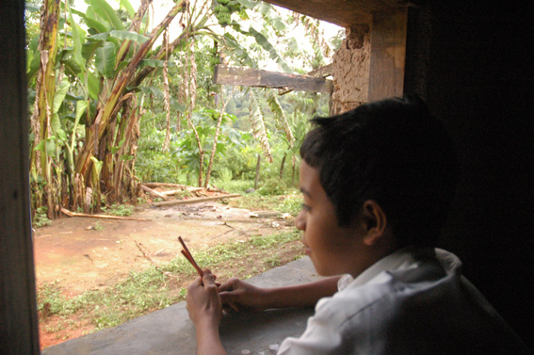
What can Erik see from his window in Honduras?
Notes:
Photo: Marcella Haddad
COUNTRY: Honduras LOCATION: Marcala in La Paz
Marcelina's son, Erik, looking through the window. Marcelina is one of the founding members of COMUCAP and provides technical support to member organisations in organic farming as well as helping women to grow aloe vera plants to make soap & shampoo.

Slide 4
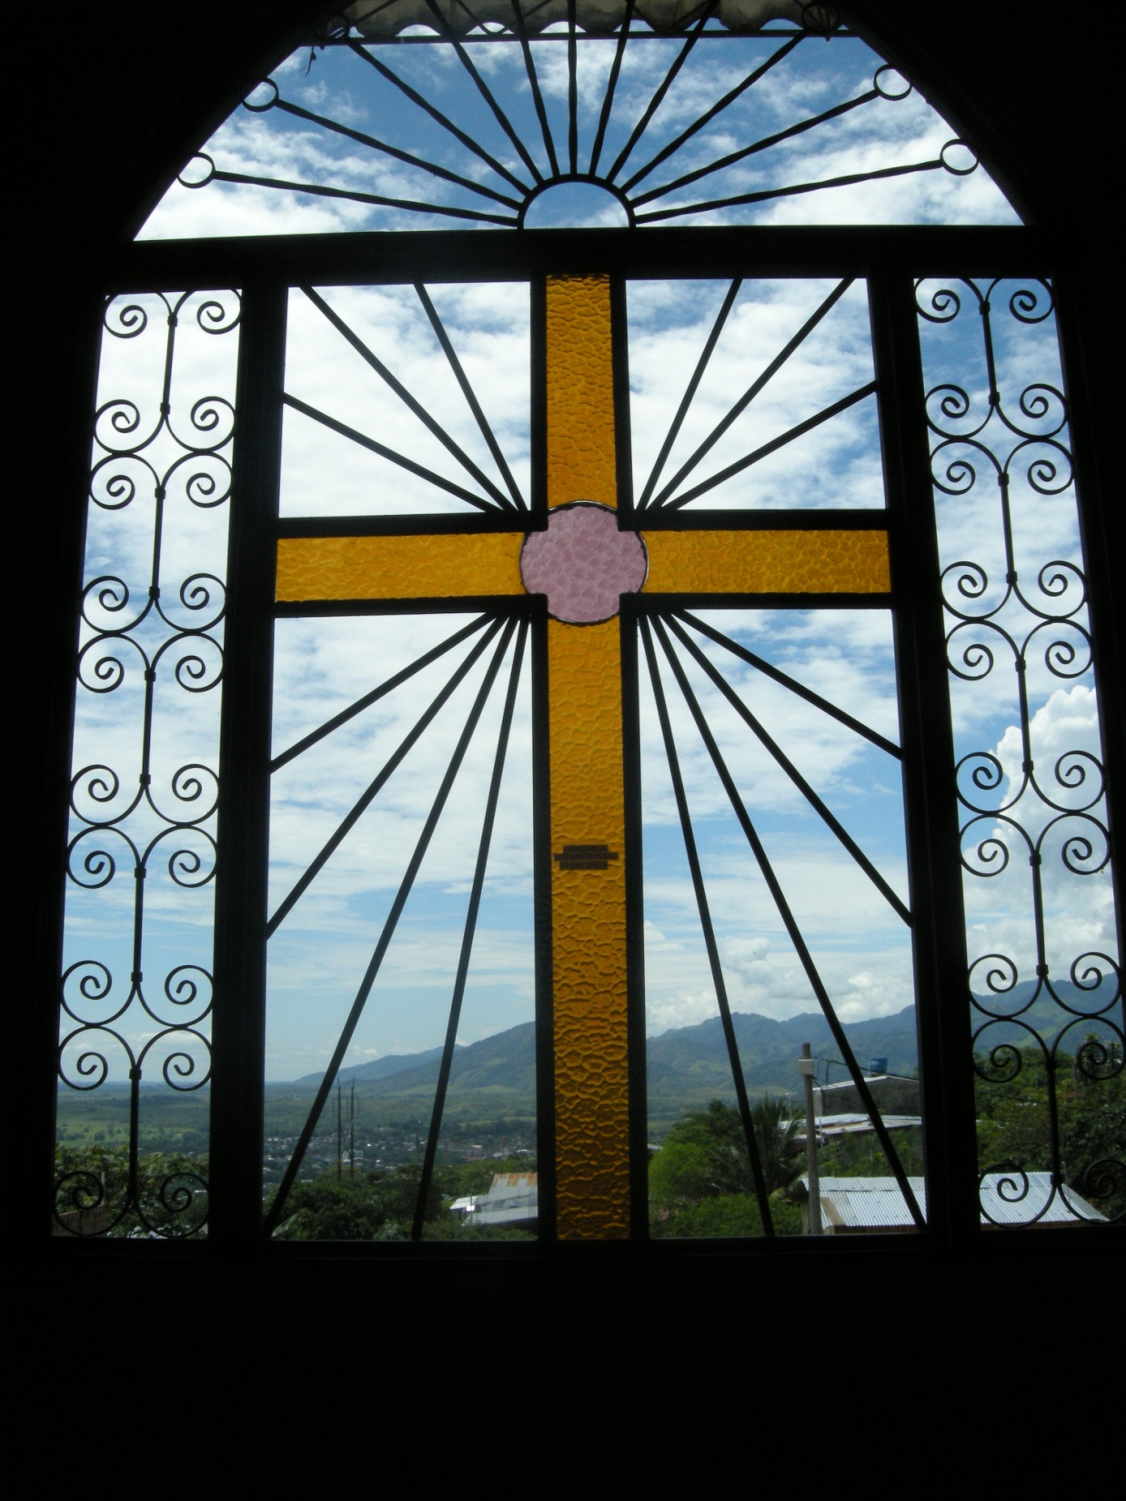
What can people see from this window in Colombia?
Notes:
Colombia
PHOTOGRAPHER: Barbara Davies
Cross and window grille at Espiritu Santo Parish, Florencia.

Slide 5
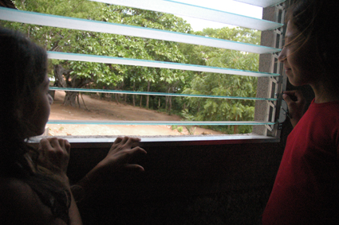
What can Dominga see from the window of her house in Nicaragua?
Notes:
Photo: Marcella Haddad
COUNTRY: Nicaragua LOCATION: Cerro Pando, Rural Nicaragua
Rosa Ramires Rodriguez and her daughter Dominga at the window of their new house which was built as part of a project that her husband, Domingo, worked on. He is a carpenter and helps on building projects with the John XXIII Institute to improve housing after Hurricane Stanley

Slide 6
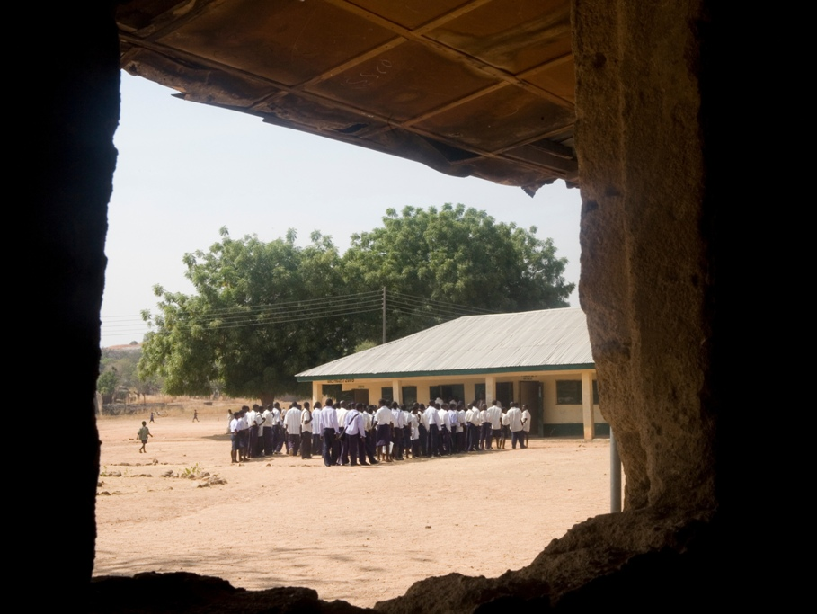
What can children see from this school window in Nigeria?
Notes:
Nigeria
PHOTOGRAPHER: Simon Rawles
The view from a window at Yakoko village school

Slide 7
What do you
see out of
your window?

Slide 8
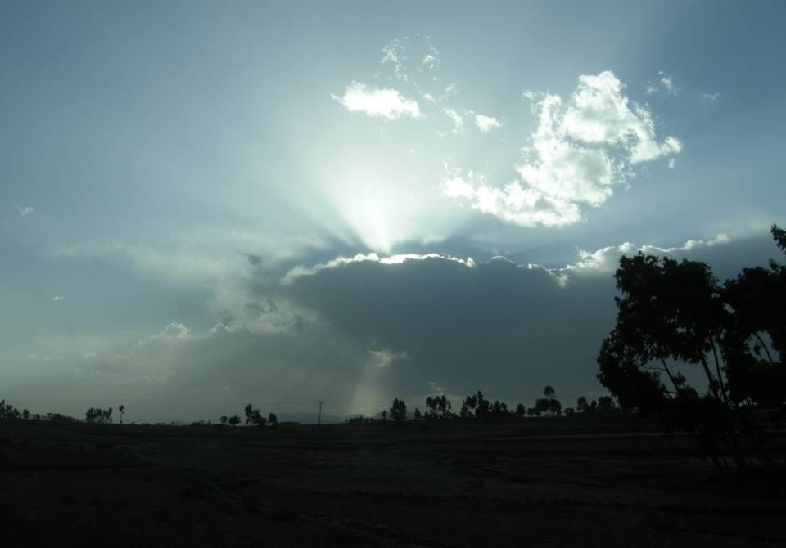
God made the earth and sky.

Slide 9
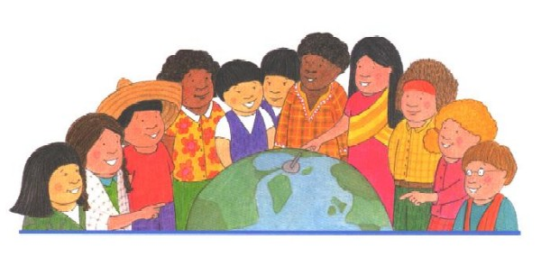
God made all people all over the world.

Slide 10
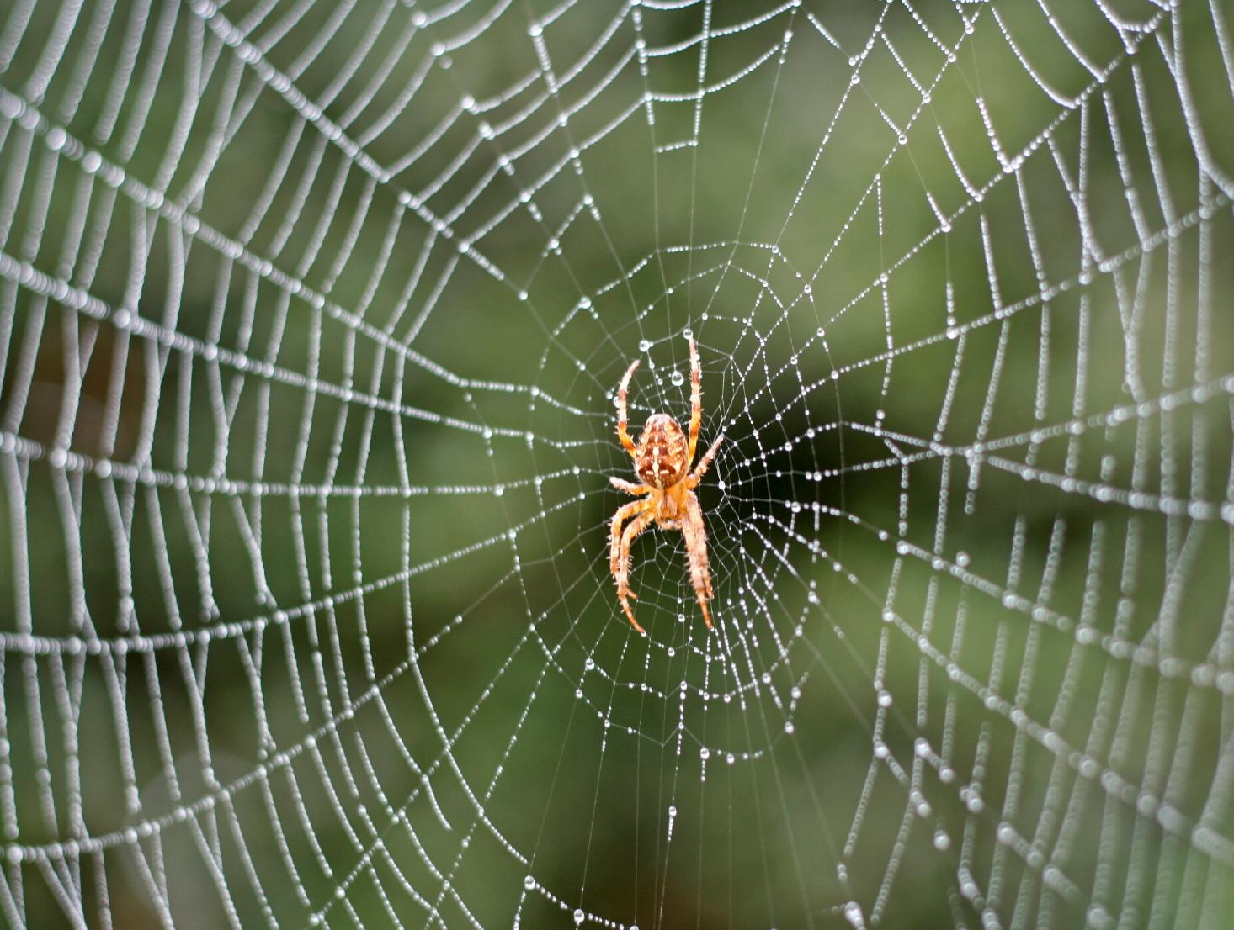
God made spiders

Slide 11
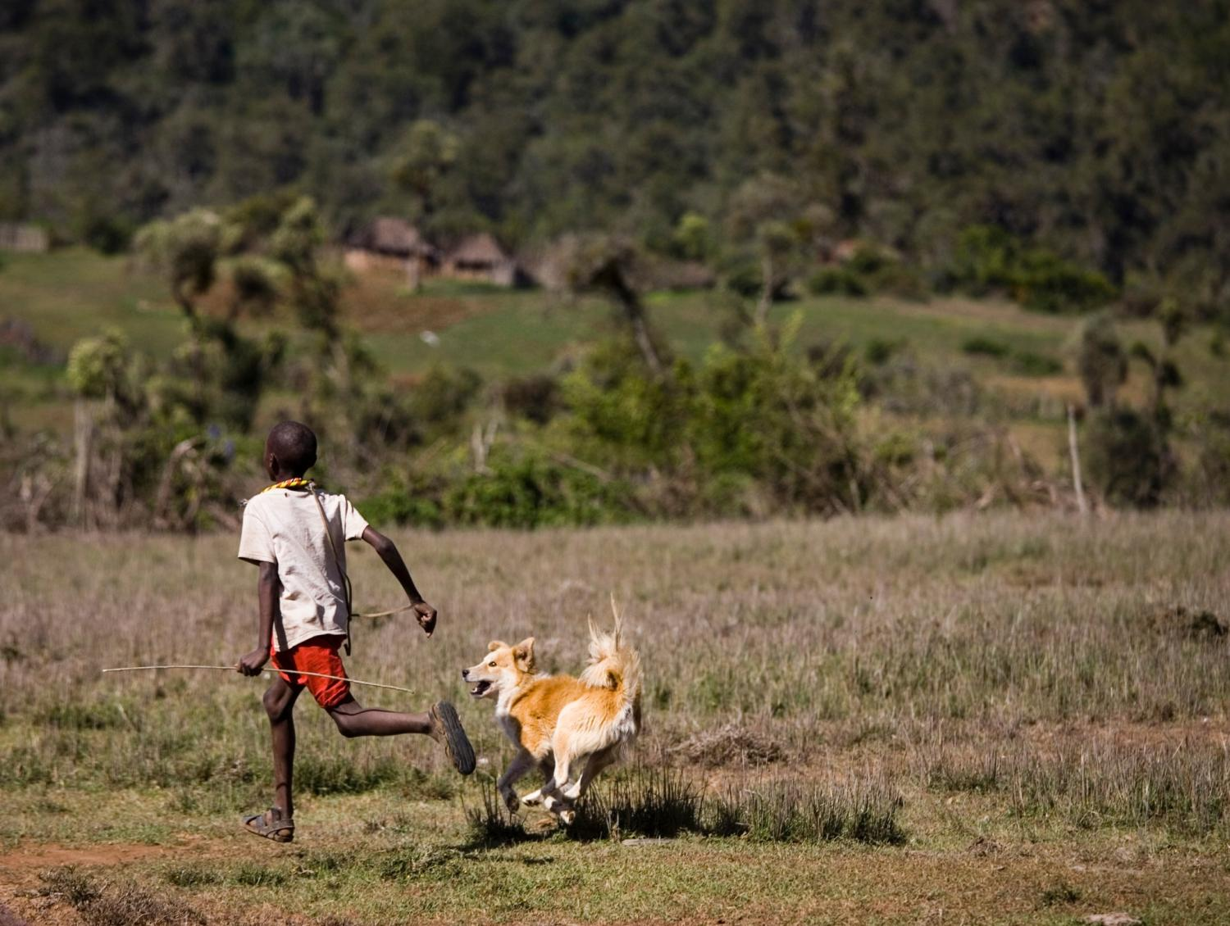
and dogs

Slide 12
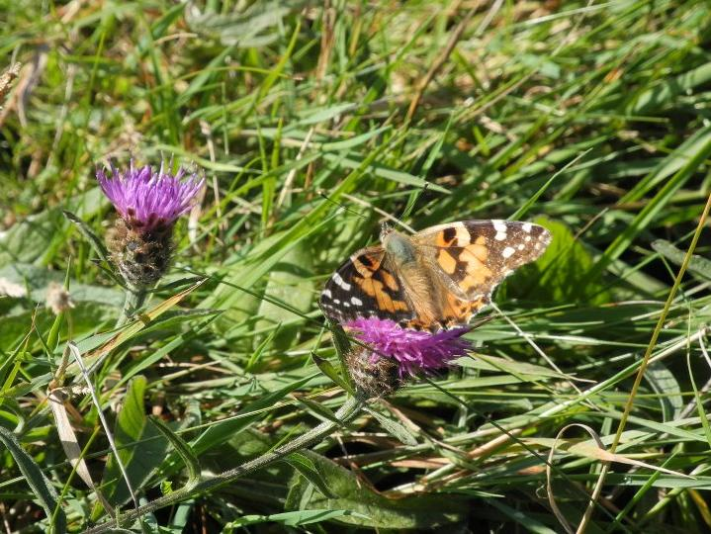
and butterflies

Slide 13
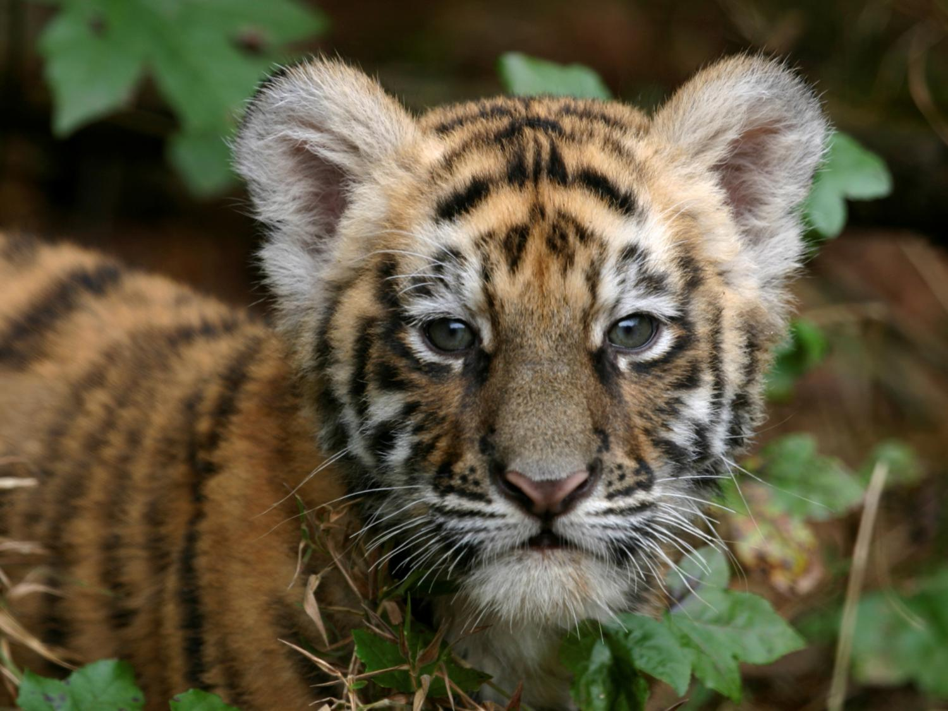
and tigers

Slide 14
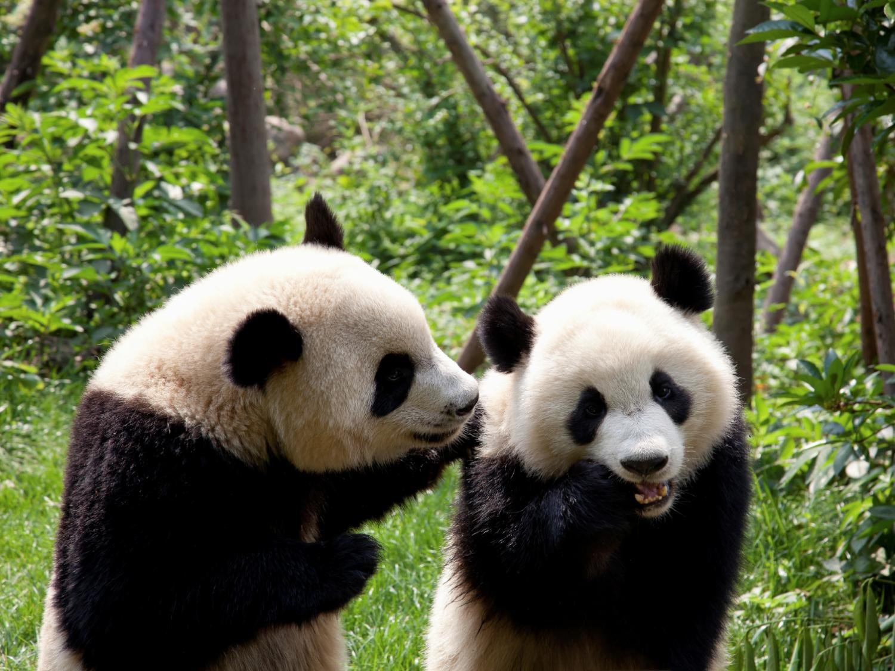
and pandas and all other animals.

Slide 15
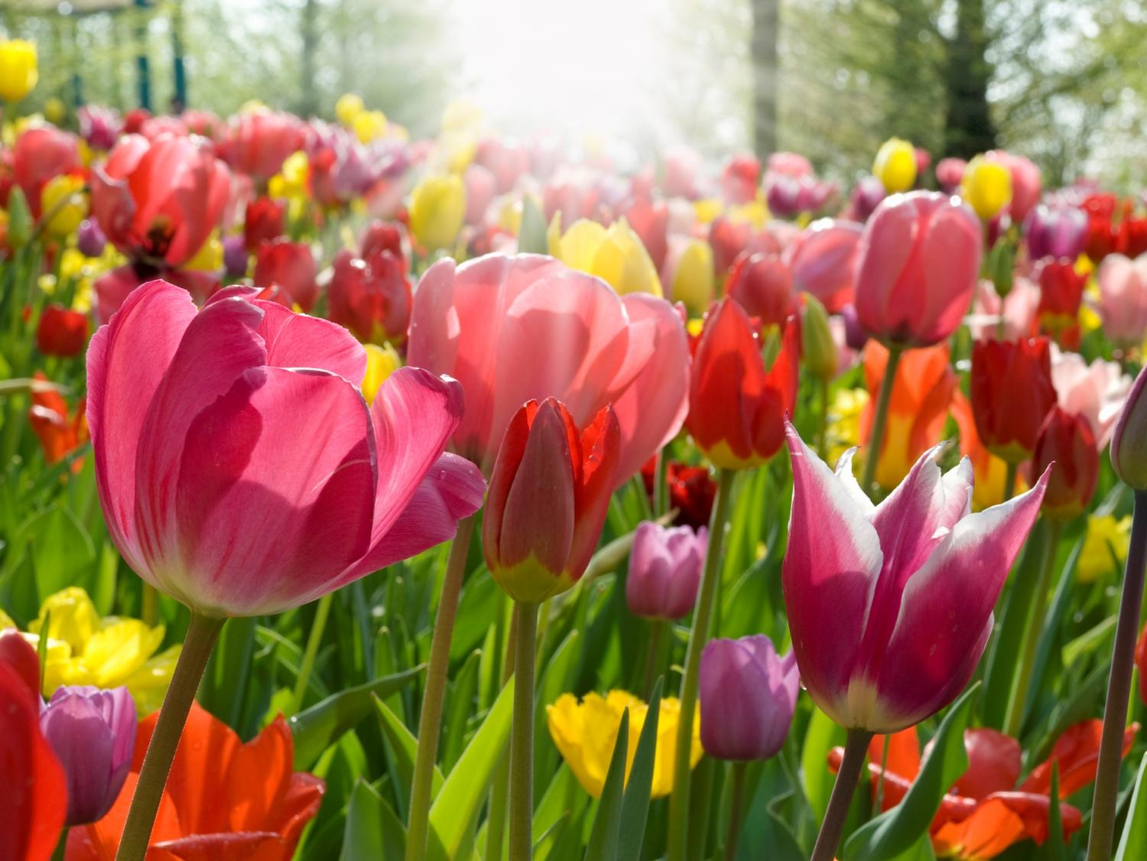
God made the tulips,

Slide 16
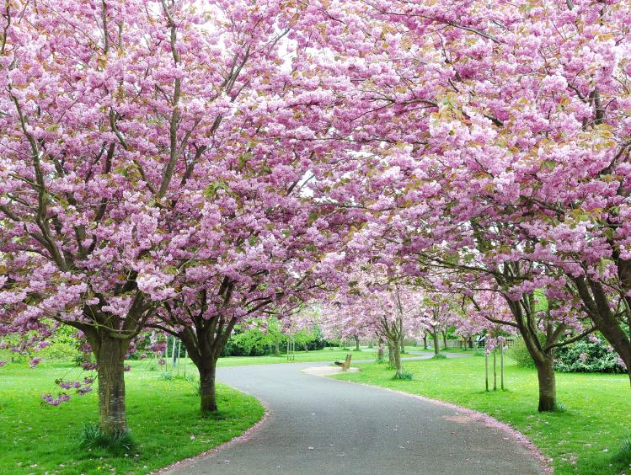
the trees,

Slide 17
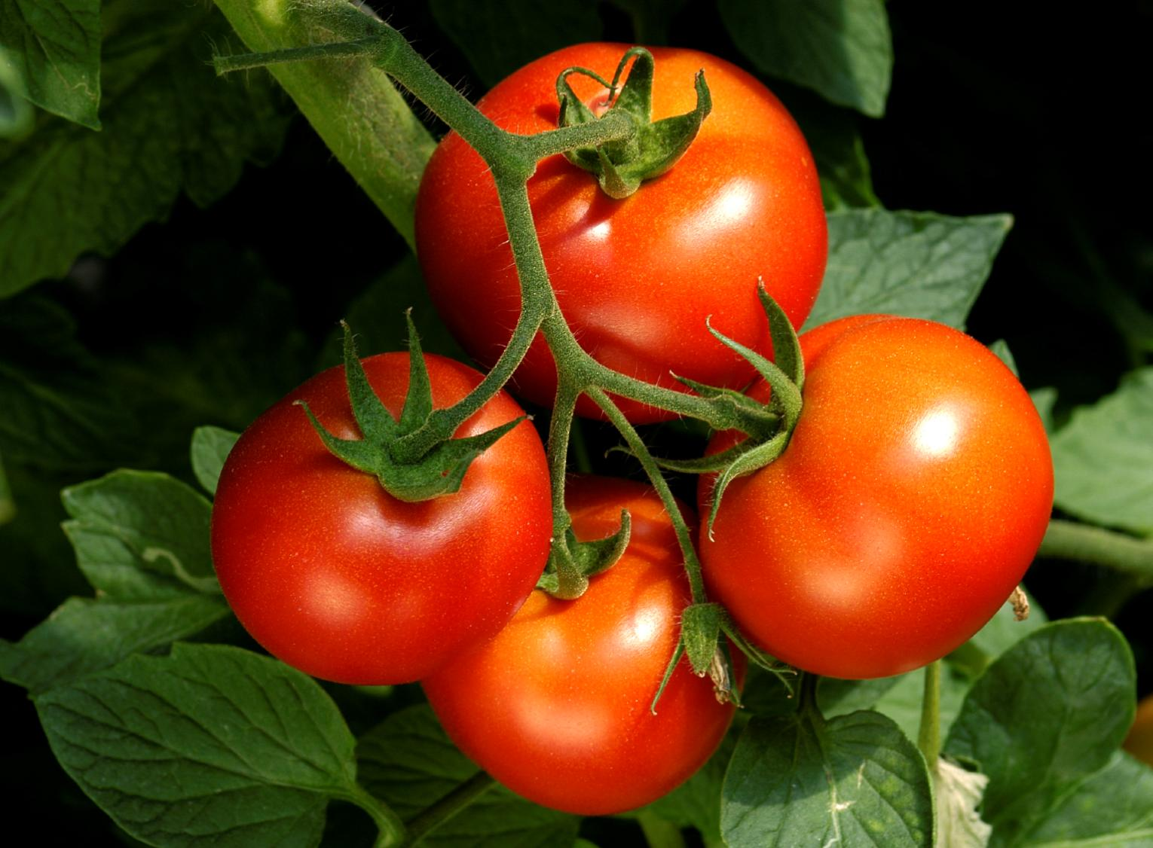
the tomatoes and all the plants

Slide 18
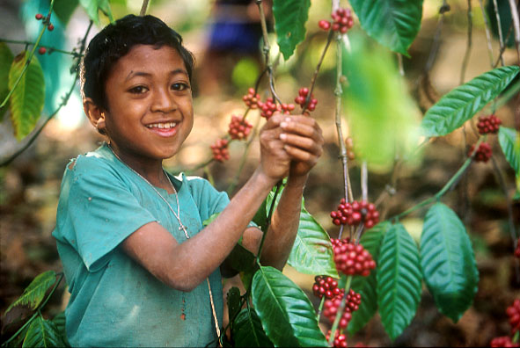
And God tells us that we must take great care of them. It’s an important job. (The Principles of Catholic Social Teaching for Kids Anne E. Neuberger 2005)
Notes:
Photo: Jim Holmes COUNTRY: East Timor LOCATION: Ermera District
Portrait of Absalao Martins, 8 yrs, picking coffee beans. He is son of the Martins family that work on the coffee plantation, barely earning enough to live on. CAFOD has funded the development of the Co-operative so the community can develop new markets and increase the income of the farmers.

Slide 19
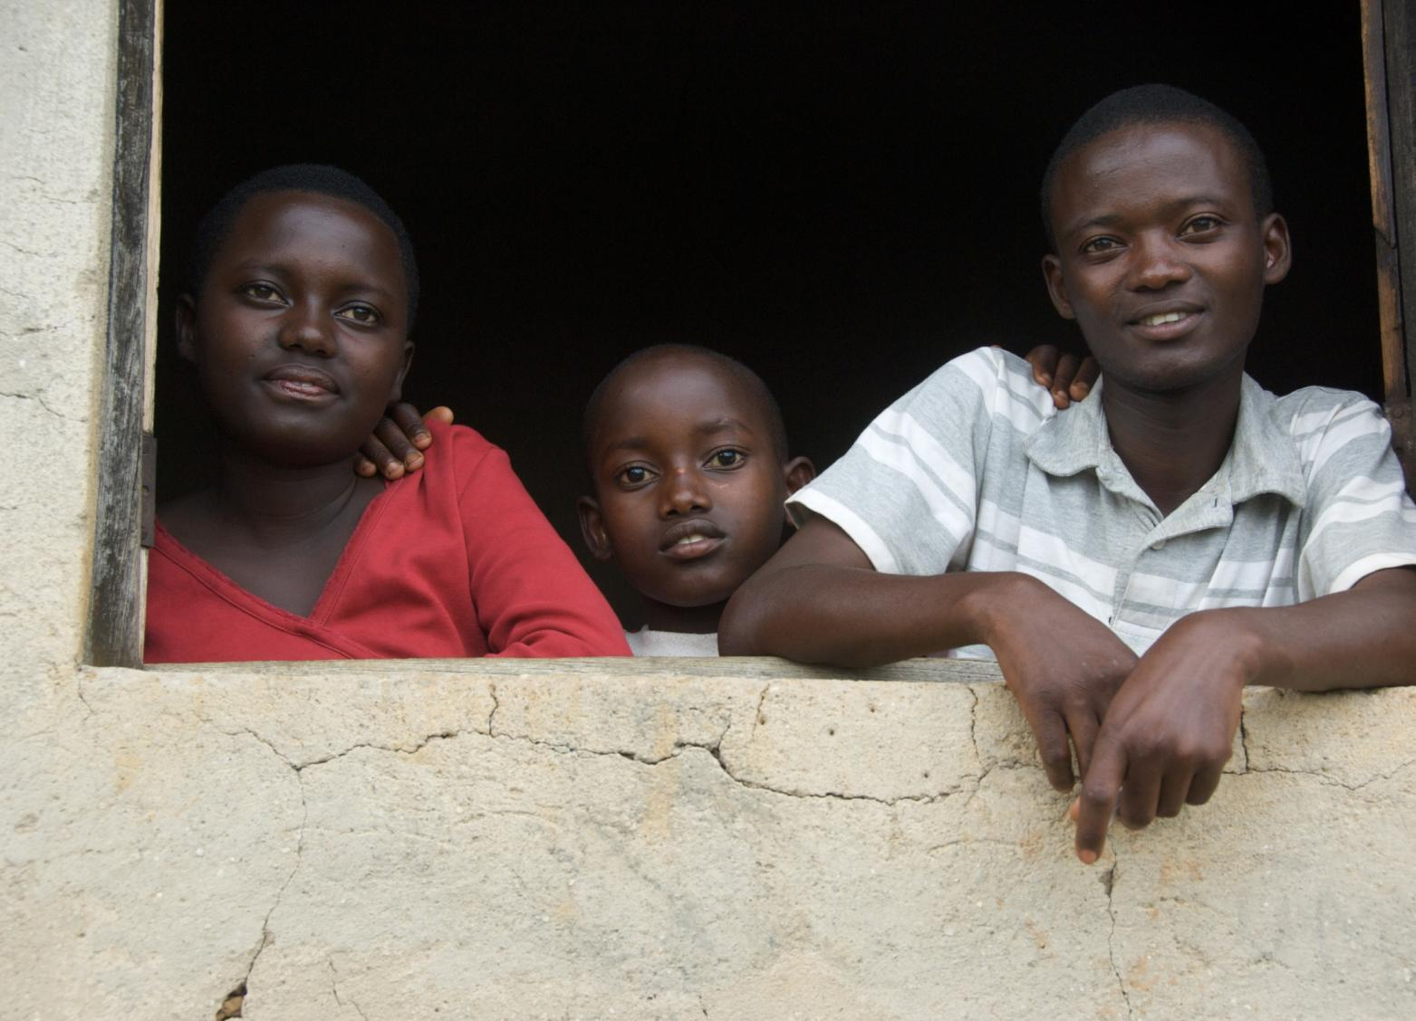
What can you do to care for and protect God’s world?
Notes:
Rwanda
PHOTOGRAPHER: Annie Bungeroth
Christine, 14yrs, Eric, 8yrs, and Jean Pierre, 20yrs, at the window.

Slide 20
Picture credits: Annie Bungeroth, Jim Holmes, Simon Rawles, Marcella Haddad, Barbara Davies.

