Slide 1
Year 1 Neighbours

Slide 2
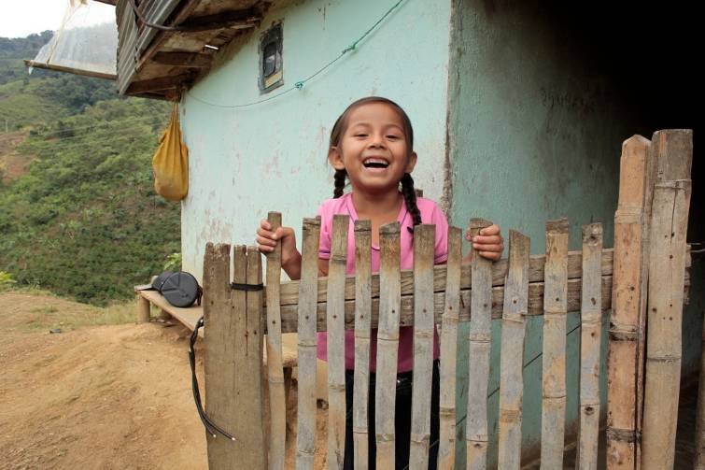
Hi.
My name is Maria and I am your neighbour.
I am 6.
I live in Colombia, in Latin America.

Slide 3
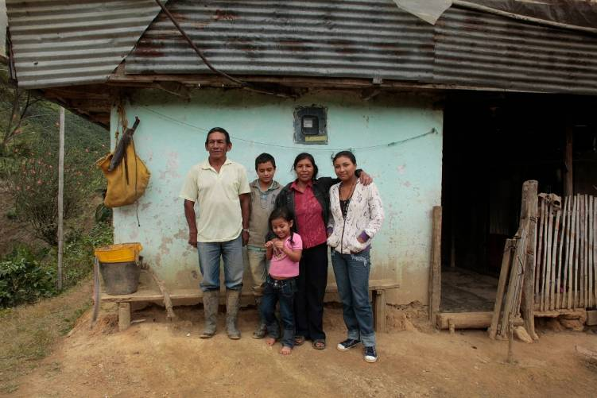
I live with my Grandparents, Auntie and cousin.
We grow coffee beans.

Slide 4
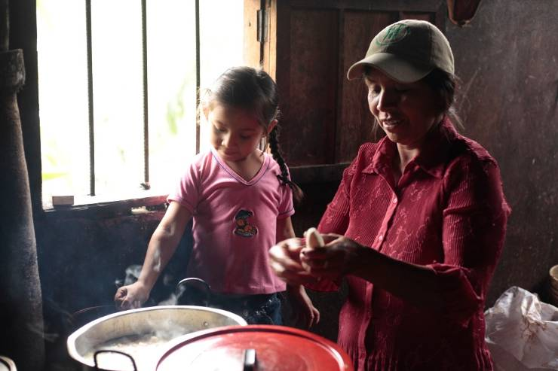
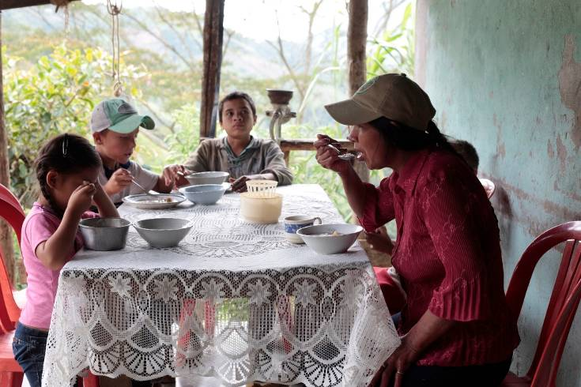
My grandparents sell coffee beans to earn money to buy things.
We buy water, electricity and food.
Notes:
We buy food, such as potatoes, rice and butter.

Slide 5
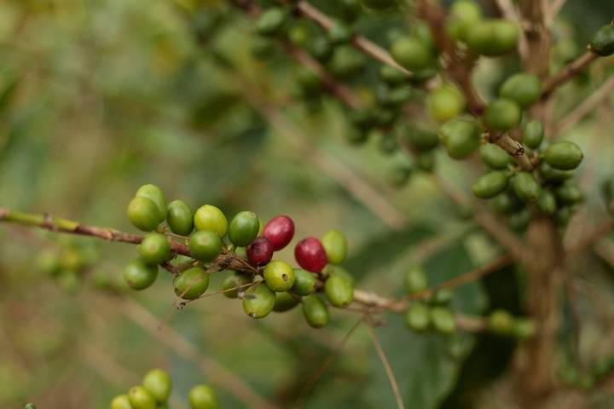
We used to find it hard to get a good price for our coffee beans.
Notes:
My Grandma and Grandad used to find it hard to get a good price for their coffee beans because so many other farmers were trying to sell their coffee beans at the same time.

Slide 6
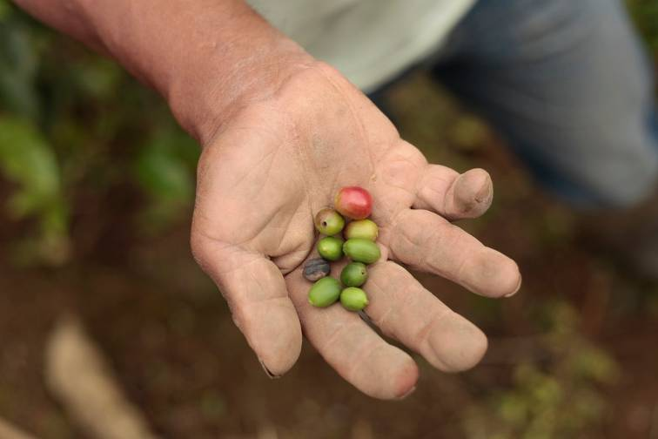
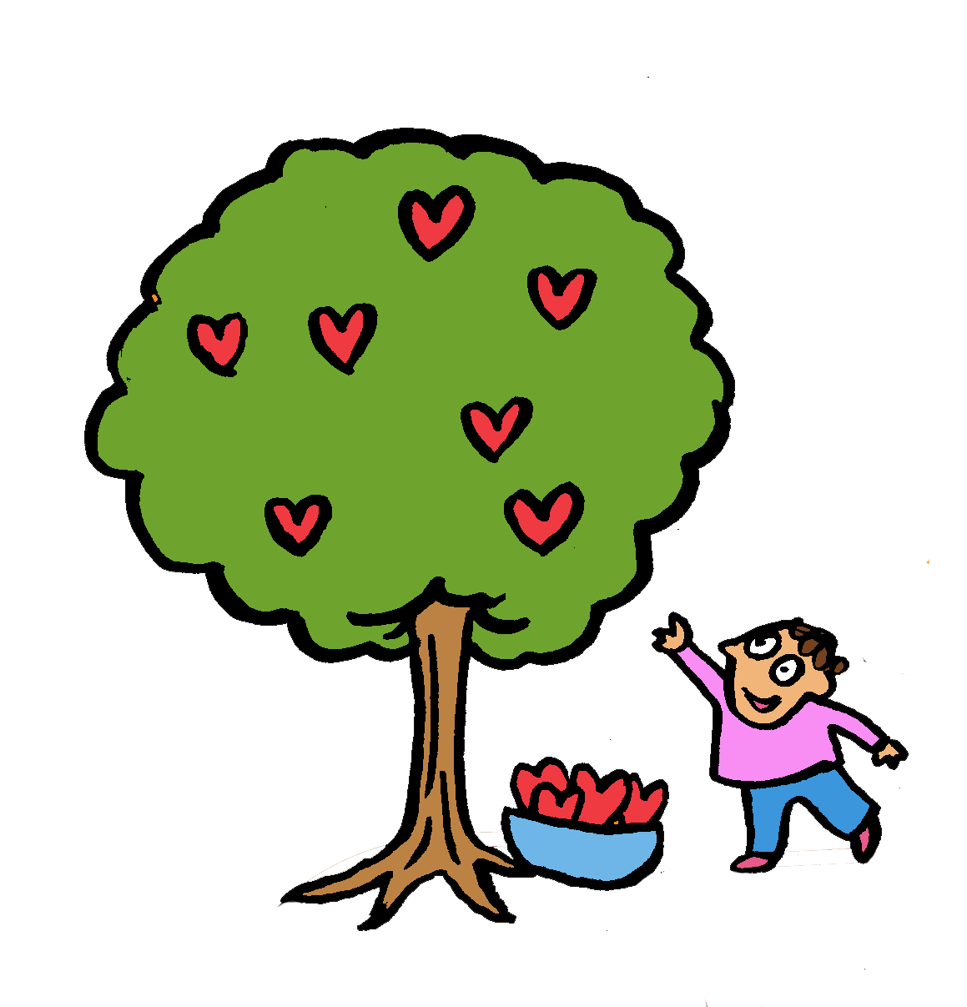
CAFOD gave my grandparents lessons in how to get good quality beans.
Now we get a fair price for the coffee beans.
Notes:
With the help of CAFOD Maria’s Grandparents and other farmers joined together to make a group called Eurocafé.

Slide 7
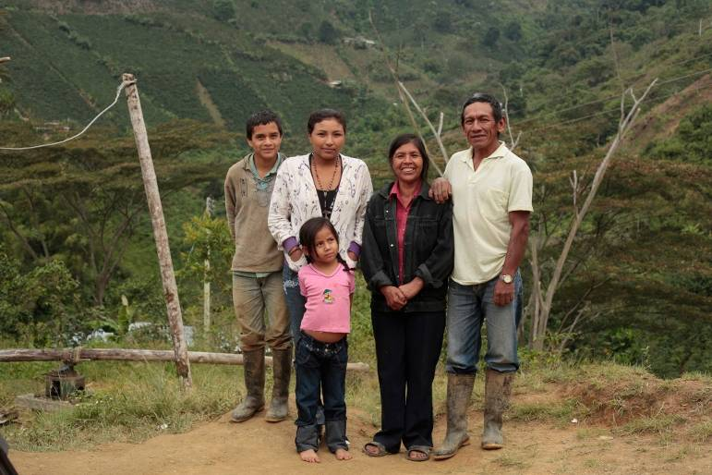
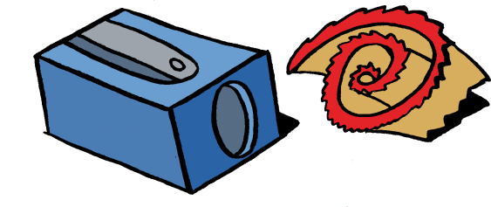
Let us pray for neighbours all over the world like Maria and her family, that they will get a fair price for the things they grow.
Amen.
Now my Grandma and Grandad can afford to send me to school!

Slide 8
When families like Maria’s have a fair price for what they grow it is called Fairtrade.
When you buy things with the Fairtrade mark on, you are helping your global neighbours.
Notes:
For more information about Fairtrade, see www.fairtrade.org.uk

Slide 9
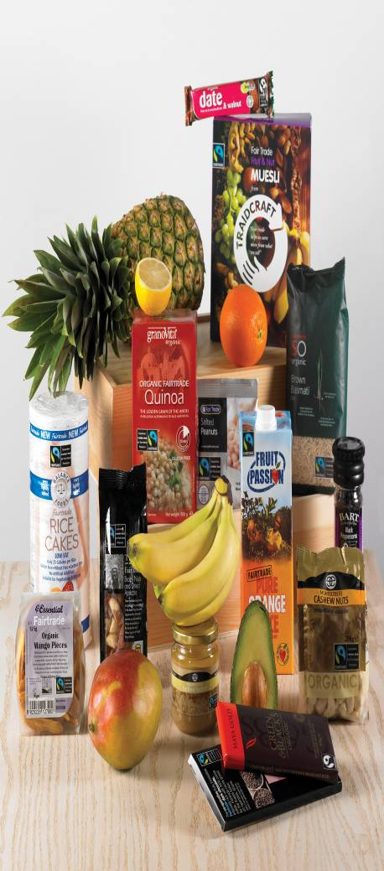
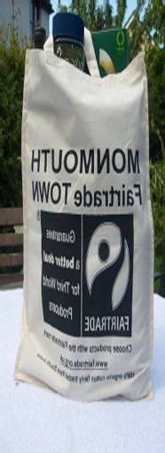
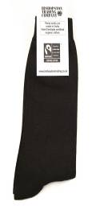
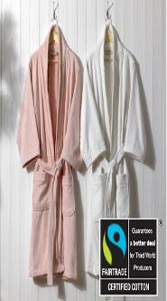
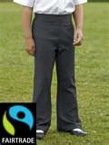
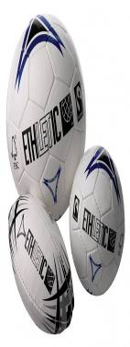
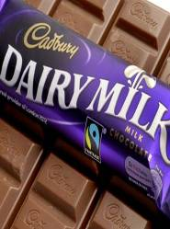
There are lots of Fairtrade items. Here are some of them!
How many can you find next time you go shopping?

Slide 10
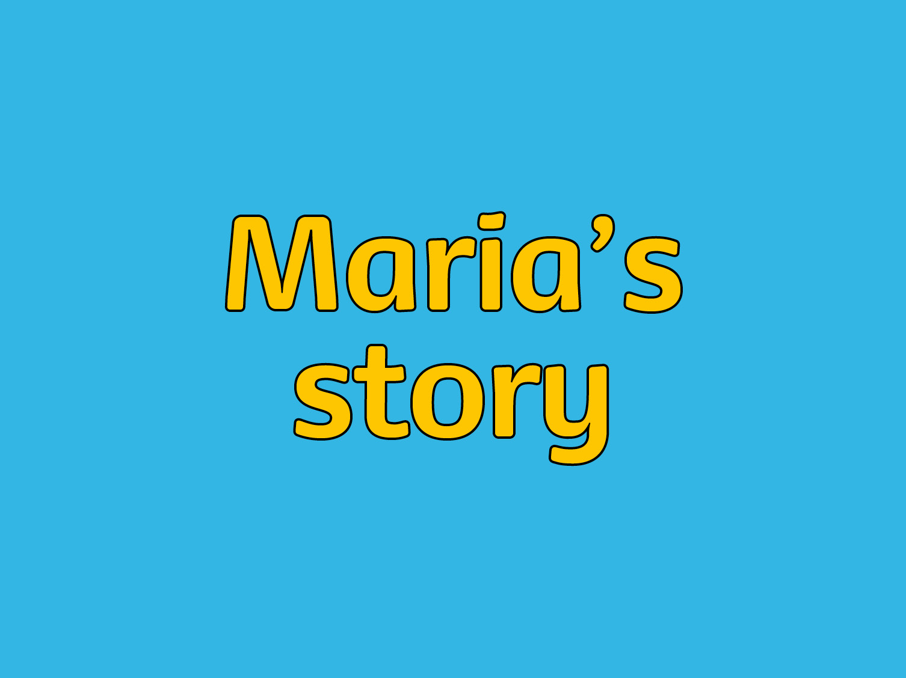
Photographs: Paul Smith
Illustrations: Per Karlen

