Slide 1
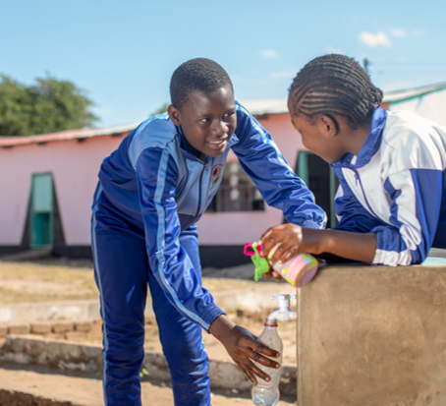
How donations can help
£10 can buy a child a daily school meal for 6 months.
£35 can buy the plumbing essentials to bring water to a school.
£100 can buy a solar panel to help power a water pump system.
£350 can buy a large water storage tank for a school, so they have water every day.
£555 can buy a school meal for 30 kids (a classroom) for a whole year.
£750 can buy a solar water pump, supplying water to a school and whole community.
Notes:
.

