Slide 1
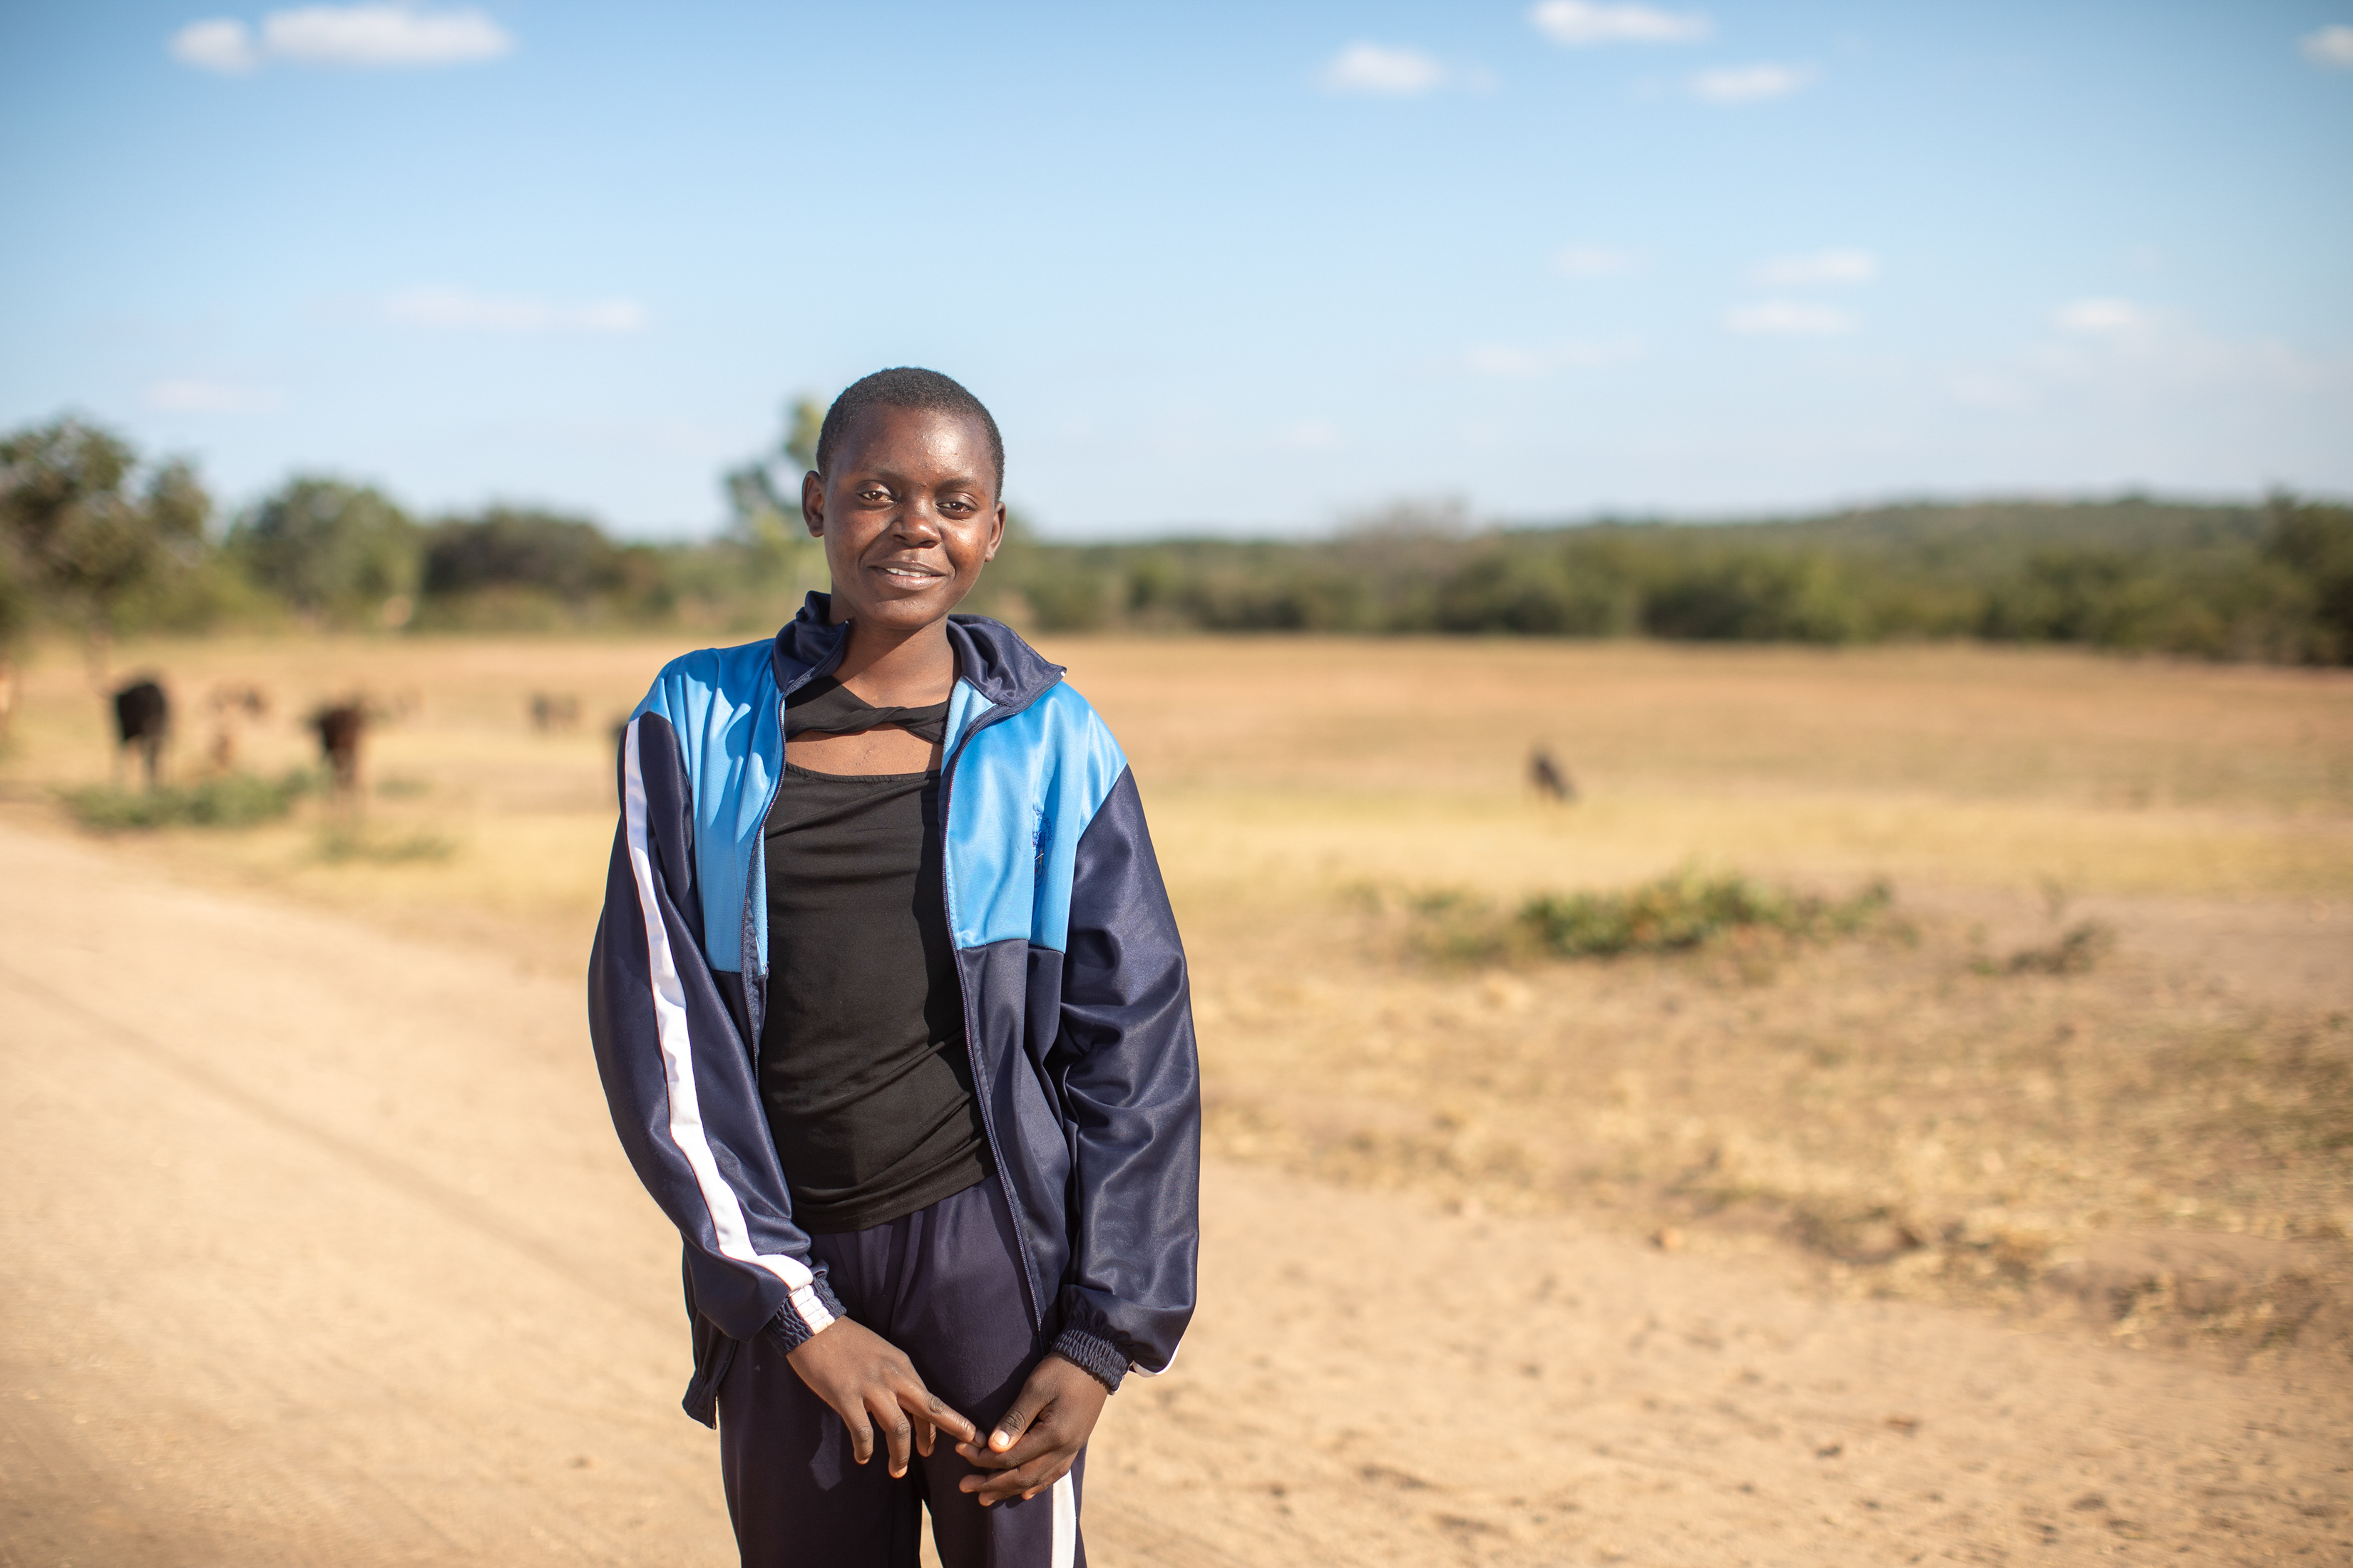

Slide 2

Photo
1
Walking for water
“We would wake up very early in the morning, and my mother would get a bucket, and I would get my tin. We’d fetch water and then come back home.
Usually the water was not clean, because there were people with livestock, especially pigs - they would play in the water.”
Maggie
Maggie said carrying the water was difficult because it was heavy. She would carry five litres of water – that’s about the weight of ten water bottles. With CAFOD’s help, taps and showers were installed at school, powered by solar panels. Pupils now have water at school, pumped from the ground and do not need to fetch water to take to school for drinking and washing. 1 in 4 people around the world do not have access to safe, clean water. Say a prayer today for people around the world who walk for water.

Slide 3
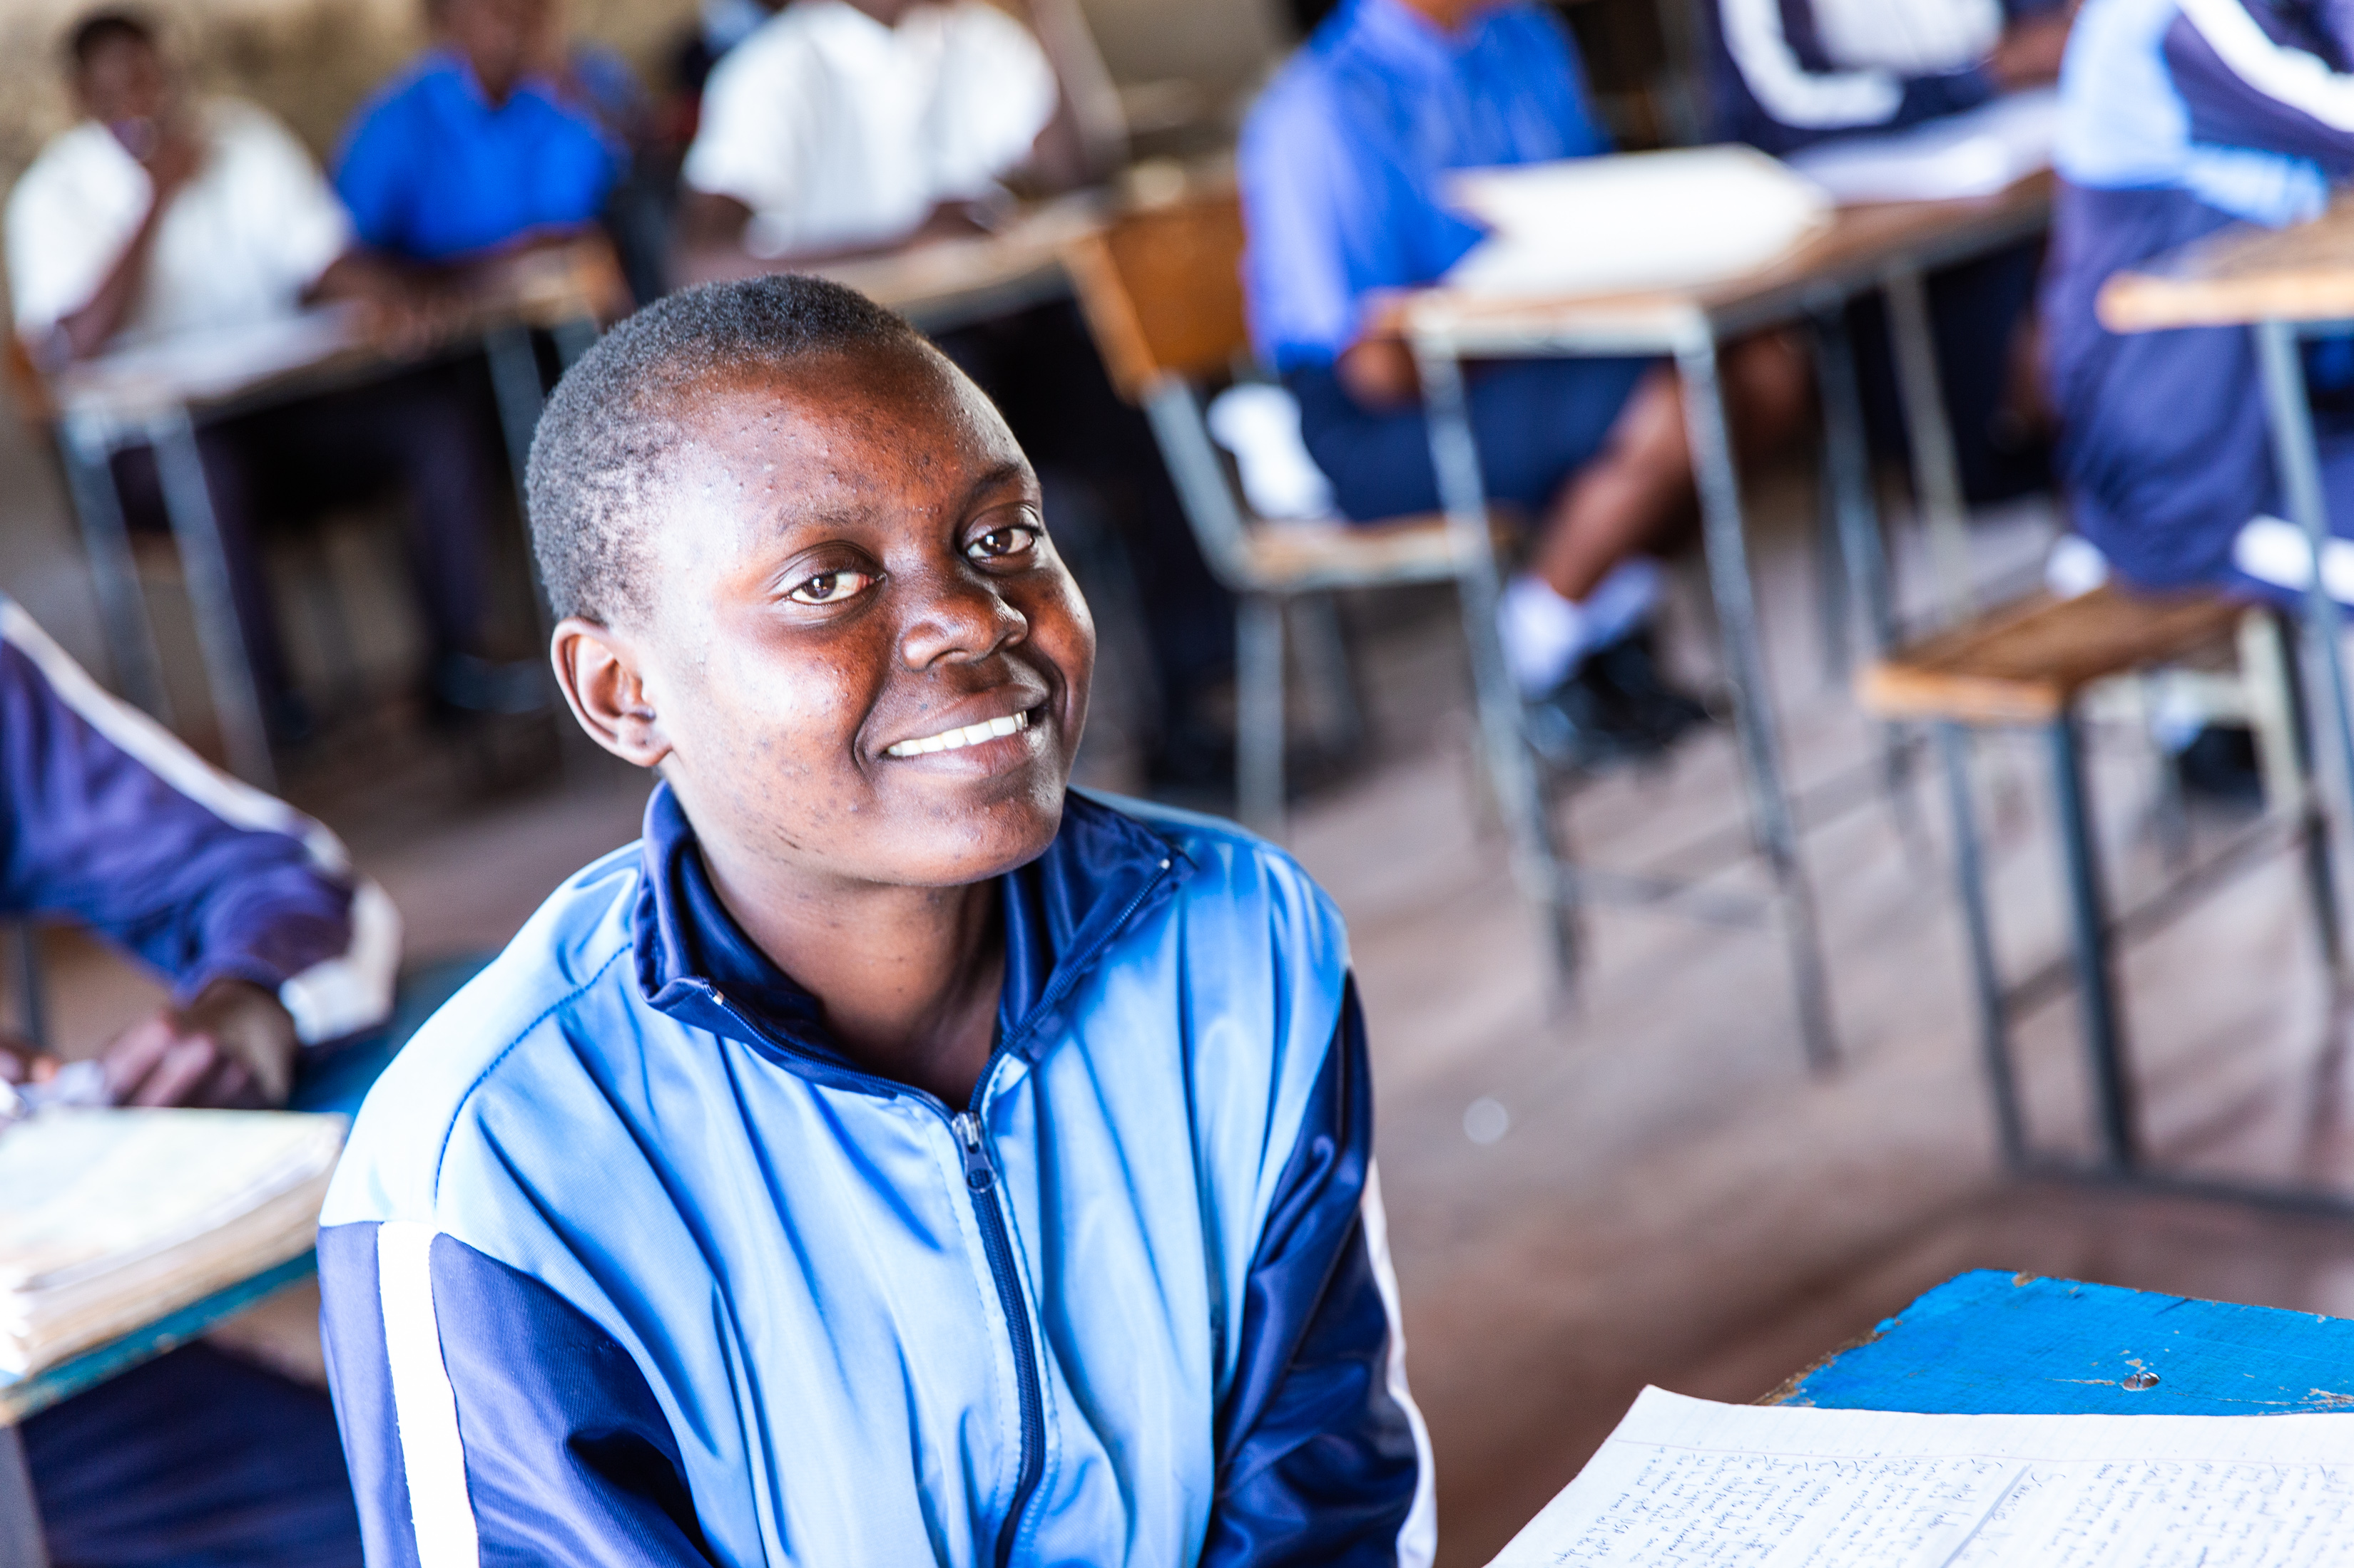
Notes:
Photo Credit: Thom Flint

Slide 4
Photo
2
Water at school
“I love coming to school. We have water. We no longer carry it to school.”
Maggie
Many girls at Maggie’s school, such as Mary, Maggie’s friend, would fetch water before school. Mary lived far from the water source and would often miss lessons because she had so far to walk. Now that there are taps at school, pupils can focus on learning. Maggie wants to be a doctor when she is older. Climate change is making it hard for communities in Zimbabwe to access water. Think of all the different ways you have used water today.

Slide 5
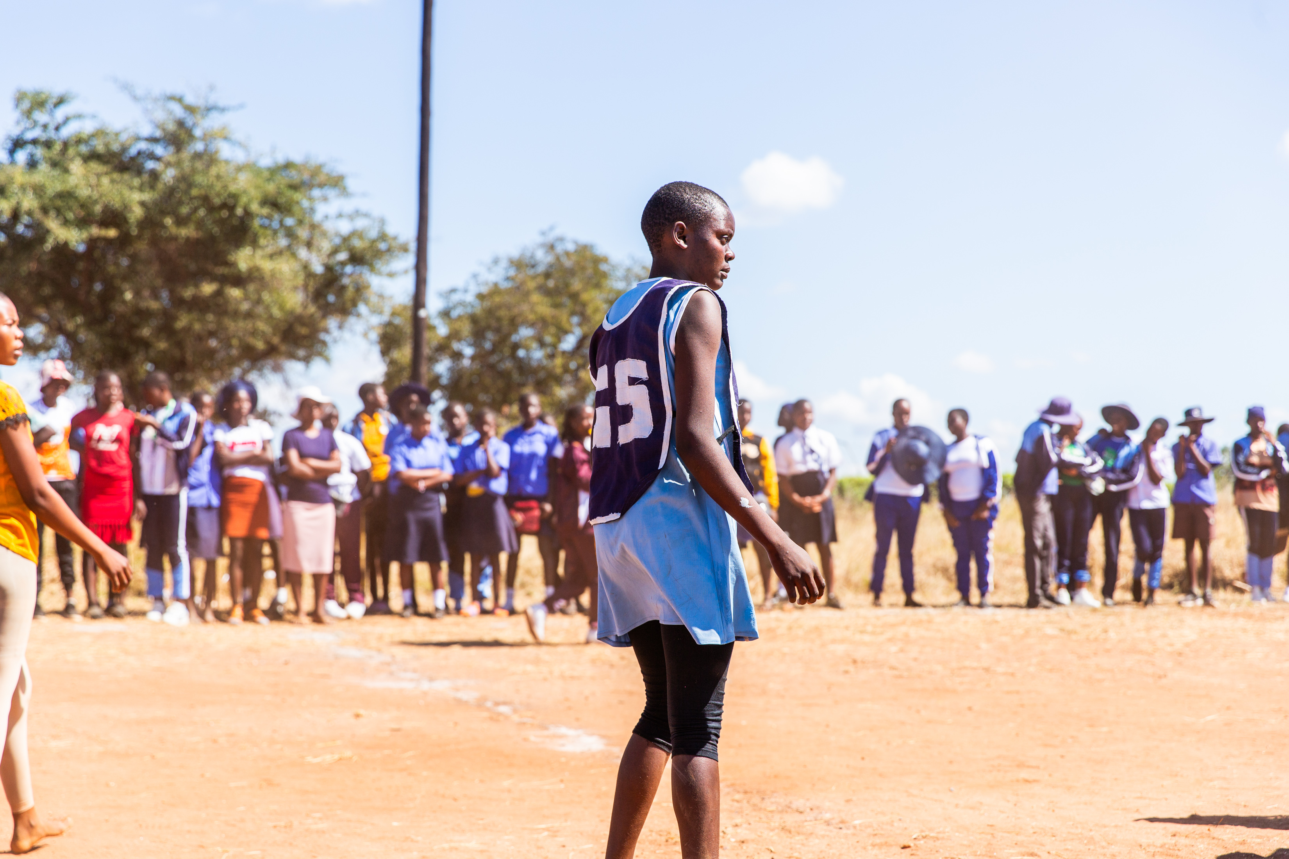
Notes:
Photo Credit: Thom Flint

Slide 6
Photo
3
Showers for netball
“It just felt good to have water. After I finished showering, I just stood in the shower and just let water flow on my body. And it was just a good feeling.”
Maggie
Maggie loves playing netball. Her position is Goal Shooter and she is happy that her school now has showers so she can wash after playing netball. Having access to clean safe water has transformed the lives of students at Maggie’s school in so many ways. Where can you see the Catholic Social Teaching principle of Human Dignity in action in Maggie’s story?

Slide 7
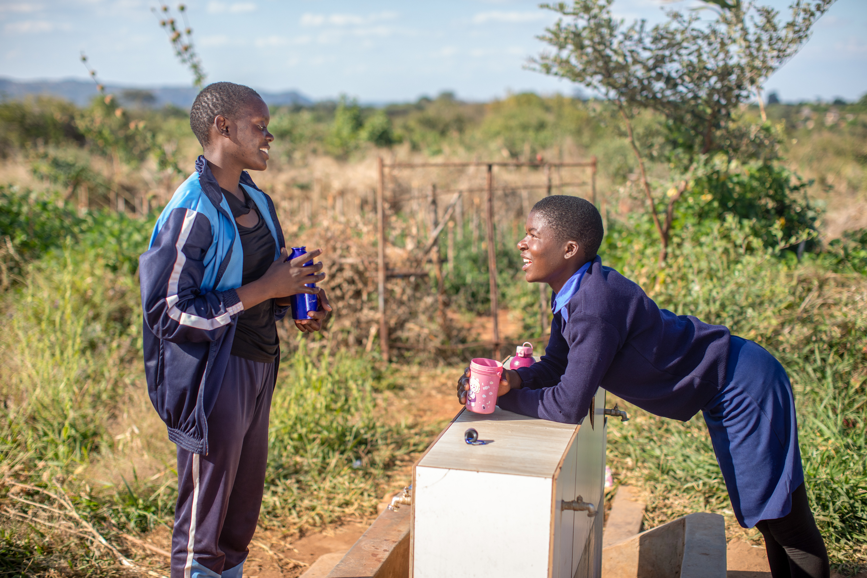
Notes:
Photo Credit: Thom Flint

Slide 8
Photo
4
Water for hygiene
“Learning about hygiene is important. Someone from the community comes and talks to girls in the clubs…We're keeping ourselves healthy. ”
Maggie
With CAFOD’s help, Gender clubs have been set up at Maggie’s school, and pupils learn about the importance of hygiene to stay healthy. Being part of the club has helped Maggie grow in confidence – she is now a prefect at her school and helps other pupils to learn about health and hygiene. Together we can build a better world. Plan a fundraising activity to raise money for CAFOD to help more communities like Maggie’s have access to water so that they can stay in school.

