Slide 1
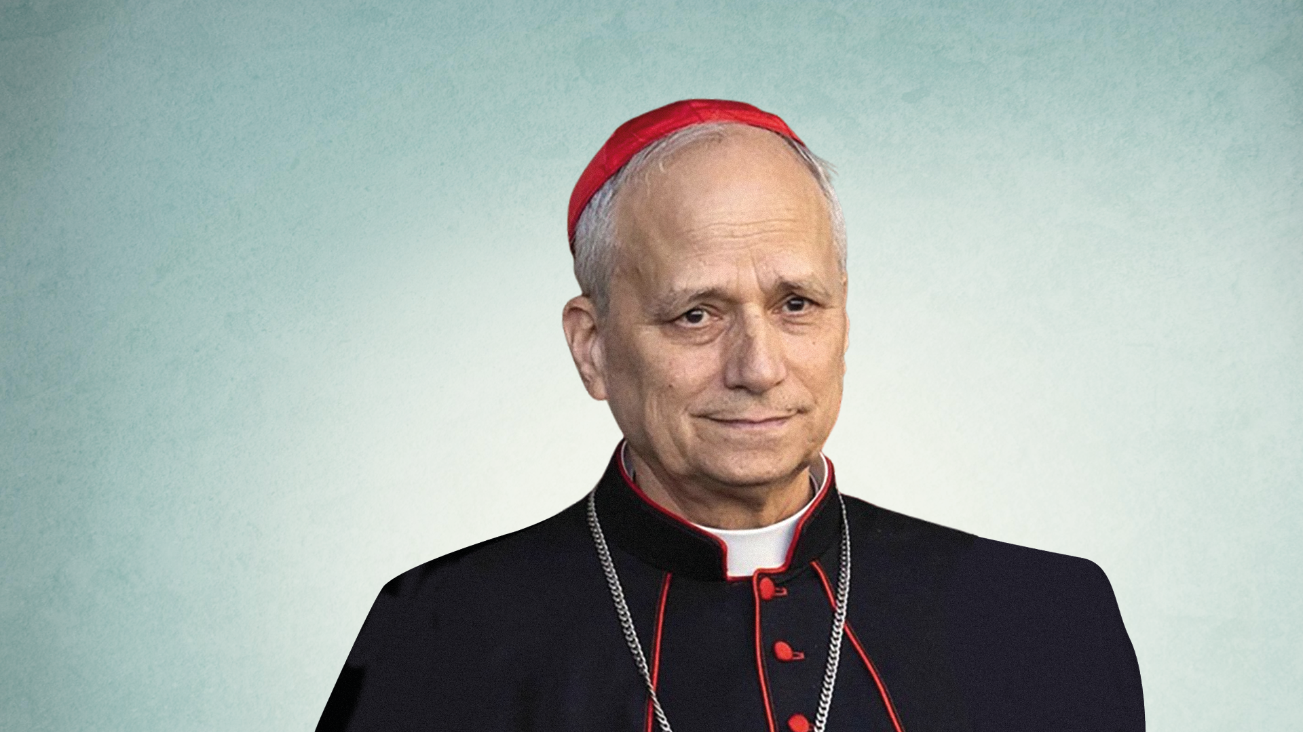

Pope Leo XIV
An assembly for primary schools

Slide 2

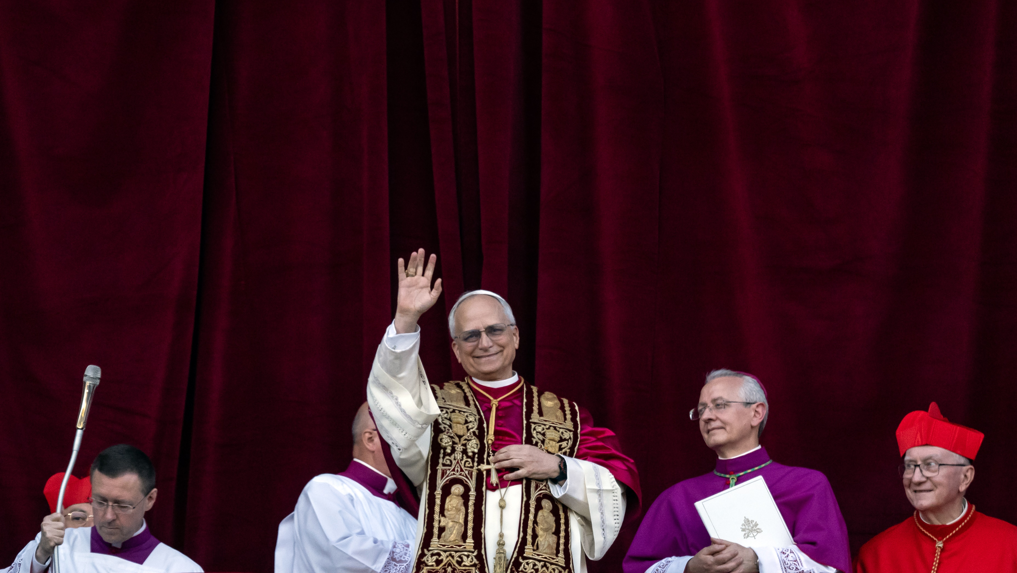

“Peace be with you all.”
Pope Leo XIV
Notes:
© Mazur/cbcew.org.uk

Slide 3
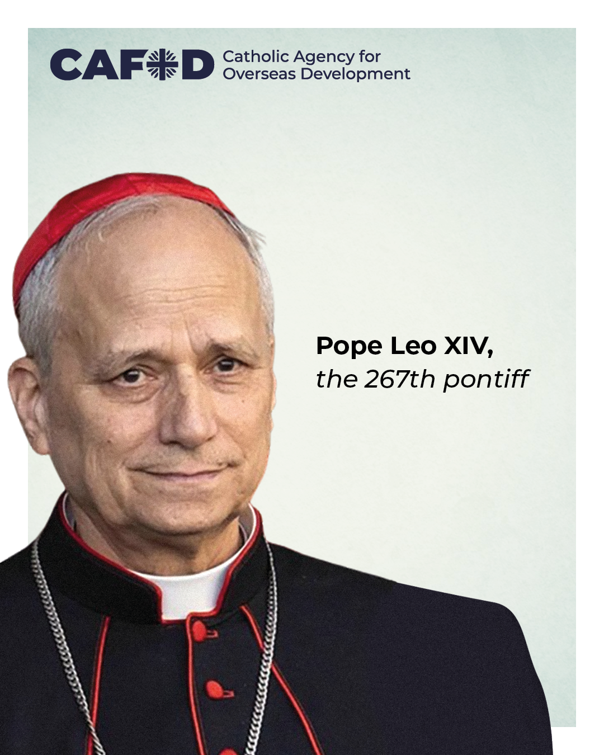
Pope Leo XIV has been elected as the new pope.
The pope is the leader of the Catholic Church.
There are 1.4 billion Catholics around the world.

Slide 4
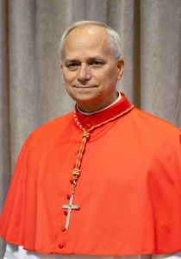
Pope Leo XIV was born Robert Francis Prevost.
He was born in America but has lived all over the world.
Pope Leo XIV lived and worked with the people of Peru, in South America, for decades.
He gave a warm greeting in Spanish to people from Peru on the balcony.

Slide 5
Building bridges
These were some of Pope Leo XIV’s words on the balcony of the Vatican:
"We must build bridges with dialogue, coming together, uniting, becoming one single people in peace.”
Pope Leo XIV will be a voice of wisdom as he continues the important work of leading the church in the world.
He will work with world leaders to make sure that the needs of the poorest and most vulnerable people are taken into account.

Slide 6
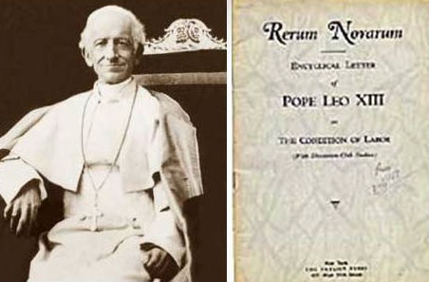
Catholic Social Teaching
Pope Leo XIV chose his name ‘Leo’ which means ‘Lion’.
An earlier pope, Pope Leo XIII, wrote about how Catholic Social Teaching guides our actions in 1891.
By living out Catholic Social Teaching we can build a better world. Pope Leo XIV will continue to build on the richness of Catholic Social Teaching to help us all work for a world of justice, love and peace.

Slide 7
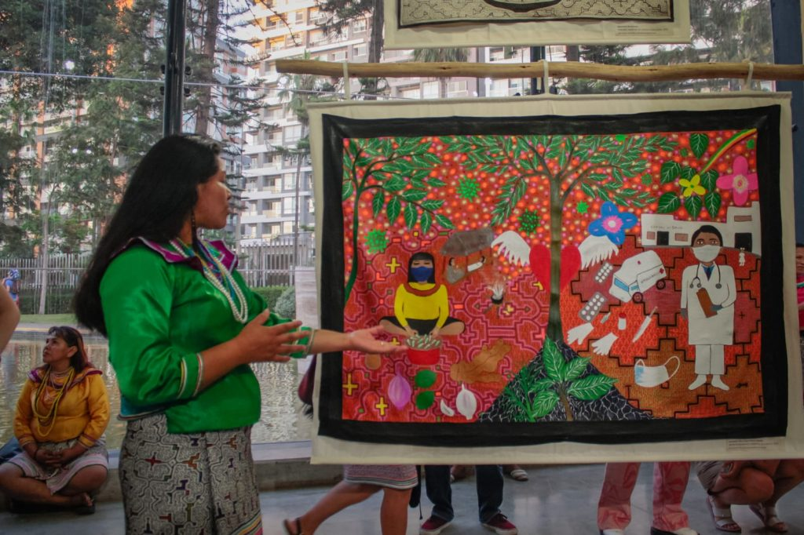
CAFOD’s work in Peru
Pope Leo XIV lived and worked with the people of Peru, in South America, for many years.
CAFOD supports projects on human rights and climate change in Peru through our local experts.
Here is a photo of a project showing how communities use artwork to stand up for their rights.

Slide 8


CAFOD will work with the Vatican and Pope Leo XIV as he takes us forward into a better world, continuing important work on global issues so that people everywhere can live life to the full.

Slide 9
A prayer for the new pope
God in Heaven
Hear our prayers for the new pope, Leo XIV.
May he be a messenger of hope and peace to the Church and the world for many years to come.
Give him the wisdom and courage to lead your people and help us to listen to him carefully.
Amen.

