Slide 1
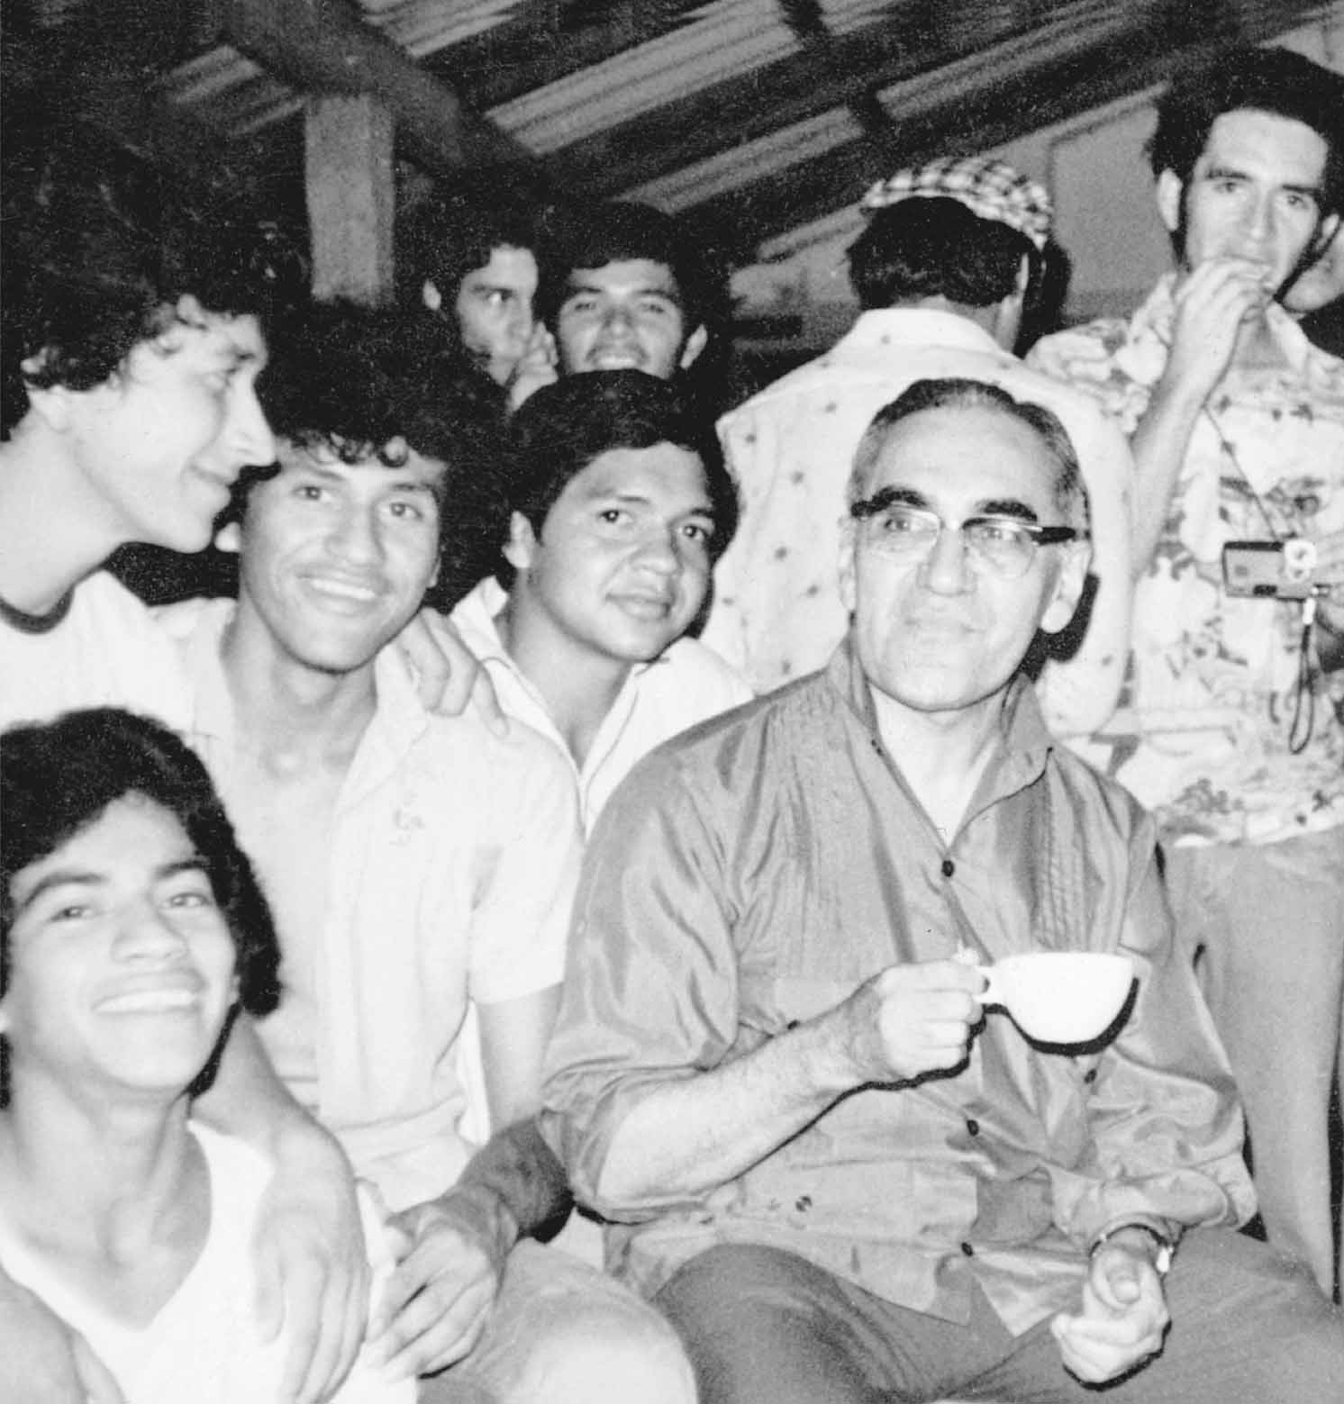
Saint
Oscar Romero

Slide 2
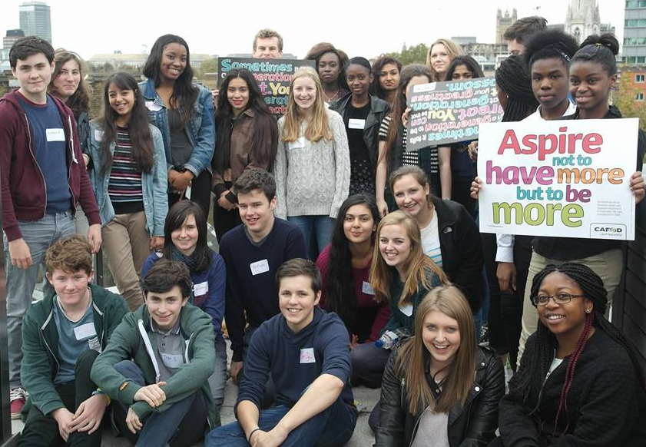
When he visited Britain, Pope Benedict told young people: “I invite you to become saints”.
We are called to be saints – examples of God’s love.
Pope Francis wrote: “The Lord wants us to be saints and not to settle for a bland and mediocre existence.”
It is a huge challenge!
Notes:
Pope Francis, APOSTOLIC EXHORTATION: GAUDETE ET EXSULTATE, para.1, 2018.

Slide 3
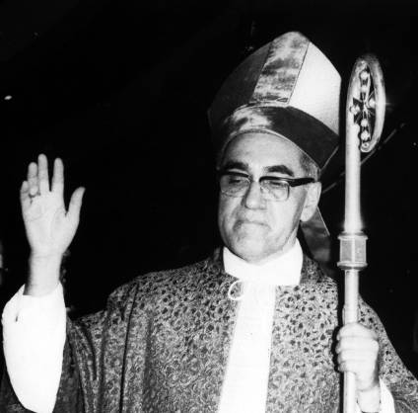
Oscar Romero was an Archbishop in El Salvador. CAFOD supported his work for people living in poverty.
When he was killed in 1980, many people called him a saint and martyr.
The Church began to investigate whether this was true.
© Daniel Dalet / d-maps.com
Brazil
El Salvador
Notes:
This version includes some edits by Julian

Slide 4
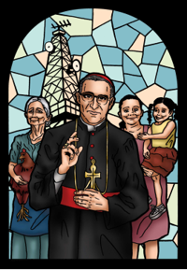
In 2016, the Church said that Romero was a martyr - that he had died for his faith.
He was ‘canonised’ in 2018, declared to be ‘Saint Oscar Romero’.

Slide 5
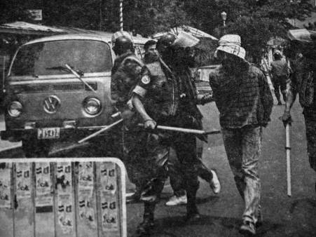
El Salvador was ruled by a few rich people.
Many did not want to share their wealth, especially land, with the poor people in the countryside, known as ‘campesinos’.
The government and army supported the rich and violently oppressed the campesinos.

Slide 6
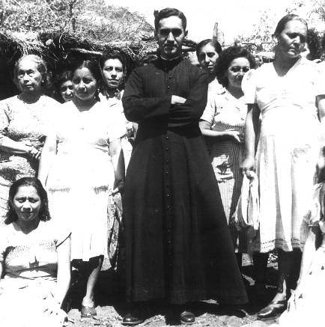
Fr. Oscar Romero was a shy, traditional priest.
He was a friend of many rich and powerful people.
When he became an Archbishop, these people thought he would help them to control the campesinos.

Slide 7
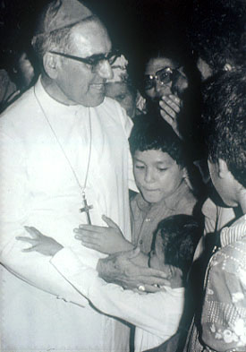
Then Romero’s friend, Fr. Grande, was shot dead after criticising the government.
Romero was upset and angry. He said that the murder must be investigated. This never happened.
From then on, Romero became a voice for those who had no power against the violence they suffered.

Slide 8
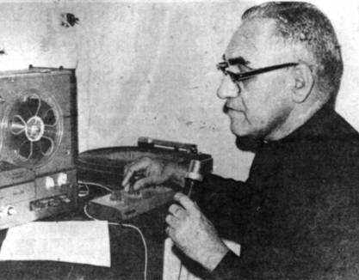
In his radio broadcasts, especially his weekly Cathedral sermons, Romero spoke out against the violence.
When Romero’s radio station was bombed, CAFOD rebuilt it.

Slide 9
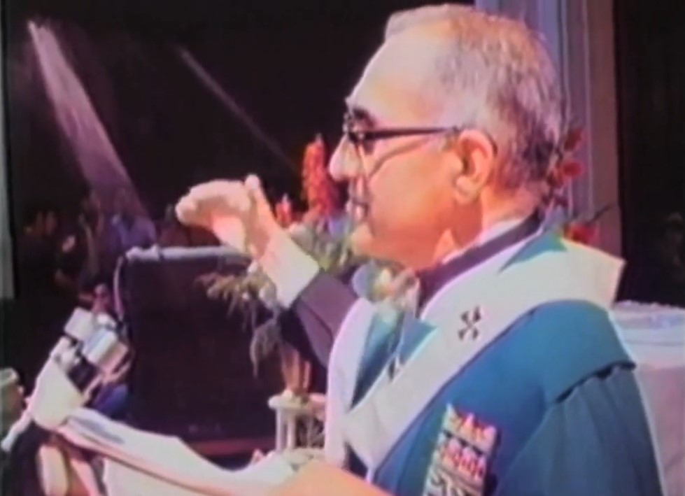
In his sermon on 23 March 1980, Romero said:
“In the name of God, and in the name of this suffering people…
I beg you,
I implore you,
I order you,
in the name of God, stop the repression!”

Slide 10
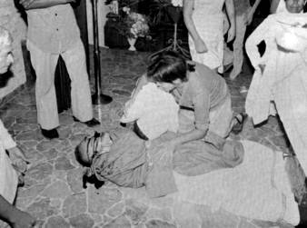
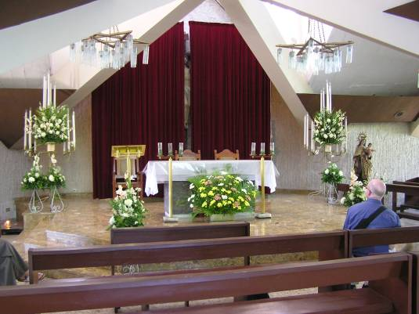
The next day, as Romero said Mass in this small chapel, a car drew up and a gunman fired through the open church door.
Romero was killed.

Slide 11
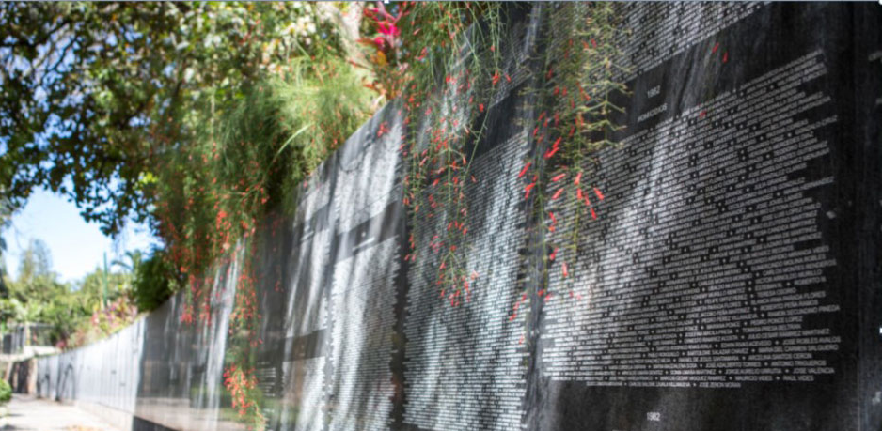
After Romero’s death, there was a civil war in El Salvador.
Many people, mostly campesinos, were killed or disappeared.

Slide 12
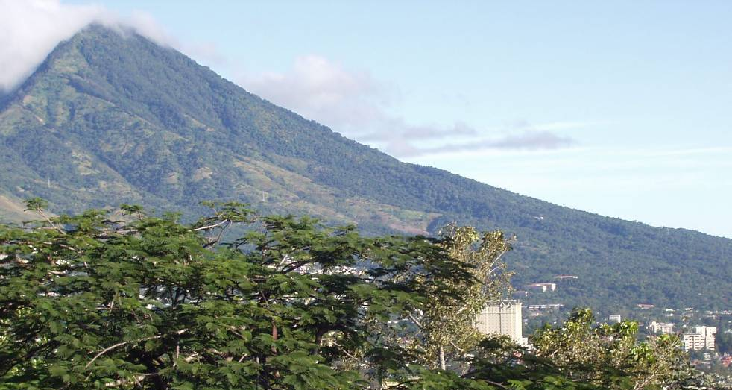
In 1992, the civil war ended.
The people of El Salvador are now working to build a more just and peaceful society.

Slide 13
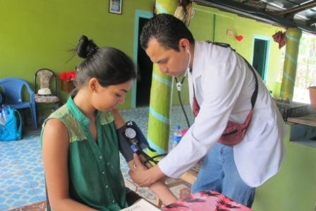
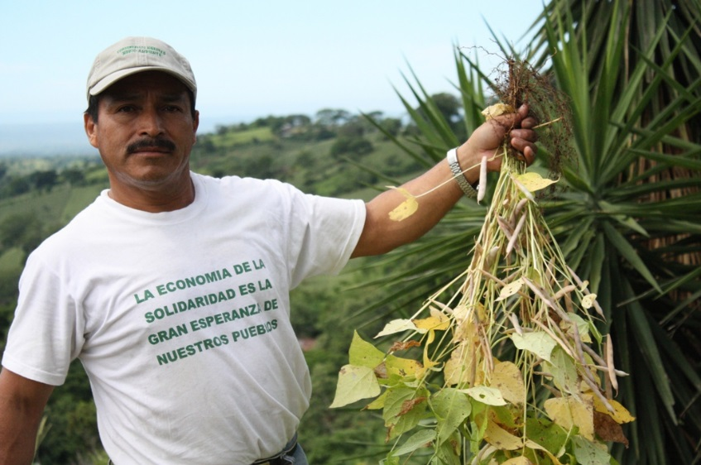
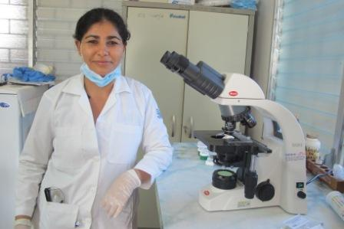
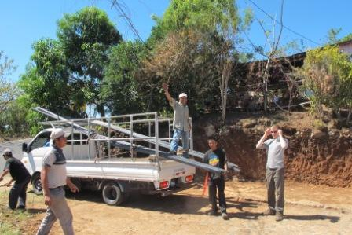
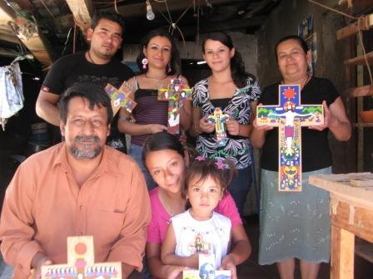
CAFOD partners, brave and dedicated like Romero, still work in El Salvador.
We can learn from them.

Slide 14
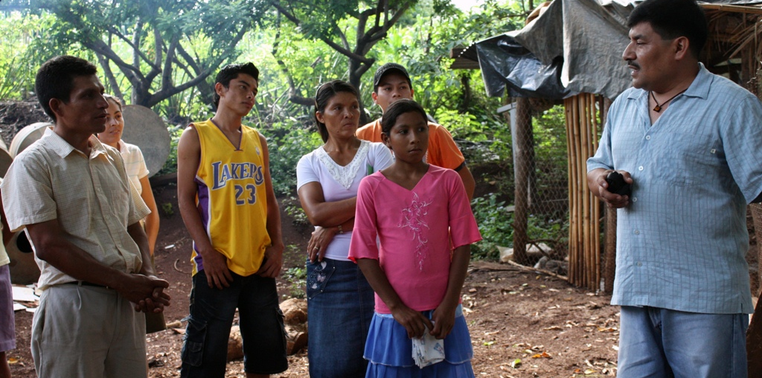
They help people find ways to make a living and prepare for natural disasters.
They care for people with HIV and AIDS and try to reduce the number of people affected.
They stand up for human rights and build peace.

Slide 15
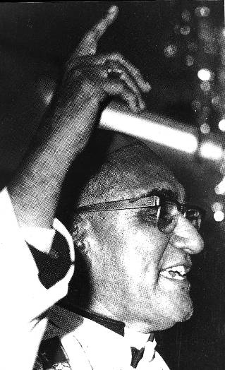
Let us pray...
Saint Oscar Romero,
You lived the gospel
and demanded justice for oppressed people.
Help us to follow your example.
Pray for the people of El Salvador.
And pray for us,
that we may become saints,
living the gospel
and bravely speaking up
for those whose voices are ignored.
Amen.

Slide 16
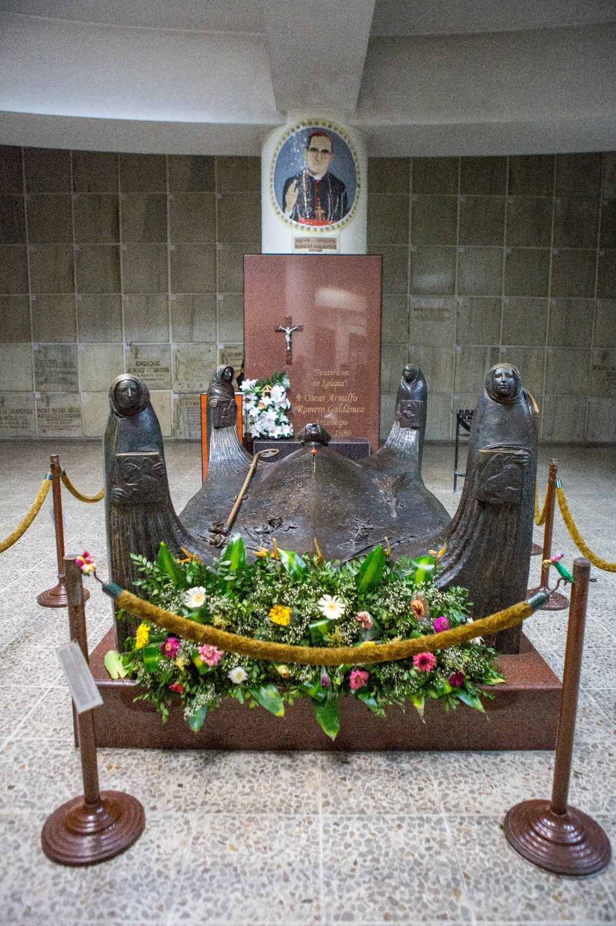
Find out more about our work in El Salvador at:
cafod.org.uk
Photographs:
Equipo Maiz
Claudia Torres
CAFOD

