Slide 1
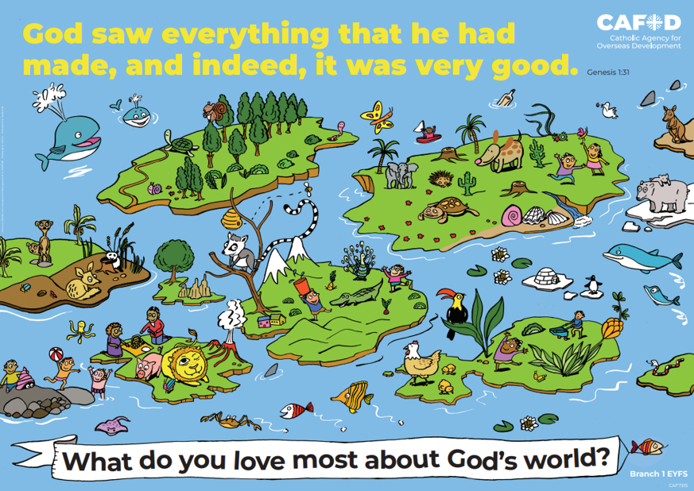
Year 1
RED poster activities
Branch 1: Creation
and Covenant
Order the RE CAFOD poster set
Notes:
Timings
This presentation has been designed to last for 10-15 minutes. It can be used as a stand-alone lesson or incorporated into a scheme.
Extension
Although this presentation was designed to simply engage pupils in discussion about key RED themes, the sessions can be developed in many ways. Some of the examples are included below:
Give pupils the poster (or a part of it) to discuss and annotate in groups
Provide pupils with their own A4 version of the poster to put in their own RE books (double page spread). This can be labelled in various ways, such as with references to scripture or Laudato Si’
Invite children to draw or list their own additions and suggestions to the poster
Offer children the opportunity to create their own poster, for example through artwork or through drama (creating freeze frames).

Slide 2
EYFS Year 1 Year 2
“God saw everything that he had made and, indeed, it was very good.” (Gen 1: 31) What do you love most about God’s world? | “We can all work together to protect the earth, our common home” (Based on Laudato Si’ 13) The world is God’s gift to us. How can we take care of it? | “We can all work together to protect the earth, our common home” (Based on Laudato Si’ 13) The world is God’s gift to us. How can we take care of it?
Creation (God, me, family) Stewardship Dignity (special, loved) | Creation Taking care of God’s world Laudato Si’ Pope Francis | Psalms Stewardship Caring for God’s world
EYFS | U1.1.2, U1.1.3, U1.1.4, U1.1.5, D1.1.1, D1.1.2, R1.1.3, R1.1.4 | U2.1.2, U2.1.3, D2.1.2, R2.1.2, R2.1.2
CAFOD poster
Themes
RED outcomes
Notes:
For teachers’ use only.
Note: The RED outcomes which are highlighted are most relevant to these CAFOD posters are highlighted in bold.

Slide 3
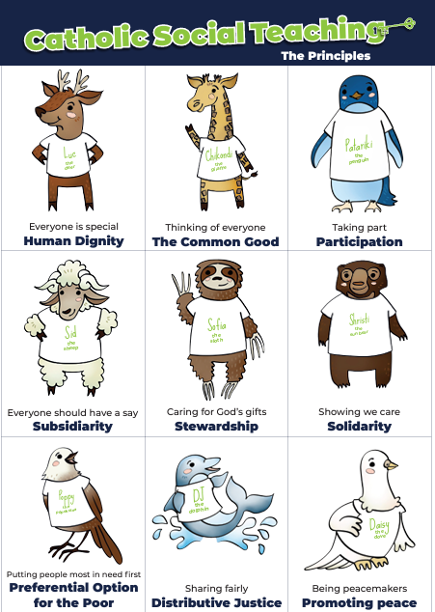
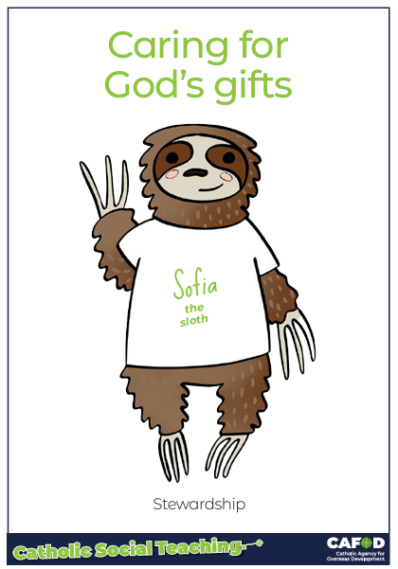
God’s gifts
Stewardship
Stewardship
This means:
Caring for all people
Caring for the world
Making things fair
Sharing with others
Looking after the poor and those in need
.
Notes:
For teachers:
This gives a brief overview of CST which includes stewardship. These posters support CST and look more closely at stewardship and how we can be better stewards.
Catholic Social Teaching helps us to know how to treat each other and the world. One principle is ‘stewardship’. Sofia the sloth reminds us about Stewardship – it is about caring for God’s gifts.
This means:
Caring for all people
Caring for the world
Making things fair
Sharing with others
Looking after the poor and those in need
For teacher support for embedding CST throughout the school see:
https://cafod.org.uk/education/primary-teaching-resources/cst-pack-for-children

Slide 4
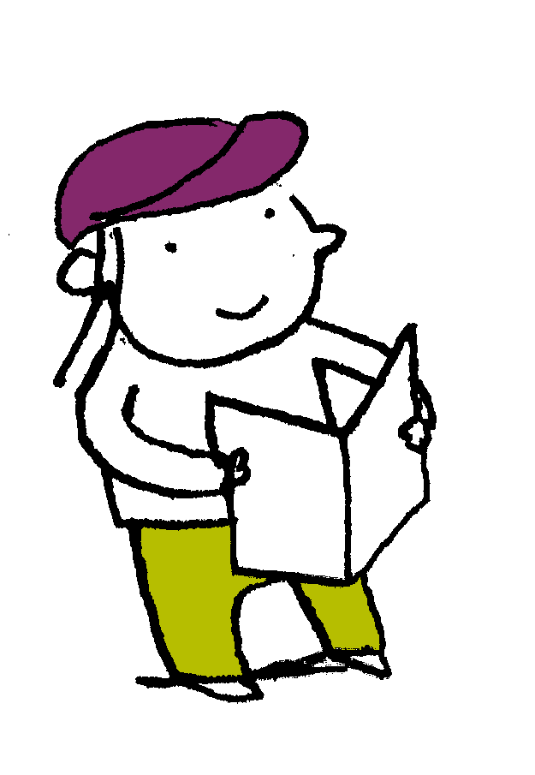
“In the beginning God made the heavens and the earth….God created man [and woman] in his own image…God saw everything that he had made and, indeed, it was very good.”
Genesis 1: 1-31
Scripture
Notes:
Read this piece of scripture before discussing the posters.
Optional: light a candle, play some gentle music and invite pupils to reflect on these words of scripture and what they mean. Read them from the Bible to demonstrate its importance and tell pupils that these words come from Genesis, the first book of the Bible.

Slide 5
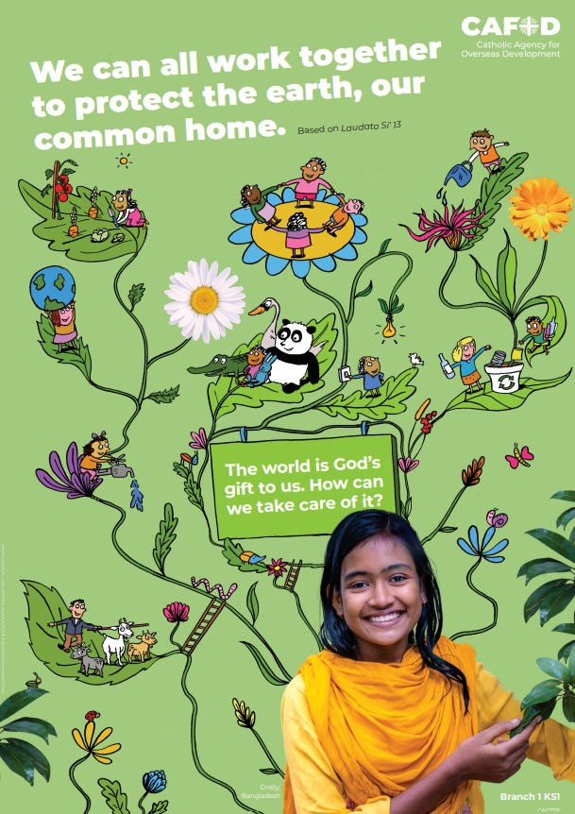
God’s world
Key words:
Laudato Si’
Pope Francis
Stewardship
Key questions:
How can we take care of the earth,
God’s gift to us?
How can we work together to
protect our common home?
Notes:
Explain that you will be looking at this poster. Read through the key words you will be exploring and the key question(s) you will be answering. Ask pupils if they can recognise how this poster links to the words from the Bible they have just heard.

Slide 6
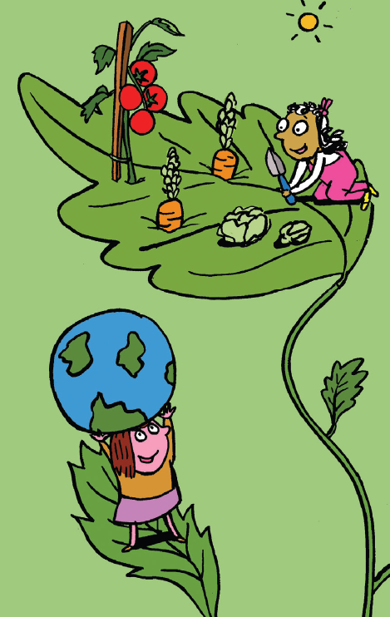
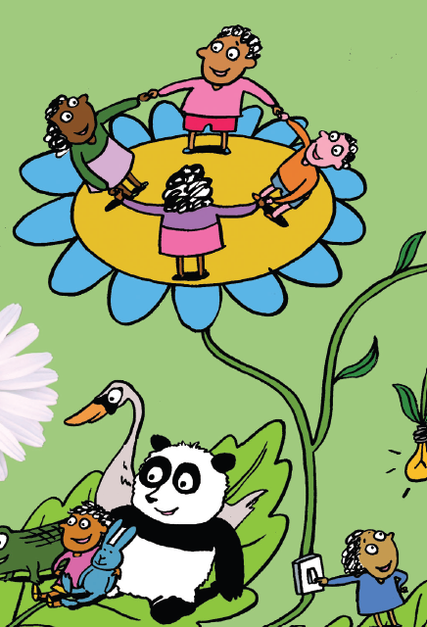
God’s world
God’s creation
God created the world and all living things.
What do you you find most beautiful in God’s creation? Why?
How can we take care of God’s creation?
Notes:
Ask pupils what they find beautiful and why. Encourage them to think of a wide range of things (such as the pattern on a leaf, the touch of their pet’s fur, the colours on a snail’s shell…)
Ask pupils:
How is the earth is a home for all people and animals?
What do you think it means that God created ‘all things visible and invisible’? (for example, we cannot see our thoughts and feelings… or the angels and heavens…)

Slide 7
God’s world
Laudato Si’
Pope Francis wrote a letter called Laudato Si’.
It reminds us to take care of the world because “The earth is the Lord’s”, not ours.
It is our common home, God’s gift to us.
Notes:
In Laudato Si’, Pope Francis reminds us that “The earth is the Lord’s” (Ps 24:1), not ours. Reflect on what this means.
Explain that common home means that it is for everyone to share. No-one deserves more than anyone else.
Ask pupils what they think is meant on the poster by ‘”The world is God’s gift to us”.
Ask pupils:
Optional:
Why do you think Pope Francis wrote a special letter telling everyone around the world to look after the earth/our common home? (Not everyone is like these people in the picture as they destroy the earth instead... He wants to tell them before it is too late… people think the earth is theirs and they can do what they want…)

Slide 8
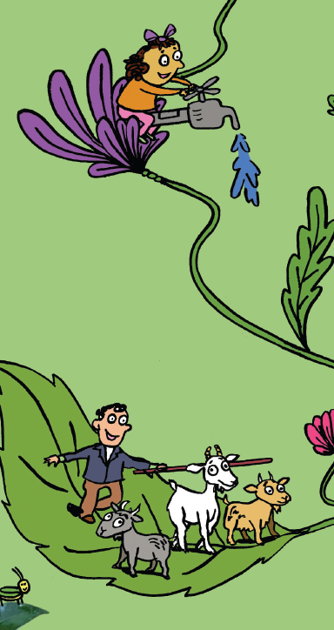
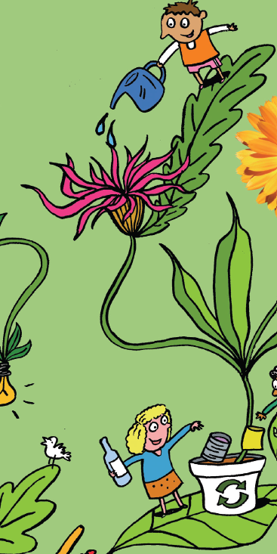
God’s world
Looking after the earth
God wants us to look after the earth and all living things.
How are they looking after the Lord’s earth in the poster?
Is there anything else they could do?
Notes:
Ask pupils to suggest what they can do. Ideas in the poster (in this slide and the next) include: watering and growing plants and looking after them, looking after all different animals so they have what they need, turning off lights…

Slide 9
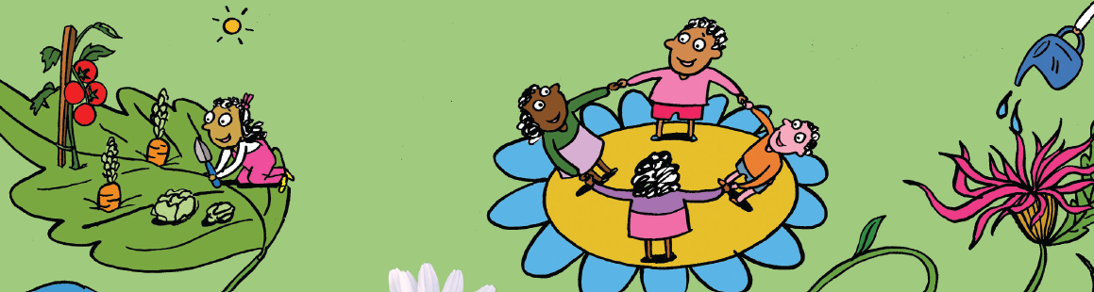
God’s world
I wonder
What would happen if we didn’t
take care of the earth?
How can we help?
Notes:
What will happen to it if we don’t look after it? (It will be dirty and the plants and animals will be unhealthy or destroyed. Our food and water will be unhealthy. People and animals will get sick. The world will get sick and things will not be beautiful and good any more…)
Why do we have to work together to protect the earth and the people in it? (Stewardship)
If you were creating a poster about protecting the earth and looking after it, what might you include?

Slide 10
God’s world
Key words:
Laudato Si’
Pope Francis
Stewardship
Key questions:
How can we take care of the earth,
God’s gift to us?
How can we work together to
protect our common home?
Notes:
Review learning

Slide 11
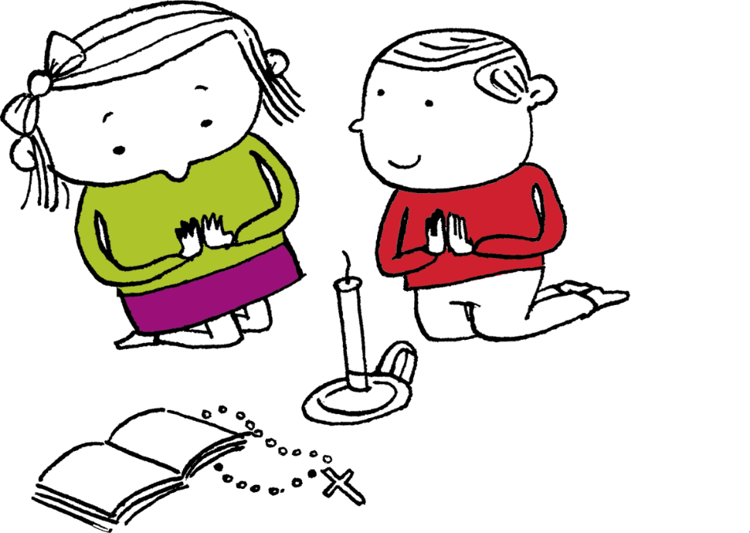
Let us pray
Thank you, God,
For giving us the earth,
which is your gift to us.
Help us to work together
to protect the earth,
our common home.
Amen

Slide 12
Order the RE CAFOD poster set

