Slide 1
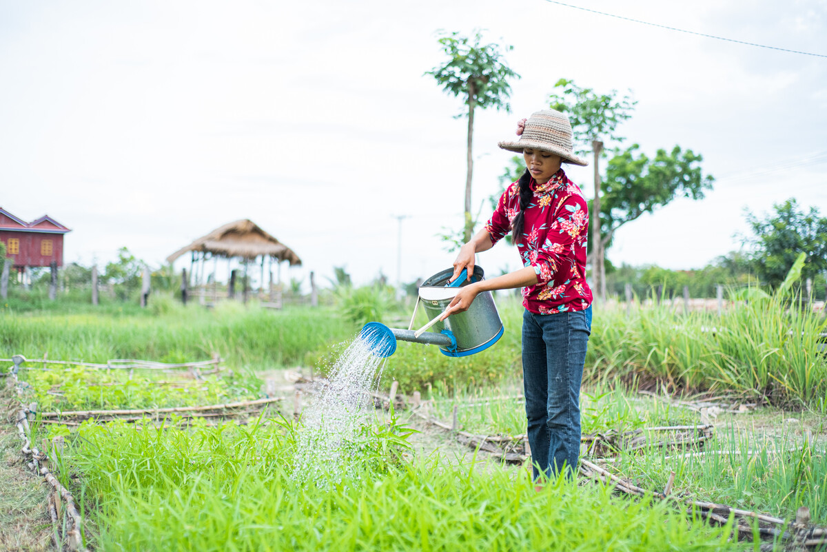
Distributive Justice
Exploring CST principles in CAFOD’s work
Notes:
Photo credit: Tom Chheat

Slide 2
Distributive Justice means we believe in sharing fairly.

Slide 3
“All who believed were together and had all things
in common.”
Acts 2:44-45

Slide 4
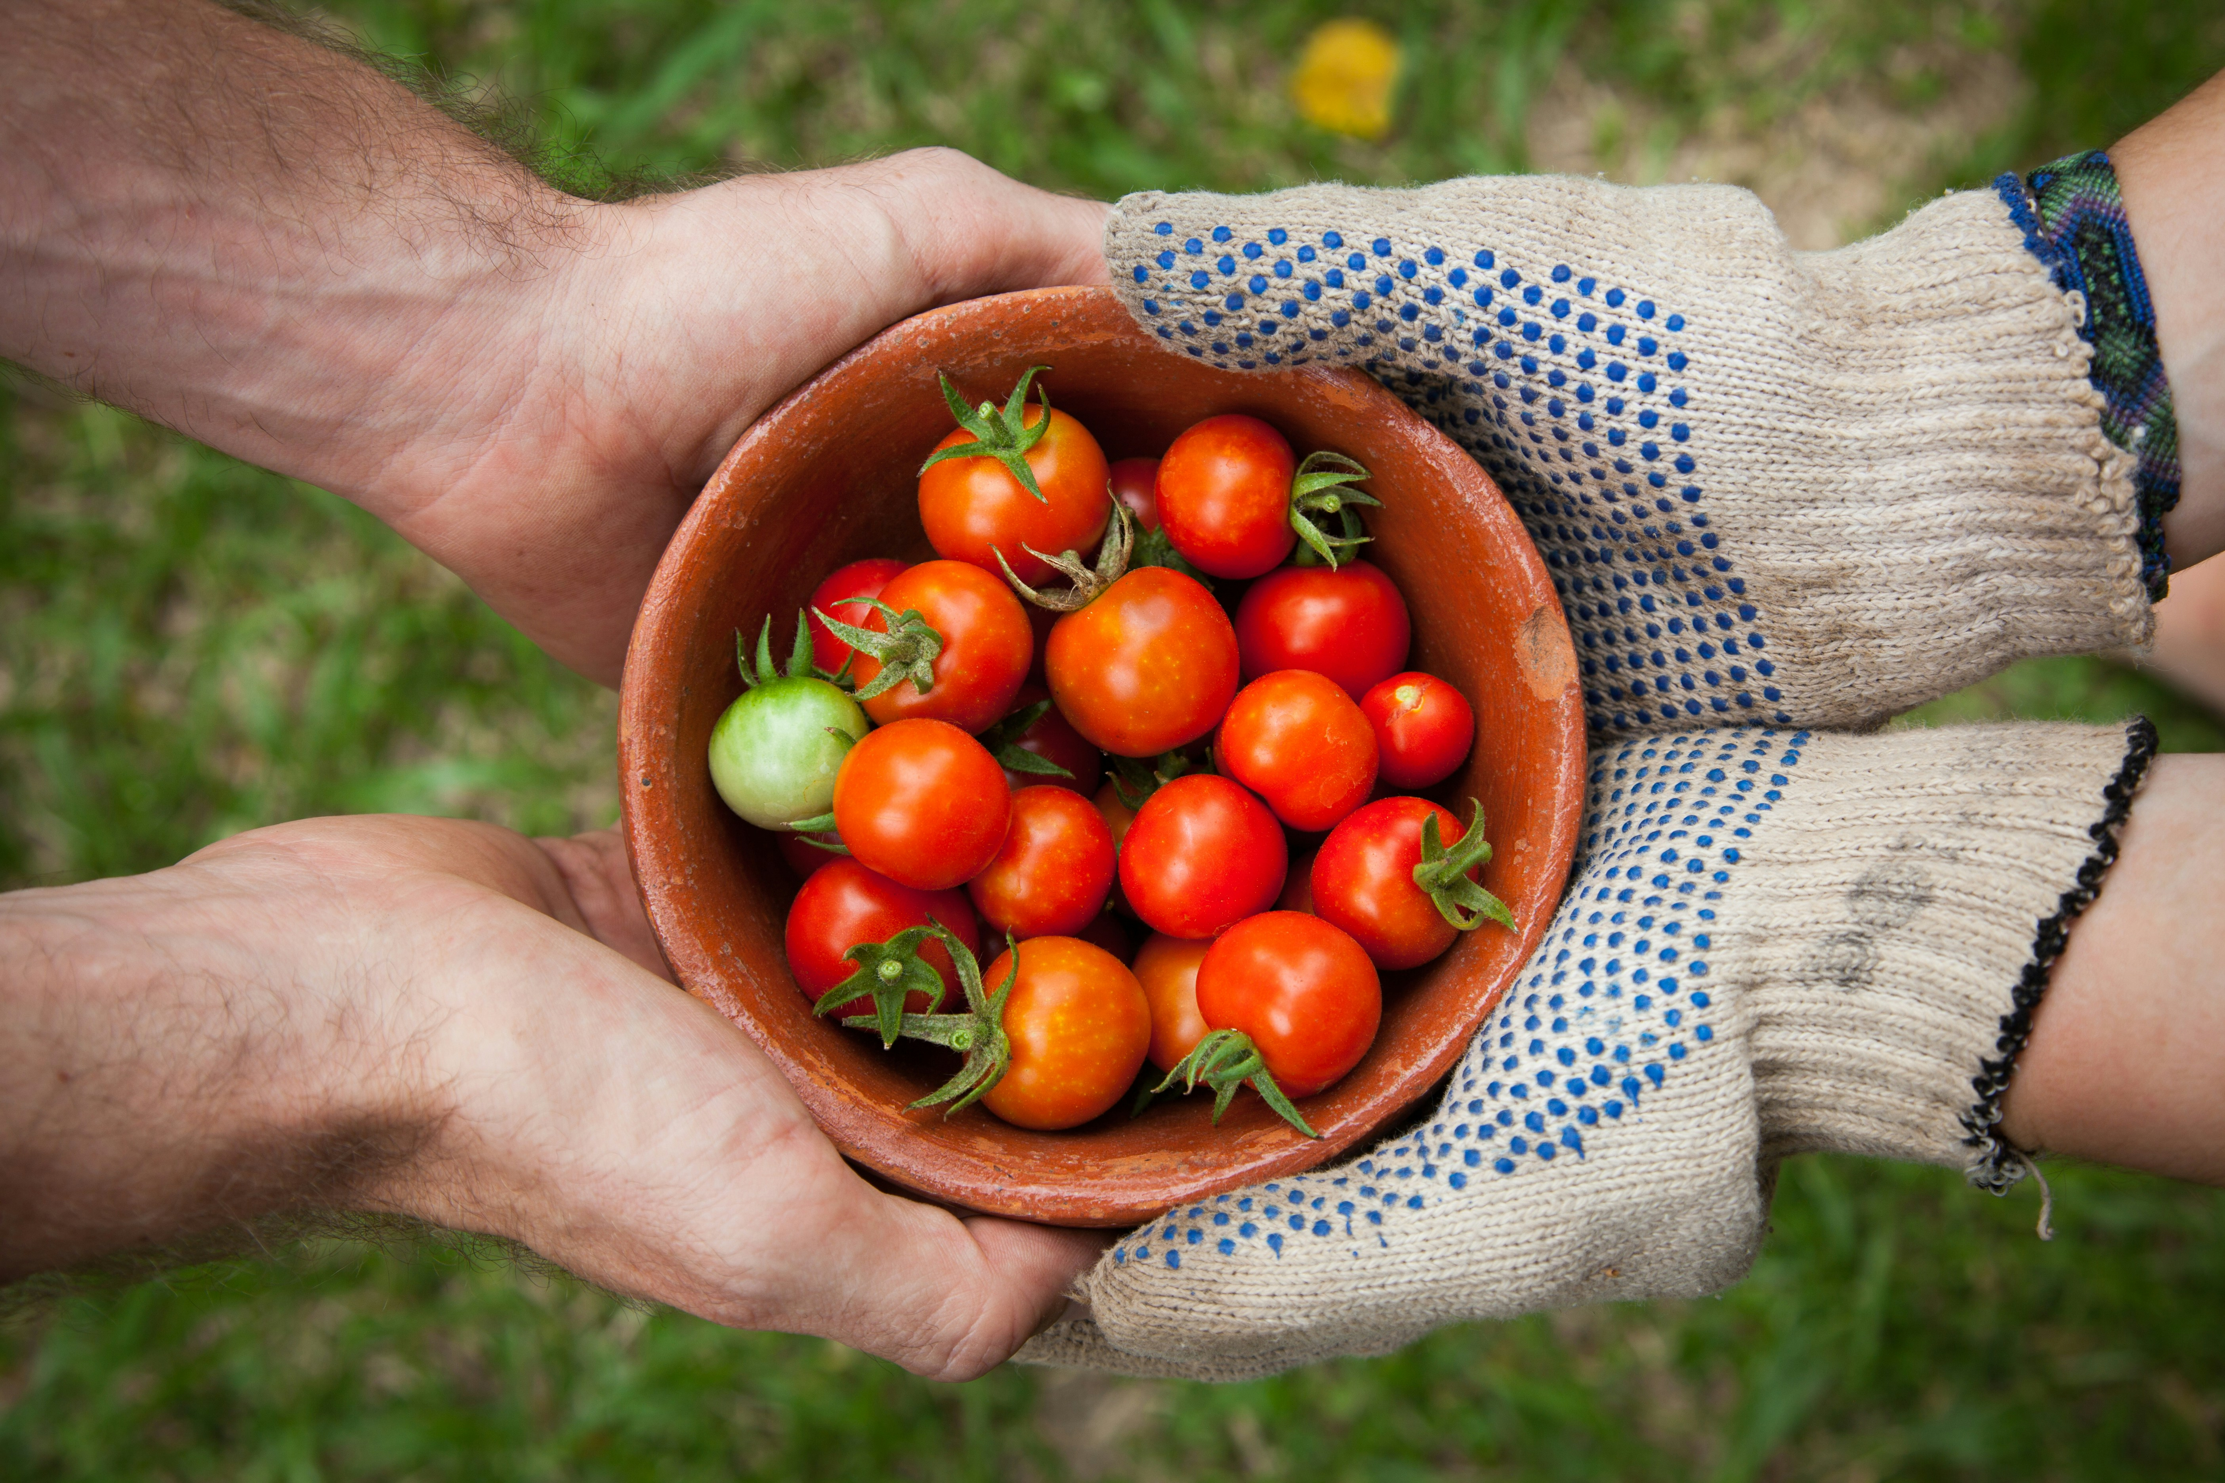
Distributive Justice
We should all make sure that everyone has a fair share in the goods of this world – food, clothing and shelter.
Notes:
Photo credit: Elaine Casap on Unsplash

Slide 5
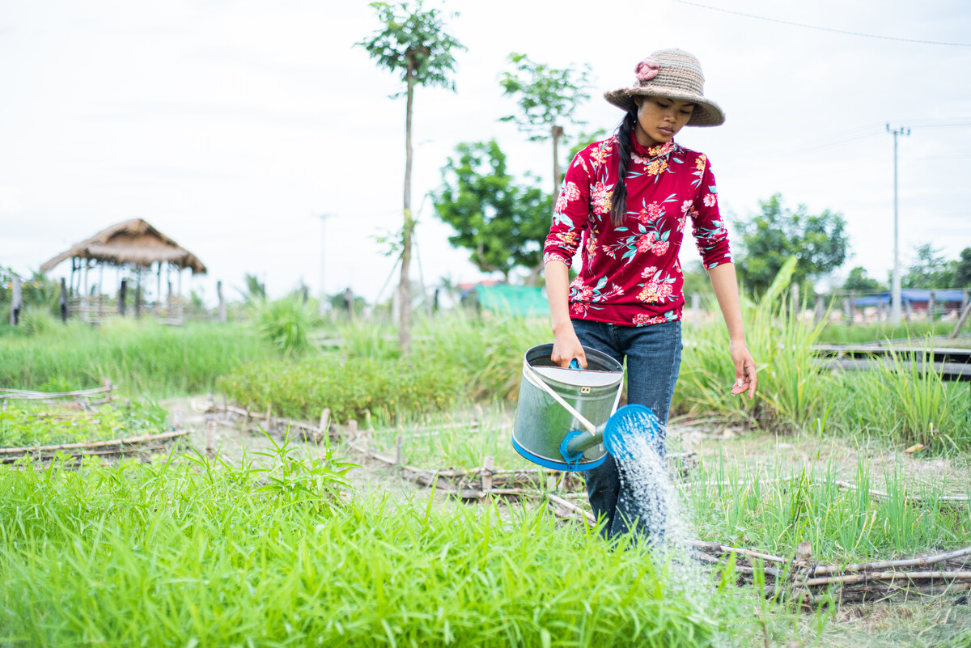
This is Long. She lives in a village in Cambodia.
Long enjoys being out in the fields. "What I find really satisfying is growing rice and crops and rearing chickens with my family," she says.
Notes:
Photo credit: Tom Chheat

Slide 6
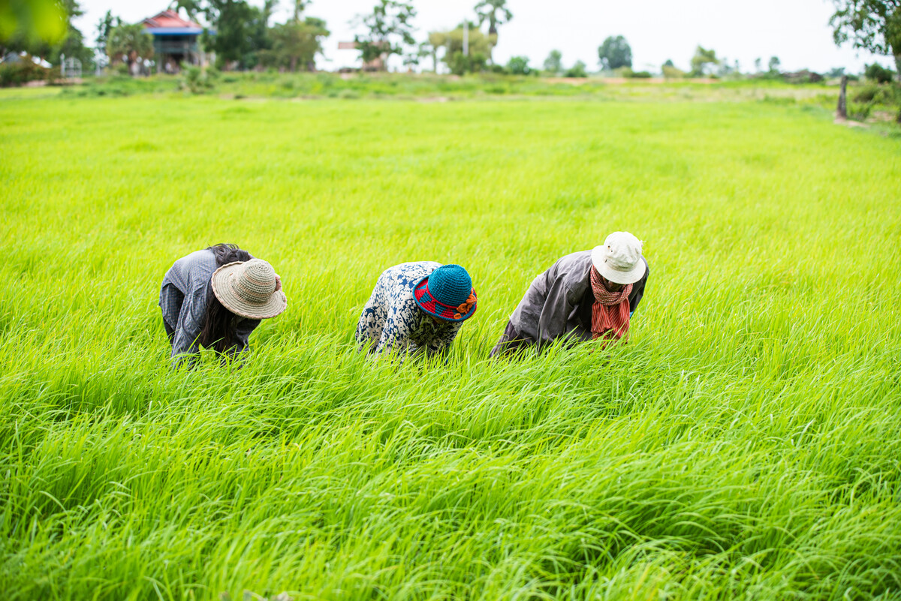
Long comes from a family of farmers who have worked on the land for generations.
They knew the best time to plant, what to grow and
when to harvest their crops, but climate change makes farming difficult for them now.
Notes:
Photo credit: Tom Chheat

Slide 7
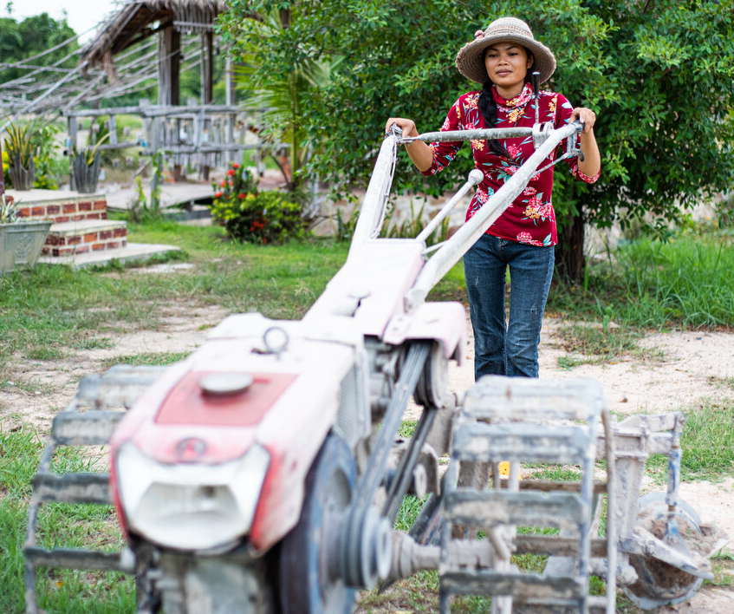
Rich countries have contributed most to climate change through pollution, but it is the people living in poverty suffer most.
If people cannot grow crops to eat or to sell for money to buy things they need, the world's goods are not being shared fairly between us all.
Notes:
Photo credit: Tom Chheat

Slide 8
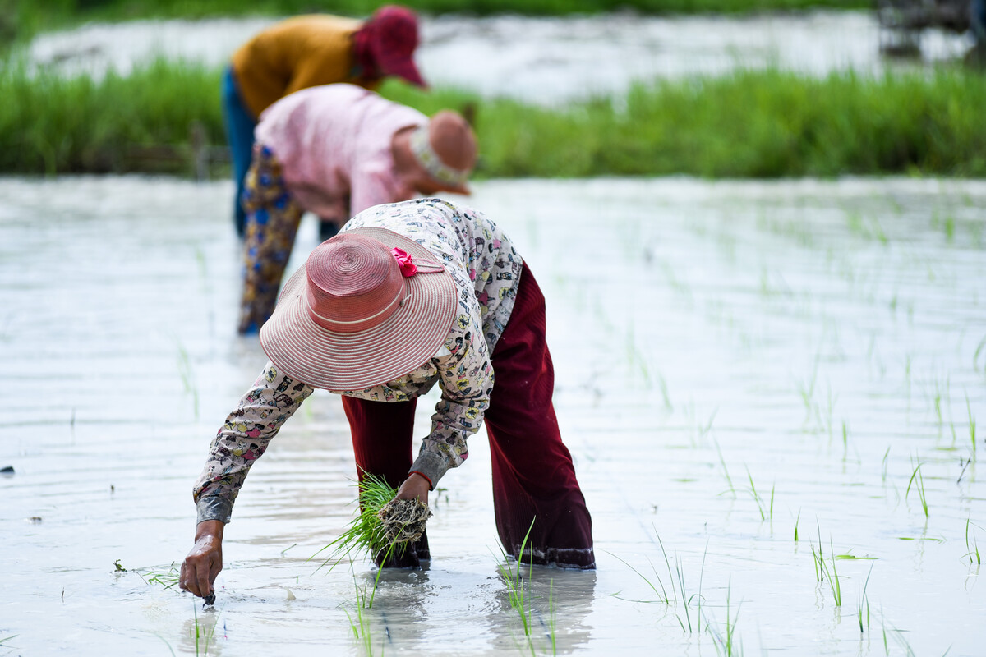
With CAFOD's help, Long's family and community are learning to plant rice and crops that can grow even in bad weather. This will help them to have enough food to eat and sell.
Notes:
Photo credit: Karuna Battambang Organisation

Slide 9
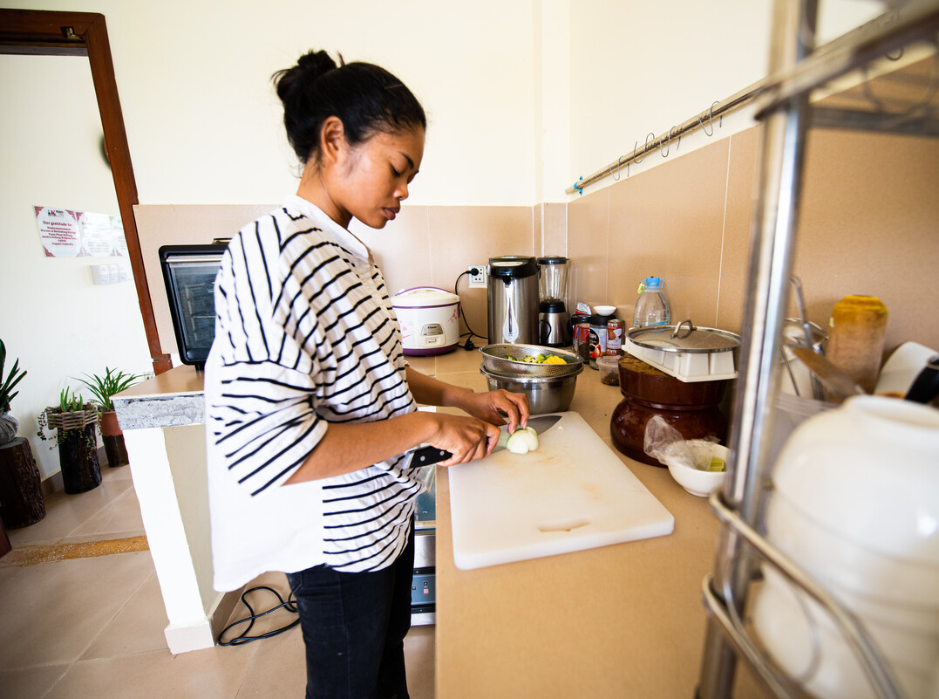
Long also works in the village café, set up with some help from CAFOD. It sells food grown by the local farmers. "In the future, I wish to start a small café to support my family," she says. "I'd like to train others to work in a café - so they can provide for their families too."
Notes:
Photo credit: Tom Chheat

Slide 10
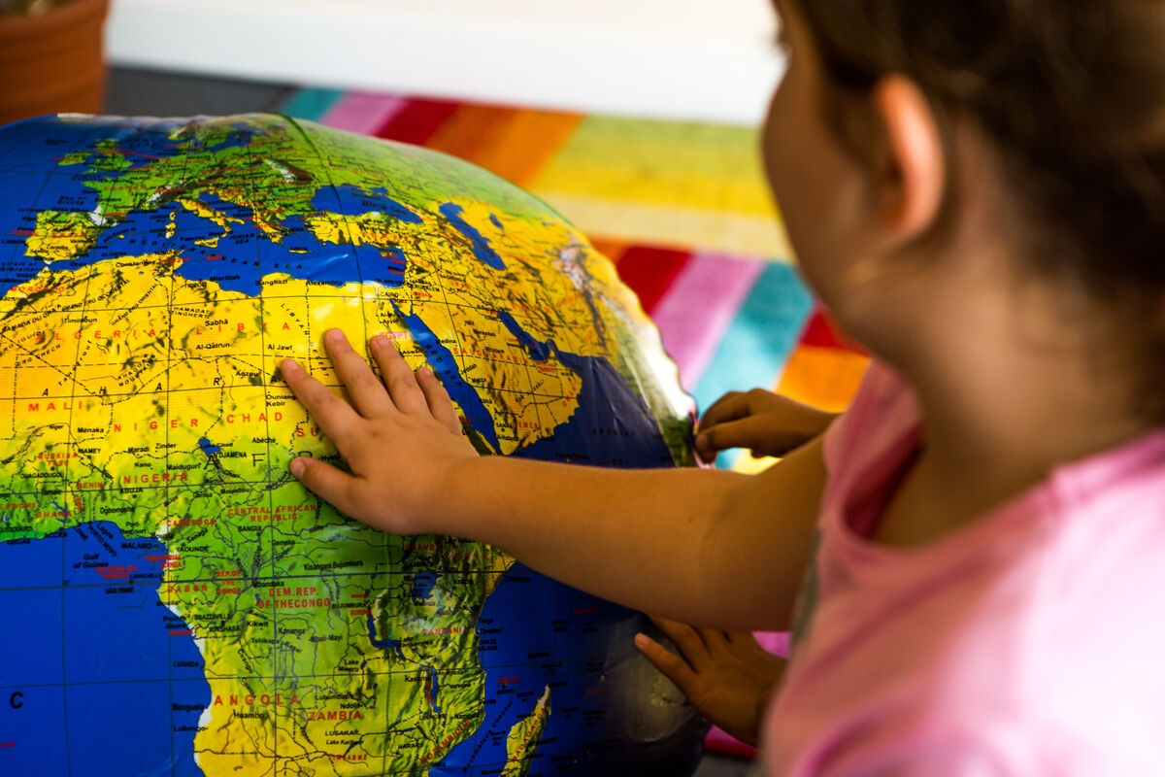
“We are agreed today that the earth is essentially a shared inheritance, whose fruits are meant to benefit everyone.”
Pope Francis,
Laudato Si’, 93
Notes:
Photo credit: Thom Flint

Slide 11
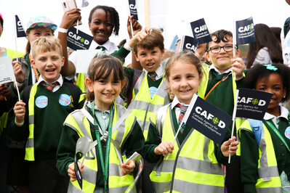
Sharing fairly
God wants us all to share in the goods of this world. No-one should struggle for food, shelter or clothing, yet 1 in 10 people are hungry.
We can pray that the earth's goods be shared more fairly. We can speak up for our brothers and sisters in poverty around the world during events like CAFOD's Big Lent Walk.
We can also do our best to share fairly at home and school with family and friends.
Notes:
Photo credit: Eleanor Church
Photo credit: M Cooper on Unsplash

Slide 12
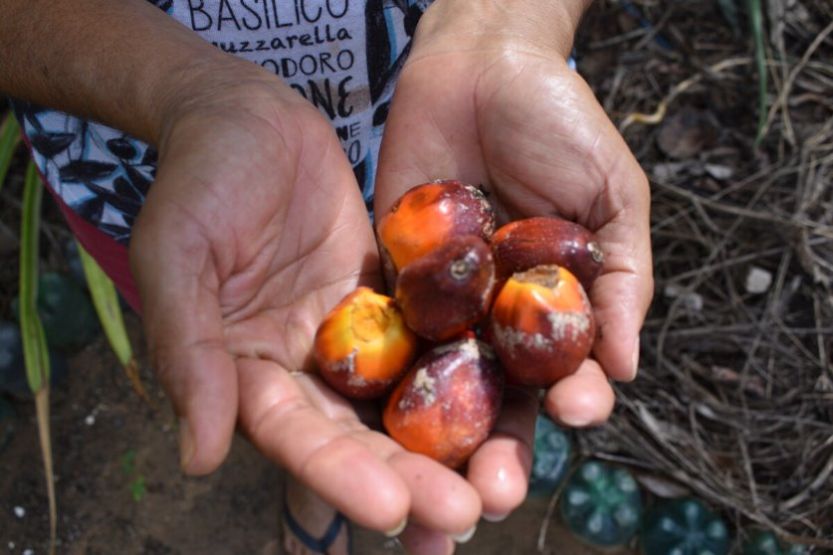
Let us pray
Loving God,
We believe that the gifts
of the world should be shared fairly.
Help us to always be grateful for what we have and share generously with others.
Lord in your mercy
Hear our prayer
Sharing fairly
Distributive Justice
Notes:
Photo credit: Kezia Lavan

Slide 13
Sharing fairly
DJ the Dolphin reminds us that Distributive Justice is sharing fairly.
How can we make sure we share fairly?

