Slide 1



for KS1

Slide 2

Notes:
Dilexi te is a message from Pope Leo about caring for people who are poor. He writes:

Slide 3
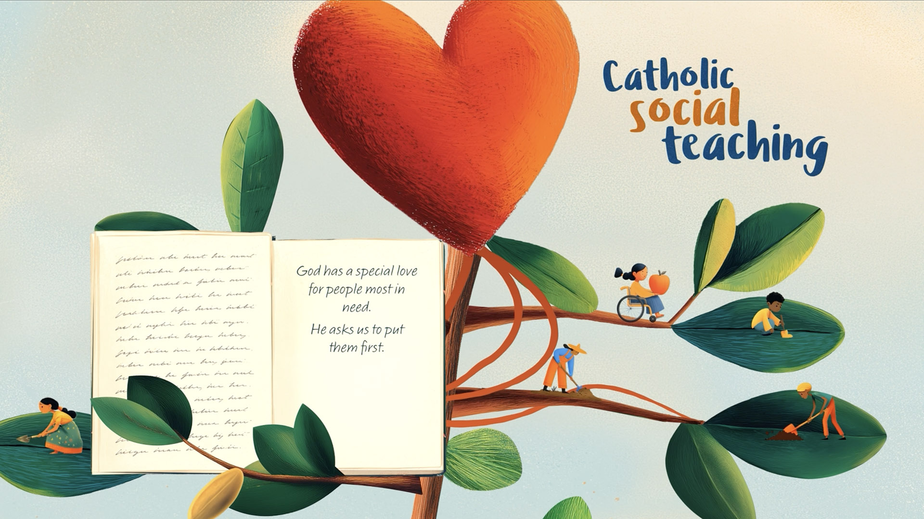
Notes:
God has a special love for people most in need. He asks us to put them first.
This is part of Catholic Social Teaching.

Slide 4
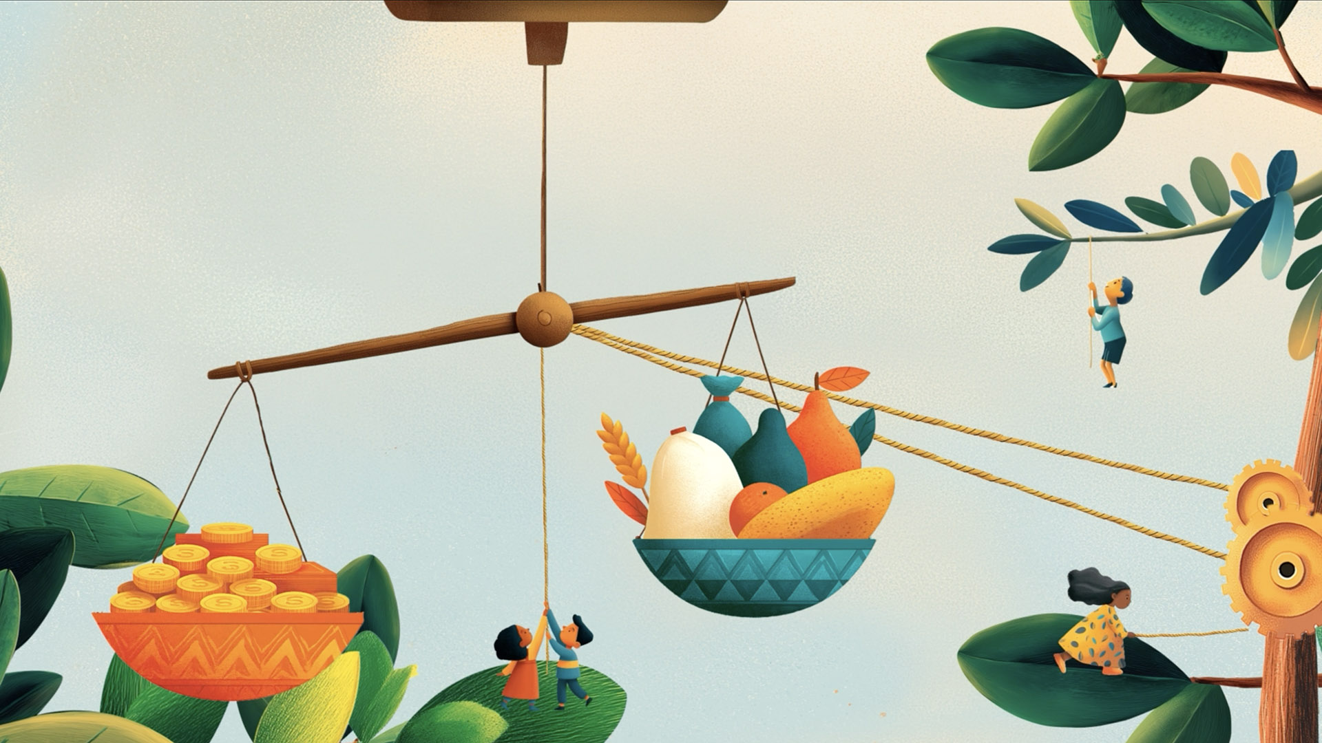
Notes:
When we put people who are most in need first, we try to love them and help them.

Slide 5

Notes:
Not everyone in the world is able to have everything they need to live a good life.
What can you see in this picture? (People growing food. People pumping water)

Slide 6
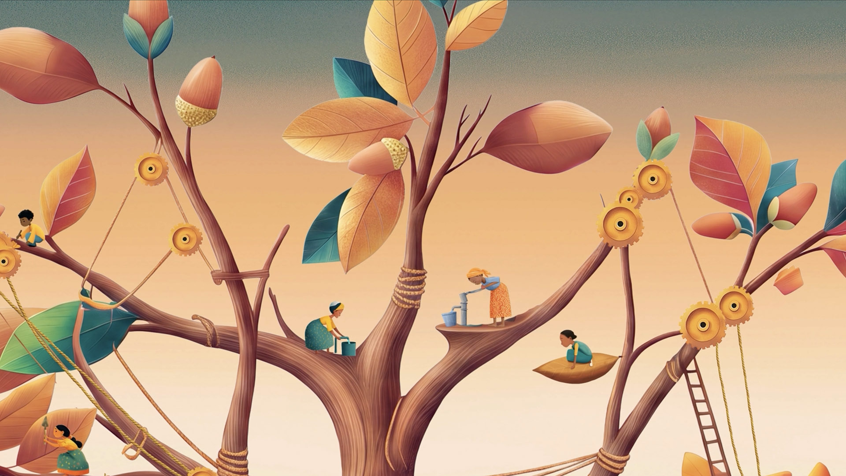
Notes:
Some people do not have safe clean water nearby and need to walk far to collect water.

Slide 7
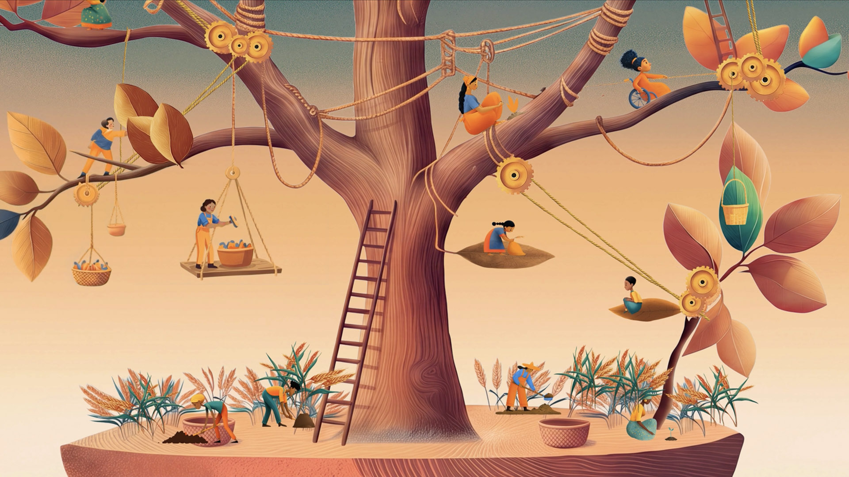
Notes:
Some people do not have enough food to eat.

Slide 8
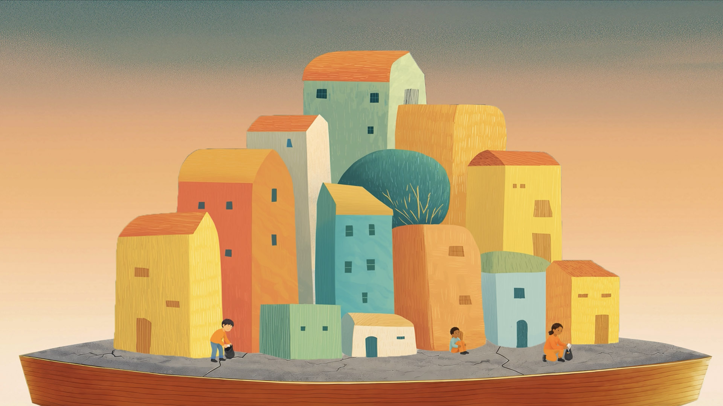
Notes:
Some people do not have a safe place to live or are not able to go to school.

Slide 9

Notes:
God created every person, so we are all very special! We all have human dignity.

Slide 10
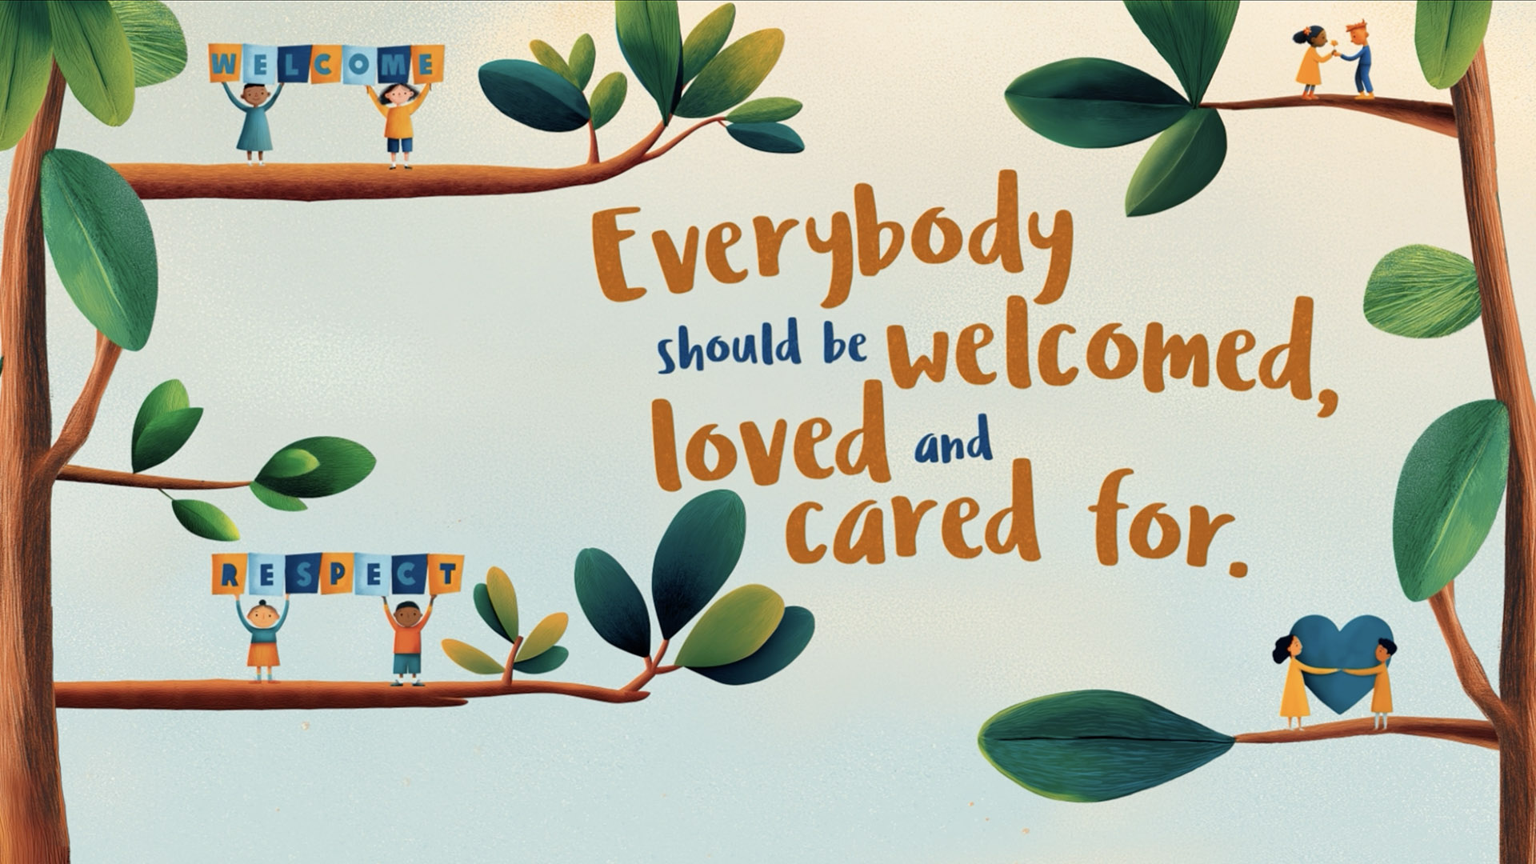
Notes:
Everybody should be welcomed, loved and cared for.

Slide 11
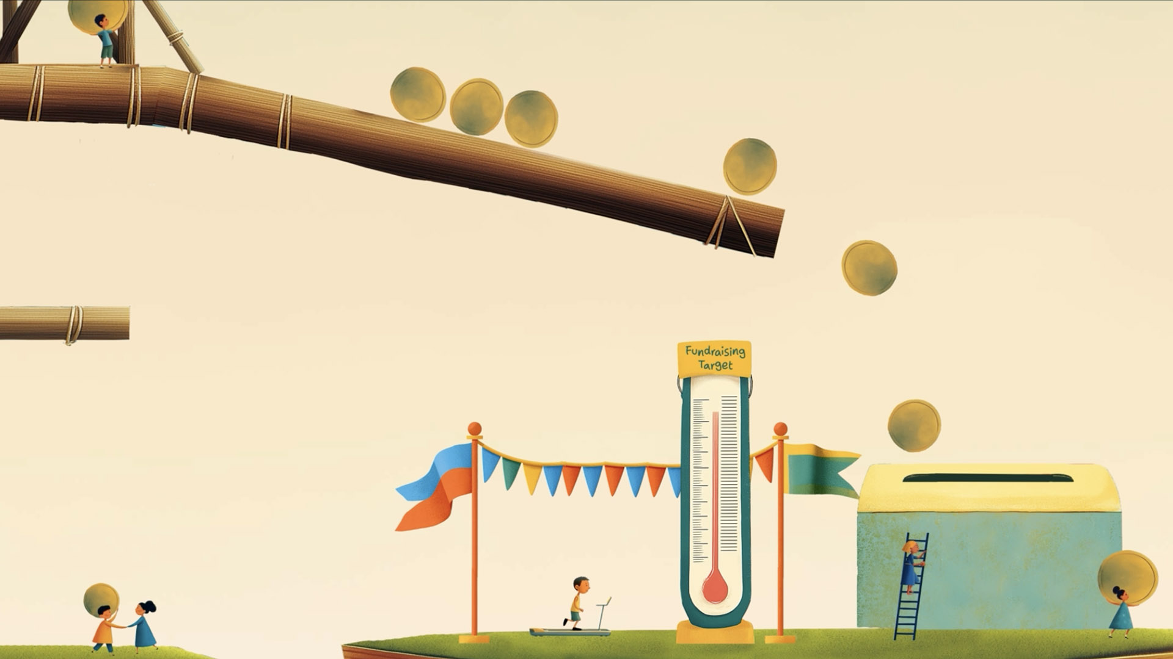
Notes:
Sharing fairly is an important way to help people in need. We can fundraise to help other people.

Slide 12

Notes:
There are so many other ways to help too. We can show our love by doing real, kind actions each day.
We can build a better world by putting love in action.
Wat can you see in this picture? Where can you see love in action?

Slide 13

Notes:
Doing something is always better than doing nothing.

Slide 14
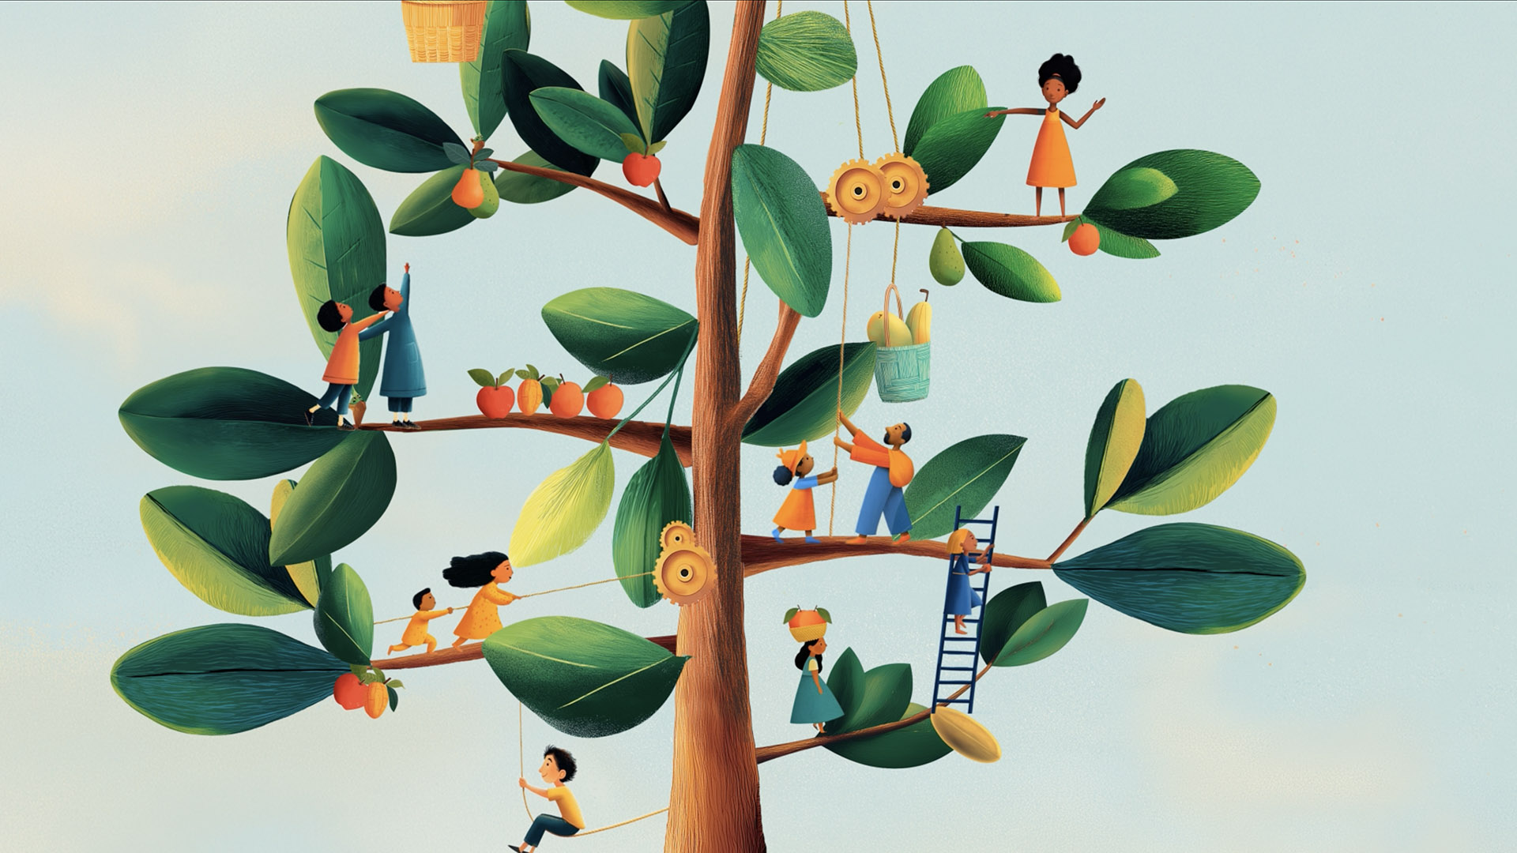
Notes:
If we want to build a better world, we must put the poorest people in our world first.
We must build a world where everyone is able to live a full and happy life.
What can you see in this picture? People are helping each other, sharing, living alongside each other happily.

Slide 15

Notes:
When we try to love others, love can work miracles!

Slide 16

Notes:
We can all build a better word when we love our neighbour.

Slide 17


