Slide 1
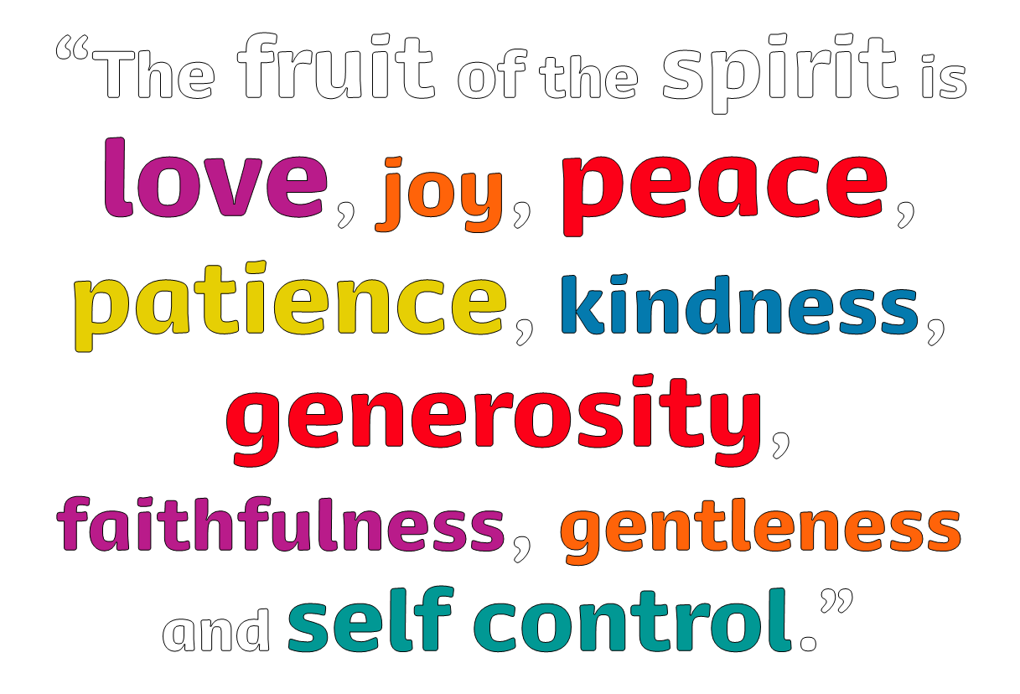
We pray to the Holy Spirit:
That love may fill our hearts so that we are open to others…
Response: Come, Holy Spirit, help us to transform our world
That all your children may find joy in their lives…
That wars may cease, and peace may come…
That all peoples may learn to be patient and tolerant…
That those who suffer may experience kindness…
That generosity may be given to those in need…
That we may be faithful to the Lord’s command
to love all our sisters and brothers…
That vulnerable and forgotten people may
receive gentleness and respect…
That we may be able to put others first to help them in their need…

