Slide 1
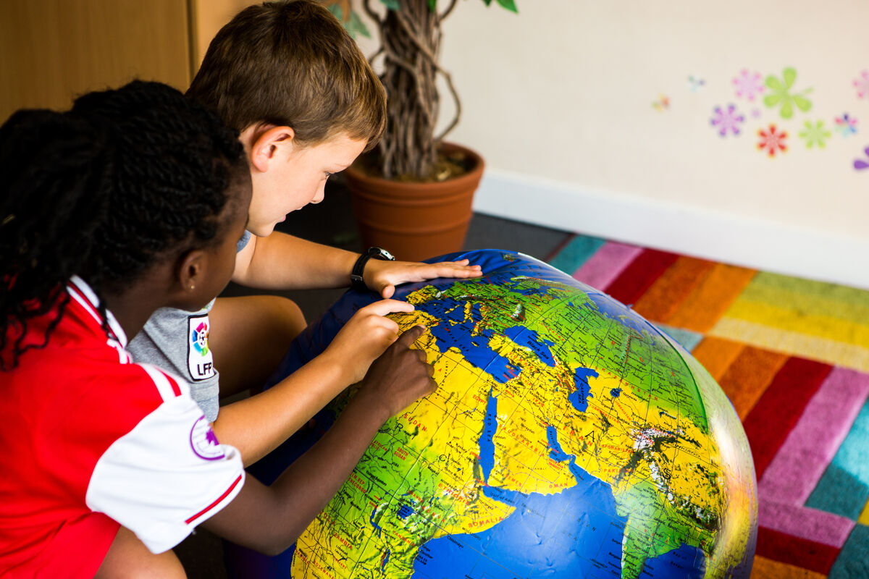
How can I show love for God’s children around the world?
Gather
Notes:
Children of Our Lady Queen of Heaven Primary School
Photo credit: Thom Flint

Slide 2
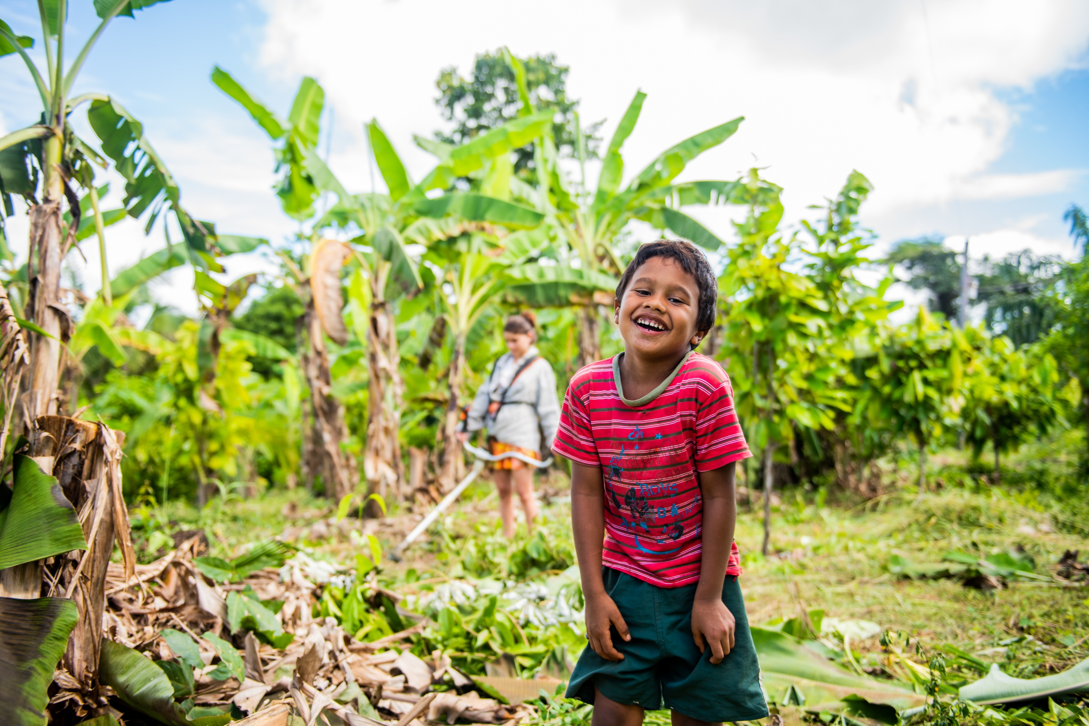
Loving God, your Son Jesus shows us that all people, including little children, are important and loved by you.
Help us to follow his example and to respect and care for all people around the world.
Amen.
Notes:
Davi, Brazil
Photo credit: Ana Caroline De Lima

Slide 3
Gospel: Mark 10:2-16
Some people brought children to Jesus for him to place his hands on them, but the disciples scolded the people.
When Jesus noticed this, he was angry and said to his disciples, “Let the children come to me, and do not stop them, because the Kingdom of God belongs to such as these. I assure you that whoever does not receive the Kingdom of God like a child will never enter it.”
Then he took the children in his arms, placed his hands on each of them, and blessed them.
Word

Slide 4
What do you remember from the Gospel reading?
People were bringing their children to Jesus for his blessing, but the disciples tried to stop them. Why do you think they did this?
Perhaps they thought the children would bother Jesus, that he would find them too loud or lively. Or maybe the disciples were worried that Jesus was tired or hungry and that it was time for him to rest.
How did Jesus feel when he noticed what the disciples were doing? What did he say?
Respond

Slide 5
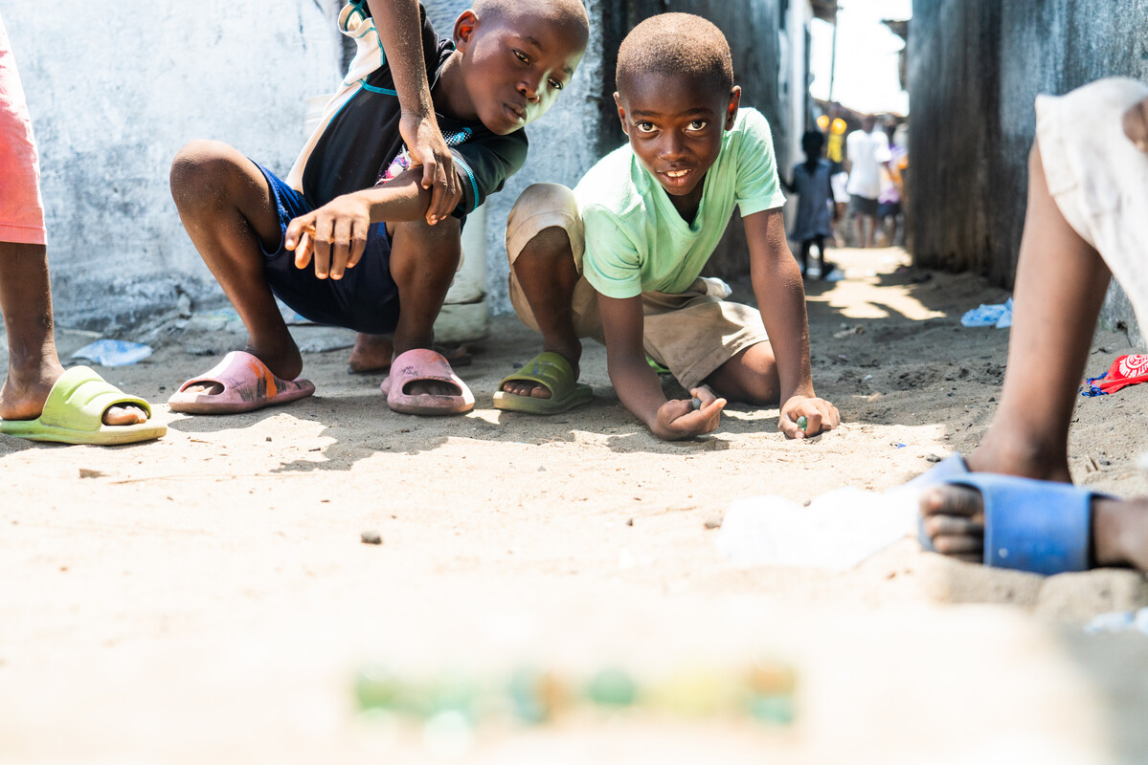
Jesus is angry and tells the disciples to let the children come to him.
He says that the kingdom of God belongs to children like these.
He says that they have a special way of looking at the world and of understanding things, which adults can learn from.
Notes:
Aaron and his friend, Liberia
Photo credit: Carielle Doe

Slide 6
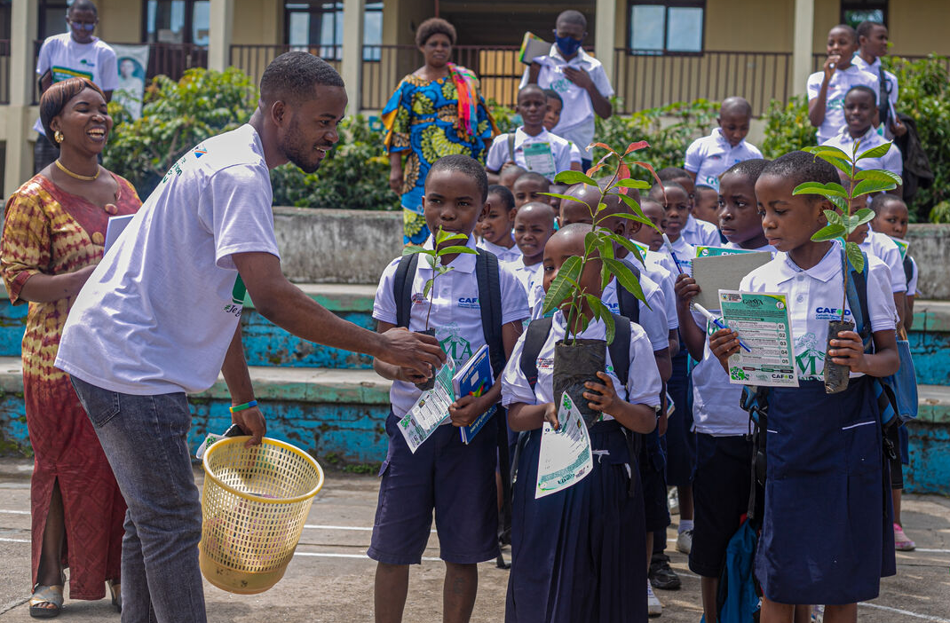
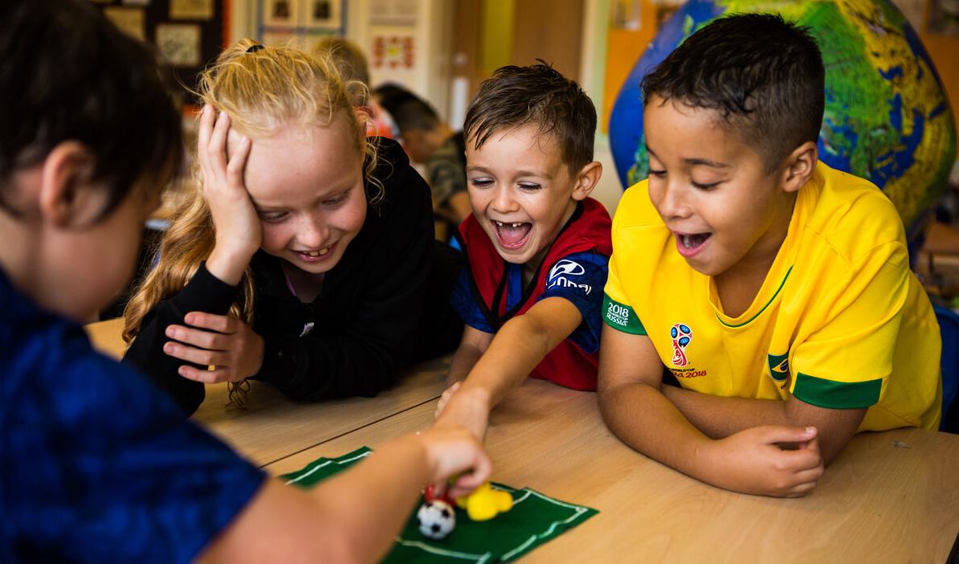
How does it make you feel to know that Jesus thinks all children are important and that he wanted to listen to them?
Jesus welcomed and blessed children who came to him. He loves us all; no matter where we live; whether we are old or young, big or small, rich or poor.
Notes:
School children, Democratic Republic of Congo
Photo credit: Goma Notre Maison Commune
Children of Our Lady Queen of Heaven Primary School
Photo credit: Thom Flint

Slide 7
In the gospel story, Jesus welcomes the children and shows the disciples how important they are. We are also called to care for children everywhere whenever we can, because we are all brothers and sisters.
All around the world, communities work hard to help children have enough food to eat and clean water to drink; to help children have the things necessary for a happy life, including the chance to go to school and learn. These communities need our support.
Raising money for CAFOD is one way we can help.

Slide 8
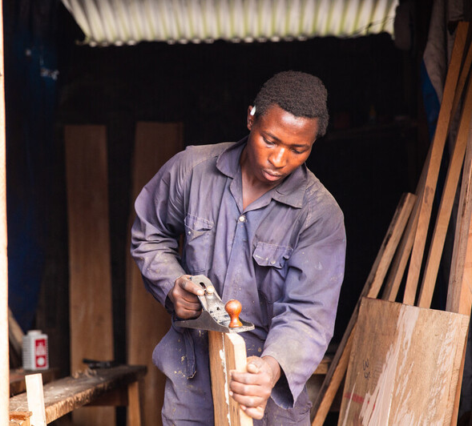
Last week we heard all about Daniel who lives in the Democratic Republic of Congo.
With money raised by school children across England and Wales, CAFOD works with local experts who help Daniel and his friends learn to make furniture. This is so that when he is older, he will be able to earn money as a carpenter and be able to look after himself and his family.
Notes:
Daniel, Goma, Democratic Republic of Congo
Photo credit: Thom Flint

Slide 9
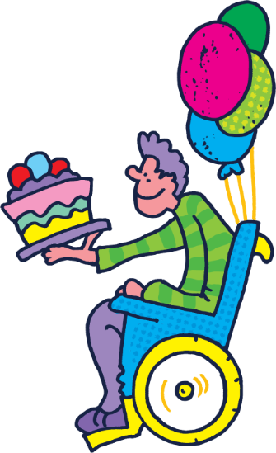
CAFOD's Harvest Family Fast Day was last week. A big thank you if you raised money to help people like Daniel and children all around the world.
Don't worry if you missed it, you can still Brighten Up for CAFOD! Why not try a sponsored walk in your brightest clothes? A bright bake sale? Or bright hair-braiding?
What could you do to show love for God's children around the world?

Slide 10
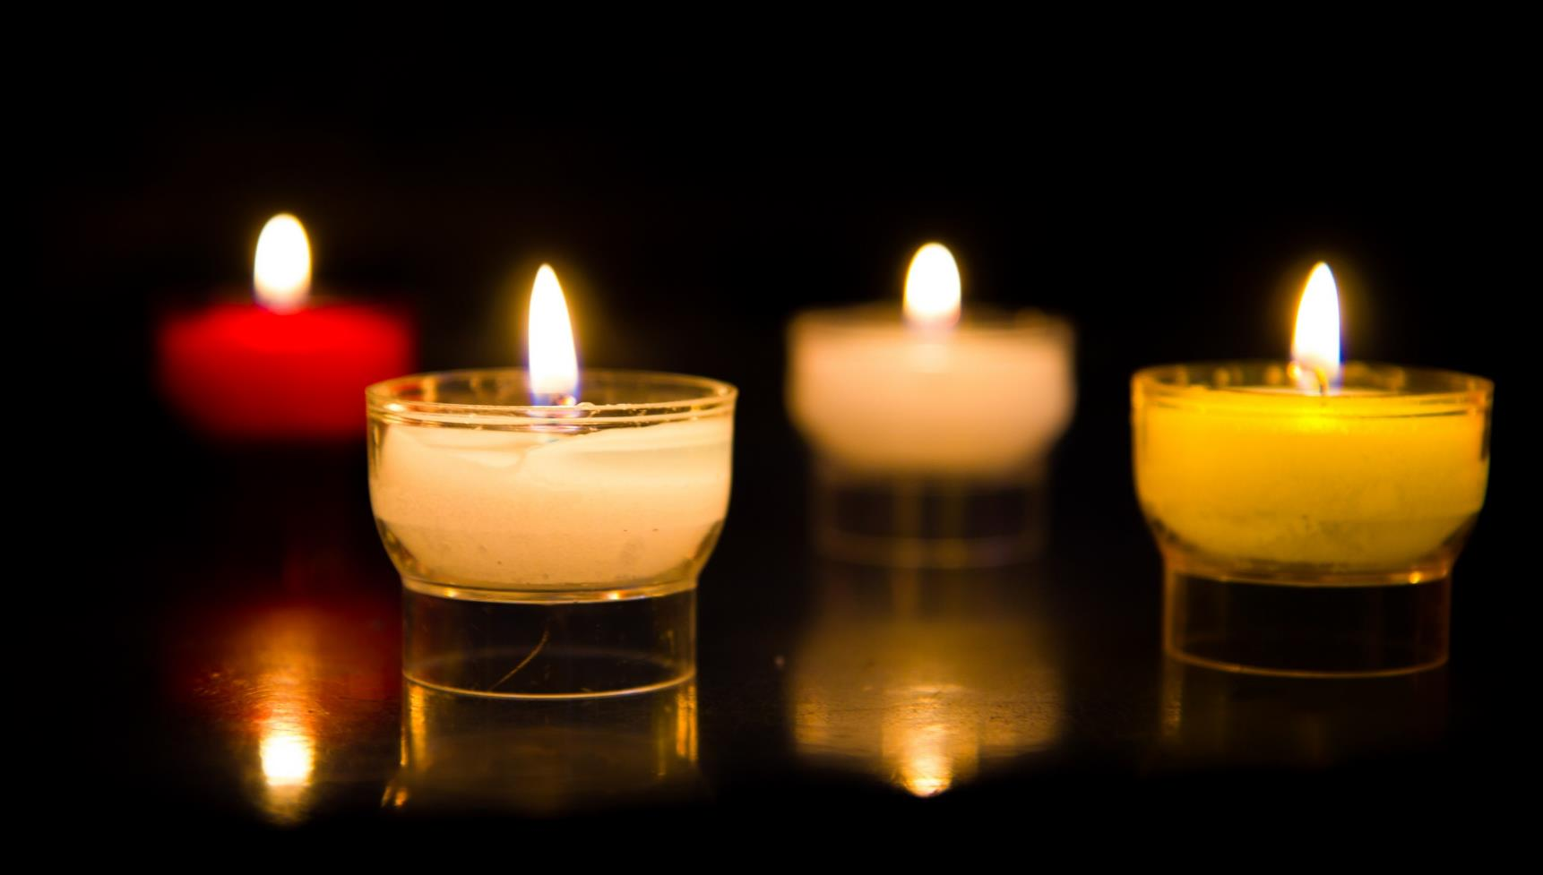
Let us pray…

Slide 11
We pray for the Church throughout the world: that it may be a place of welcome and support for all people, especially those who are poor. Lord, in your mercy…
We pray for children throughout the world: that they may have the chance to grow and learn and live happy lives with hope for the future. Lord, in your mercy….

Slide 12
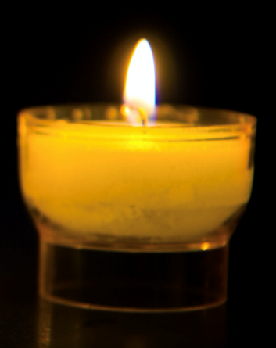
We pray for our parish, family and friends: that we may be filled with love for all God’s children. May God lead us to care for one another and for the world we live in.
Lord, in your mercy…

Slide 13
God of love,
you teach us to see that everyone is special. Help us to play our part in welcoming others and sharing your love with all people.
Amen.

Slide 14
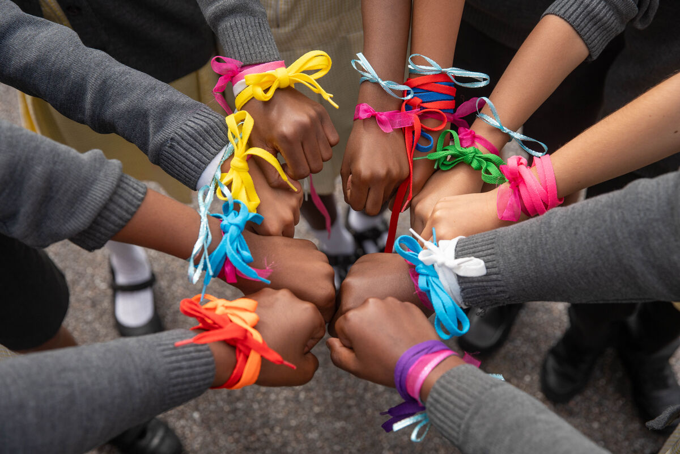
What will you do this week to show your love for God’s children around the world?
Send
Notes:
Children of St Chad's Primary School
Photo credit: Joe Newman

Slide 15
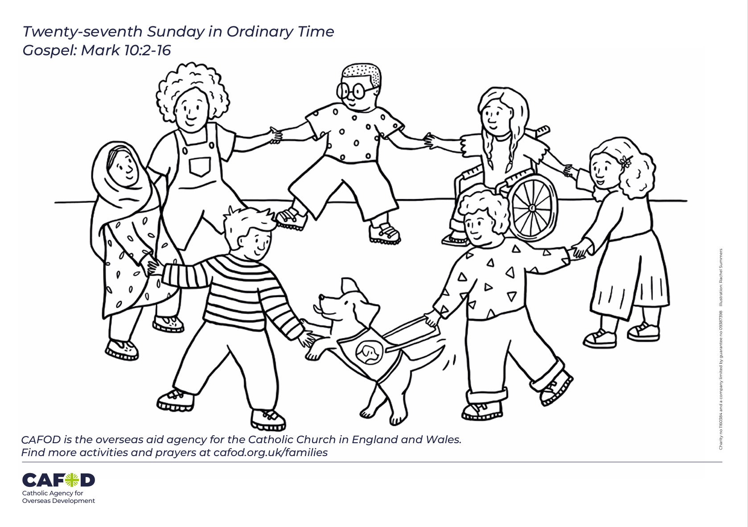
Activity suggestions
Share the accompanying illustration with the children. Encourage the children to draw Jesus into the picture, to remind them that all children are special and loved by God.
Share Daniel's story as he explains how his workshop has changed his life. Back to school - Brighten up!
There's still time to fundraise for CAFOD's Harvest Family Fast Day. Remind the children we can help other children in need have enough food to eat, clean water to drink and the chance to learn by raising money for CAFOD's work around the world.
Harvest resources for primary schools (cafod.org.uk)
Brighten Up fundraising
World Gifts for primary schools (cafod.org.uk)

Slide 16
Share with the children how we can put love for God, our neighbour and the world into action this term by watching CAFOD's national assembly. Harvest Assembly for KS 1 and 2 (cafod.org.uk)
Encourage the children to think about how they can show kindness and generosity to their brothers and sisters around the world as Jesus taught. Putting CST into practice (cafod.org.uk)
Remind the children to share all that they heard and thought about with the people at home during the week. Talk to them about how special and loved they are by God, whose Son Jesus welcomed the little children. Invite them to pray for children everywhere this week and to do what they can to care for others at home, at school and around the world.

Slide 17
Notes:
Illustration: Rachel Summers

