Slide 1
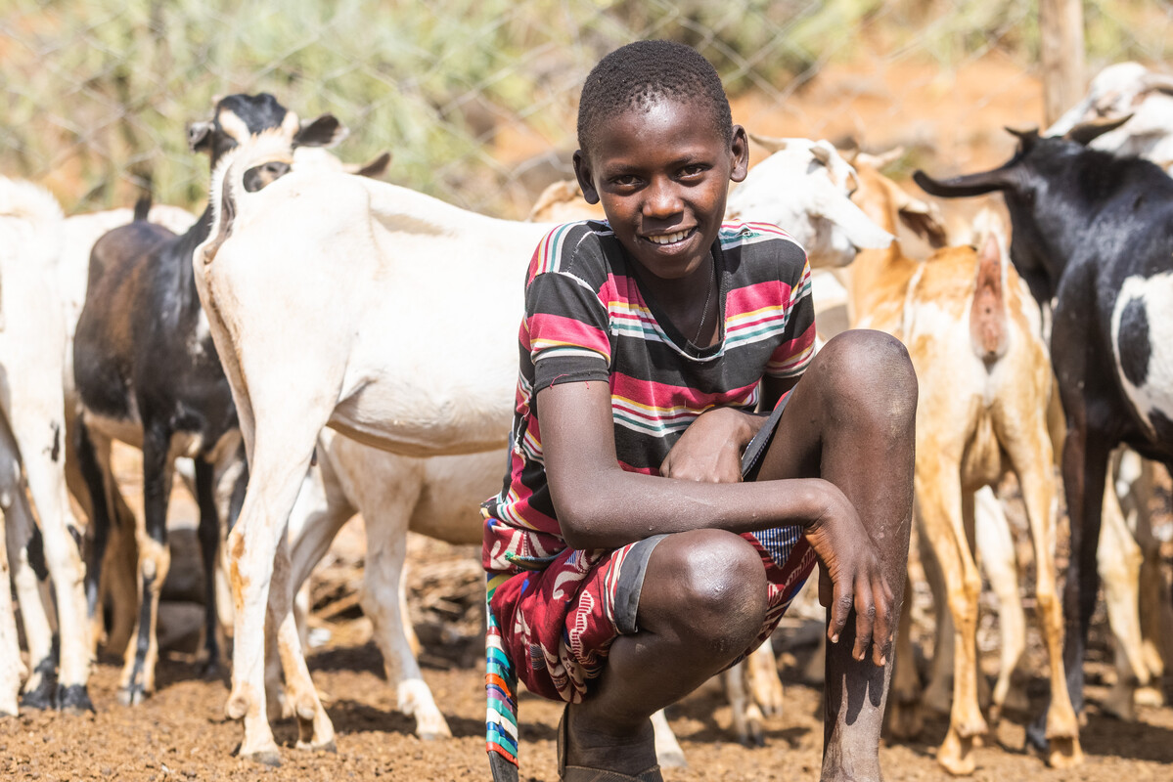
Participation
Exploring CST principles in CAFOD’s work
Notes:
Photo credit: Mwangi Kirubi

Slide 2
Participation means
we believe in
taking part.

Slide 3
"When each separate part works as it should, the whole body grows and builds itself up through love."
Ephesians 4:16

Slide 4
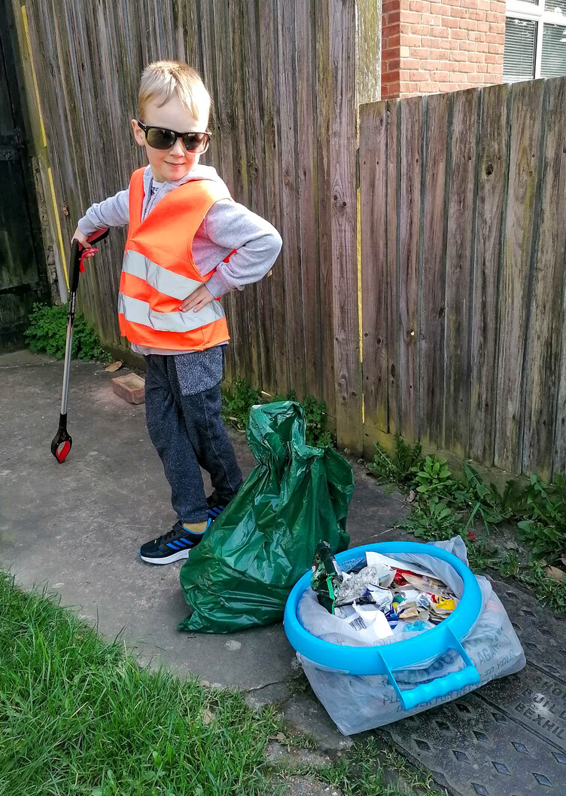
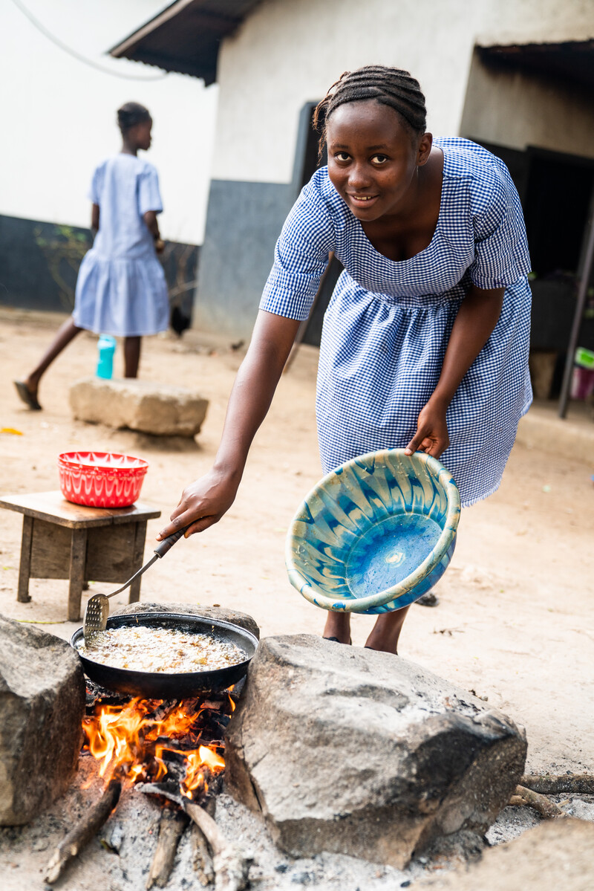
Participation
God calls us to work for the good of everyone.
Notes:
Photo credit: Joey's family
Photo credit: Michael Duff

Slide 5
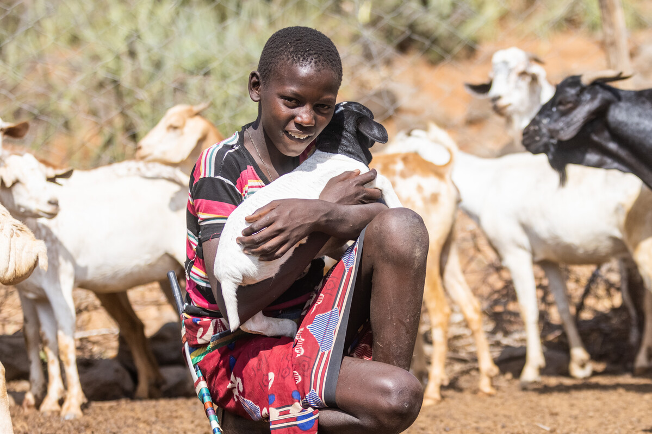
This is Saidimu. He lives in a village in Kenya.
He loves helping his dad, Ochuroi, grow crops on the farm.
"It is how we eat. I like growing vegetables. I also cook them when we harvest them," says Saidimu.
"Without the farm, we would be hungry."
Notes:
Photo credit: Mwangi Kirubi

Slide 6
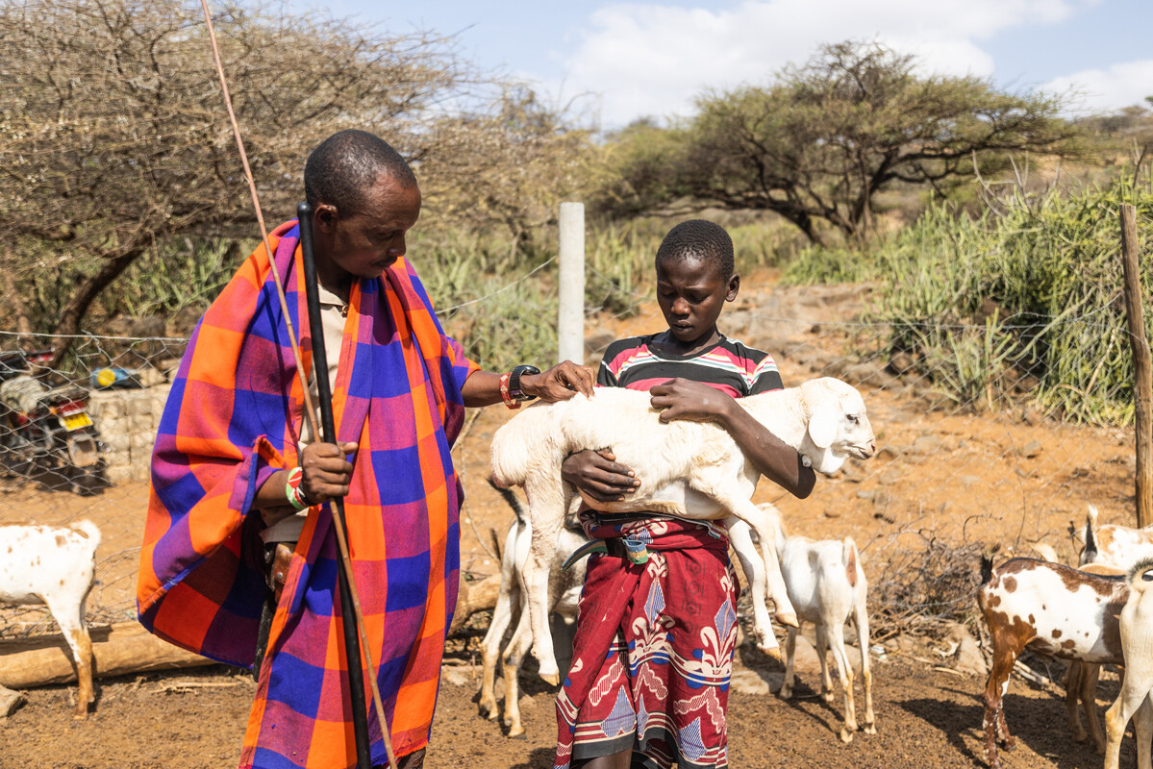
With CAFOD's help, families in Saidimu's village are learning how to grow weather-resistant crops, keep honey bees and run a business selling their produce.
By taking part and all working together, they will have food to feed their families and money for the things they need to live a happy life.
Notes:
Photo credit: Mwangi Kirubi

Slide 7
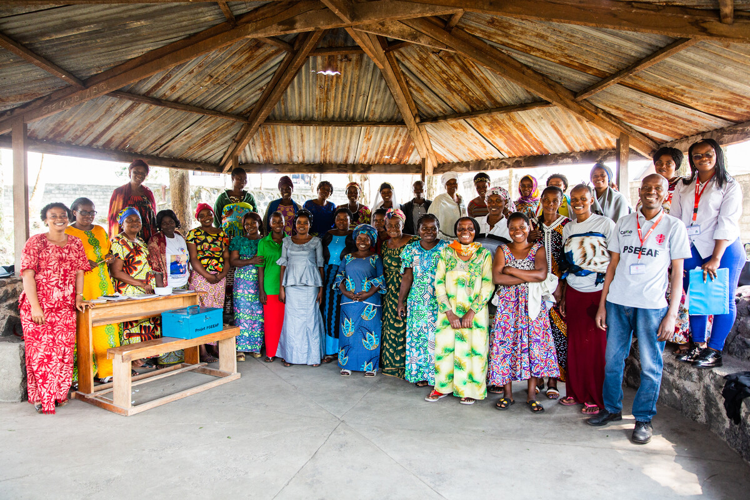
Saidimu takes part in his community, using his talents by helping on the farm.
It is important that we make sure everyone can take part in our community, so that everyone feels included.
Notes:
Photo credit: Thom Flint

Slide 8
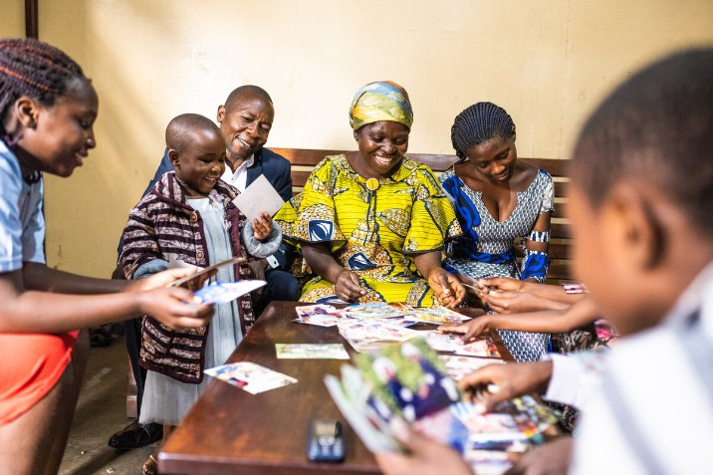
"Each of us has
a part to play,
a gift to share,
a service to offer,
for building up the Body of Christ in love."
Pope Francis,
19 June 2013
Notes:
Photo credit: Arlette Bashizi

Slide 9
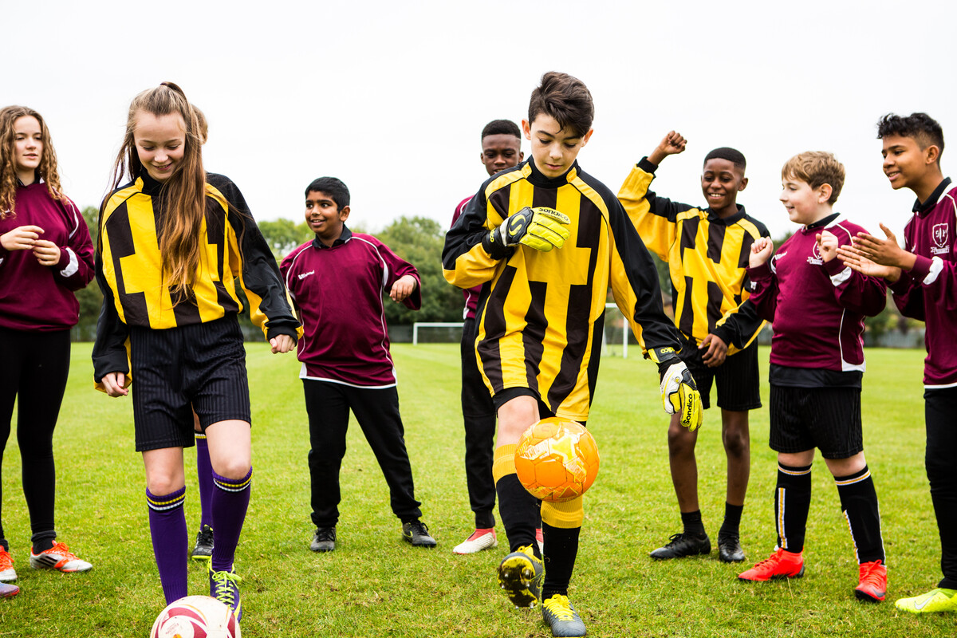
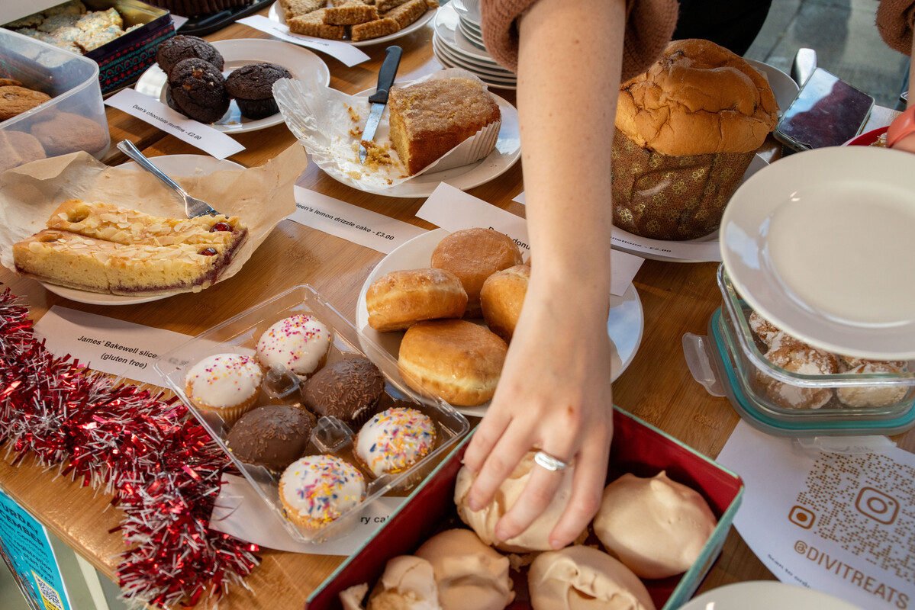
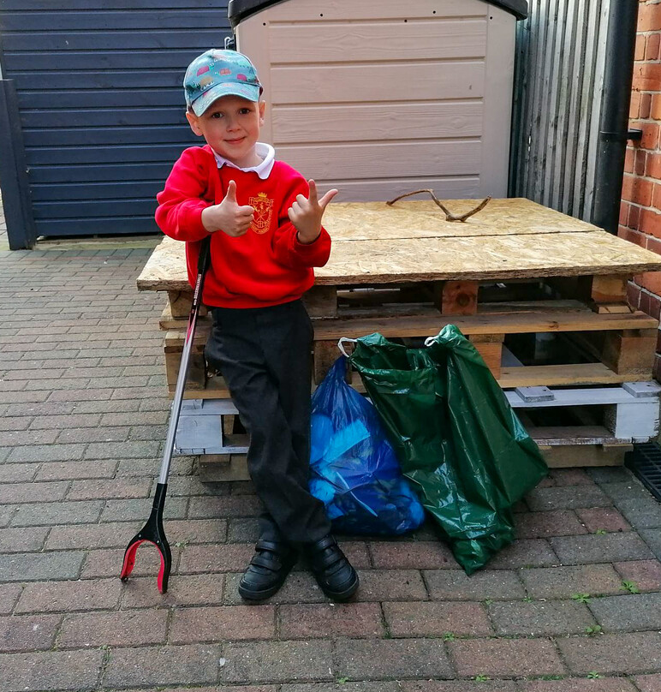
All taking part
School children in England and Wales have used
their talents and played a part helping our brothers and sisters around the world to help themselves.
Sponsored keepy-uppies
CAFOD cake sale
Sponsored litter pick
Speaking out
Notes:
Photo credits: Thom Flint, Joe Newman, Joey's family, David Gallardo

Slide 10
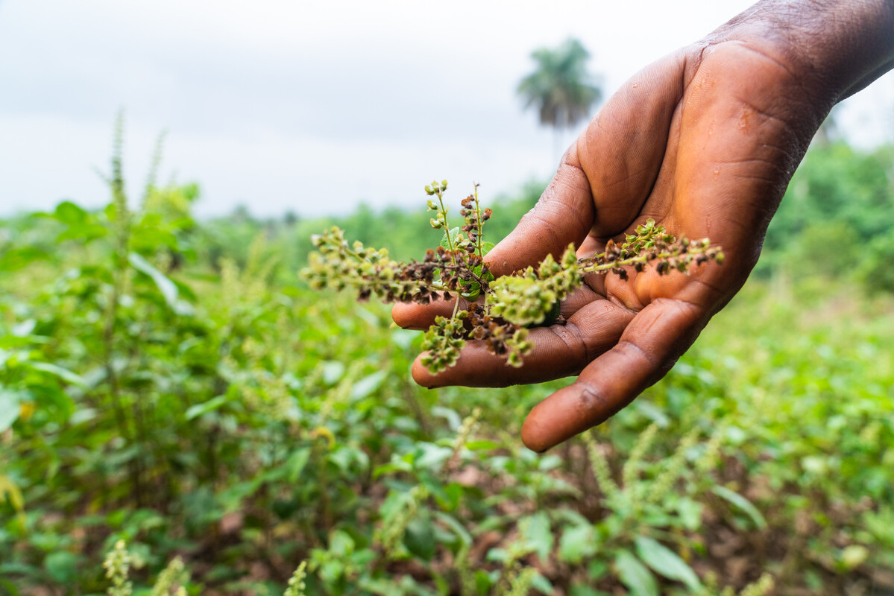
Let us pray
Loving God,
We believe that everyone has special gifts and talents.
Thank you for the gifts you have given us.
Help us to make sure everyone can use the talents you gave them.
Lord in your mercy
Hear our prayer
Taking part
Participation
Notes:
Photo credit: Carielle Doe

Slide 11
Taking part
Patariki the penguin, reminds us that Participation is taking part, just like Saidimu is doing.
How can we make sure we are taking part and using our gifts?

