Slide 1
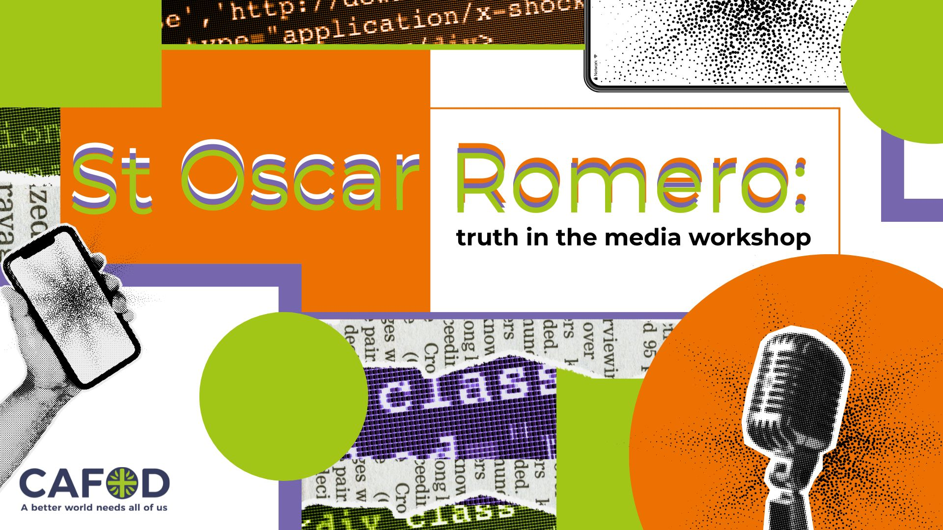

Slide 2
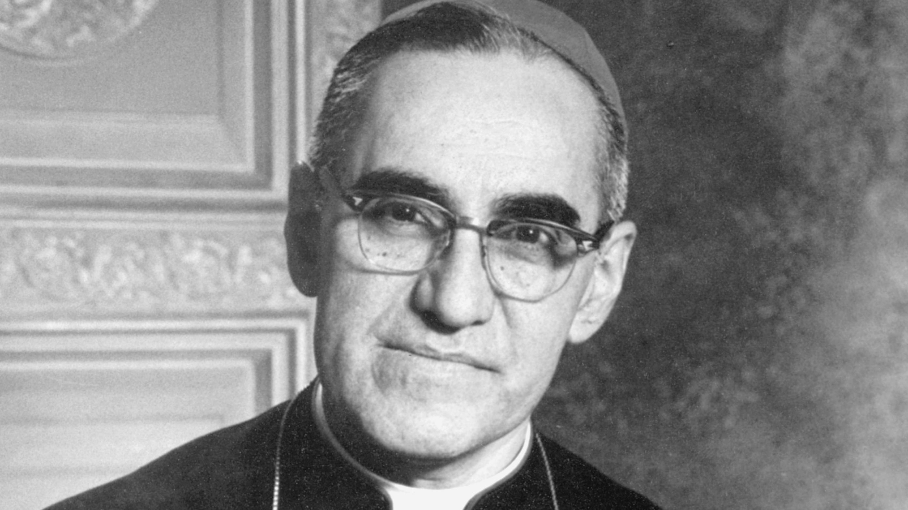

Slide 3


Slide 4
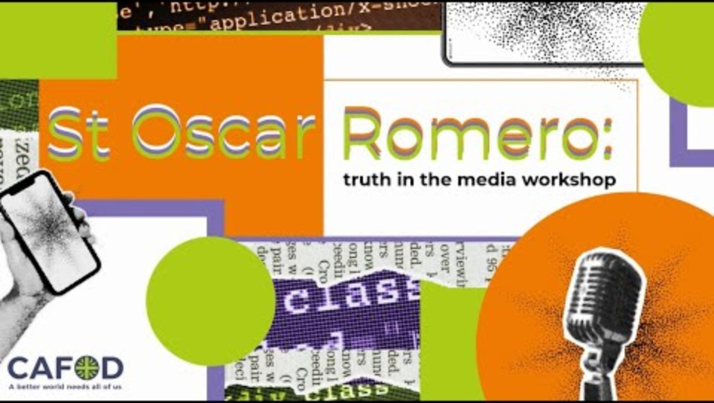
Pablo
Notes:
First video

Slide 5
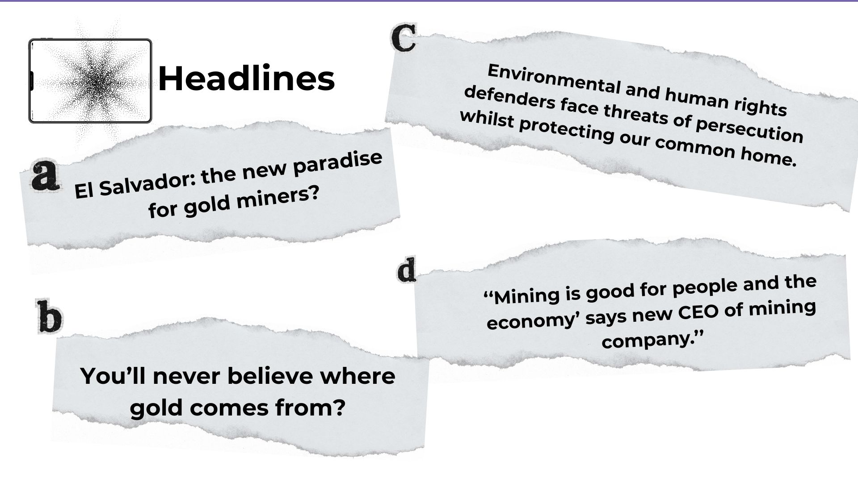

Slide 6


Slide 7
Charlotte
Notes:
Start at 3minutes

Slide 8
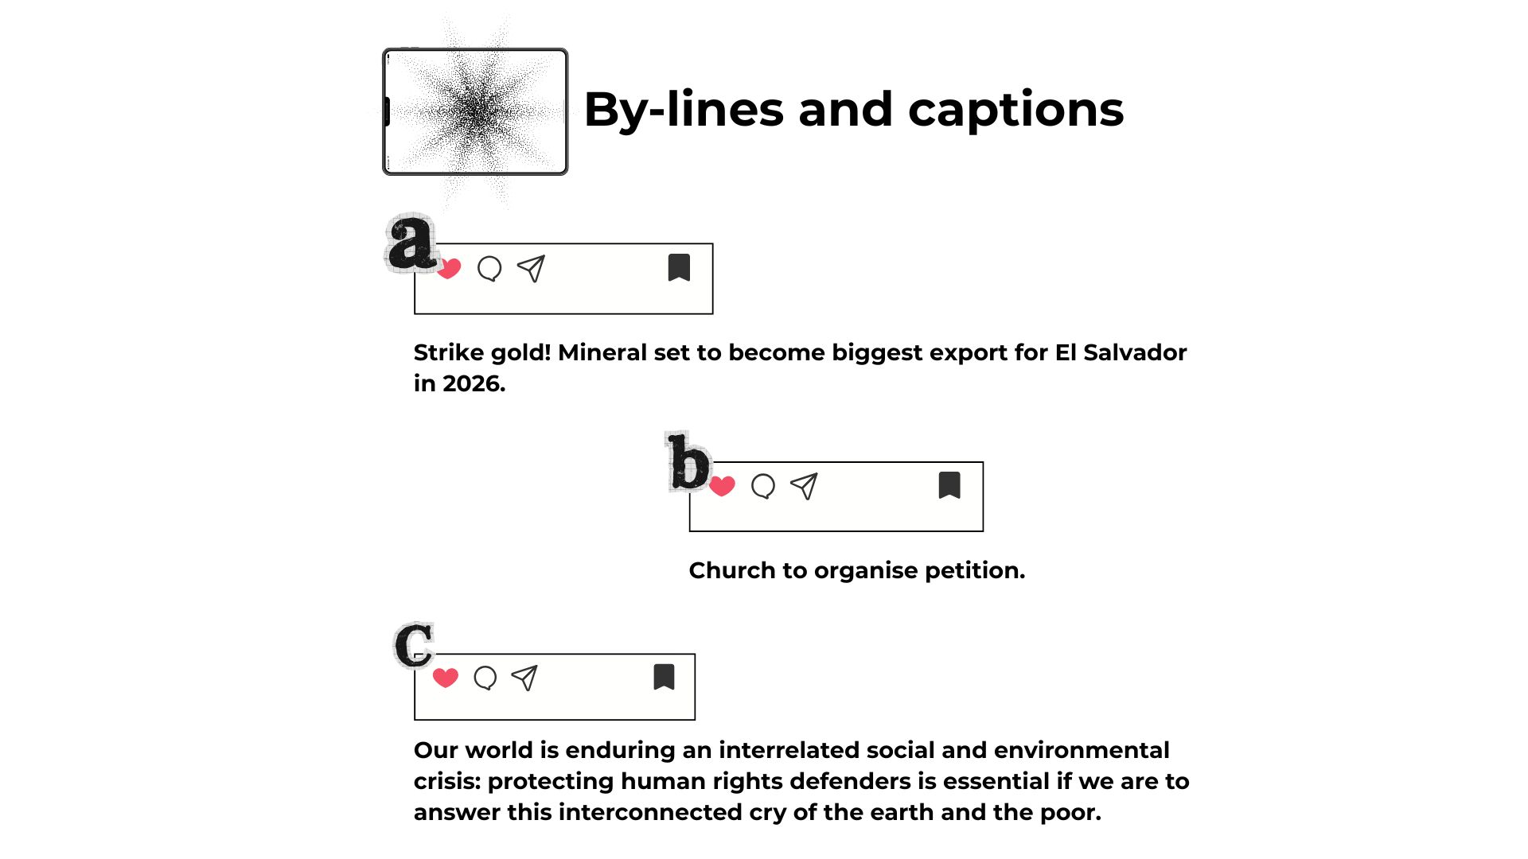

Slide 9


Slide 10
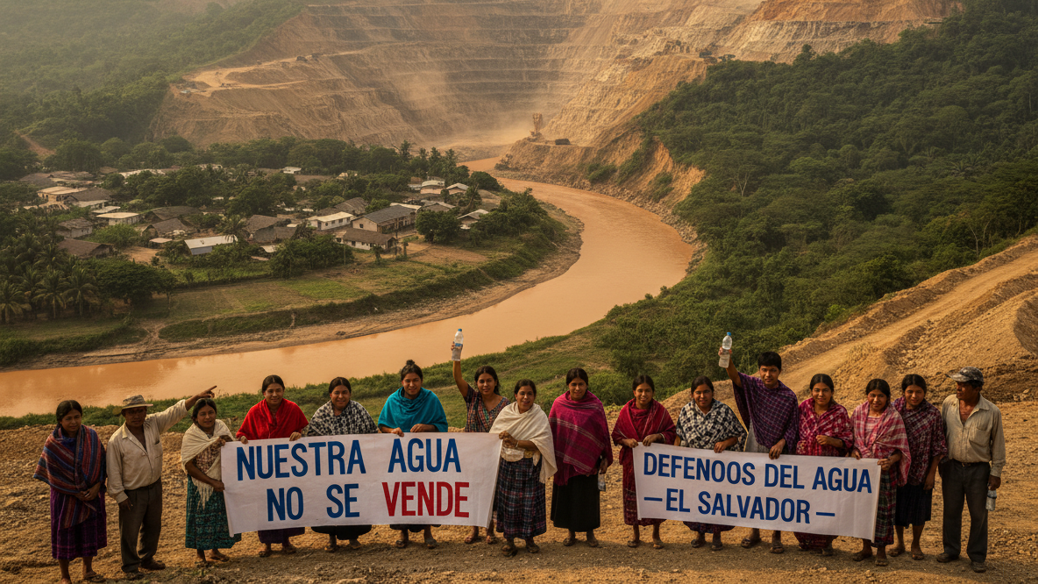

Slide 11
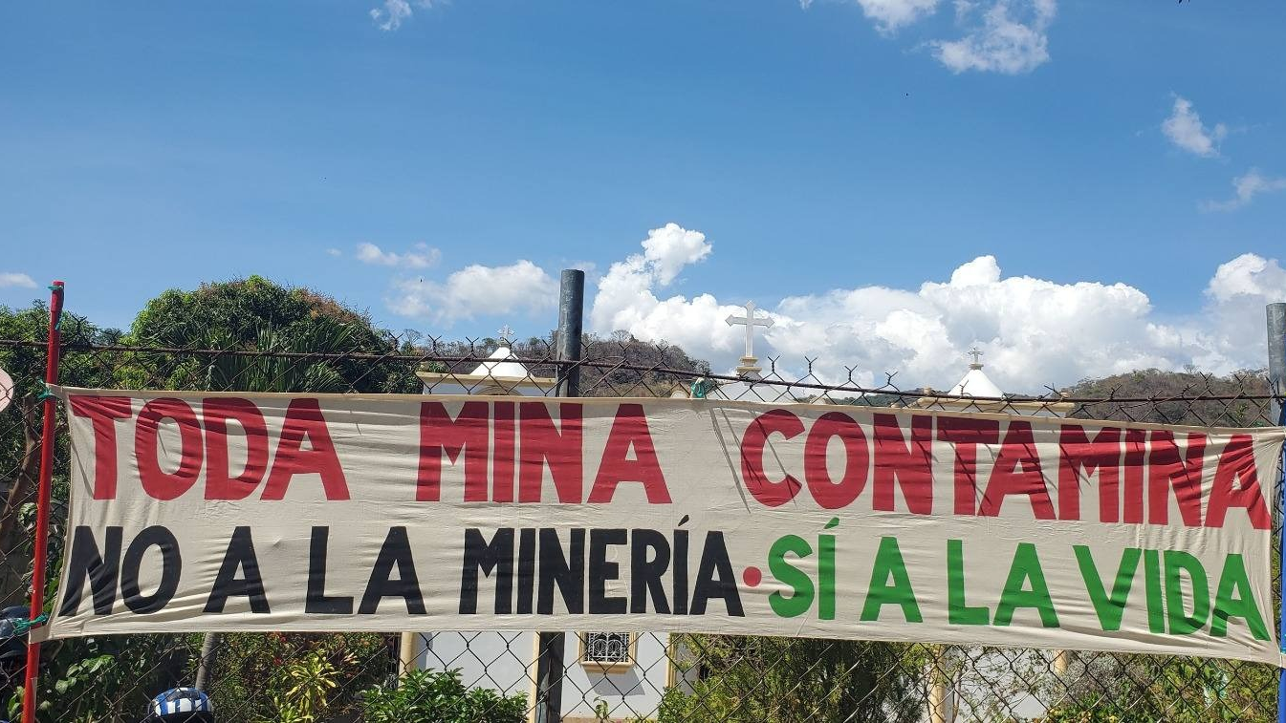
Notes:
Photo credit withheld for security purposes

Slide 12
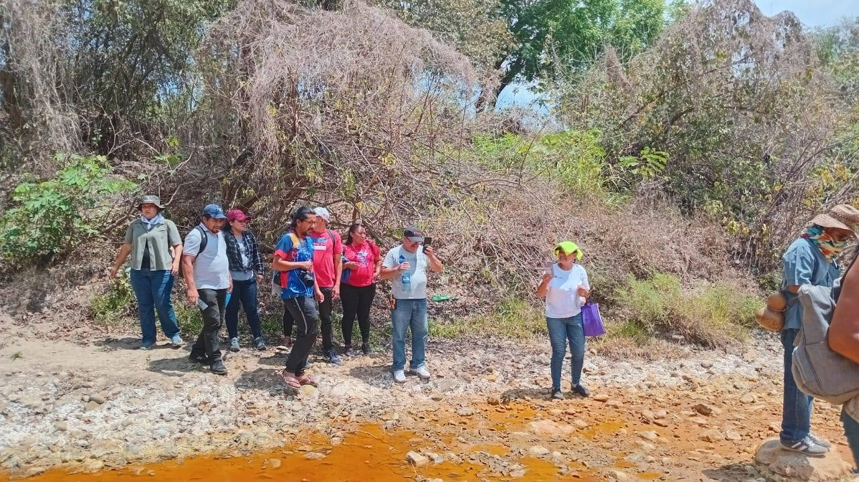
Notes:
Photo credit withheld for security purposes

Slide 13


Slide 14
Paz
Notes:
Start at 4minutes 37

Slide 15
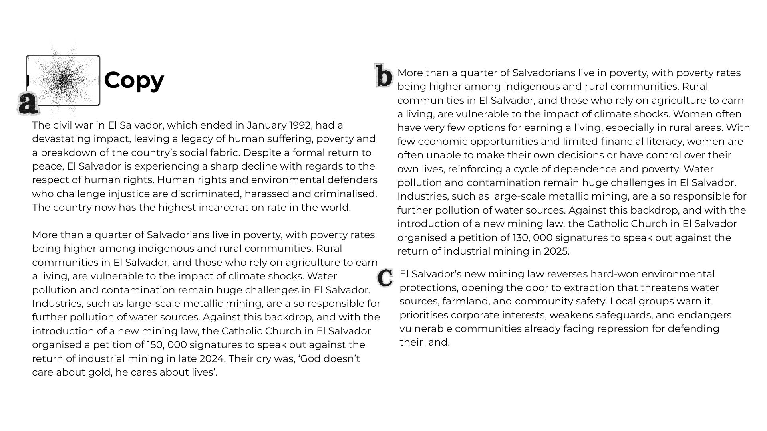

Slide 16
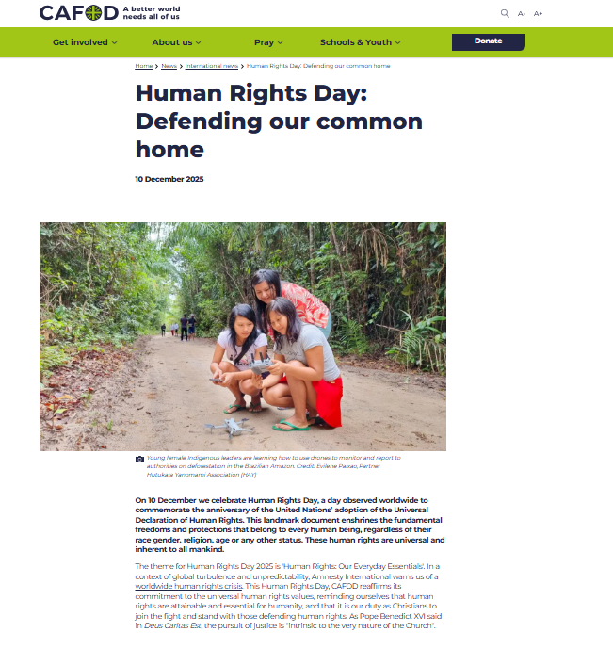
A-Level
Human Rights Day: Defending our common home
Read through our latest article on Human Rights across Latin America. This also gives an update on our partners work in Colombia, Brazil and Honduras.

Slide 17

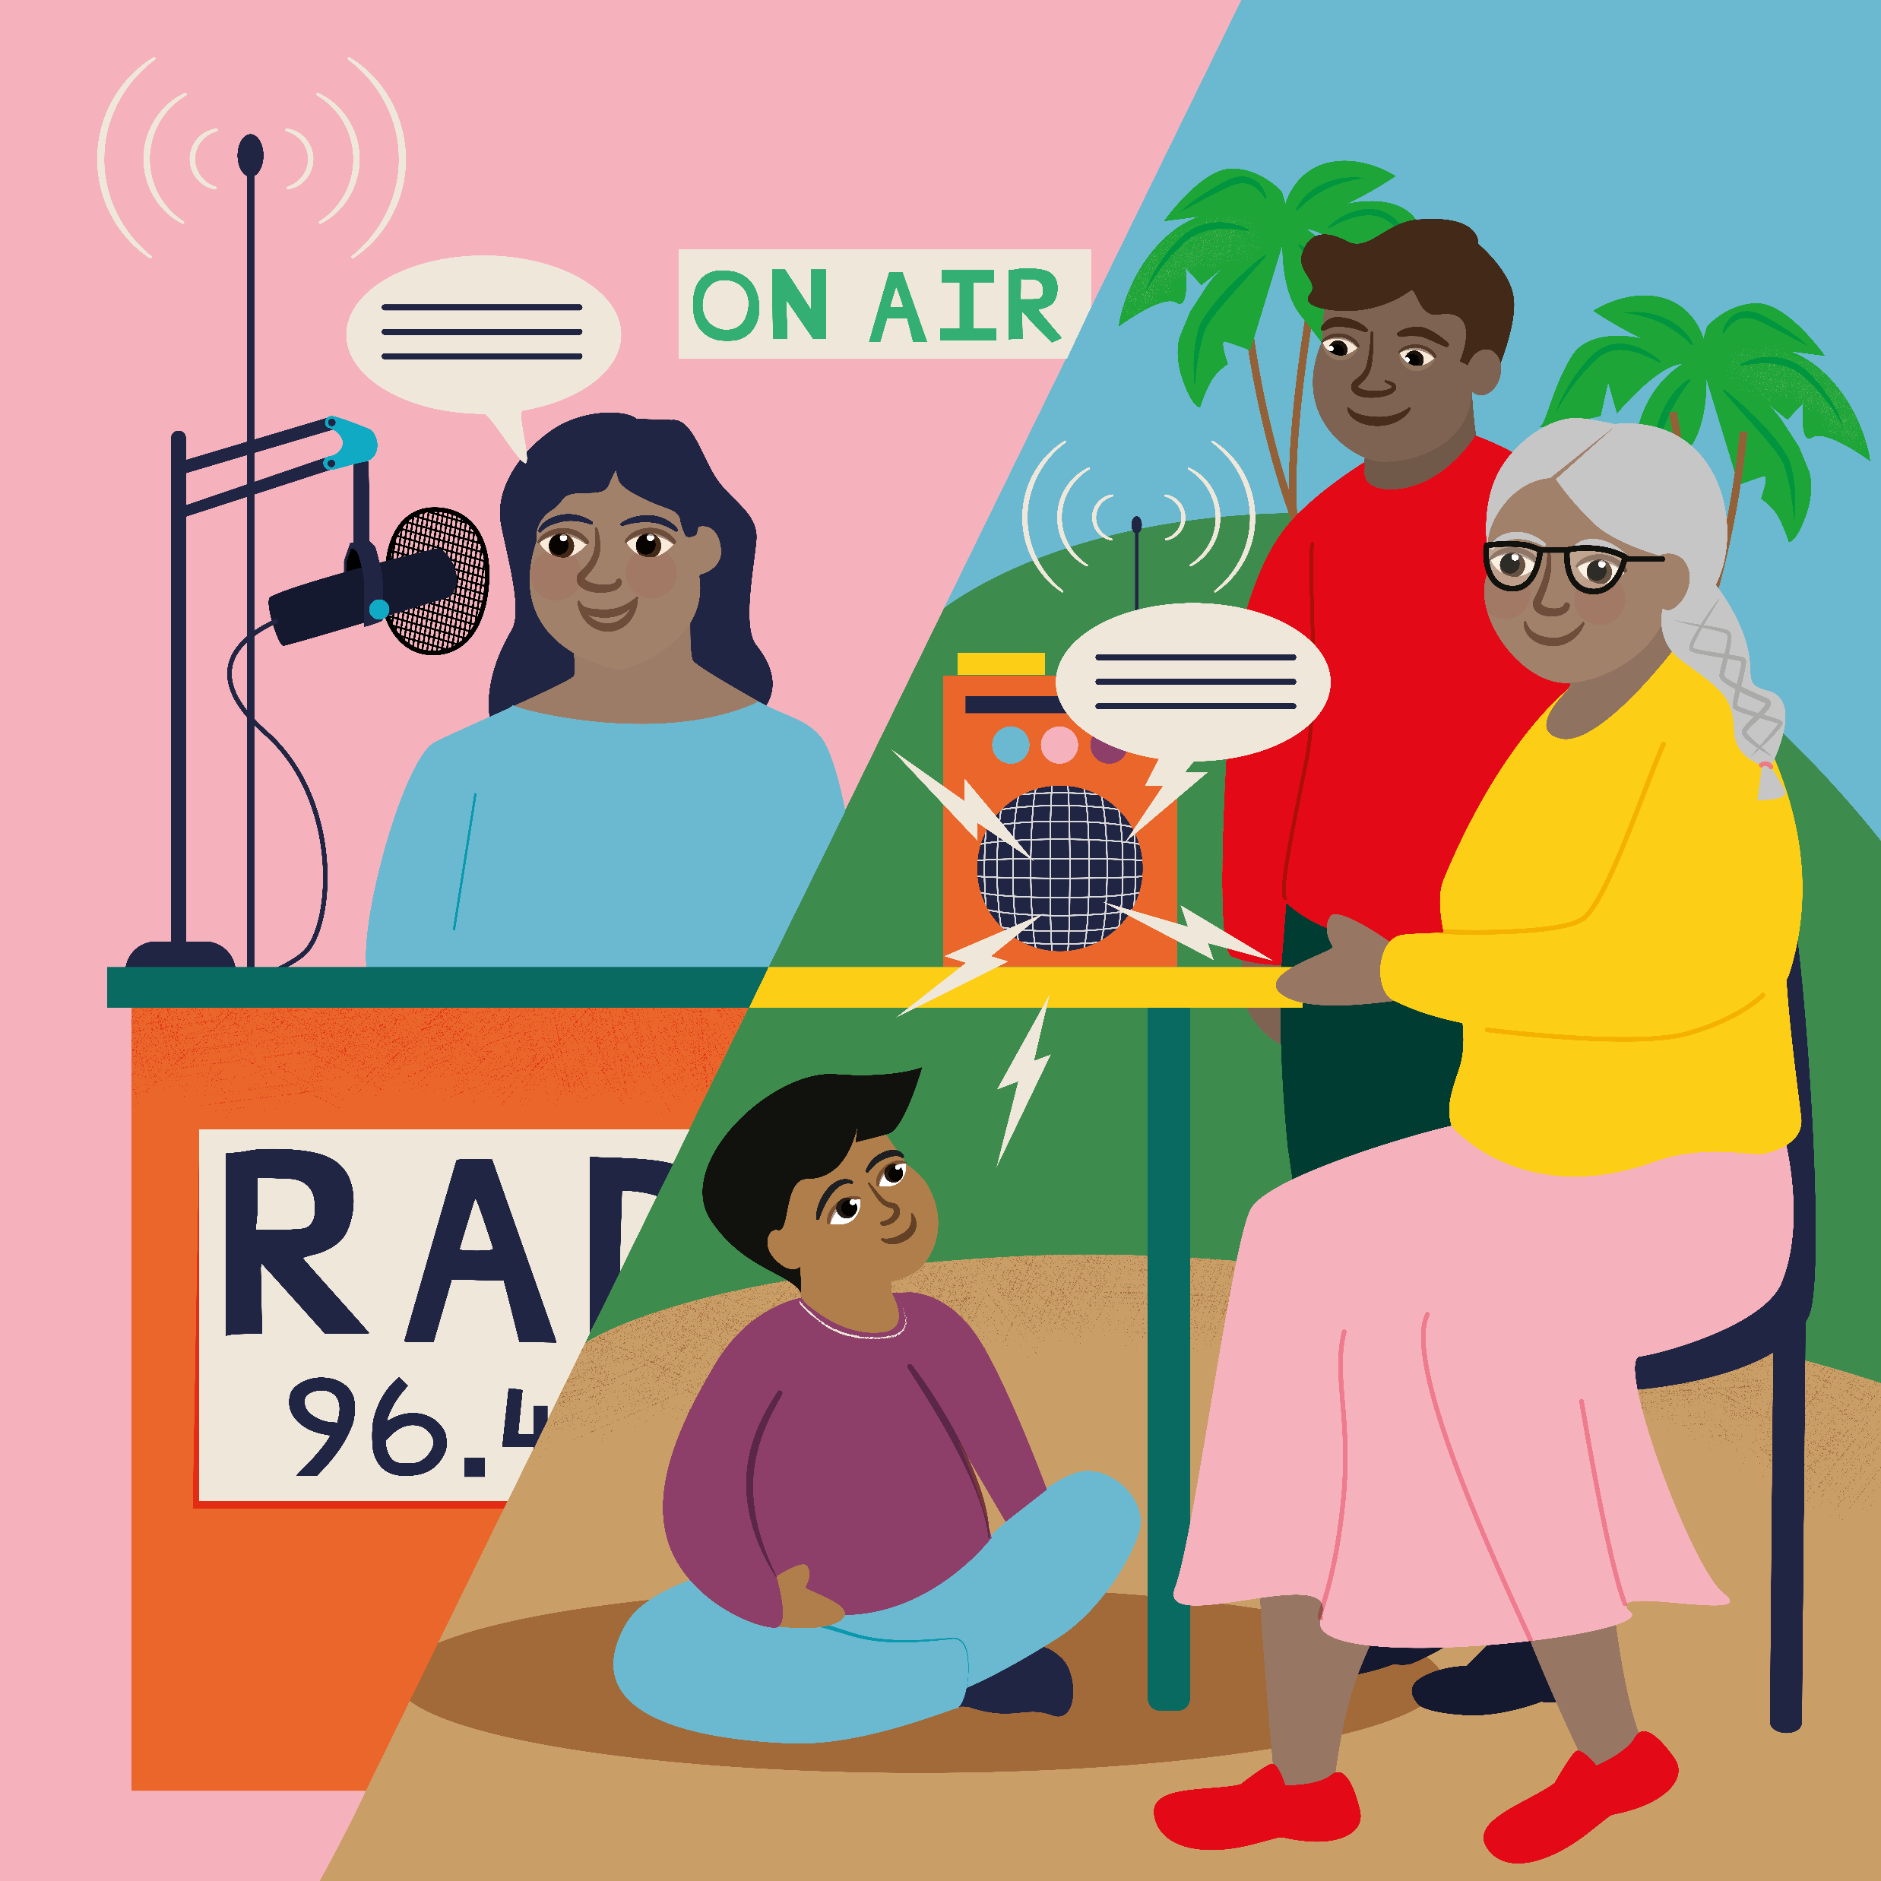
Remarkable Radio
Tune in! Every person who hears a hopeful message can pass this advice on to their friends and family, keeping even more people safe.
Speak up for justice! A radio means that indigenous people living in remote areas are aware of their rights helping them to protect their communities and the land they live on.
Use your voice! Radios help to spread awareness and encouragement for those defending our common home from deforestation and exploitation.

