Slide 1
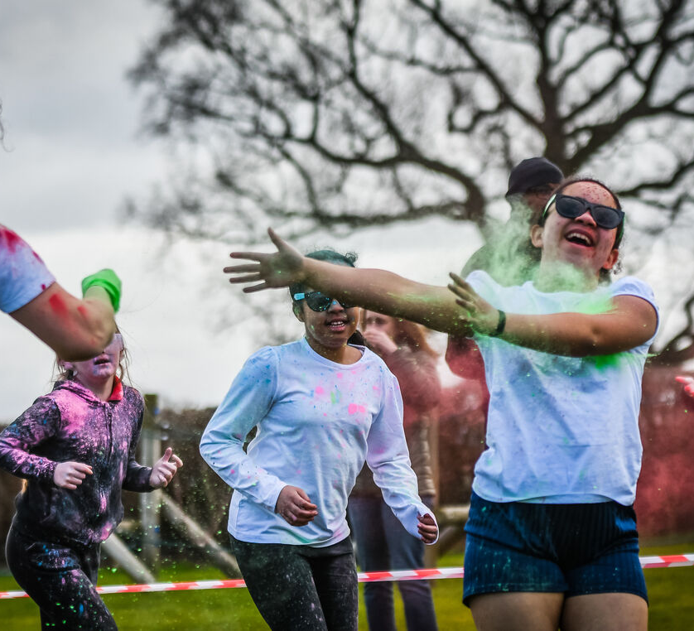
What will you do to live life to the full and help others to do the same?
Gospel Celebration of the Word
Notes:
Children’s liturgy: Fourth Sunday of Easter (Year A)
Preparation of the worship space
Colour: white
Song suggestions
Take my hands (676, Celebration Hymnal for Everyone)
Welcome
Today Jesus tells us that he has come so that we may have life in all its fullness. But what does it mean to live life to the full? Let’s think some more about this today…
Pupils at St. George's Catholic Voluntary Academy
Photo credit: St. George's Catholic Voluntary Academy

Slide 2
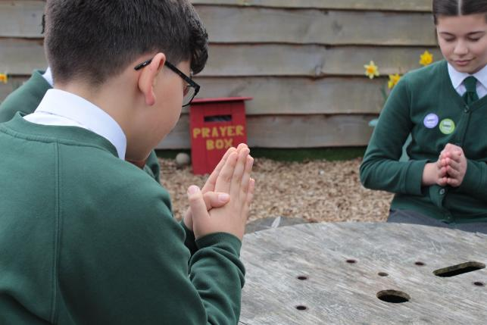
God of all,
You sent your Son Jesus, so that we may have life to the full. Inspire us to do all that we can so that all our brothers and sisters around the world may live free from poverty and hunger. Amen.
  Gather
Notes:
St Francis Xavier's RC Primary School, Herefordshire
Photo credit: Vicky Ahmed

Slide 3
Gospel: John 10: 1-10
Jesus said, “I am telling you the truth: the man who does not enter the sheepfold by the gate, but climbs in some other way, is a thief and a robber.
"The man who goes in through the gate is the shepherd of the sheep. The gatekeeper opens the gate for him; the sheep hear his voice as he calls his own sheep by name, and he leads them out.
"When he has brought them out, he goes ahead of them, and the sheep follow him, because they know his voice. They will not follow someone else; instead, they will run away from such a person, because they do not know his voice.”
Word

Slide 4
Jesus told them this parable, but they did not understand what it meant.
So Jesus said again, “I am telling the truth: I am the gate for the sheep. All others who came before me are thieves and robbers, but the sheep did not listen to them. I am the gate.
"Whoever comes in by me will be saved; they will come in and go out and find pasture. The thief comes only in order to steal, kill and destroy. I have come in order that you might have life – life in all its fullness.”

Slide 5
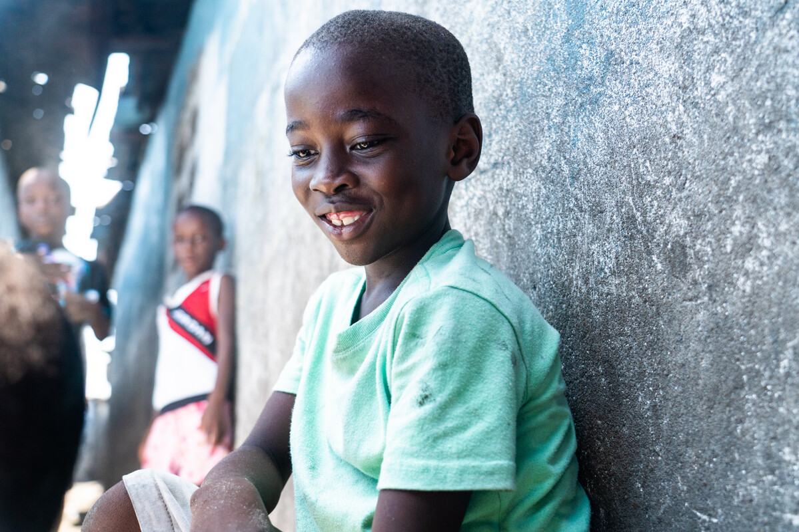
What do you remember from the Gospel reading?
In today’s reading Jesus tells us a parable in which he is the gate which takes us to God.
But can you remember what Jesus says right at the end of today’s gospel?
Jesus says, “I have come so that you might have life – life
in all its fullness.”
Aaron and his community in Liberia strive to live life to the full
Respond
Notes:
Aaron, Liberia
Photo credit: Carielle Doe

Slide 6
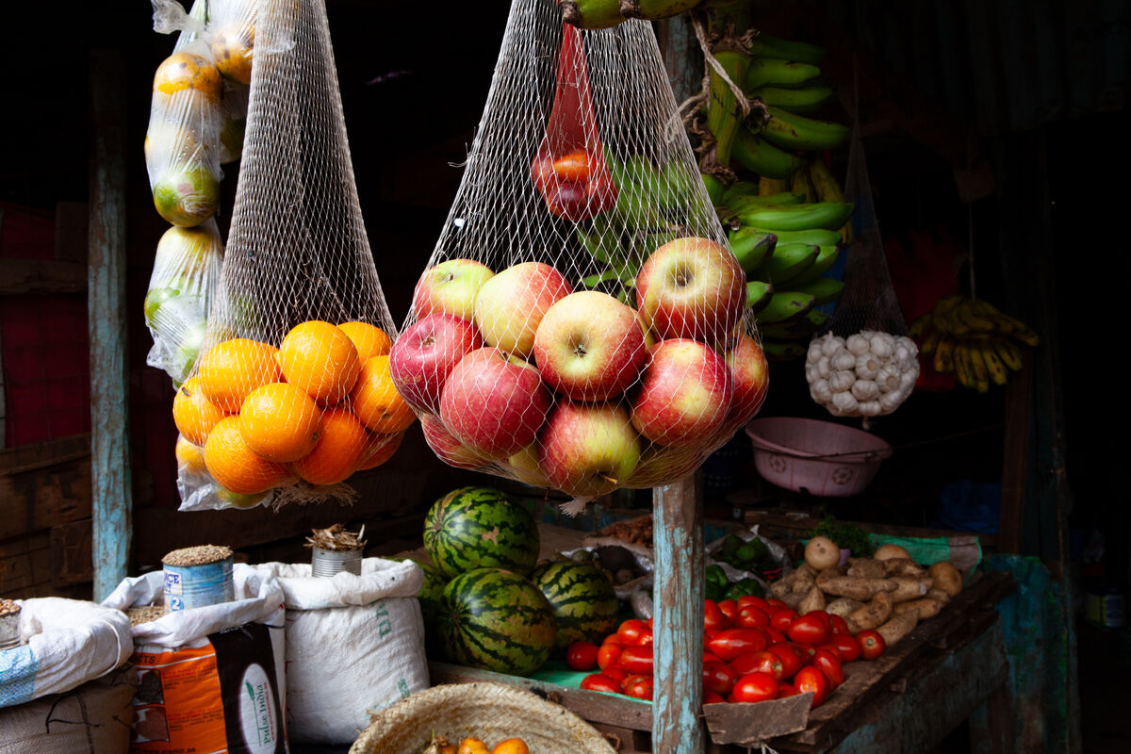
What do you think it means to have life in all its fullness?
Living life to the full doesn’t mean having all the latest toys or the coolest clothes or the biggest house.
It doesn’t mean just having all the things we need in life, like enough food to eat and a safe place to live, although that's an important part of living life to the full.
Notes:
Local market, Kenya
Photo credit: Louise Norton

Slide 7
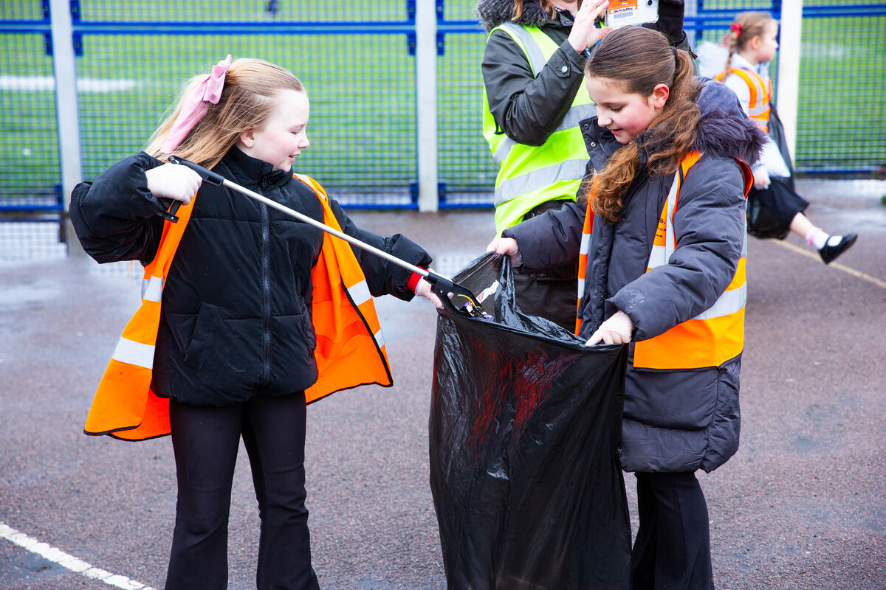
It also means being the best person we can be, living our lives well and having the chance to use our gifts and talents for the good of all.
What gifts and talents do you have? What are you good at?
Do you always make the most of the gifts that you have? Do you always try to be the best person you can be?
Being the best people we can be
Notes:
Litter-picking pupils, Our Lady of Perpetual Help, Doncaster
Photo credit: Thom Flint

Slide 8
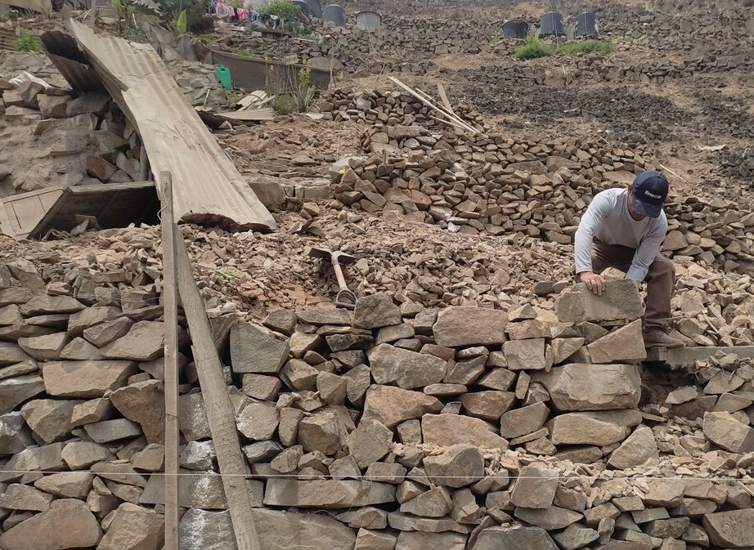
Lima, a city in Peru, is extremely dry with very little rain. It faces many challenges, particularly when it comes to the climate.
Lima is surrounded by a chain of mountains called the Lomas de Lima. Lomas means ‘hills’. These mountains are very important and are known as Lima’s ‘green lung’.
Despite their importance they are threatened by pollution and mining.
Notes:
Lima
Photo credit: DESCO

Slide 9
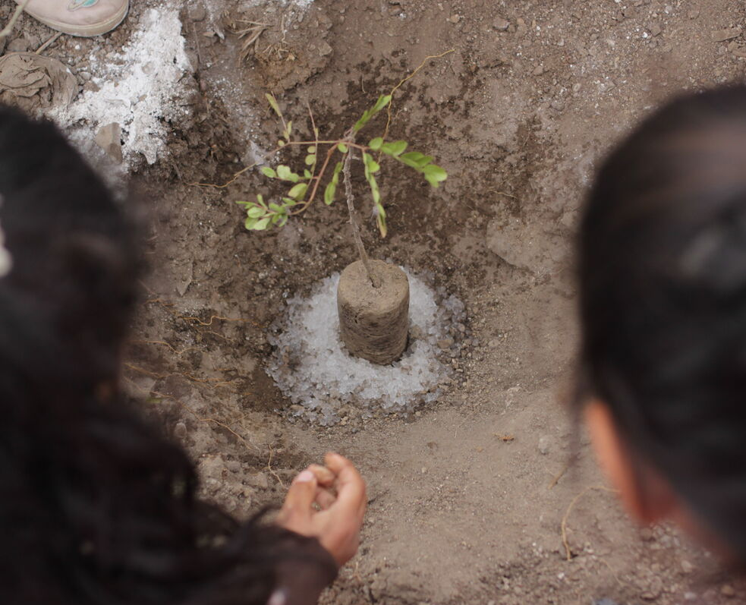
Children in schools in Lima are doing what they can to protect them.
Supported by CAFOD, a local organisation called CIDAP have set up an eco-brigade in four local schools.
Gloria is 11 and a member of an eco-brigade. She says: “If I could change the world, I would collect water and grow plants. If there are no plants, there is no life. They give us life; they protect us so we can breathe fresh air.”
Notes:
Caring for the environment, Peru
Illustration: Gemma Salter

Slide 10
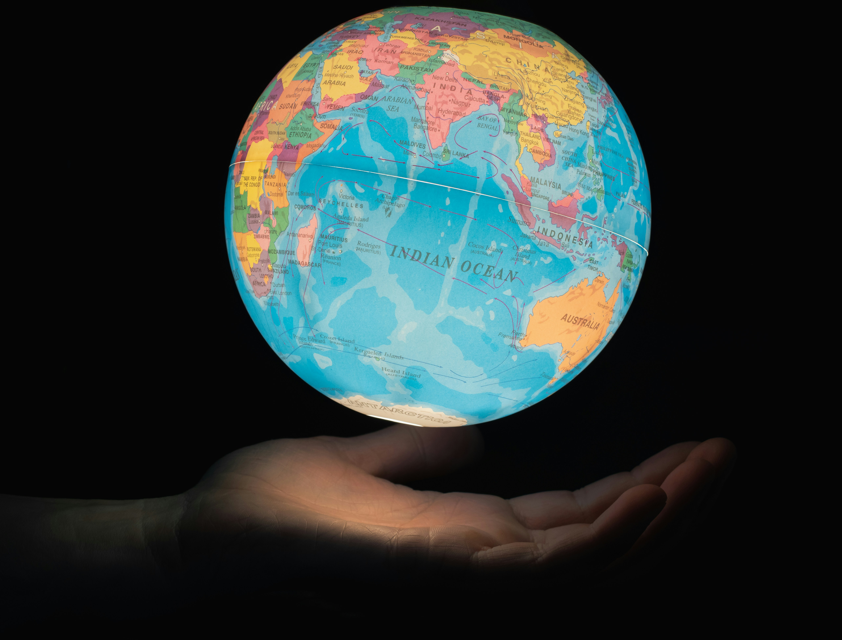
Gloria and the eco-brigades are using their talents to protect the Lomas and to make the world a better place.
Let’s do all we can to live our lives to the full – being the best people we can be, using our gifts and talents for the good of others.
Let’s do all we can to help others to live their lives to the full too – people we see every day and our brothers and sisters around the world.
Notes:
The world
Photo credit: Greg Rosenke on Unsplash

Slide 11
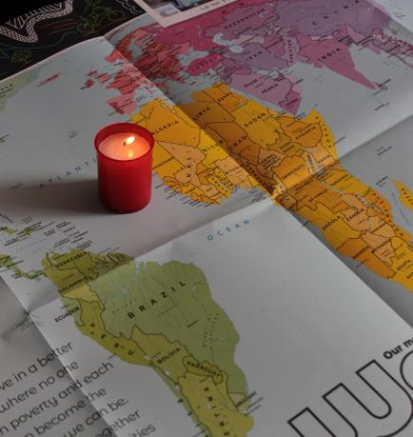
Let us pray
We pray for world leaders:
that they may do all they can to make sure all their people have a chance to live life to the full.
Lord in your mercy…
We pray for our parish, families and friends:
that we may use our gifts and talents to be the best people we can be and for the good of all.
Lord in your mercy...

Slide 12
Let us pray
We pray for all our brothers and sisters around the world:
that together we may all live lives free from poverty and hunger and be able to make the most of our talents and gifts to build a better future.
Lord in your mercy…
God of life in all its fullness: be with us as we try to be the best people we can be. Inspire us to help one another to use the gifts and talents you have given us so that the world may be a better place, reflecting the glory of your Kingdom. Amen.

Slide 13
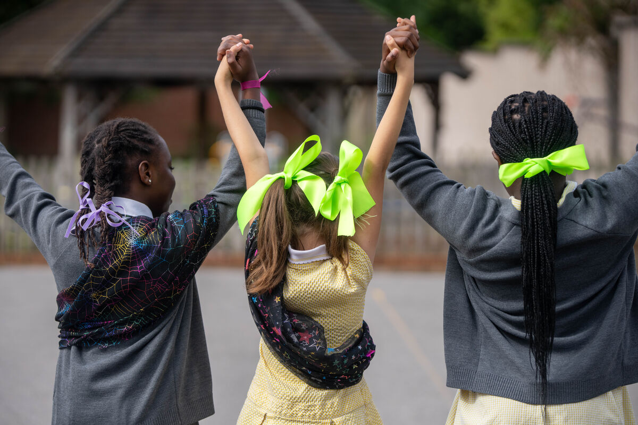
What will you do this week to live life to the full and help others to do the same?
Send
Notes:
St Chad's Primary School students, UK
Photo credit: Joe Newman

Slide 14
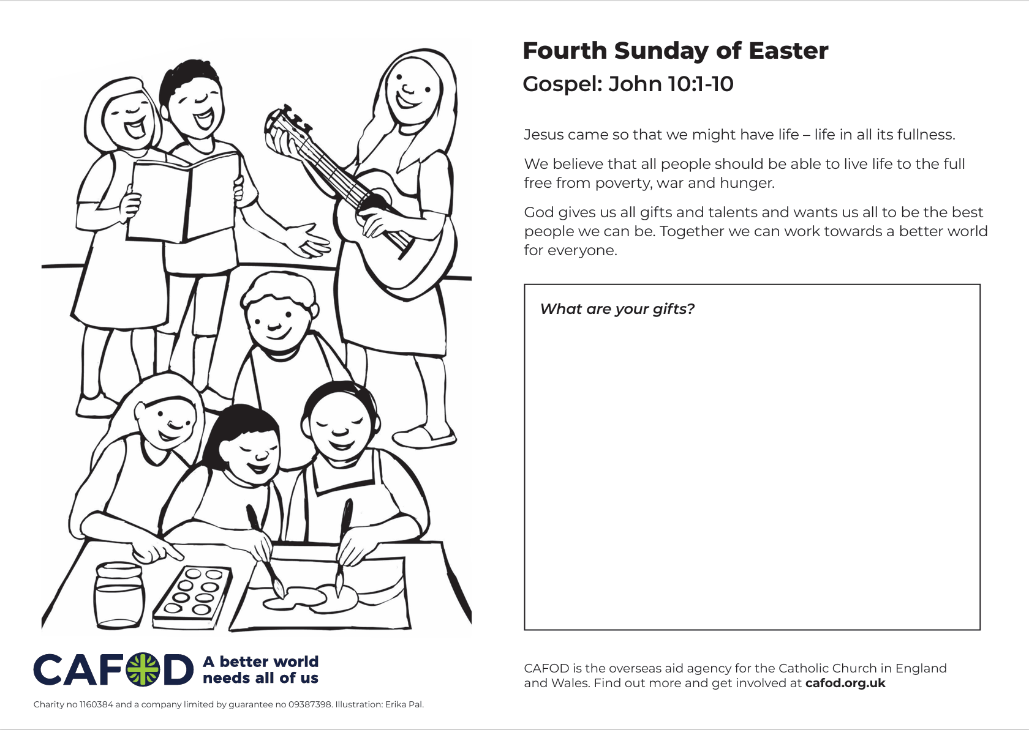
Activity suggestions
Download the illustration
Share the accompanying activity sheet with the children and encourage them to complete it, either in the liturgy or at home. Once they’ve identified their gifts, encourage them to think about how they can use these gifts for the good of others in our world.
Remind the children to share all they have heard and thought about today with the people at home. Encourage them to try during the week to be the best people they can be and to use their gifts and talents for the good of others and our world.
Notes:
Illustration: Erika Pal

Slide 15
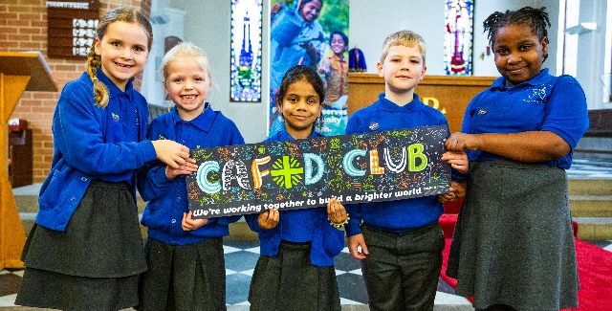
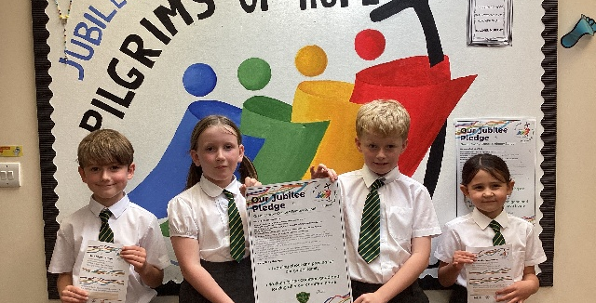

Get involved with CAFOD this term
Explore our summer term resources
Ways to live out your Jubilee Pledge
Fundraise for a World Gift

Slide 16


