Slide 1
Visio Divina
for primary schools
Jubilee Icon

Slide 2
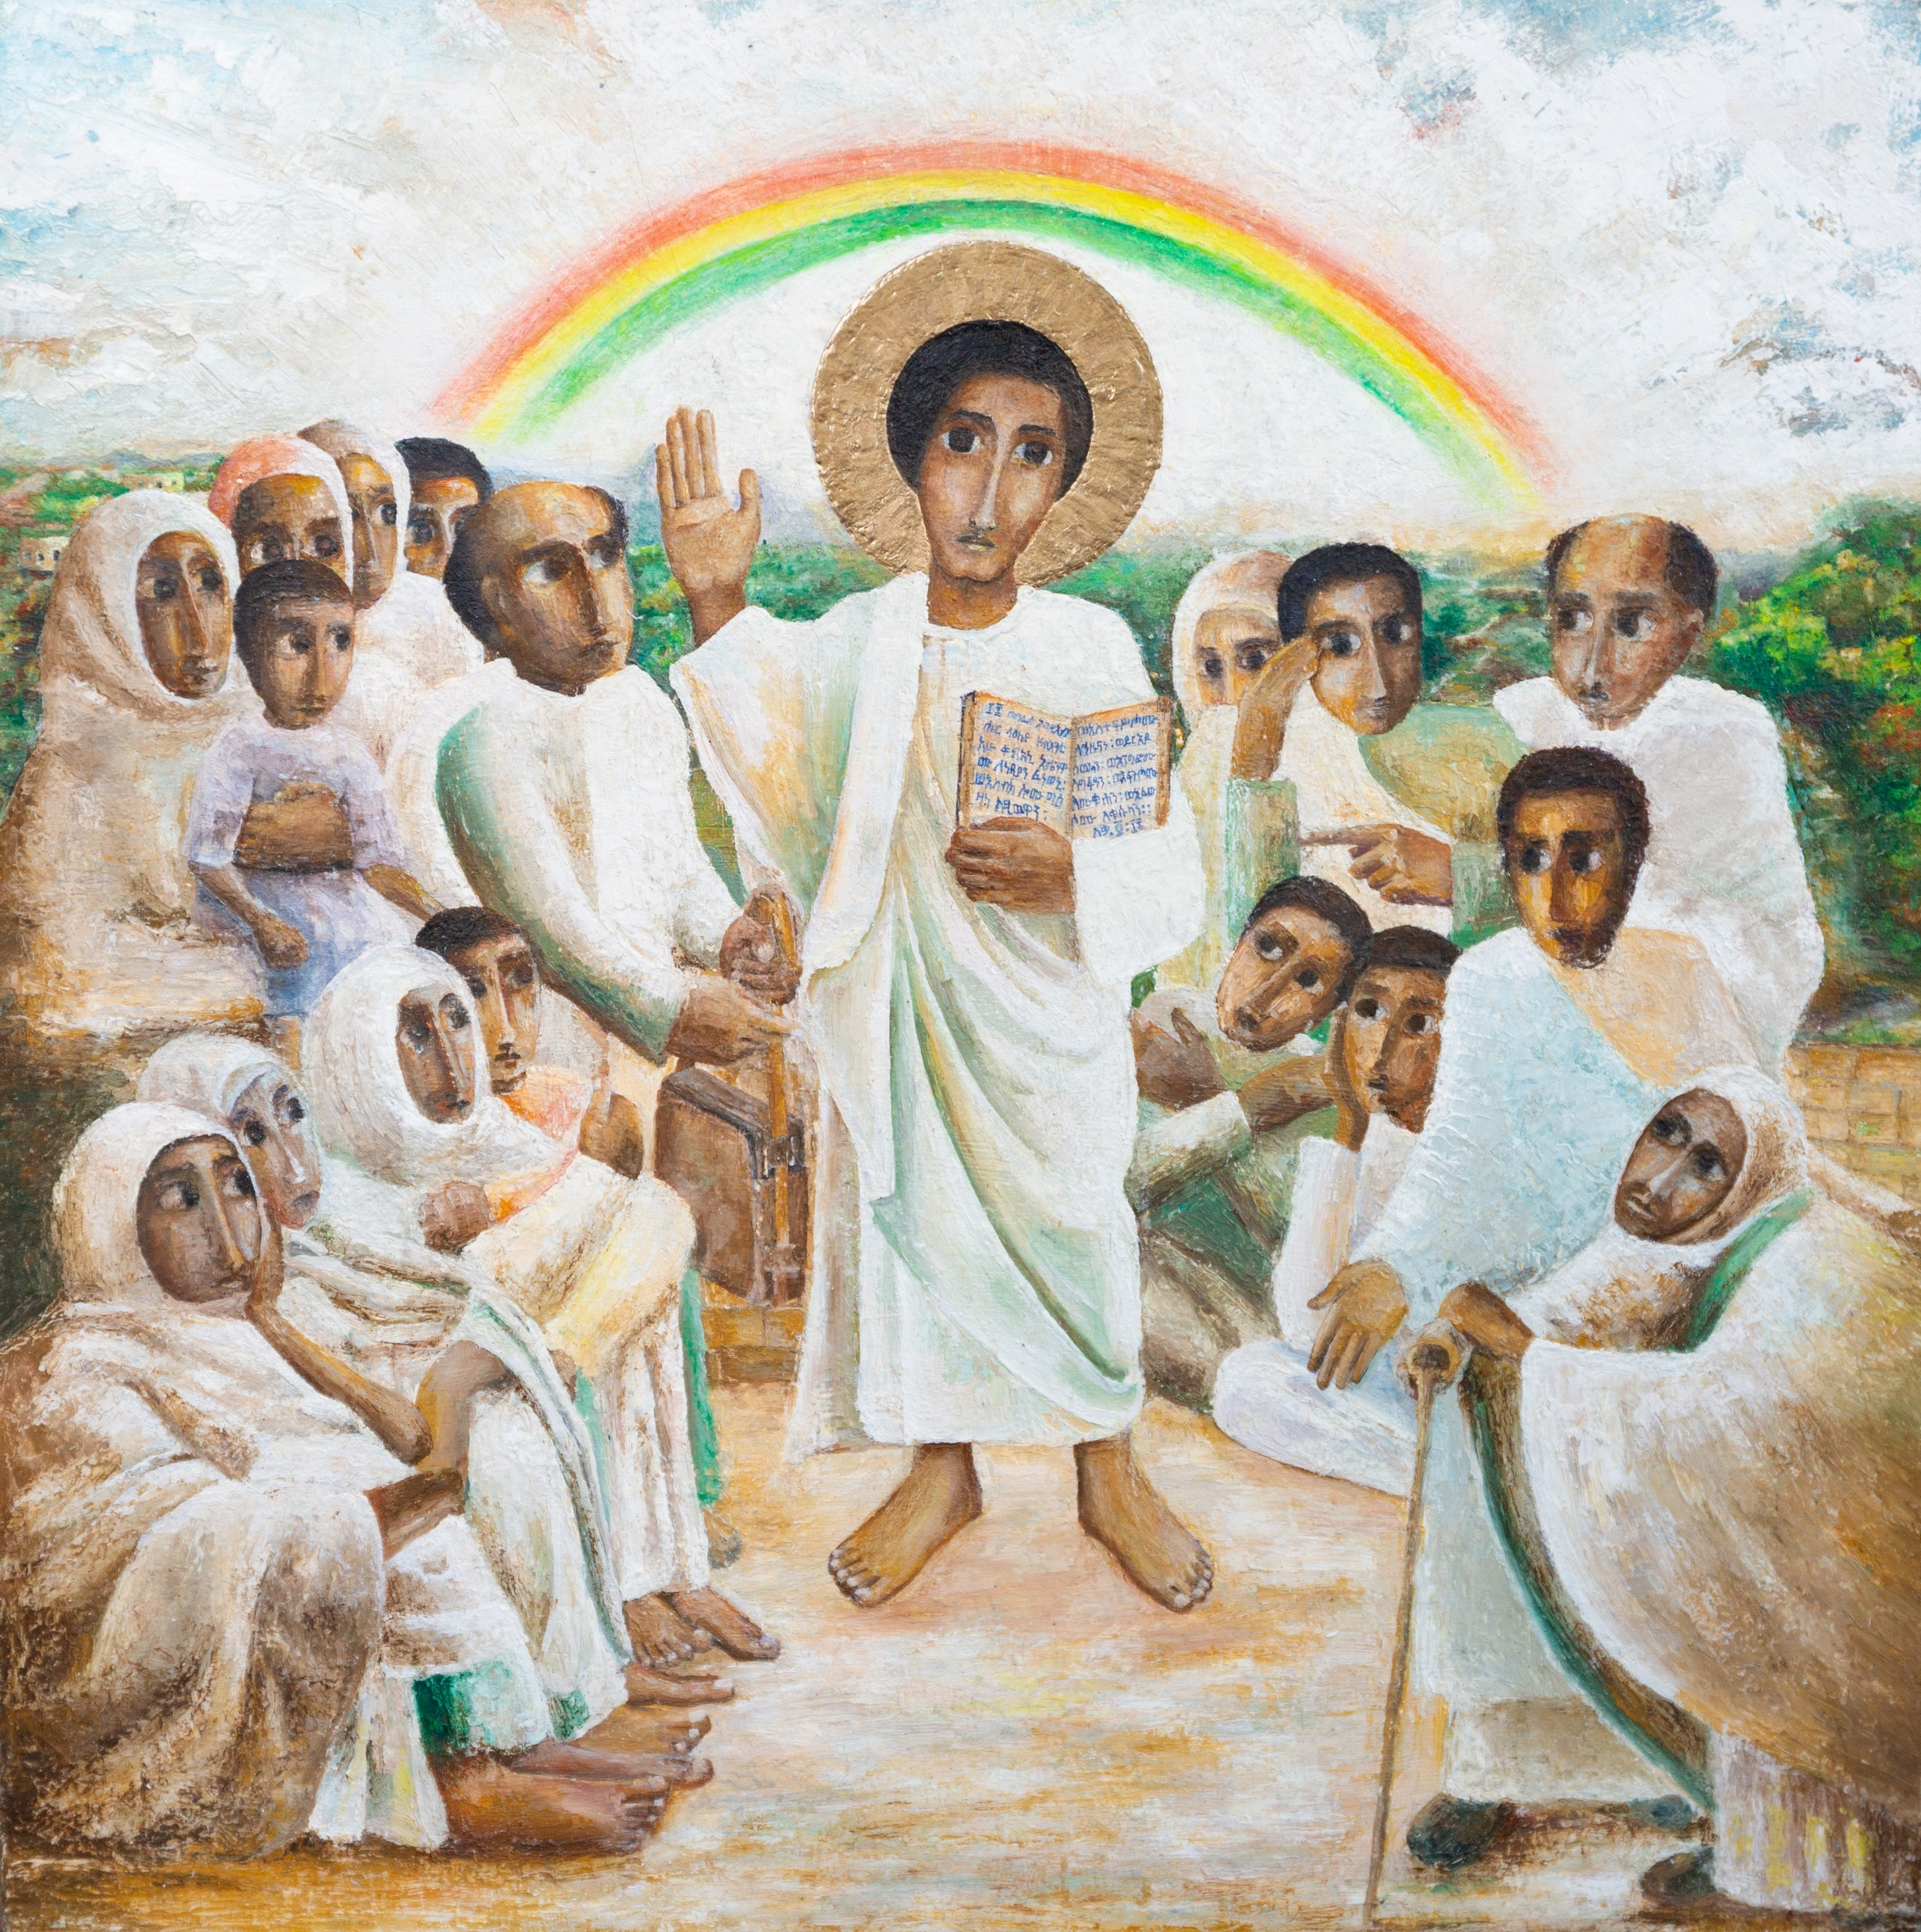
Gather
Lord,
Open our eyes so that we can see you.
Open our ears so that we can hear your word.
Open our hearts so that we can love you
and others more and more.
Amen.

Slide 3
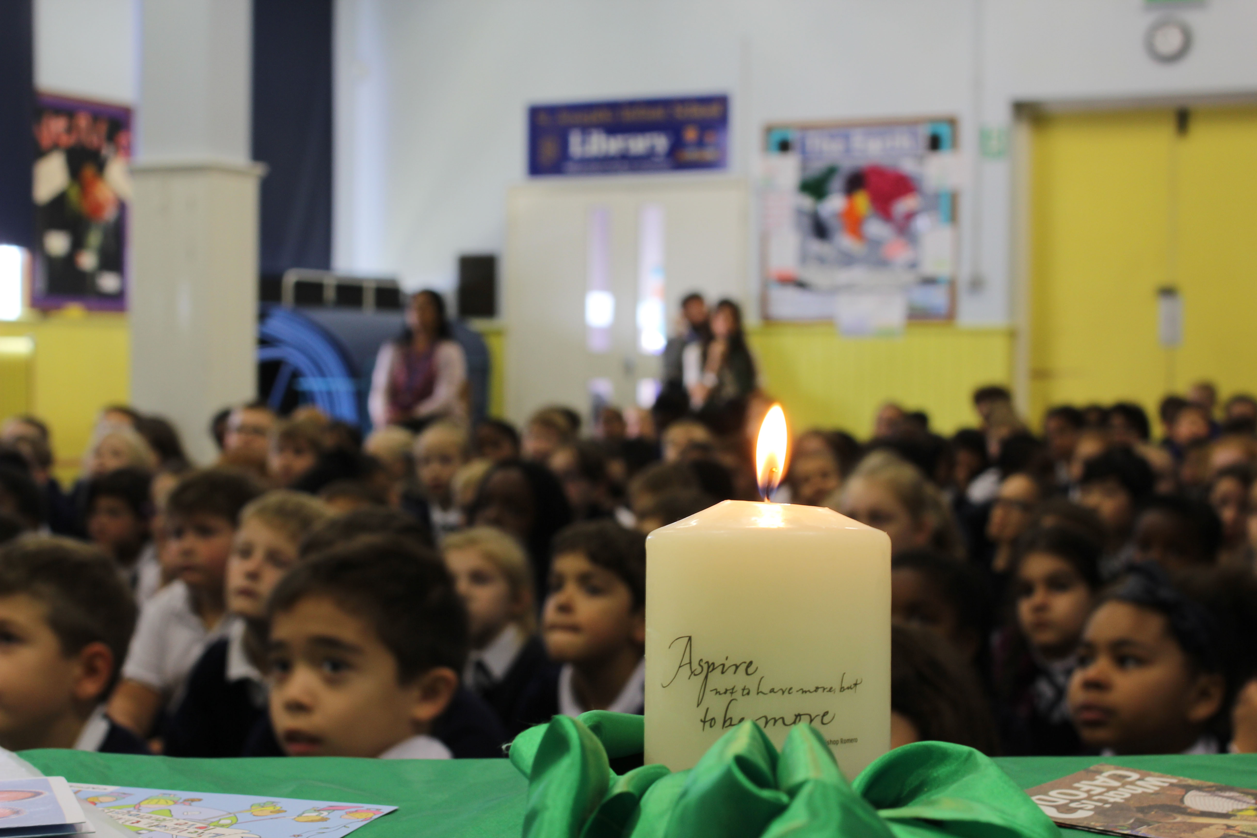
Word
A reading from the Gospel of Luke.

Slide 4
Word
“The Spirit of the Lord is upon me, because he has chosen me to bring good news to the poor. He has sent me to proclaim liberty to the captives and recovery of sight to the blind, to set free the oppressed and announce that the time has come when the Lord will save his people.”

Slide 5
Respond
WHO is in the picture?
WHO is in the picture?

Slide 6
Respond
Jesus

Slide 7
Respond
Jesus
People – male and female
People – young and old
People who may be vulnerable

Slide 8
Respond
WHAT is Jesus doing?
WHO is in the picture?

Slide 9
Respond
Halo – Son of God who loves us all
Hand up – teaching everyone
Eyes - looking at us, calling us
Reading scripture – Good News
WHAT is Jesus doing?

Slide 10
Respond
WHY has the artist used these symbols?

Slide 11
Respond
Rainbow – God’s promise. Sign of hope.
Leather bag – to protect the Bible/God’s word.
WHY has the artist used symbols?
Wall – people not divided. Shows equality.

Slide 12
Respond
“The Spirit of the Lord is upon me, because he has chosen me to bring good news to the poor. He has sent me to proclaim liberty to the captives and recovery of sight to the blind, to set free the oppressed and announce that the time has come when the Lord will save his people.”
WHAT is Jesus’ message for today?

Slide 13
Send
How could you speak out against unfairness and inequality?

Slide 14
Send
Let us pray:
Jesus, our light,
In this Jubilee year,
you remind us of our call to love our neighbours and to set free those who suffer.
Help us to treat everyone with dignity; to be fair, forgiving and kind.
All: Guide us on our journey as pilgrims of hope. Amen.

