Slide 1
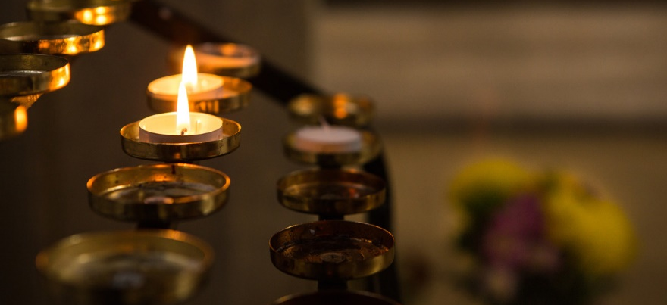
WE REMEMBER
Notes:
[Please consider the particular needs of any bereaved young people in your school when deciding whether this assembly is appropriate.]
In the name of the Father and of the Son and of the Holy Spirit, Amen.
Welcome to our assembly.
November is traditionally a month when we particularly remember those who have died.
The Feast of All Souls is on the second day of November.
And at 11 o’clock on the eleventh day of November, we have a minute’s silence to remember those killed in the World Wars and in other conflicts.

Slide 2
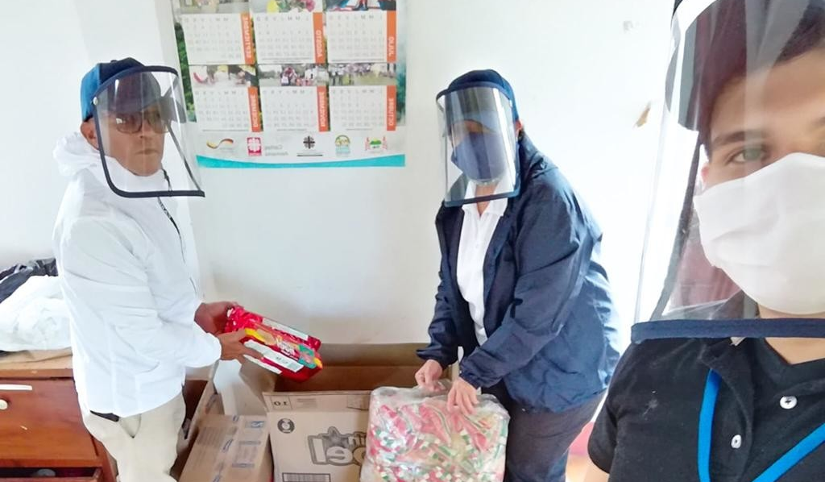
Notes:
This year, there has been a different sort of conflict.
People in our country, in our own community, and in our wider world, have lost loved ones due to coronavirus.
This assembly is a time to pray for all those who have died and for those left behind, people we have known and people we have never met.
[Picture credit: FUNVIPAS]

Slide 3
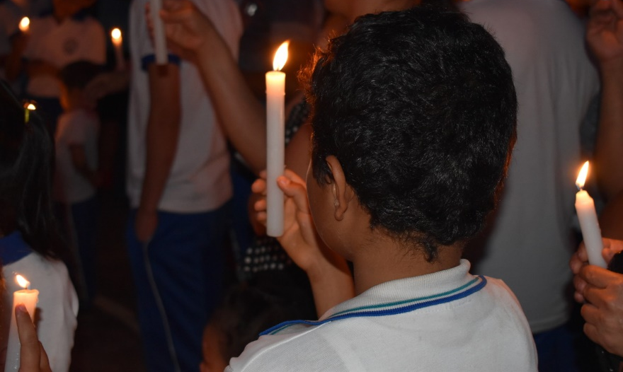
“All the darkness
in the world
cannot extinguish
the light
of a single candle.”
St Francis of Assisi
Notes:
In our churches, we can light a candle to pray for someone we love or for a special need.
We light a candle now [one representative lights a candle at the front of the space],
and will leave it burning during our assembly as a symbol of everlasting life, still present in those who have gone before us.

Slide 4
Jesus said to her,
‘I am the resurrection and the life.’
John 11:25
Notes:
Let’s listen to our reading from Saint John’s Gospel, (11:21-27):
“Martha said to Jesus, ‘Lord, if you had been here, my brother would not have died. But even now I know that God will give you whatever you ask of him.’ Jesus said to her, ‘Your brother will rise again.’ Martha said to him, ‘I know that he will rise again in the resurrection on the last day.’ Jesus said to her, ‘I am the resurrection and the life. Those who believe in me, even though they die, will live, and everyone who lives and believes in me will never die. Do you believe this?’ She said to him, ‘Yes, Lord, I believe that you are the Messiah, the Son of God, the one coming into the world.’
[Pause for reflection]

Slide 5
We reflect
Notes:
To Jesus, who wept at the death of Martha’s brother Lazarus, we bring our loved ones who have died.
And we entrust to the God of all life, every person who has died with no-one to mourn them.
Leader: In a moment, you are invited to write in silence on your slip of the paper the name or names of anyone that you particularly wish to remember today. It may be a relative or someone you have known, or you might wish to remember those who have died in conflict, or in the pandemic, here or in another country. When you are ready, maintaining silence and respect for each other, please come forward and place your paper in the basket at the front, then return to your seat.
[Reflective music suggestion: Within our darkest night (Taize)]
[Each person places in a basket before the candle their slip of paper. For larger groups, baskets could be passed around by stewards.]
Leader: Later, our basket of names will be placed in our school chapel/local parish church and will remain before the altar for the month of November, so that the people named here can be held before God by everyone who visits to pray.
We will now stand and observe a minute’s silence to remember and pray for all those we have named. [1 minute of silence]

Slide 6
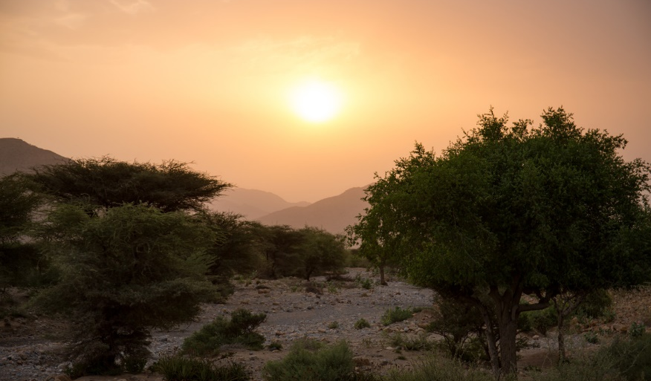
A litany of hope
Response: You are the resurrection and the life.
All our hope is in you.
Notes:
Lord Jesus, you understand the pain of loss,
the grief that seems to take air from our lungs.
We pray together:
You are the resurrection and the life. All our hope is in you.
Christ Jesus, you wept at the death of your friend, Lazarus.
Now your compassion wipes the tears from our eyes.
We pray together:
You are the resurrection and the life. All our hope is in you.
Risen Jesus, you conquered death in the dawn of Easter day.
Shed your light on our universal family, here and in eternity.
We pray together:
You are the resurrection and the life. All our hope is in you.

Slide 7
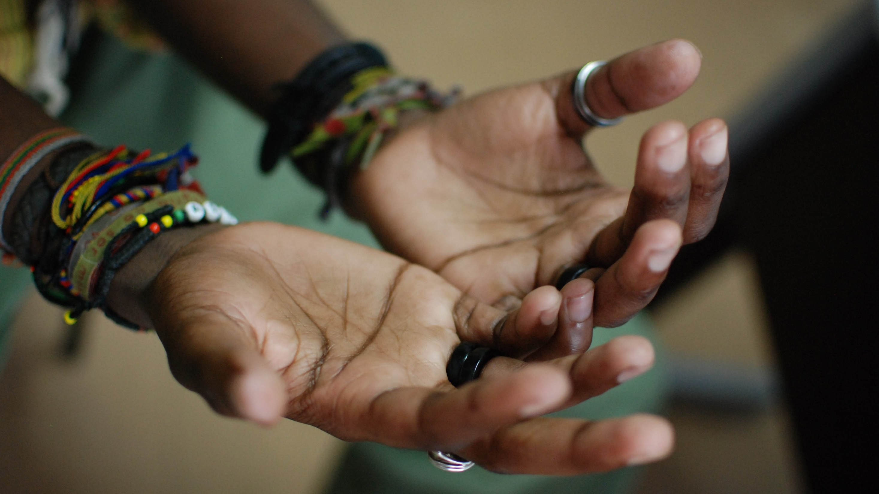
Our Father, who art in heaven,
hallowed be thy name;
Thy kingdom come;
thy will be done on earth as it is in heaven.
Give us this day our daily bread;
and forgive us our trespasses
as we forgive those who trespass against us;
and lead us not into temptation,
but deliver us from evil.
Amen
Notes:
Let us pray together the prayer that Jesus taught us.
Our Father…

Slide 8
Notes:
With trust and with love, in peace and in hope,
we go forth,
in the name of the Father, and of the Son, and of the Holy Spirit, Amen.
[Teachers and chaplains – You or your school can remember a named person on CAFOD’s virtual candle stand, by lighting a virtual candle and making a small donation to our work: https://lightacandle.cafod.org.uk/#/ ]

