Slide 1
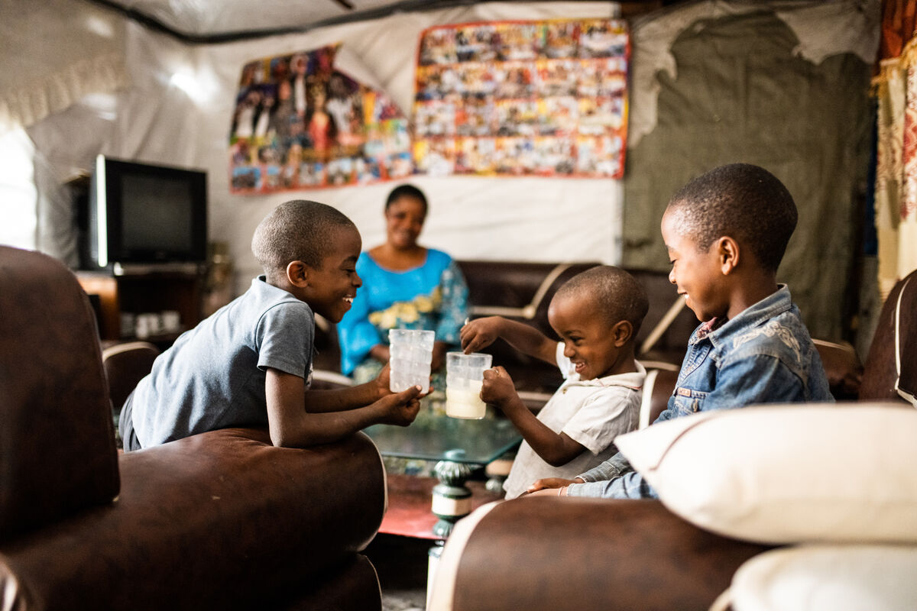

How can we share what we have with others to make the world a fairer place?
Gather
Notes:
Children’s liturgy: Third Sunday of Easter (Year C)
Preparation of the worship space
Colour: white
Props: coloured paper cut into the shape of fish, pens and pencils
Song suggestions
Come to the feast (612, Laudate) Bread for the world, a world of hunger (625, Laudate)
Welcome
Today we hear about how Jesus appeared to the disciples while they were fishing, helped them to catch more fish and ate with them on the beach afterwards. Let’s think some more about this today.
Anuarite sharing milk with her children, Goma, DRC
Photo credit: Arlette Bashizi

Slide 2
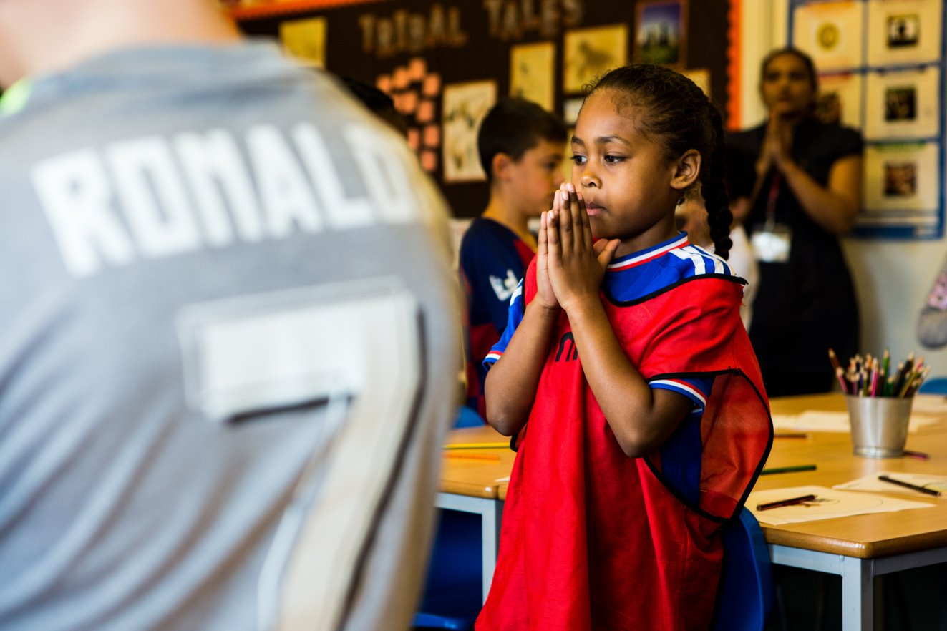
Christ Jesus,
You returned to give your disciples courage and strengthen their faith. Make us brave and help us to believe in you, so that we may share your love with others.
Amen.
Notes:
Children at Our Lady Queen of Heaven Primary School
Photo credit: Thom Flint

Slide 3

Gospel: John 21: 1-19
After this, Jesus appeared once more to his disciples at Lake Tiberias. This is how it happened. Simon Peter, Thomas (called the Twin), Nathanael (the one from Cana in Galilee), the sons of Zebedee, and two other disciples of Jesus were all together. Simon Peter said to the others, “I am going fishing.”
“We will come with you,” they told him. So they went out in a boat, but all that night they did not catch a thing. As the sun was rising, Jesus stood at the water’s edge, but the disciples did not know that it was Jesus. Then he asked them, “Young men, haven’t you caught anything?”
“Not a thing,” they answered. He said to them, “Throw your net out on the right side of the boat, and you will catch some.” So they threw the net out and could not pull it back in because they had caught so many fish.
The disciple whom Jesus loved said to Peter, “It is the Lord!”
Word

Slide 4
When Peter heard that it was the Lord, he wrapped his outer garment round him (for he had taken his clothes off) and jumped into the water. The other disciples came to shore in the boat, pulling the net full of fish. They were not very far from land, about a hundred metres away.
When they stepped ashore, they saw a charcoal fire with fish on it and some bread. Then Jesus said to them, “Bring some of the fish you have just caught.”
Simon Peter went aboard and dragged the net ashore full of big fish, 153 in all; even though there were so many, still the net did not tear.
Jesus said to them, “Come and eat.” None of the disciples dared ask him, “Who are you?” because they knew it was the Lord. So Jesus went over, took the bread, and gave it to them; he did the same with the fish.
This was the third time Jesus appeared to the disciples after rising from death.

Slide 5
After they had eaten, Jesus said to Simon Peter, “Simon son of John, do you love me more than these others do?” “Yes, Lord,” he answered, “you know that I love you.” Jesus said to him, “Take care of my lambs.”
A second time Jesus said, “Simon son of John, do you love me?” “Yes, Lord,” he answered, “you know I love you.” Jesus said to him, “Take care of my sheep.”
A third time Jesus said, “Simon son of John, do you love me?” Peter was sad because Jesus asked three times. He said, “Lord, you know everything; you know I love you!”
Jesus said to him, “Take care of my sheep. I am telling you the truth: when you were young, you used to go anywhere you wanted to; but when you are old, you will stretch out your hands and someone else will take you where you don’t want to go.” (In saying this, Jesus was indicating the way Peter would die and bring glory to God.) Then Jesus said to him, “Follow me!”

Slide 6
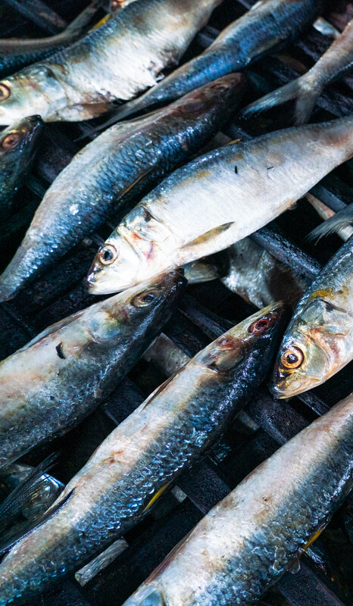

What do you remember from the Gospel reading?
After Jesus had died and risen again, the disciples were out fishing in their boat, when Jesus appeared on the beach. They hadn’t caught anything, so Jesus told them to throw out their net again. This time they caught lots of fish.
How do you think the disciples felt catching so many fish?
The disciples headed back to the beach and they shared some breakfast with Jesus. How do you think the disciples felt about seeing Jesus again and spending time with him?
They must have been so happy and excited. But maybe a little nervous too?
Respond
Notes:
Fish, Liberia
Photo credit: Carielle Doe

Slide 7
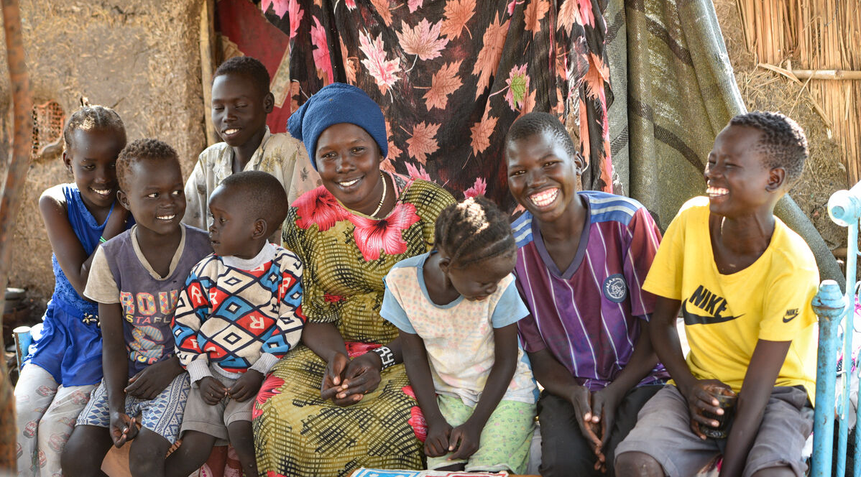
How do you feel when you see someone you haven’t seen for ages?
Perhaps you have some friends or family members who live a long way away?
What do you do and what do you say when you see them again after a long time?
Notes:
Yani and her family, Sudan
Photo credit: Ahmed Seed

Slide 8
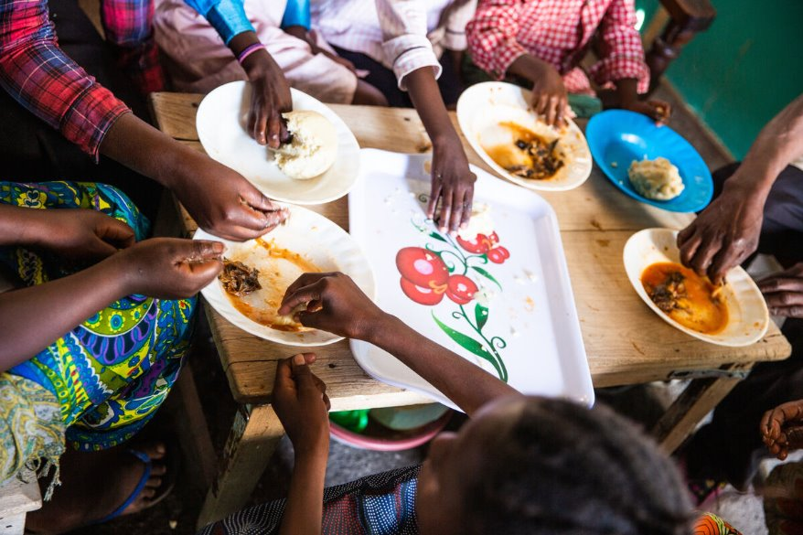
Sitting together to eat is a great way to get to know or to catch up with people and can be great fun.
Can you think of a time when you have sat with others to eat a meal? Was it dinner at home? Or school lunch? Or at Easter or another special occasion?
Who was there? What did you do? Did you eat in silence? Or did you spend time talking to each other? Did you share the same food?
Notes:
Marie-Claire and her family, Goma, DRC
Photo credit: Thom Flint

Slide 9
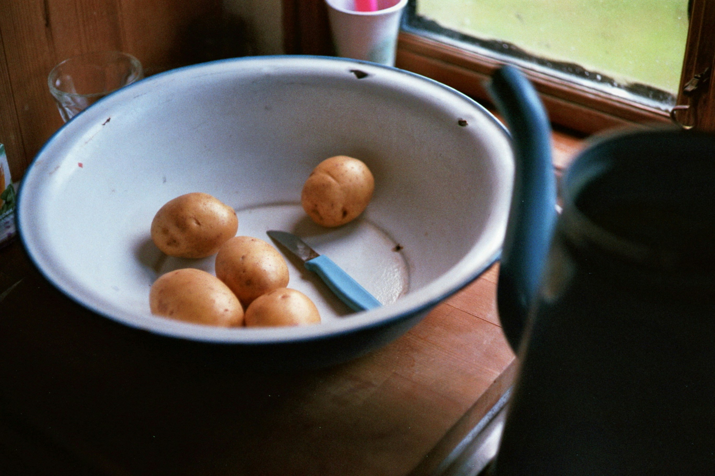
All around the world, people come together to eat and share food with one another.
But there are lots of people around the world who struggle to get enough food to eat and clean water to drink for themselves and their families. Do you think that is fair?
Even though there is enough food in the world for everyone to have what
they need, it is not shared fairly. Some people have more than they need
and some people do not have enough.
Notes:
Fruit in a bowl
Photo credit: Jan Tinneberg on Unsplash

Slide 10
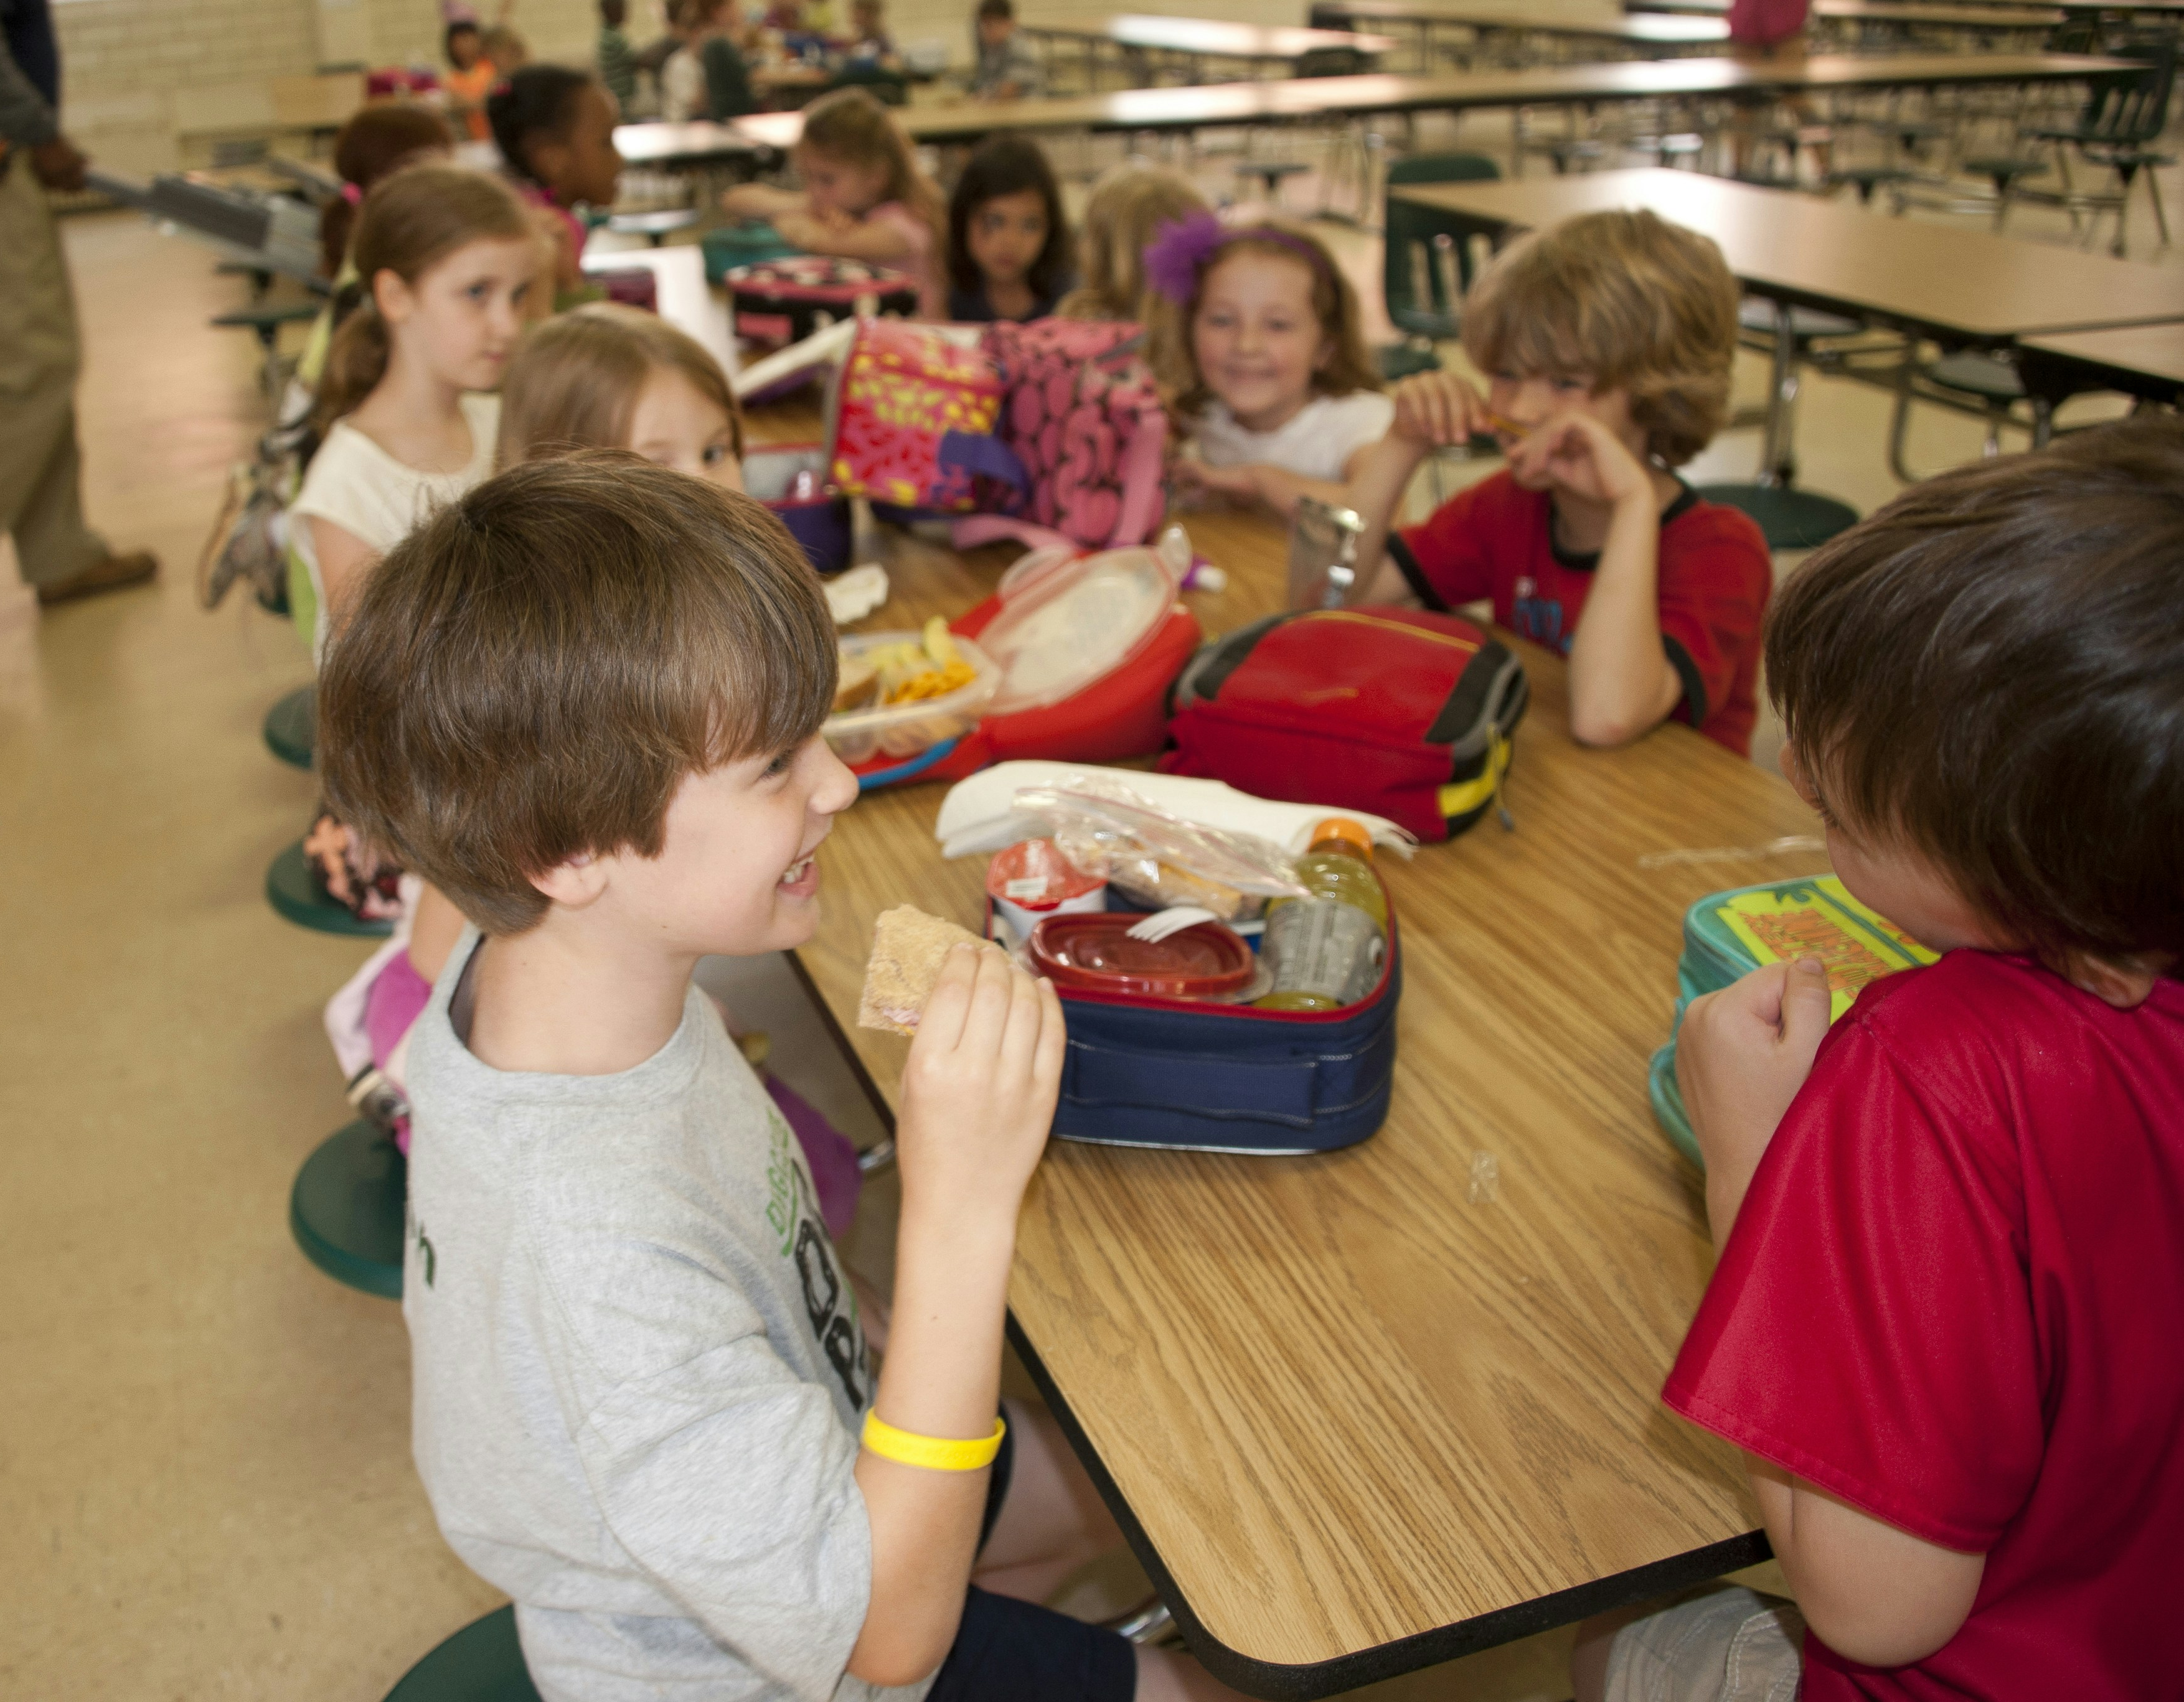
So this week as we sit together and eat with others, let’s think about all the other people around the world who are doing the same thing.
And let’s also think about all the people who do not have enough food to eat.
Let’s pray for them and work together with them to make sure everyone has their fair share of food.
Let’s give what we can of our time and talents to make the world a fairer place.
Notes:
Lunchtime
Photo credits: CDC on Unsplash

Slide 11
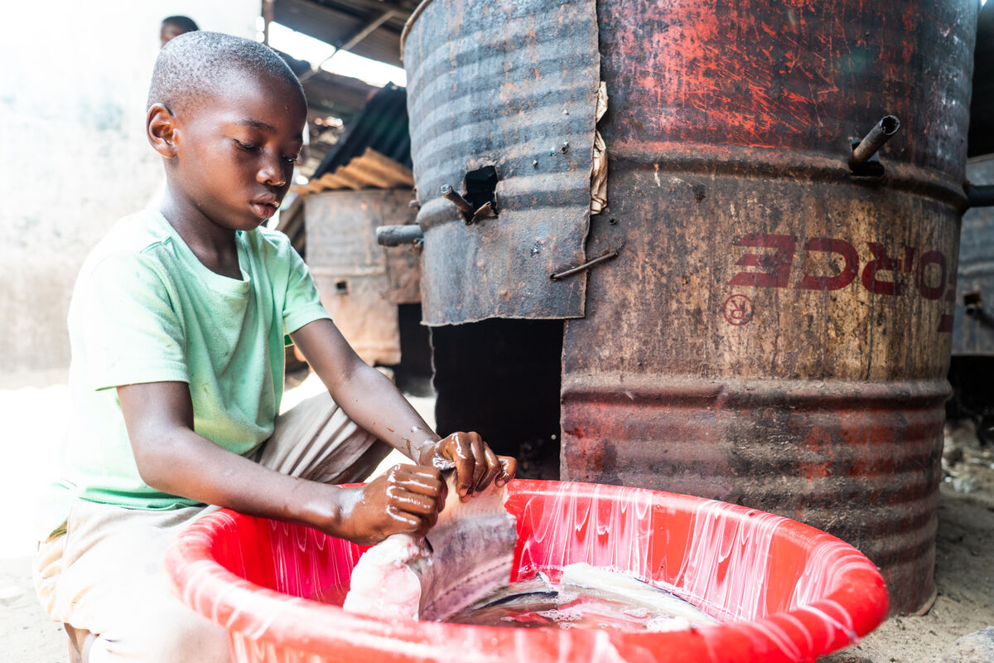
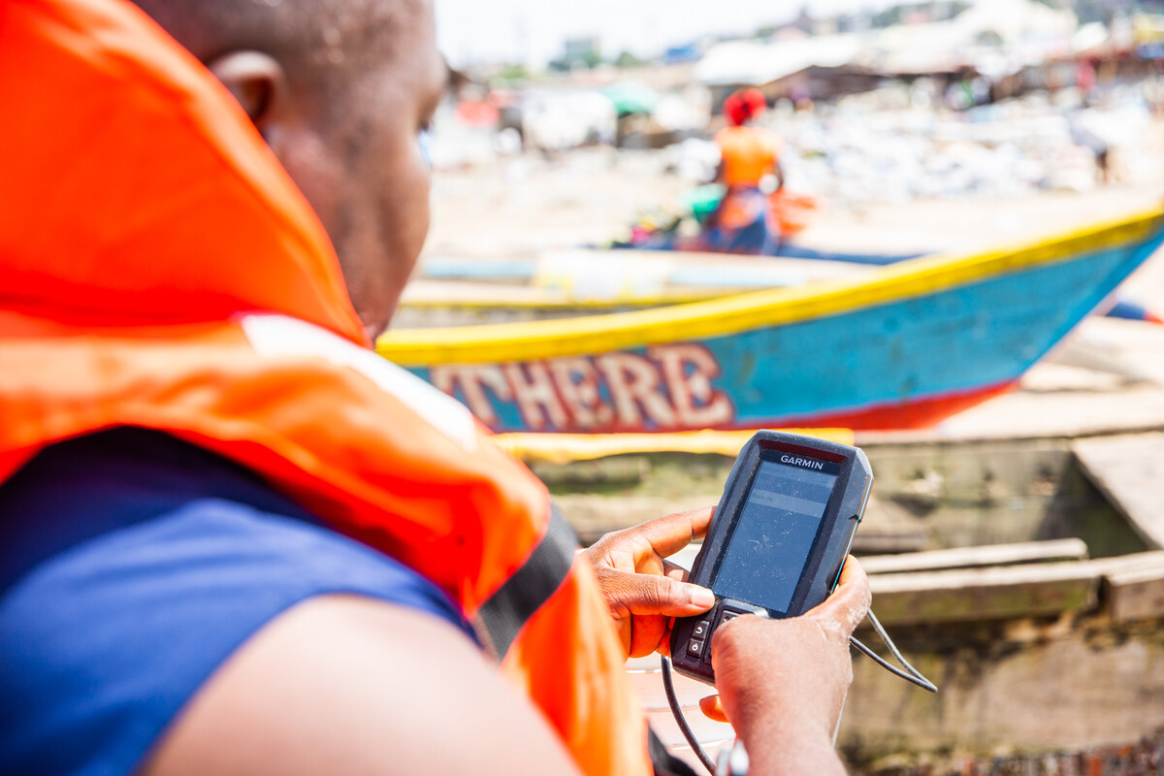
Aaron lives by the sea in Liberia. His grandfather is a fisherman. "I help wash and dry the fish he catches," says Aaron.
"I would like to be a fisherman," says Aaron, but being a fisherman is hard and dangerous. The fish are becoming more and more difficult to find.
With CAFOD's help, local fisherman use fishfinders on their boats so they can safely catch fish to eat and sell. This means Aaron's grandparents can give him food to eat and other things he needs to be happy - as everyone deserves.
Notes:
Aaron and Tekon the fisherman, Liberia
Photo credit: Carielle Doe

Slide 12
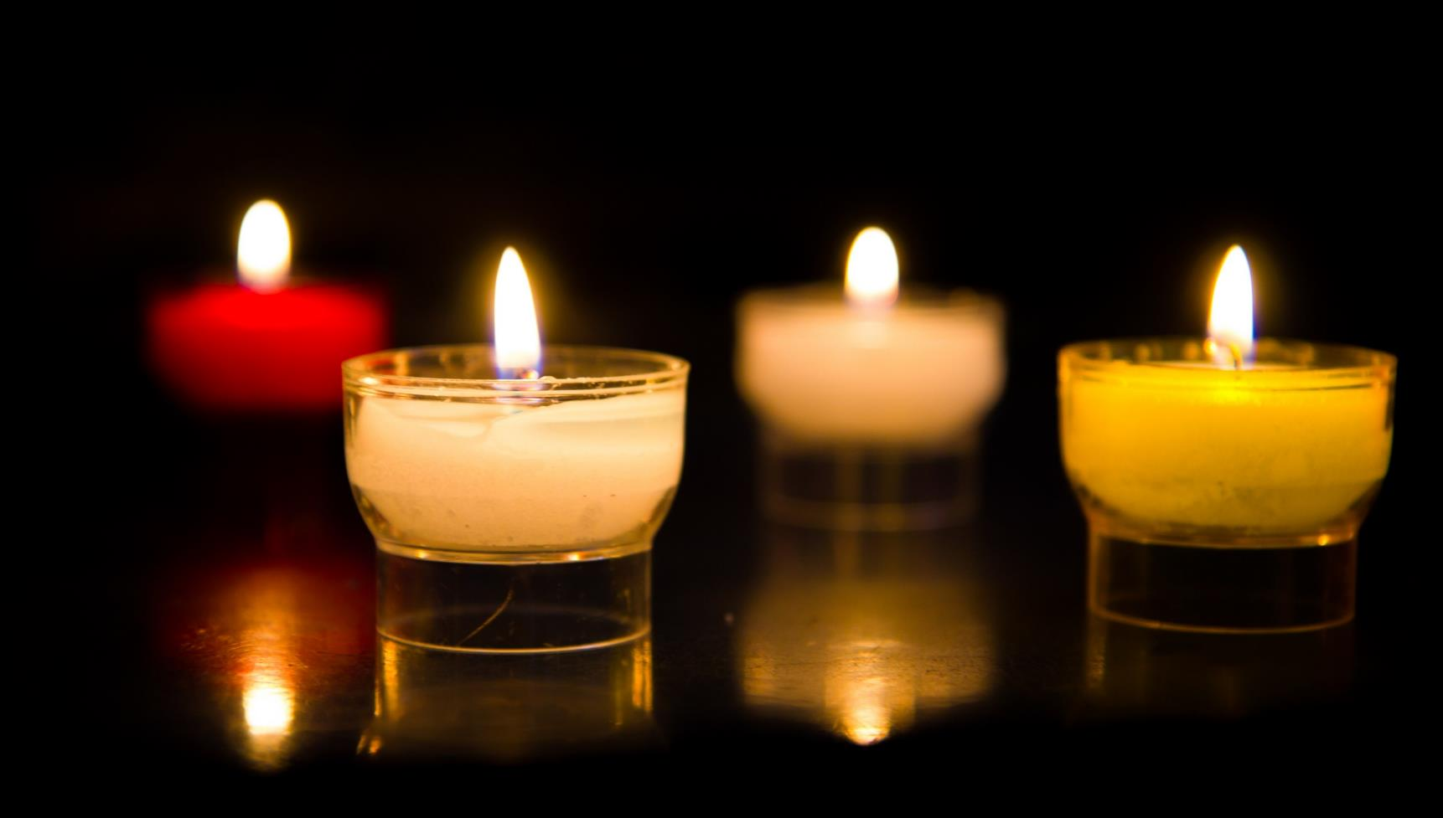
Let us pray…

Slide 13
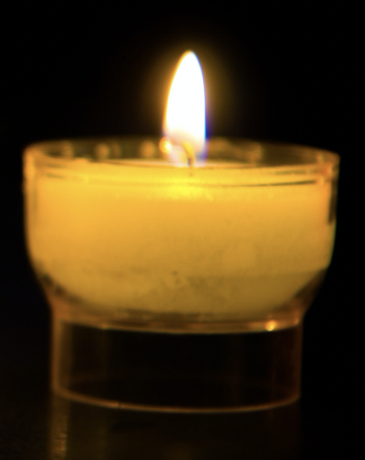
We pray for the Church throughout the world: that it may follow Jesus’ example and be a place of welcome for everyone.
Lord, in your mercy…
We pray for all people throughout the world: that they may have enough food to eat and find comfort and support as they share food with others.
Lord, in your mercy…

Slide 14
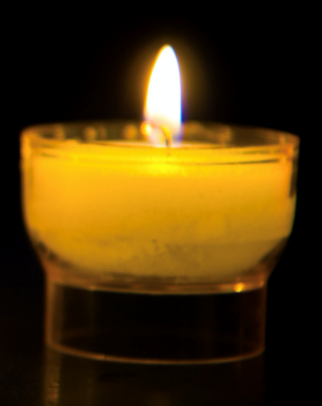
In this Jubilee Year, we pray that we may be signs of hope in our world through all that we do and how we treat one another. Lord, in your mercy…
Creator God,
You made a world of plenty with enough food for everyone. As we break bread together, fill us with your love and lead us to share whatever we are able. Amen.

Slide 15
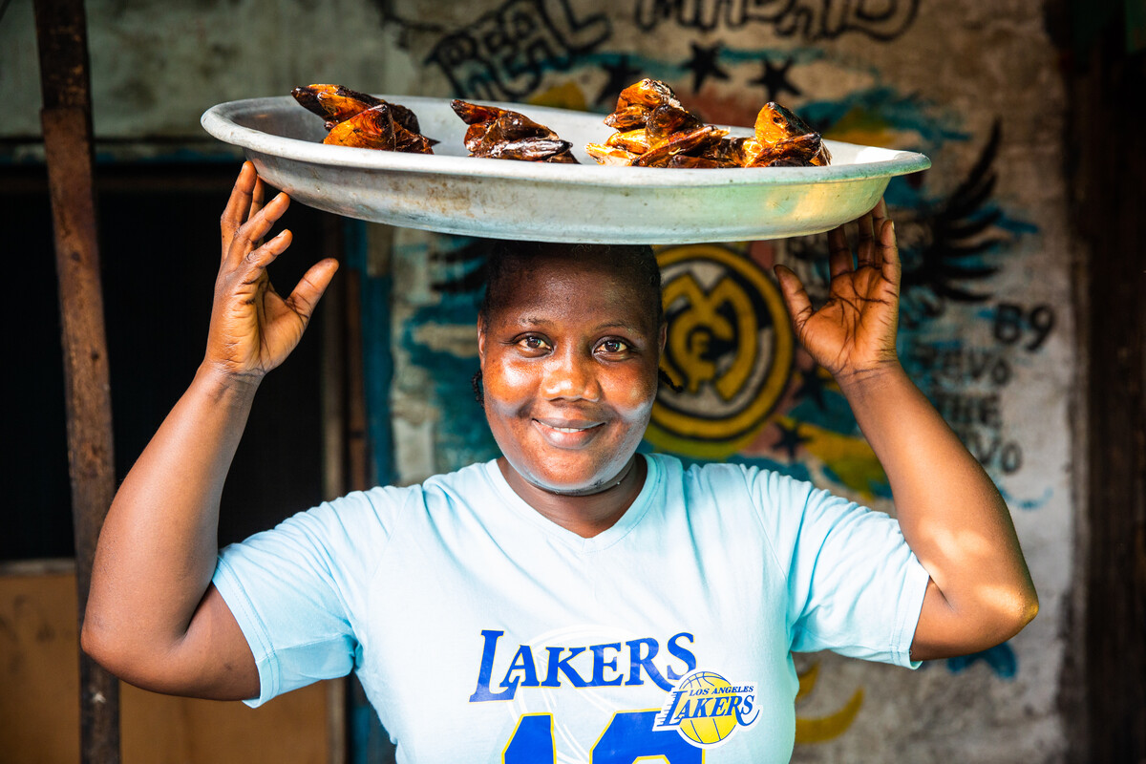

How can we share what we have with others to make the world a fairer place ?
Send
Notes:
Vivian, the fishmonger, Liberia
Photo credit: Thom Flint

Slide 16
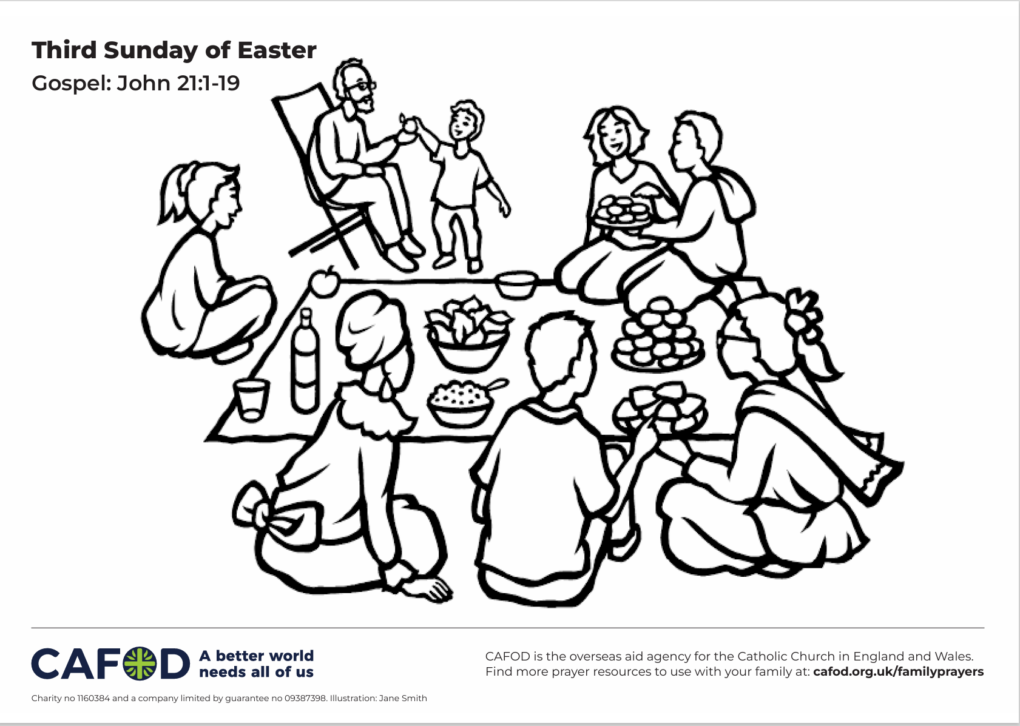
Activity suggestions
Invite the children to colour in the accompanying illustration of a group of people sharing food together. Encourage them to write a prayer for all people who are struggling to feed themselves and their families or a prayer of thanksgiving to be said at a meal on the back of the sheet.
Give the children each a fish-shaped piece of paper. Encourage them to write a prayer on it for all people who do not have enough to eat or a prayer of thanksgiving to be said at a meal with others. Get the children to add these to a net on a big piece of paper to display them.
Remind the children to tell the people that they live with all that they have heard and thought about in the liturgy today. If they sit down to share a meal with others in this coming week, can they think about all their brothers and sisters throughout the world who are doing the same thing?
Invite the children to think about what they can do to help others in their local community and around the world to have enough food.
Notes:
Illustration: Jane Smith

Slide 17
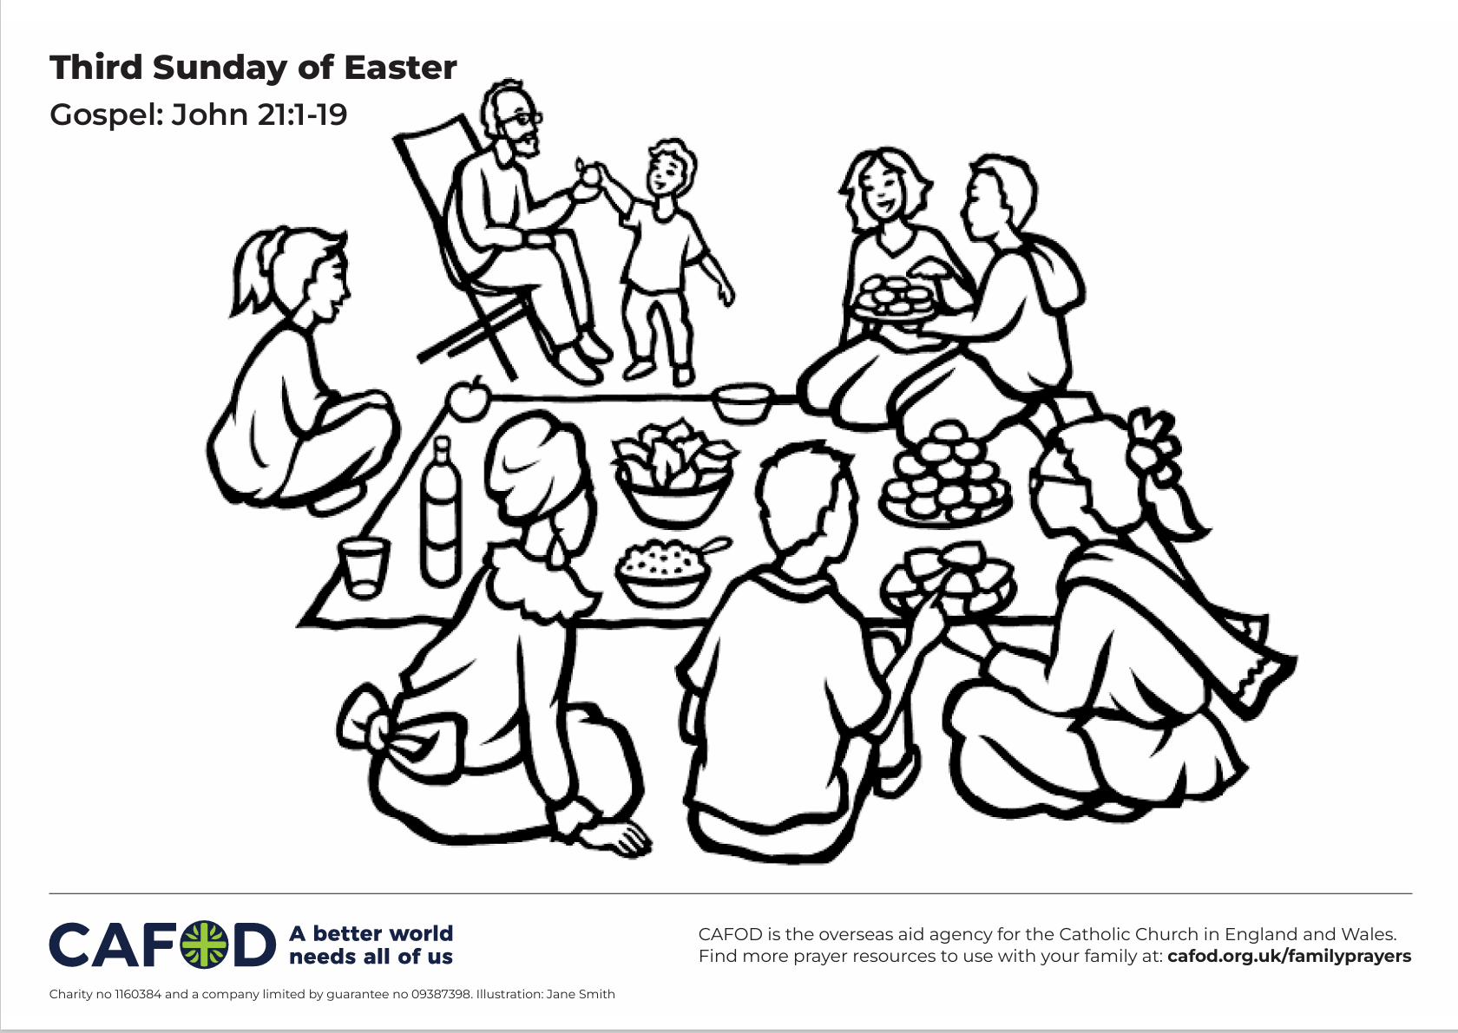
Notes:
Illustration: Jane Smith

Slide 18
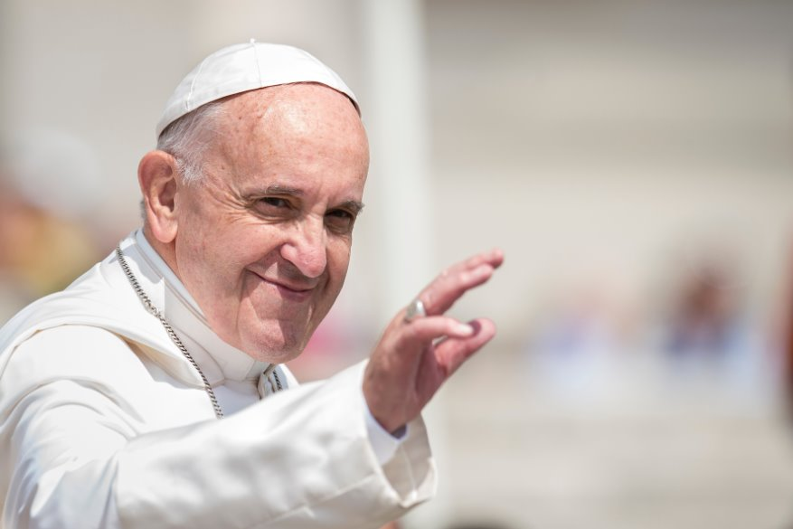
Remembering Pope Francis
As the world mourns his passing, Pope Francis’ legacy will be remembered as one that brought the Church closer to its mission of love, mercy and justice.
Pope Francis was a passionate advocate of children and young people, calling them the ‘joy and hope of the Church and the world!’ (Spes Non Confundit, #12).
Find resources to mark his passing and to celebrate Pope Francis' legacy here:
Remembering Pope Francis in schools

Slide 19

Jubilee activities!
The Jubilee Year is a landmark moment in the life of the global church. School communities are invited to join together as pilgrims of hope, pledging to work together for God’s kingdom of justice, peace and love. Find resources at:
Jubilee for schools 2025 – Pilgrims of Hope
A CAFOD club could strongly support the Catholic life of your school, particularly in this Jubilee year. Find out more:
https://cafod.org.uk/Education/For-teachers/CAFOD-clubs
Find resources to learn about and fundraise for the Myanmar Earthquake: https://cafod.org.uk/education/education-resources/emergency-resources-schools

Slide 20
