Slide 1
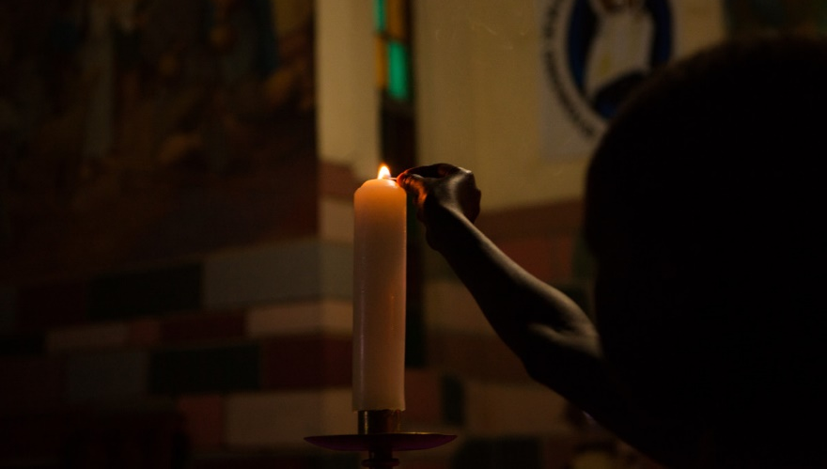
A prayer for Turkey and Syria
We pray for the people of Turkey and Syria.
We pray for everyone who is affected by the earthquake,
those who have lost loved ones,
and all who have lost their homes.
May they be comforted by so many people
reaching out to offer support.
Lord, bless the efforts of rescuers and medical staff,
CAFOD and all the other agencies trying to help.
Move our hearts with compassion.
May our sisters and brothers know that they are loved
and find their hope restored.
Amen.

