Slide 1
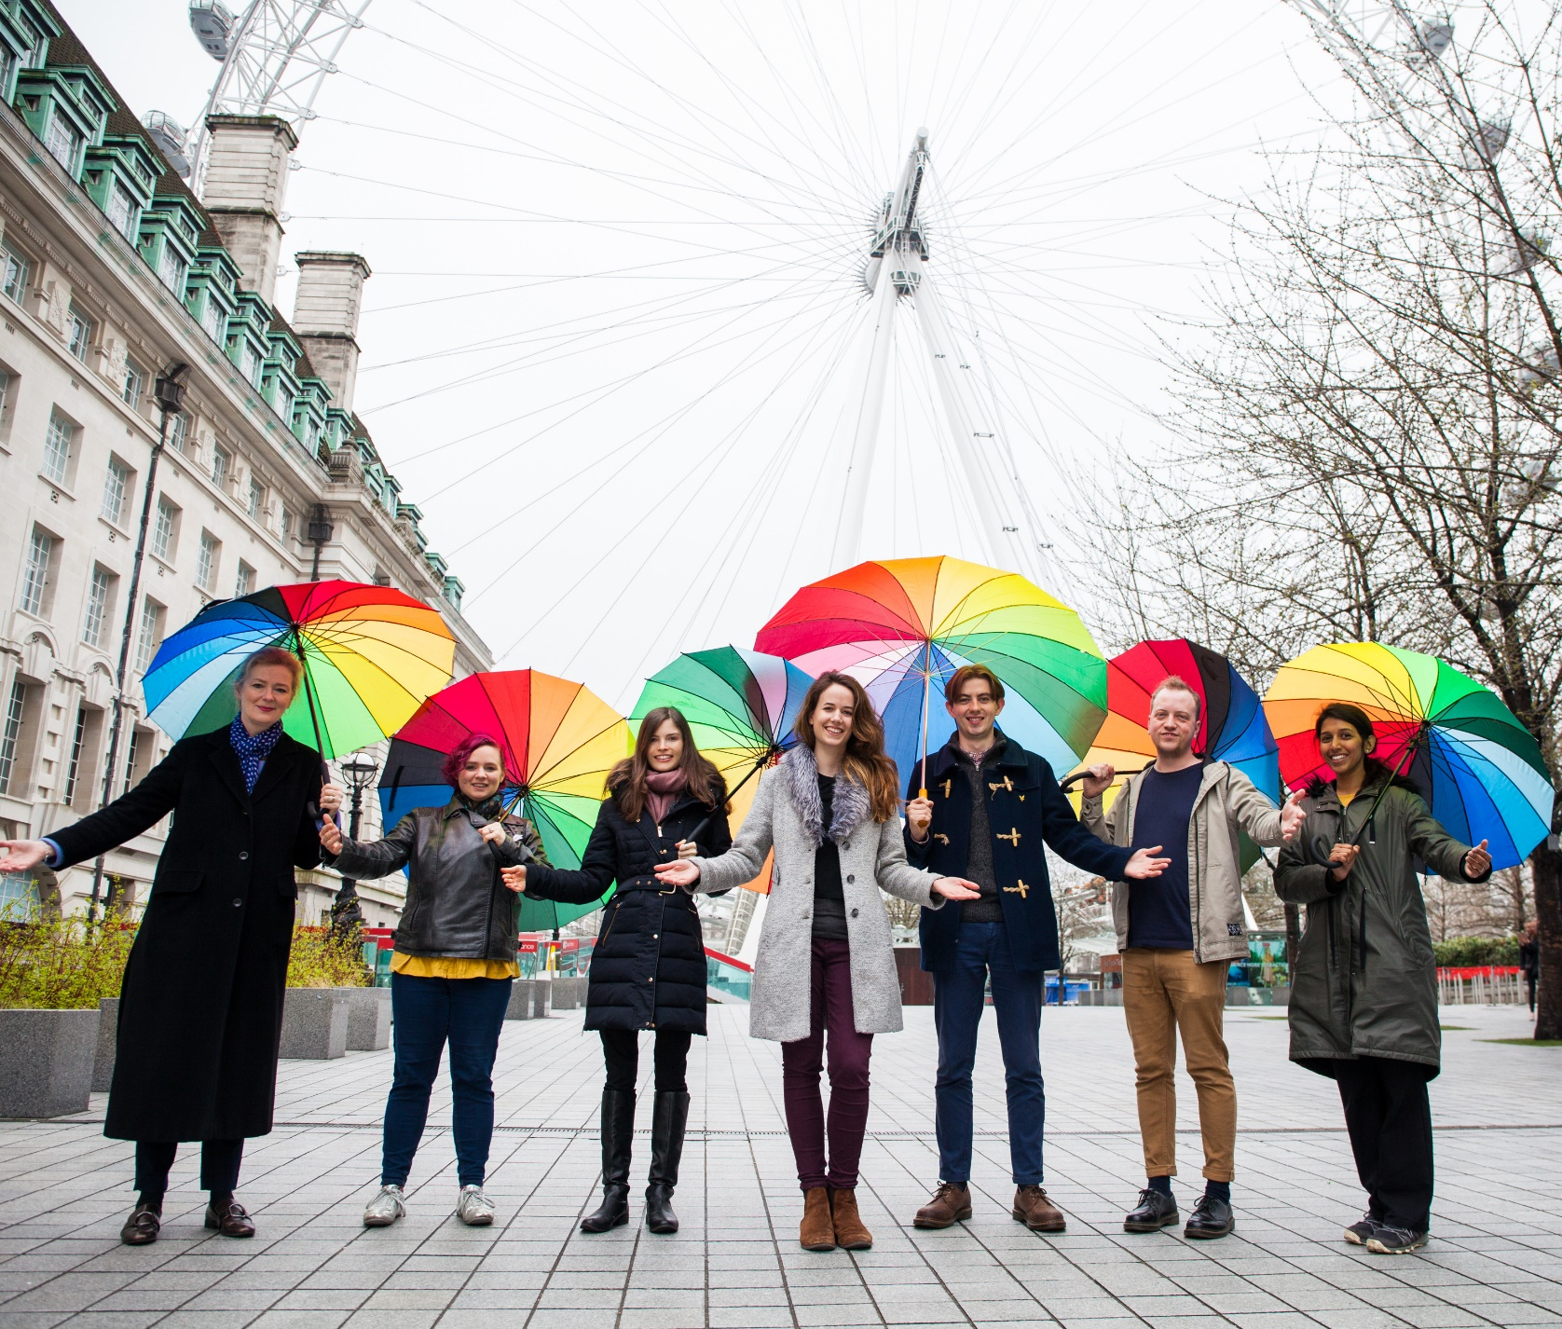

How can I welcome others with love, kindness and respect this week?
Gather
Notes:
Children’s liturgy –Palm Sunday of the Passion of the Lord
Preparation of the worship space
Colour: red
Note – The liturgy is based on the entrance Gospel rather than the Passion reading.
Song suggestions: Give me joy in heart (722, Laudate)
Welcome: Today is called Palm Sunday, when we remember a time Jesus entered Jerusalem. We have these palms to remind us how the people welcomed Jesus and praised him as their Saviour and King. How do we welcome Jesus in our lives?
People with bright umbrellas
Photo credit: CAFOD

Slide 2
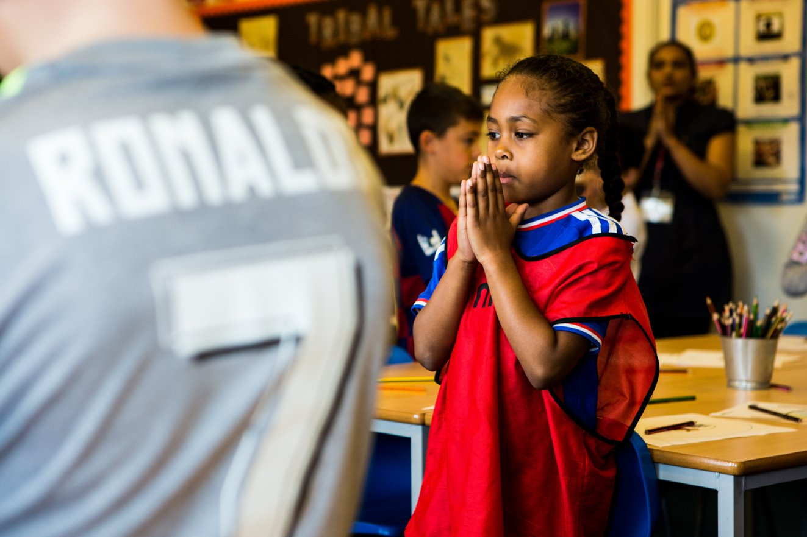
Eternal God,
May we always welcome Jesus into our hearts with joy. Help us to see Christ in all people and to make them feel welcome.
We make this prayer to you through Christ our Lord. Amen.
Notes:
Children at Our Lady Queen of Heaven Primary School
Photo credit: Thom Flint

Slide 3

Gospel: Luke 19:28-40
After Jesus said this, he went on ahead of them to Jerusalem. As he came near Bethphage and Bethany at the Mount of Olives, he sent two disciples ahead with these instructions: “Go to the village ahead of you; as you go in, you will find a colt tied up that has never been ridden. Untie it and bring it here. If someone asks you why you are untying it, tell him that the Master needs it.”
They went on their way and found everything just as Jesus had told them. As they were untying the colt, its owners said to them, “Why are you untying it?”
“The Master needs it,” they answered, and they took the colt to Jesus. Then they threw their cloaks over the animal and helped Jesus get on. As he rode on, people spread their cloaks on the road.
When he came near Jerusalem, where the road went down the Mount of Olives, the large crowd of his disciples began to thank God and praise him in loud voices for all the great things that they had seen: “God bless the king who comes in the name of the Lord! Peace in heaven and glory to God!”
Some of the Pharisees in the crowd spoke to Jesus. “Teacher, command your disciples to be quiet!”
Jesus answered, “I tell you that if they keep quiet, the stones themselves will start shouting.”
Word

Slide 4
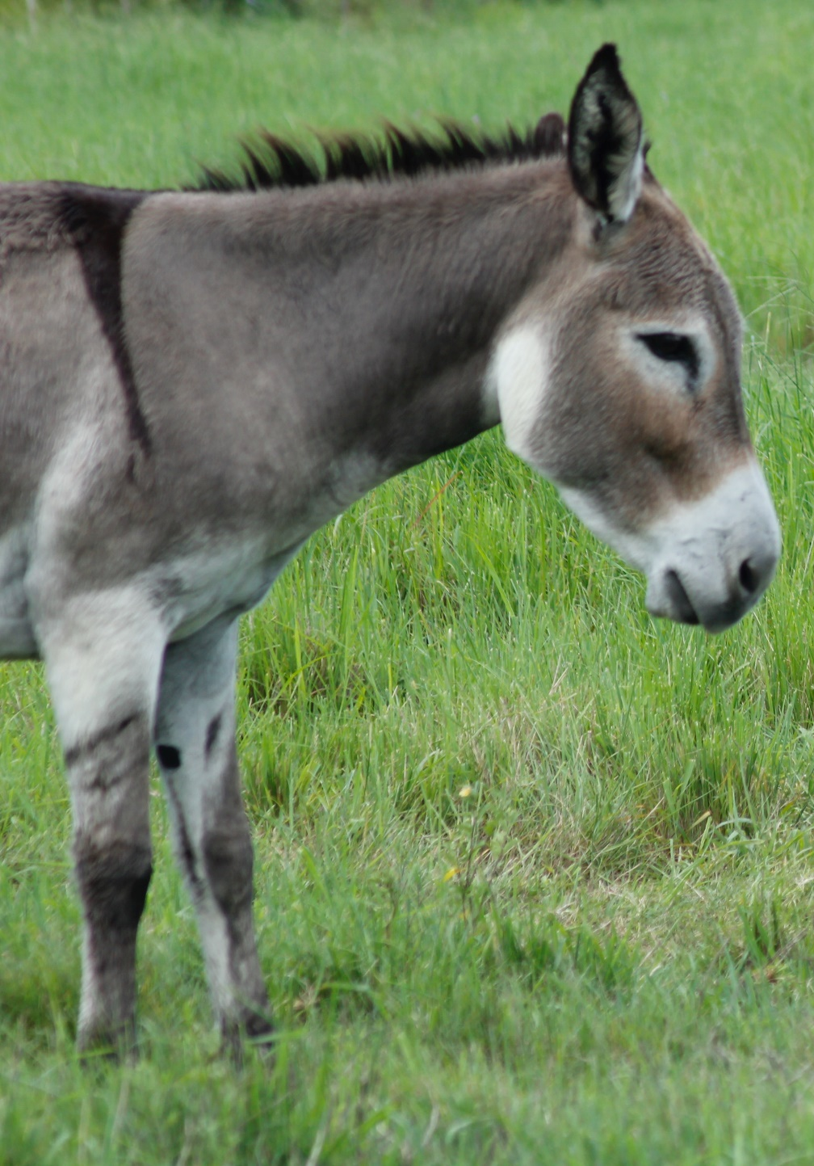

What do you remember from the Gospel reading?
Today is a special day, when we hear two readings from Saint Luke’s Gospel. One is the Passion telling how Jesus was arrested, tried, crucified, died and was buried.
We also heard another gospel story at the start of Mass.
It tells how Jesus sent the disciples off to borrow a donkey, and to say, “The Master needs it”, if they were asked where they were taking it. How do you think the disciples felt when everything happened just as Jesus said it would?
Respond
Notes:
A donkey
Photo credit: Anthony Rae on Unsplash

Slide 5

Then Jesus entered into Jerusalem on this donkey, while the people shouted their praises to God. How do you think Jesus must have felt to hear the people shouting and welcoming him into the city?
Why do you think the disciples were so joyful?
Can you think of a time when someone important or special came to visit you at home or school? How did you welcome them? Did you sing a song, wave flags, shout and cheer?
What would you do to welcome Jesus if he arrived here today?
Notes:
Bunting
Photo credit: Stock image

Slide 6
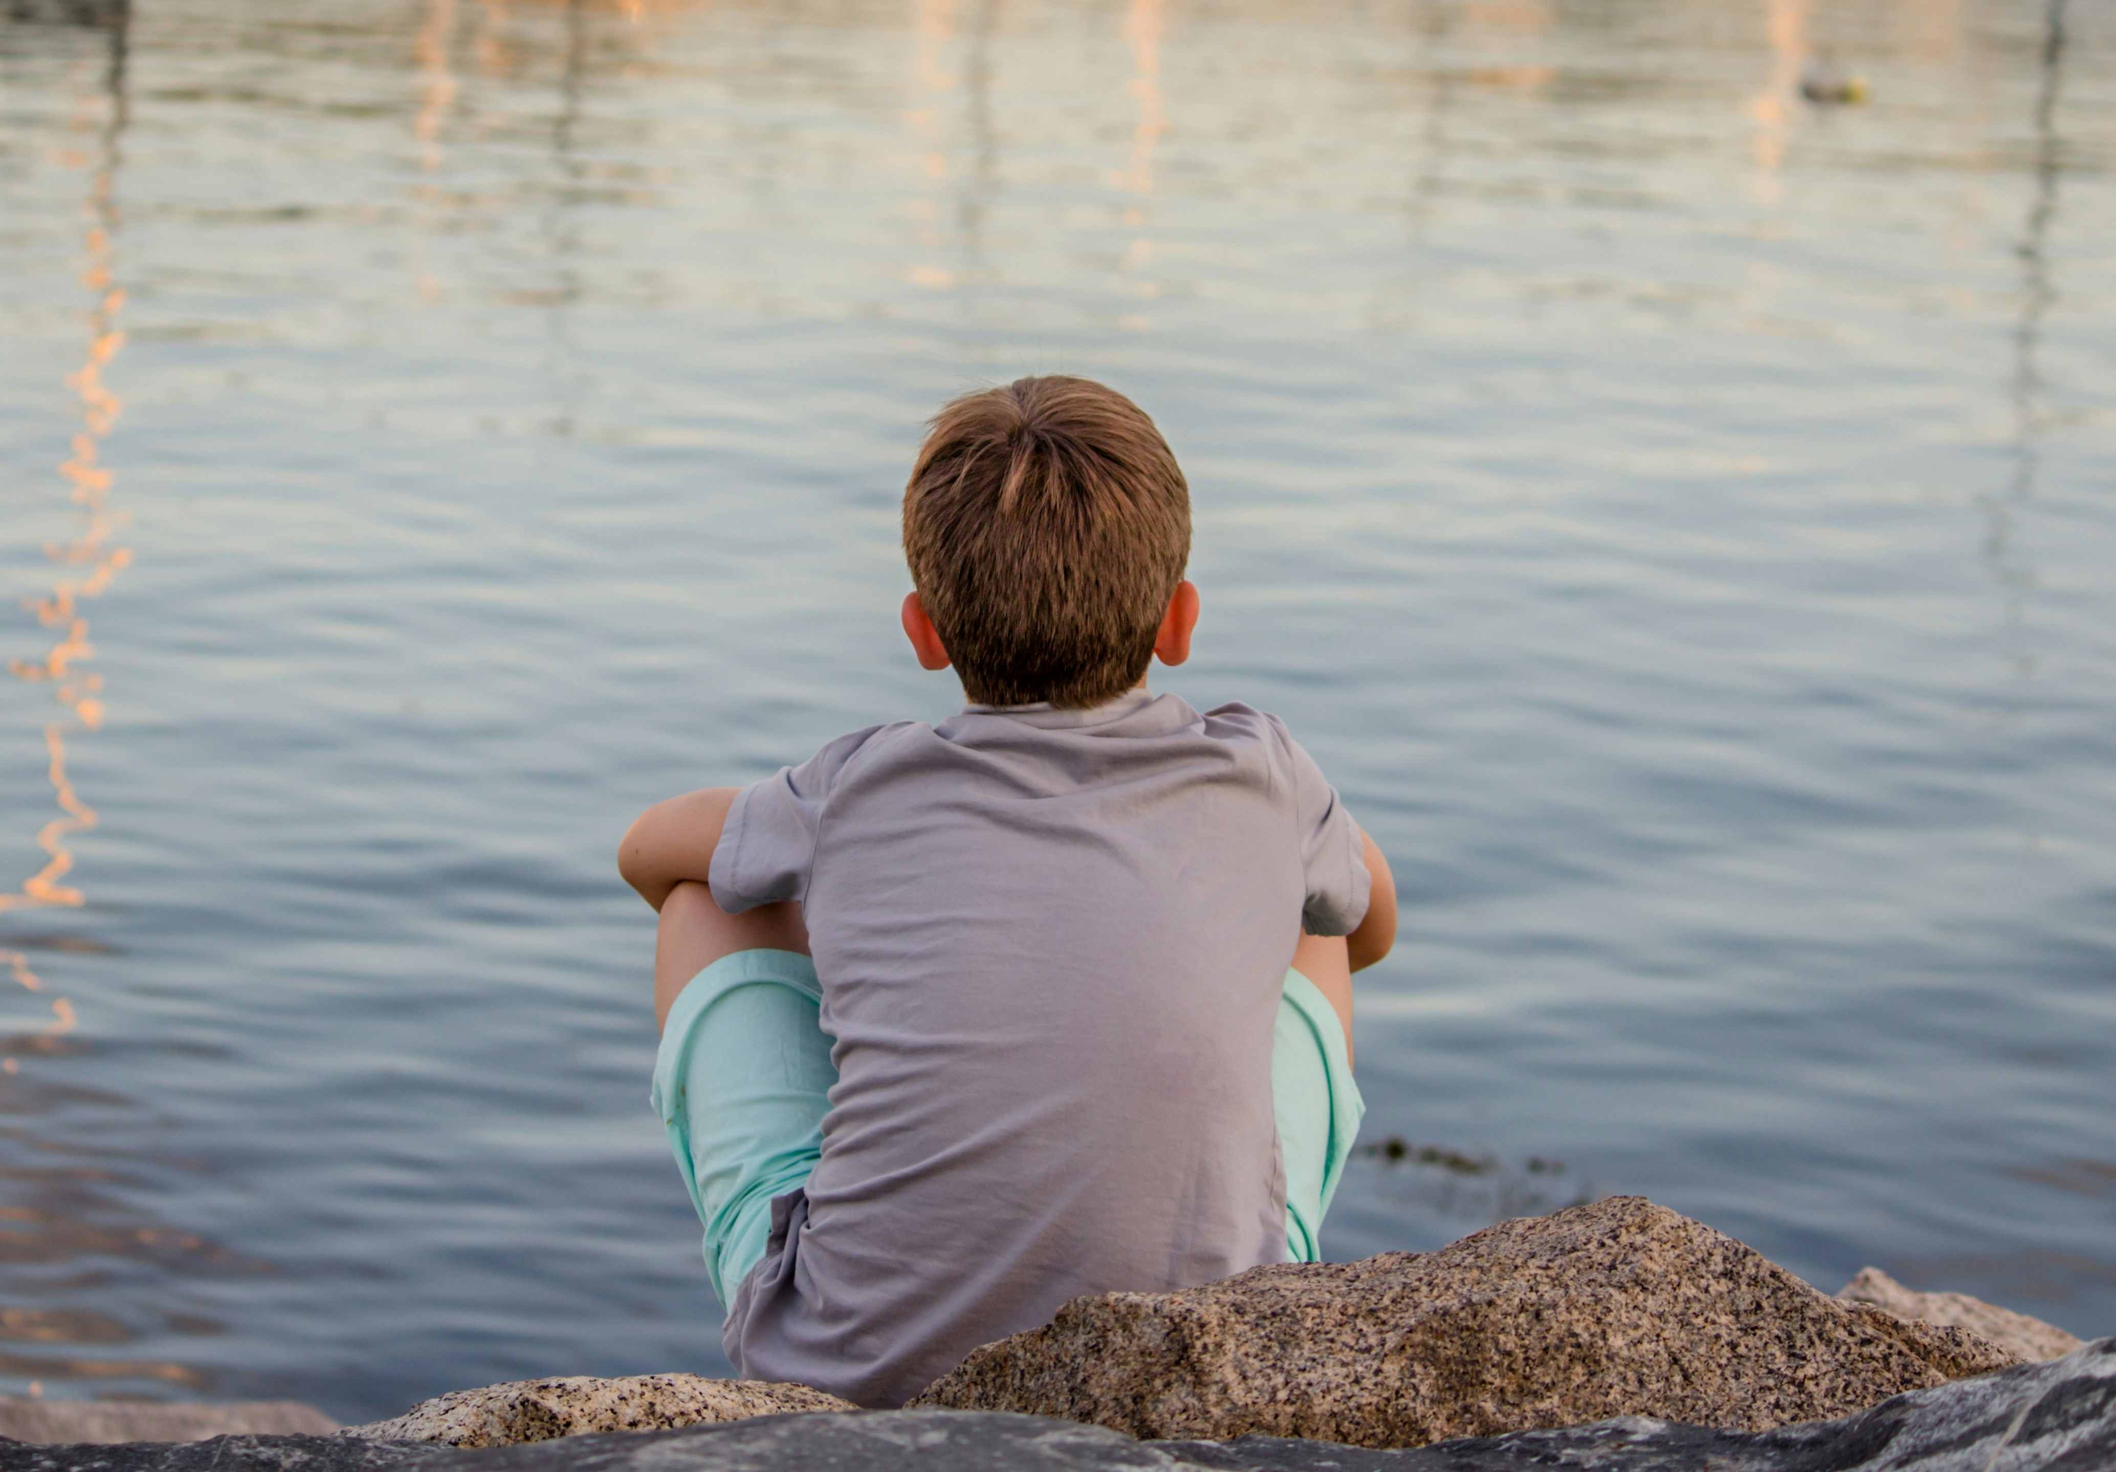
Jesus is in all of us, so every time we meet someone and welcome them, we are welcoming Jesus. We are asked by God to treat all people as we would like to be treated.
Can you think of a time when you have not treated someone as you would like to be treated?
Have you ever stopped people from joining in your game, or sharing in your toys or in your group? Is that welcoming?
This week how do you think we can make all the people we spend time with at home, at school and elsewhere feel welcome?
Notes:
Child alone
Photo credit: Bonnie Kittle on Unsplash

Slide 7
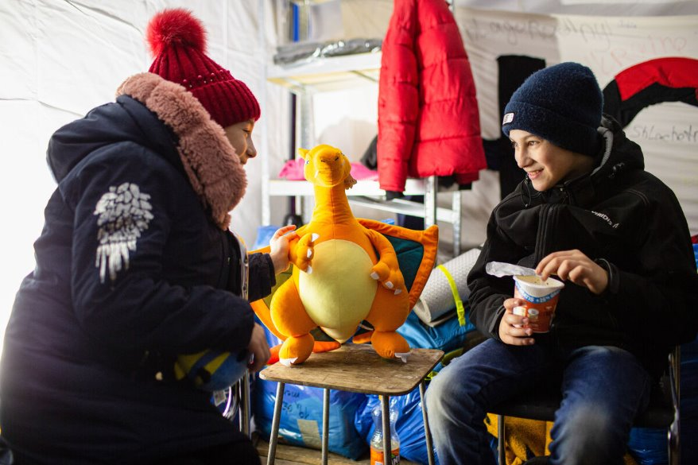
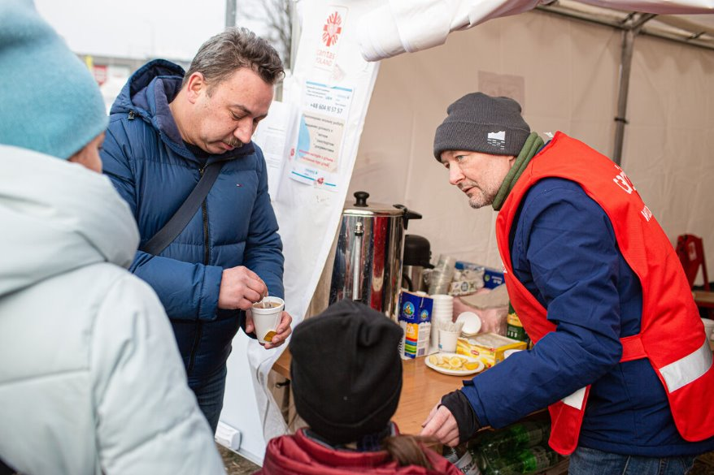
Because Jesus is part of every person, we need to also welcome people all over the world. We can hold all people in our hearts when we pray and do what we can so all people feel welcome.
CAFOD is part of Caritas, a charity that helps people in times of crisis. When Maria's family fled from the war in Ukraine, a Polish Caritas worker welcomed them into Poland.
He took Maria's family to a tent where refugees get a meal, clothing, soap - even a cuddly toy. This Caritas volunteer welcomed a cold, tired and scared refugee family.
Notes:
Maria's children and refugees fleeing from Ukraine
Photo credit: Caritas Poland

Slide 8
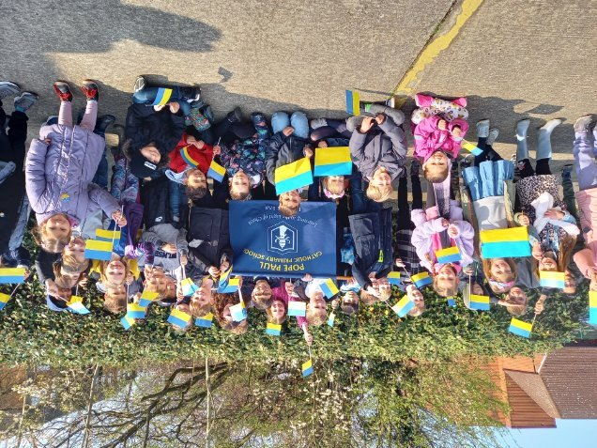
Just like the disciples, we need to live as Jesus asks us to. This may mean being different from others, as we try to share God's love and make the world a fairer place for all. But let's try to do our best. If anyone asks why we are doing this, we can say "the Master needs it".
School children from Pope Paul's showed their community that they welcome refugees from Ukraine.
Let's try to welcome all people as we would welcome Jesus - with love, kindness and respect.
Notes:
Pope Paul school children supporting refugees from Ukraine
Photo credit: Pope Paul Catholic primary school

Slide 9
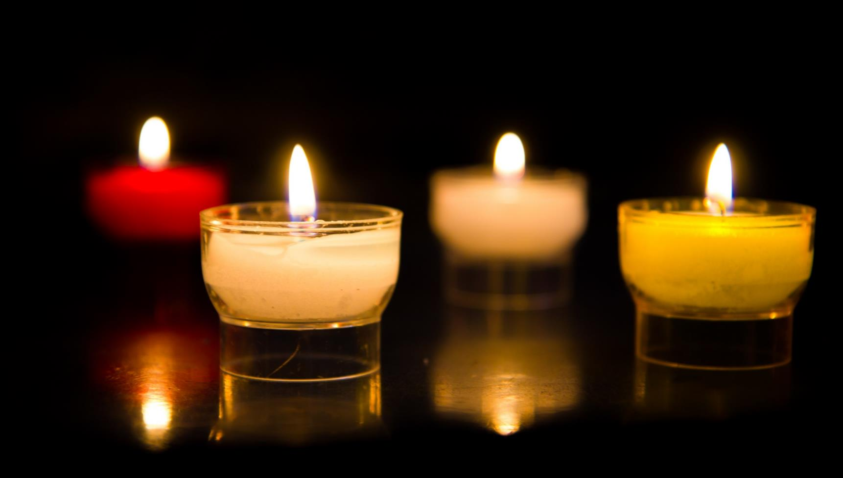
Let us pray…

Slide 10
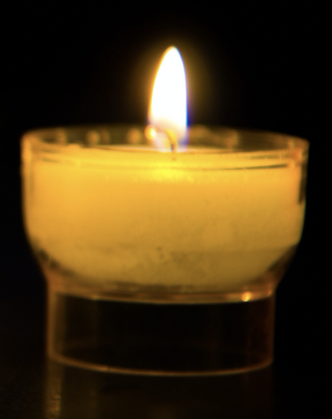
We pray for the Church that she may follow Jesus’ example of welcome and love for all. In this Jubilee Year, we pray that we may be signs of hope in our world through all that we do and how we treat one another.
Lord, in your mercy…
We pray for our parish, family and friends: that we may look for Jesus within others and treat them as we would wish to be treated.
Lord, in your mercy…

Slide 11
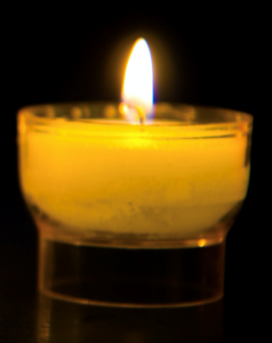
We pray for ourselves: that we may welcome all people with respect and love as Jesus was welcomed into Jerusalem.
Lord, in your mercy…
Christ Jesus,
Open our hearts so we may sing your praise. Help us to welcome you into our lives, and to see you in all our brothers and sisters throughout the world.
Amen.

Slide 12

How can I welcome others with love, kindness and respect this week?
Send
Notes:
People with bright umbrellas
Photo credit: CAFOD

Slide 13
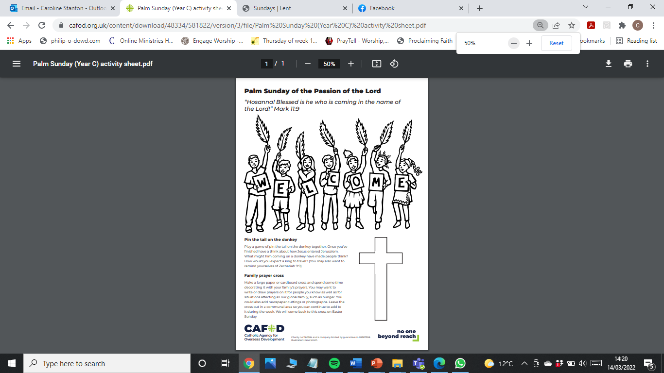
Activity suggestions
Share the activity sheet with the children and invite them to colour in the illustration. Also invite them to write or draw on the back how they will make all people - including those around the world - feel welcome in the coming week. Encourage the children to do the remaining activities at home during the week.
Invite the children to act out Jesus’ triumphant arrival and/or the Passion story. Or, invite them to do a role play to show how they can welcome and respect all people.
Ask the children share all that they have heard and thought about today with the people at home and to try their best to be welcoming to others in the coming week.
For more activities and resources for children this Lent visit
cafod.org.uk/primary
A CAFOD club could strongly support the Catholic life of your school. Find out more: https://cafod.org.uk/Education/For-teachers/CAFOD-clubs
Notes:
Illustration: Jane Smith

Slide 14


Jubilee activities!
The Jubilee Year is a landmark moment in the life of the global church. School communities are invited to join together as pilgrims of hope, pledging to work together for God’s kingdom of justice, peace and love. Find resources at:
Jubilee for schools 2025 – Pilgrims of Hope
There's a little time left to do the Big Lent Walk! Why not do it as part of your Jubilee pledge? For sign up and more information go here:
BLW25 Schools Sign up – Formstack
Find resources to learn about and fundraise for the Myanmar Earthquake: https://cafod.org.uk/education/education-resources/emergency-resources-schools
A CAFOD club could strongly support the Catholic life of your school, particularly in this Jubilee year. Find out more:
https://cafod.org.uk/Education/For-teachers/CAFOD-clubs

Slide 15
Notes:
https://cafod.org.uk/content/download/48334/581822/version/3/file/Palm%20Sunday%20(Year%20C)%20activity%20sheet.pdf
Illustration: Jane Smith

Slide 16


