Slide 1
STEP UP TO THE PLATE
A workshop for young people

Slide 2
Step into their shoes!

Slide 3
Step into their shoes!
You have the chance to buy special seeds that are promised to grow big, healthy crops.
Do you say yes, or no?
Notes:
If time, after each question, ask one or two students why they chose to move forwards. But don’t reveal whether you agree that it was a good choice.

Slide 4
Step into their shoes!
A big company has asked your government to sell them land, so that they can grow soya beans to sell around the world.
Do you agree? Yes or no?

Slide 5
Step into their shoes!
You have the chance to buy pesticides that will kill pests and protect your crops.
Do you say yes, or no?

Slide 6
Step into their shoes!
You have been advised to buy fertilisers, to help your farms produce bigger harvests.
Do you say yes, or no?

Slide 7
Step into their shoes!
A big company wants to buy lots of your land so that it can breed cattle to produce beef.
Will you say yes, or no?
Notes:
Ask students to return to their seats.
Watch the Step up to the plate animation at cafod.org.uk/schools.
Then use the following slides to debrief.

Slide 8
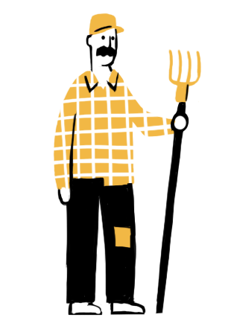
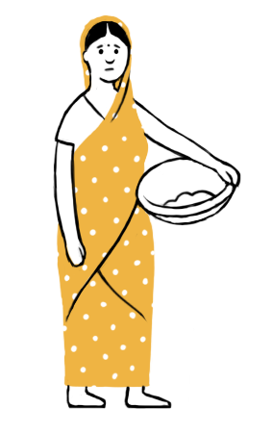
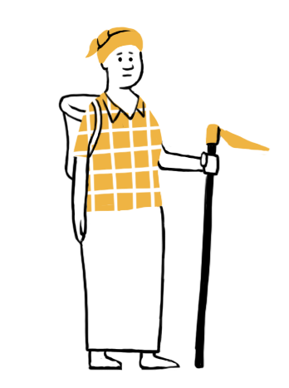
Watch the
animation
Notes:
The animation is at cafod.org.uk/secondary

Slide 9
Step into their shoes: debrief
The special seeds you bought had been altered so that the crops produced no seeds to plant the following year.
So, your farmers had to buy seeds again and again. Your farmers got into debt and could not grow enough food for their families or to sell at local markets.
Notes:
Ask who bought seeds in the activity before the animation. Then explain the consequences using the slide.
Reinforce learning by referring back to what students have just seen in the animation.

Slide 10
Step into their shoes: debrief
Growing a single crop like soya beans for the world sounded a great idea.
But the soya in your fields was mostly used for chicken food.
Yes, eventually people ate chicken, but when the land was used to grow a variety of vegetables, fruit and grains, it fed far more people in the local community.
Notes:
Who sold land to grow soya?

Slide 11
Step into their shoes: debrief
Pesticides helped you to produce a big harvest the first year. But harvests were smaller each year. And the pesticides were so expensive that your farmers got poorer and poorer.
The chemicals in the pesticides also poisoned the land, making it harder to grow food.
Notes:
Who bought pesticides?

Slide 12
Step into their shoes: debrief
Fossil fuels were used to produce and transport the fertilisers that you bought, making the climate crisis even worse.
More storms, floods and droughts mean less food for everyone.
Notes:
How many of you bought fertilisers?

Slide 13
Step into their shoes: debrief
The land sold to produce beef was in the rainforest. The trees cut down to make room for cattle had been protecting the world from climate change.
Also, the land was being used by local people growing a variety of foods.
They lost their land and could no longer feed their families or local communities.
Notes:
Who sold land to produce beef?

Slide 14
Consider…
How did you feel when your country was offered these opportunities?
Do you think real country leaders would react as you did? Why/why not?
How do you think small-scale farmers feel when their land is taken from them, or when they have to buy seeds every year?
The way the world produces and shares food is called the global food system. Which problems of our broken food system did you experience in the activity?
If you were a world leader, what would you do to solve one of the problems?
Notes:
Prompt for Q4: What happened when you let foreign companies grow food in your country?
Before Q5: Our broken food system speeds up climate change, damages the soil, supports big companies while driving many small food producers into poverty, and causes hunger around the world. 1 person in 10 is hungry, even though our world has more than enough food for everyone.

Slide 15
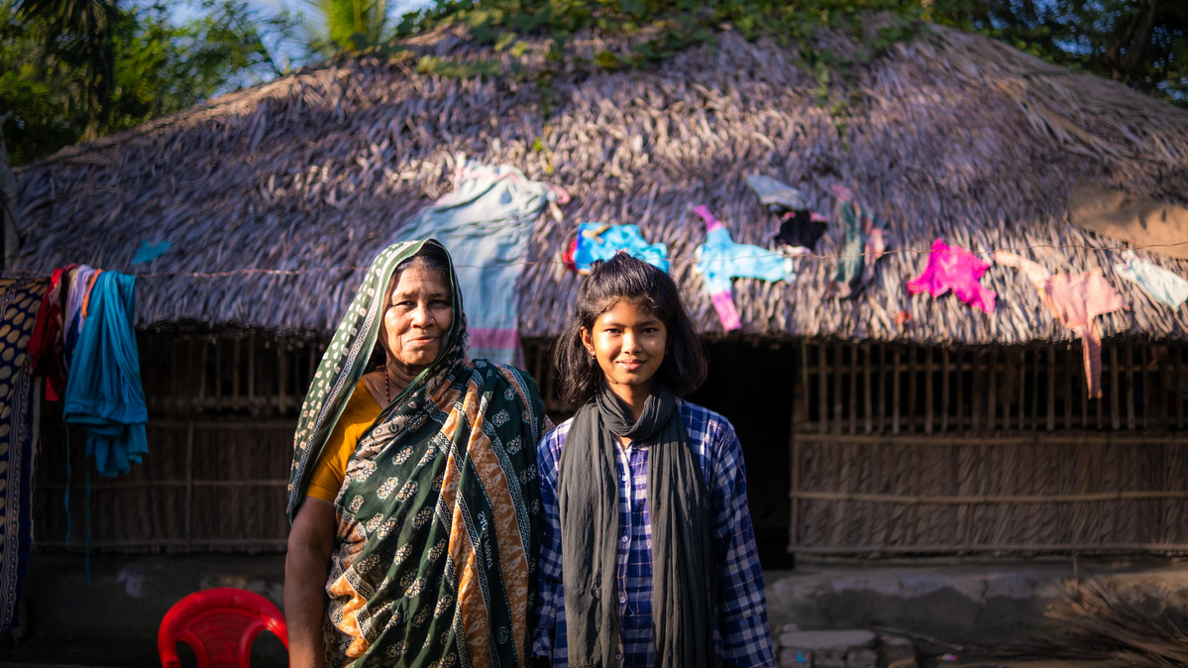
Eco-villages in Bangladesh
Notes:
Picture credit: Amit Rudro
Toma is 10 years old. She lives in southern Bangladesh, not far from the sea, with her parents, grandparents, older sister and five-year-old brother.
In Toma’s area, the climate crisis is causing more and stronger tropical storms that flood the land with sea water and make the soil salty. This kills many plants and makes it hard to grow food.
Some of Toma’s community received training from Bangladesh Association for Sustainable Development (BASD) in ways to grow food even where the land is salty. Everyone shared what they had learned and BASD supported the community to become an eco-village - a village where the community is committed to living sustainably.

Slide 16
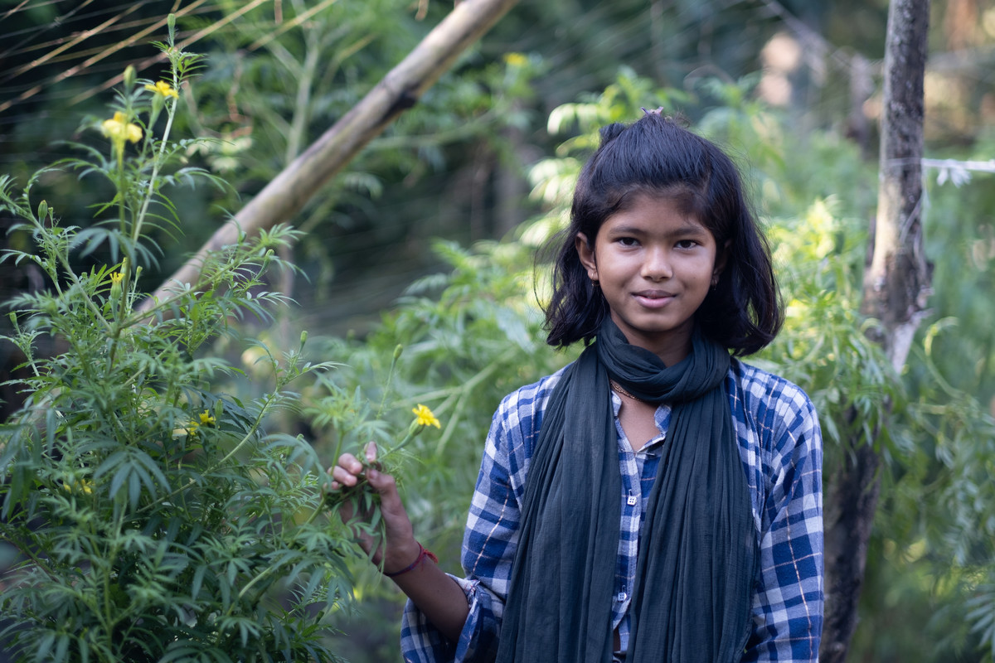
Notes:
Picture credit: Amit Rudro
BASD train people to use “permaculture”. This is a way to grow food and live sustainably, without wasting anything. Food scraps are used to make compost. No chemical fertilisers are used.
Toma said: “We use permaculture here—we make our own fertilisers at home—so it helps plants to grow.”
Toma’s house is surrounded by greenery. She enjoys helping her parents in the garden and has planted fruit trees like papaya and mango, as well as vegetables.
“The vegetables we eat come from our garden, like wax gourd, water gourd, pumpkins, and more. The stuff we grow is much tastier, and I’ve been told it’s healthier too.”

Slide 17
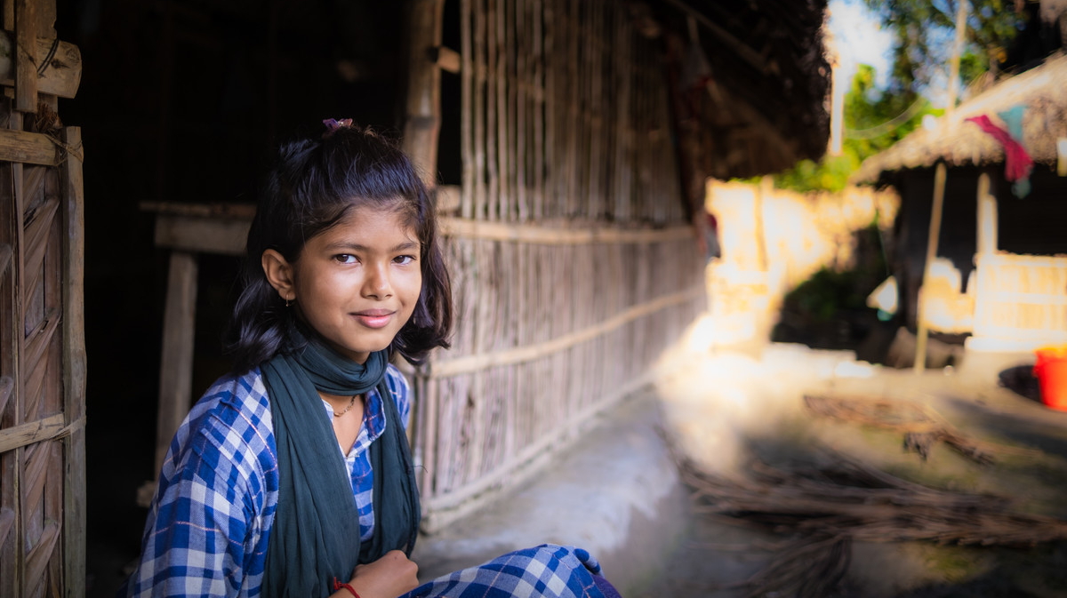
Notes:
Picture credit: Amit Rudro
In some parts of the world, a big company has bought legal rights so that it ‘owns’ some of the most popular seeds. Farmers must buy the seeds from the company, making them poorer.
But in Toma’s community, people grow crops that produce seeds. They can save the seeds and plant them the next year. This is free, is more sustainable and means that people can swap and share seeds.

Slide 18
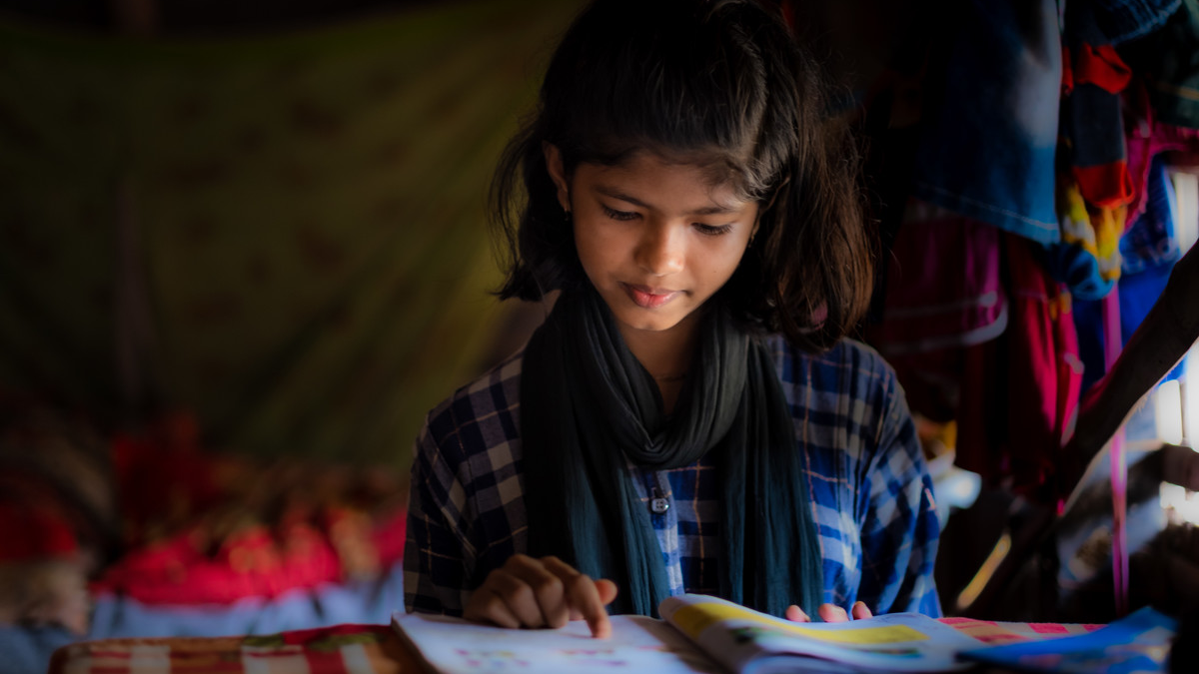
Notes:
Picture credit: Amit Rudro
Toma attends a children’s club set up by BASD. She says, “That’s where I learnt all about the importance of planting trees and how to plant them. It was closed for a while during the pandemic, but I used to go before Covid too. There, I learnt that using organic fertiliser is good to help trees grow.”
“The other thing I’ve learnt is that trees give us oxygen, and make our environment safe, because trees can protect us during storms by making the winds slow down.”
The children planted trees together at the school. Toma told us: “It wasn’t something our teachers told us to do, we decided to do it ourselves. We planted lots of trees in our school, and flowers and vegetables too. Our teachers then helped us to sell them at the market, and then we donated the money to our school.”

Slide 19
Why is it difficult to grow food in Toma’s area?
What is permaculture?
What is good about the trees and vegetables that Toma’s family grows?
Which problems in our food system are Toma’s community avoiding or solving?
What might the world learn from Toma’s community to help us grow food more fairly and responsibly?
Notes:
Picture credit: Amit Rudro

Slide 20
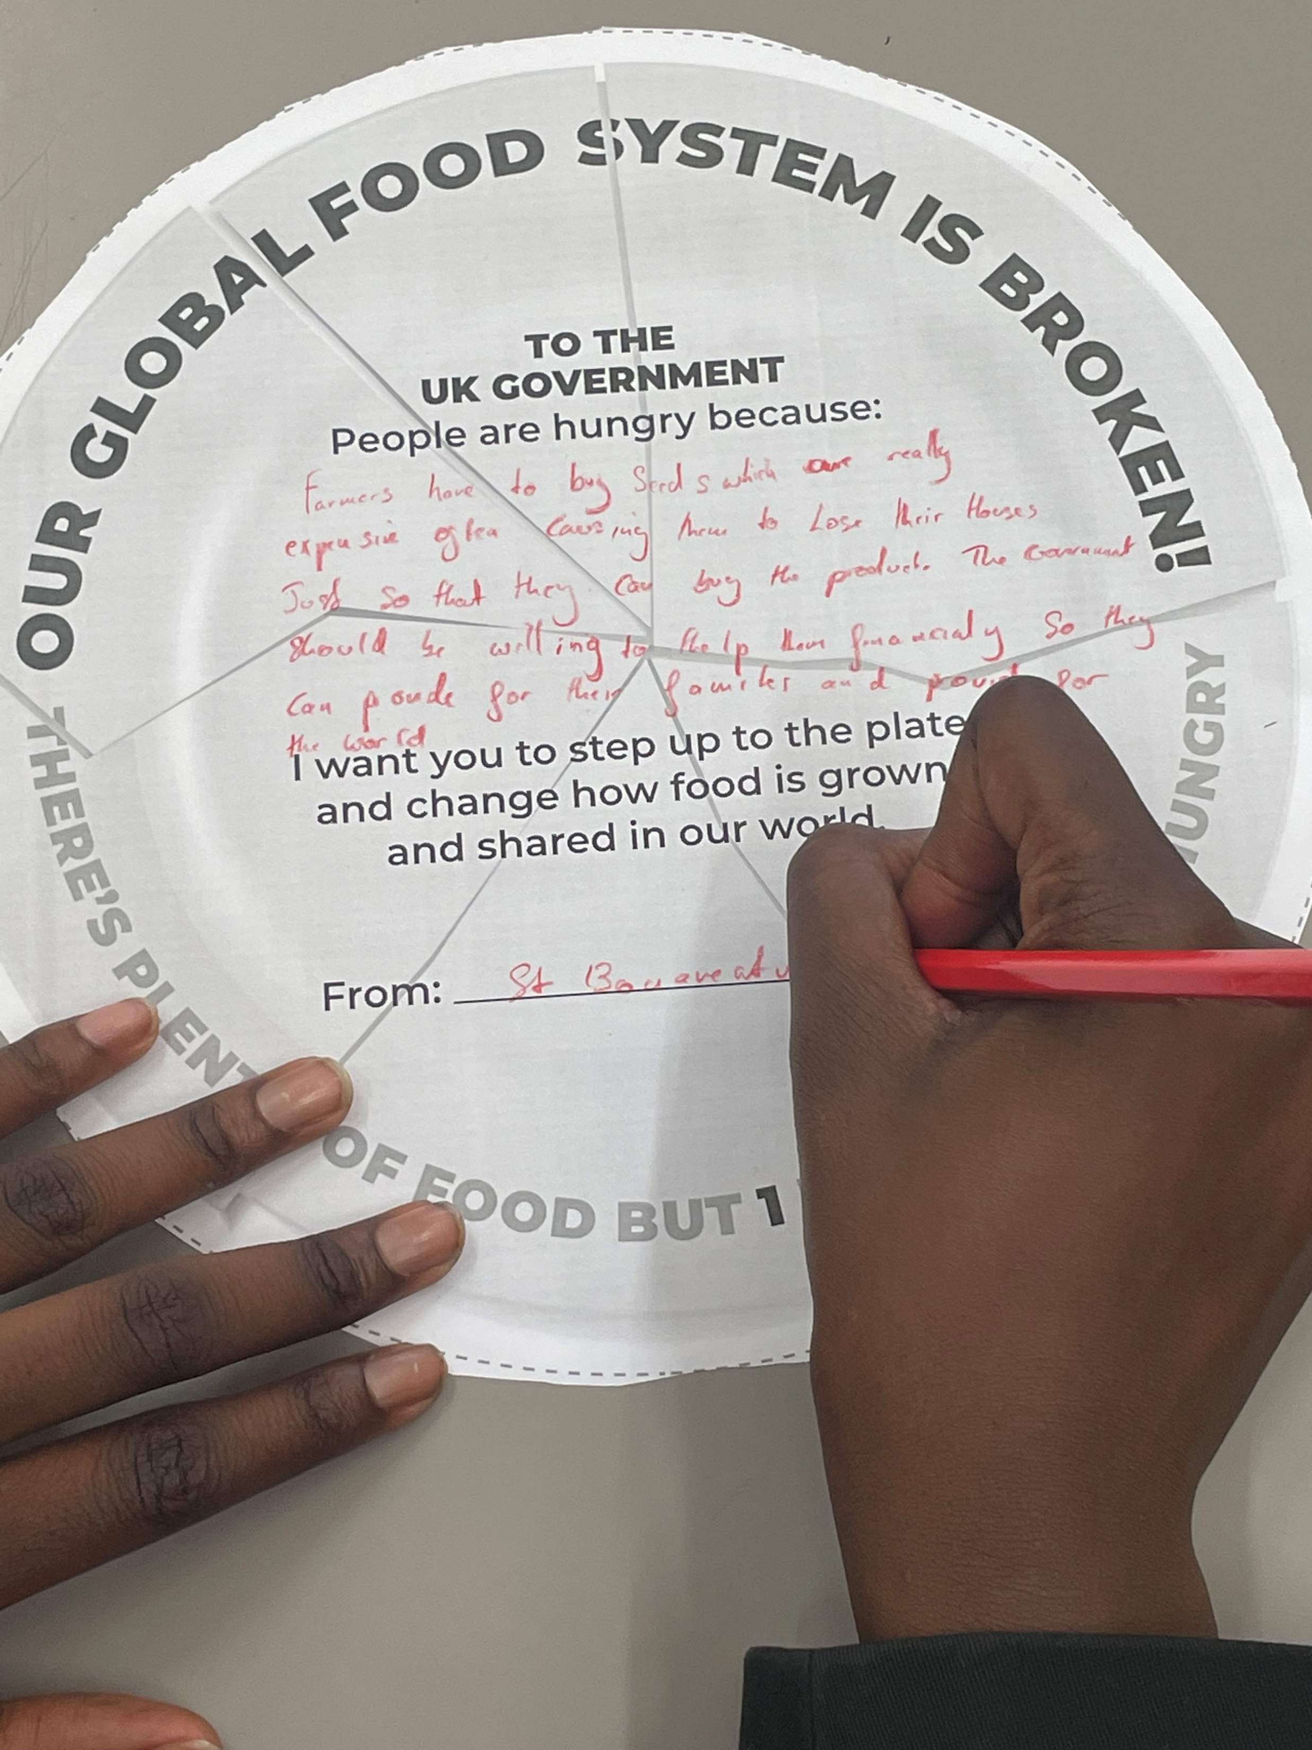
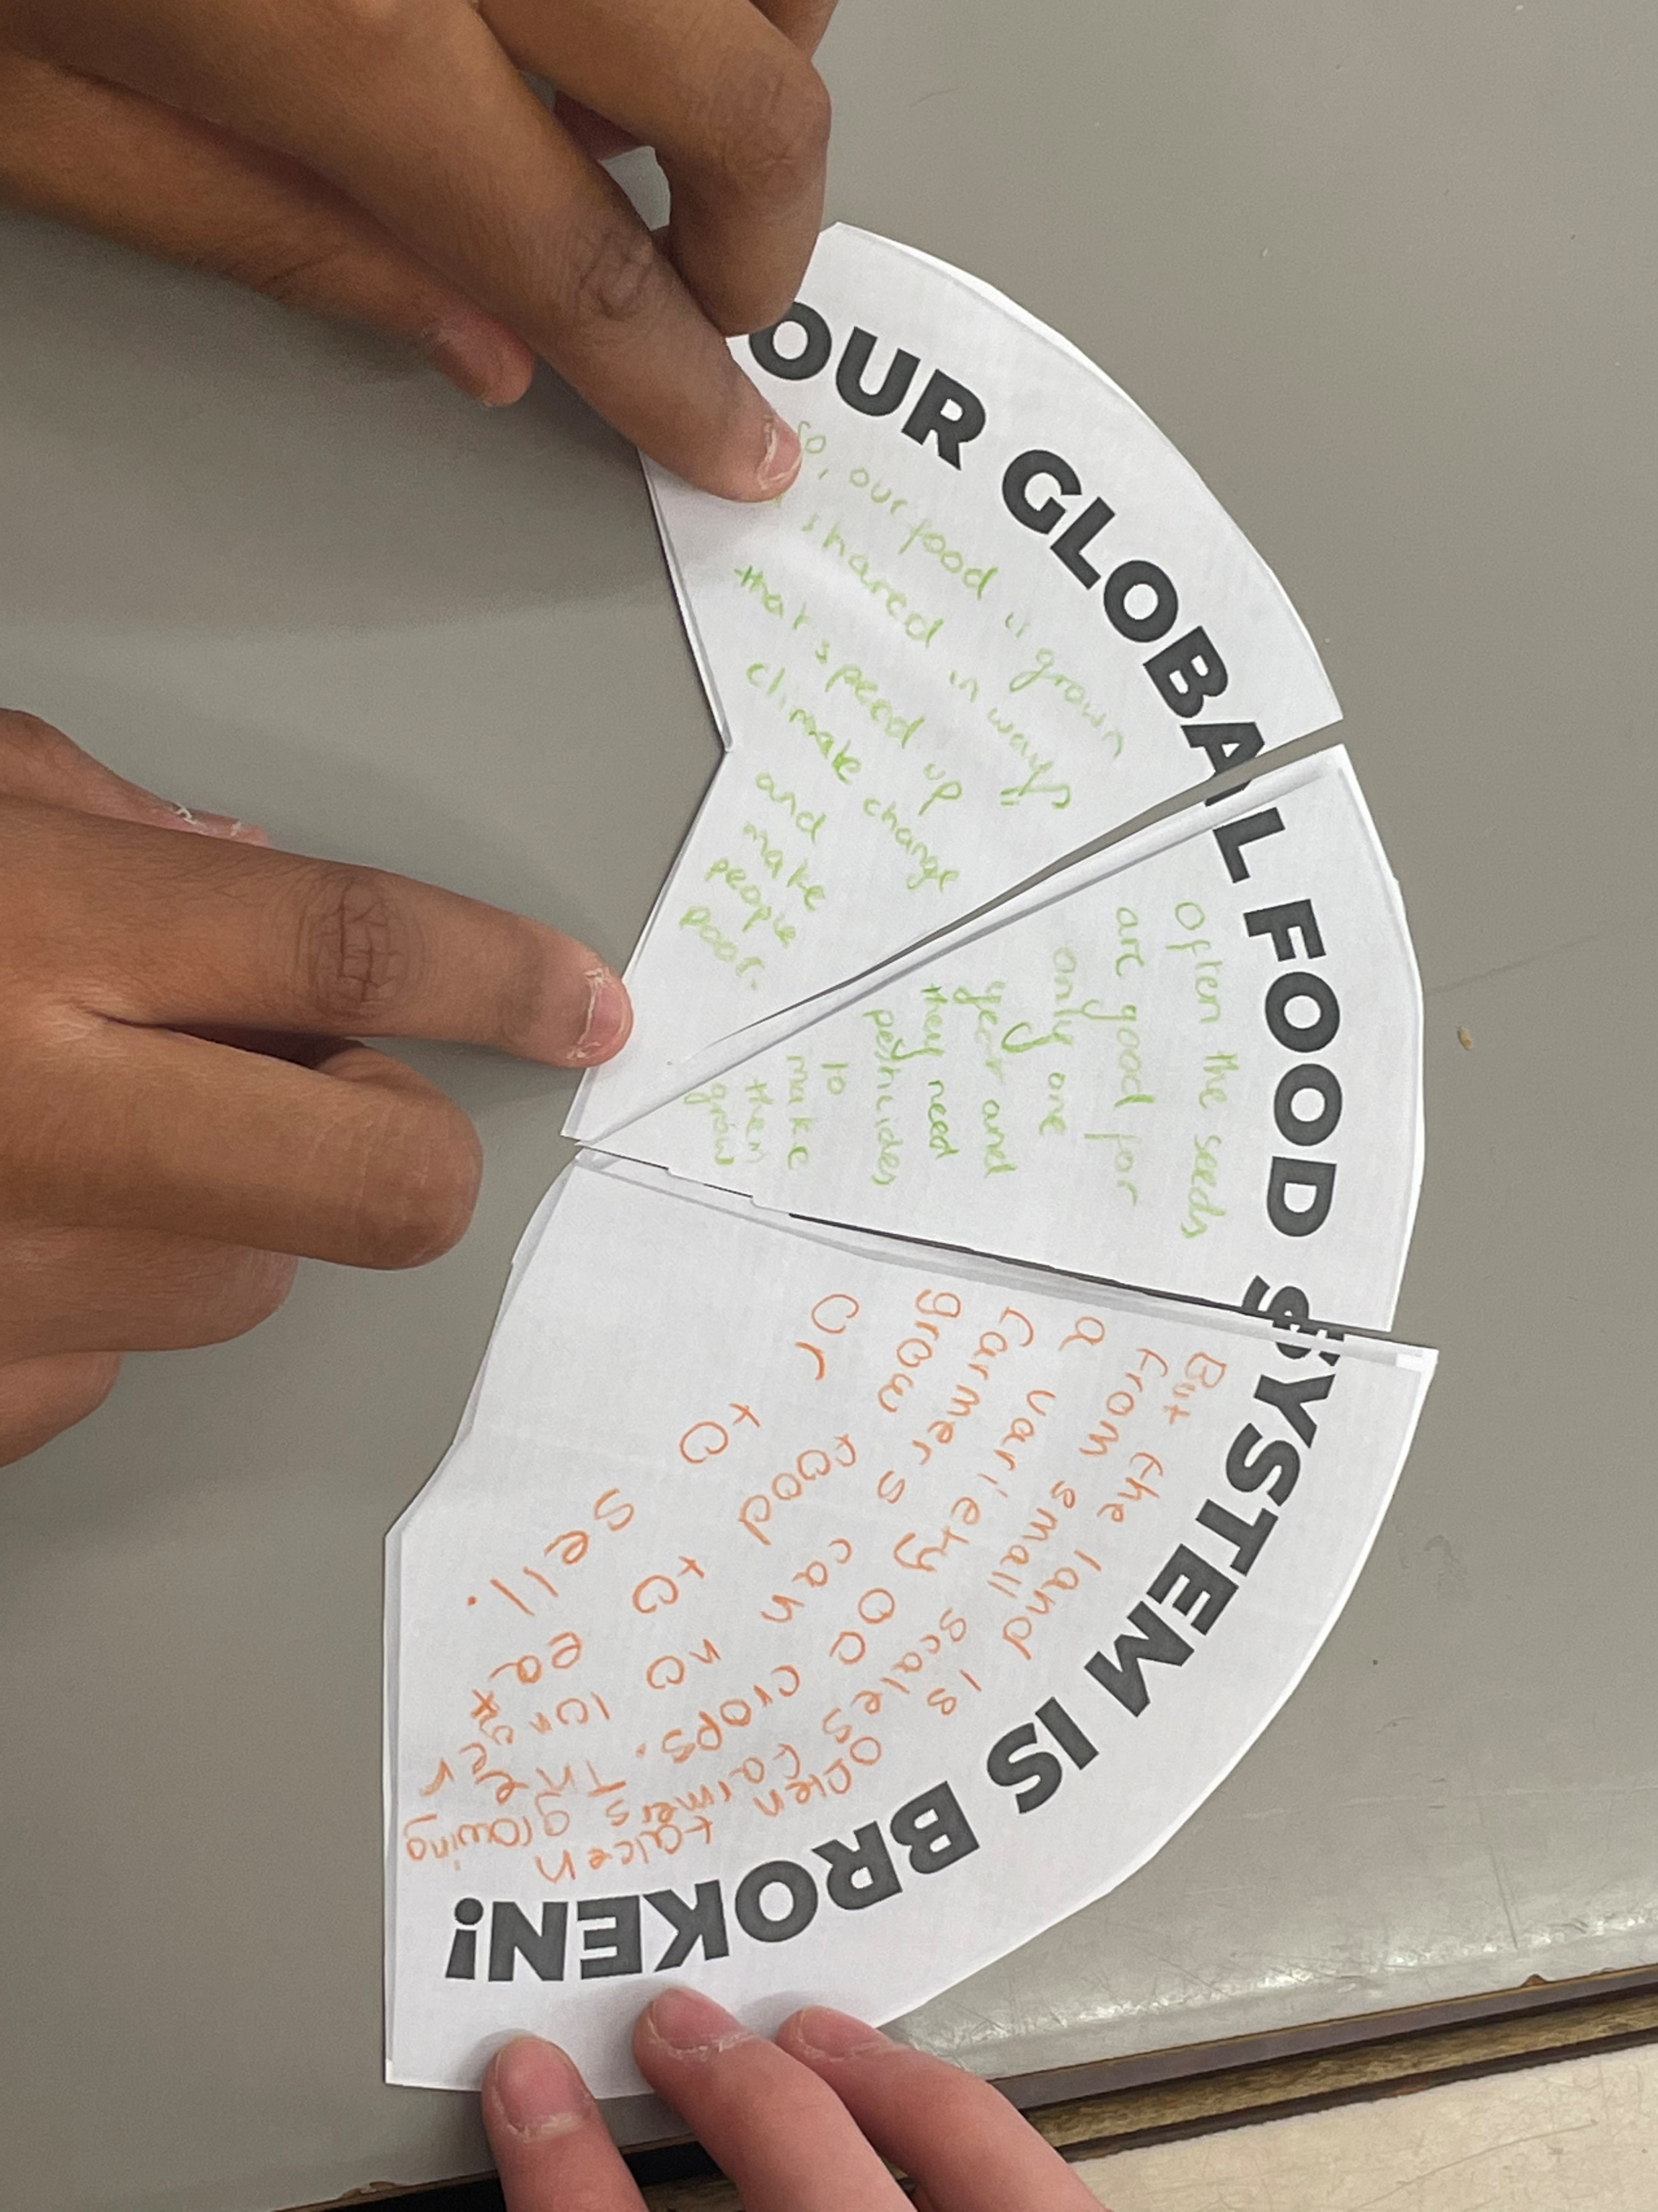
Take action!
Use CAFOD’s tem‘plates’ to tell our government to Step up to the plate and start to fix our food system.
Either write one thing you have learnt about why people are hungry
or, on an empty piece of broken plate, write your own message to the government.
Complete the form at cafod.org.uk/schools, then post photos of your plates tagging @CAFODschools or email to schools@cafod.org.uk.

Slide 21
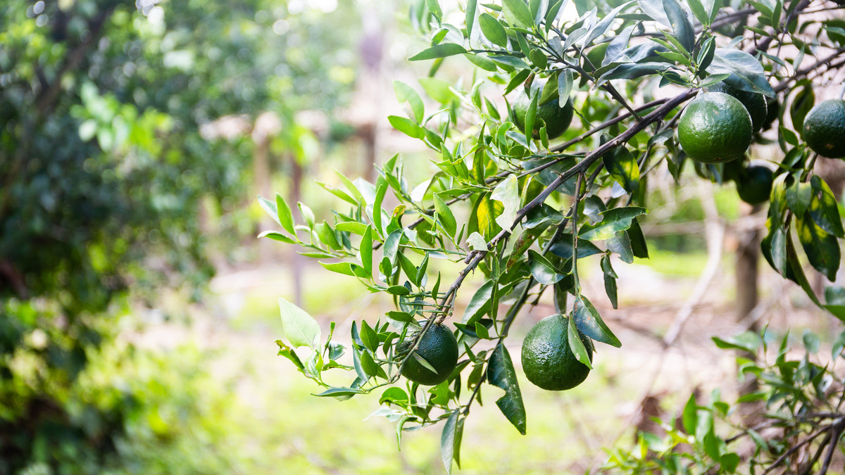
Jesus,
You understand what it is like to be hungry.
Teach us to have grateful and generous hearts.
Forgive us when we waste food
or don’t want to share.
You welcomed everyone to your table.
Remind us that all are invited to share the feast,
as one family,
who share one common home.
You fed the hungry crowds.
Open our eyes to the needs of others
and help us to follow your example,
of love and service.
You come to us as bread and wine.
Fill us with your kindness.
Give us the appetite and strength
to change our world for the better.
Amen

