Slide 1
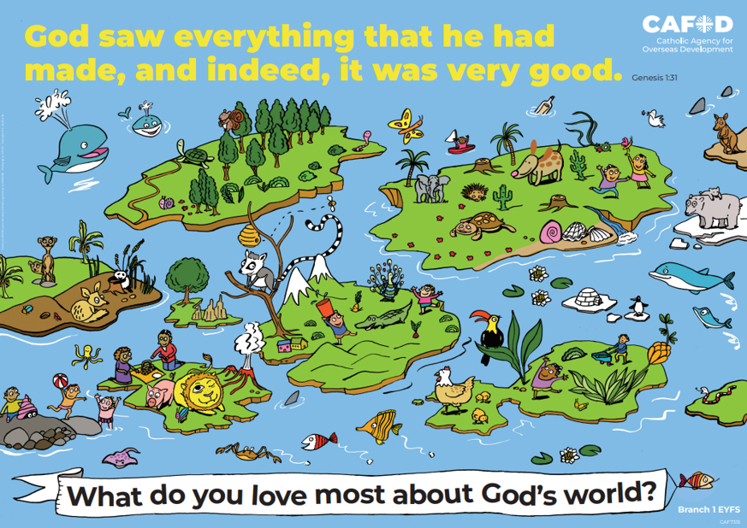
EYFS RED poster activities
Branch 1: Creation and Covenant
Order the RE CAFOD poster set
Notes:
Timings
This presentation has been designed to last for 10-15 minutes. It can be used as a stand-alone lesson or incorporated into a scheme.
Extension
Although this presentation was designed to simply engage pupils in discussion about key RED themes, the sessions can be developed in many ways. Some of the examples are included below:
Give pupils the poster (or a part of it) to discuss and annotate in groups
Provide pupils with their own A4 version of the poster to put in their own RE books (double page spread). This can be labelled in various ways, such as with references to scripture or Laudato Si’
Invite children to draw or list their own additions and suggestions to the poster
Offer children the opportunity to create their own poster, for example through artwork or through drama (creating freeze frames).

Slide 2
EYFS Year 1 Year 2
“God saw everything that he had made and, indeed, it was very good.” (Gen 1: 31) What do you love most about God’s world? | “We can all work together to protect the earth, our common home” (Based on Laudato Si’ 13) The world is God’s gift to us. How can we take care of it? | “We can all work together to protect the earth, our common home” (Based on Laudato Si’ 13) The world is God’s gift to us. How can we take care of it?
Creation (God, me, family) Stewardship Dignity (special, loved) | Creation Taking care of God’s world Laudato Si’ Pope Francis | Psalms Stewardship Caring for God’s world
EYFS | U1.1.2, U1.1.3, U1.1.4, U1.1.5, D1.1.1, D1.1.2, R1.1.3, R1.1.4 | U2.1.2, U2.1.3, D2.1.2, R2.1.2, R2.1.2
CAFOD poster
Themes
RED outcomes
Notes:
For teachers’ use only.
Note: The RED outcomes which are highlighted are most relevant to these CAFOD posters are highlighted in bold.

Slide 3
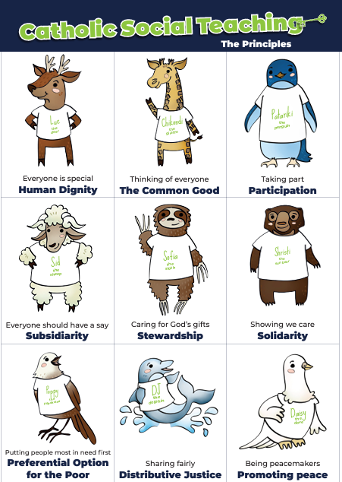
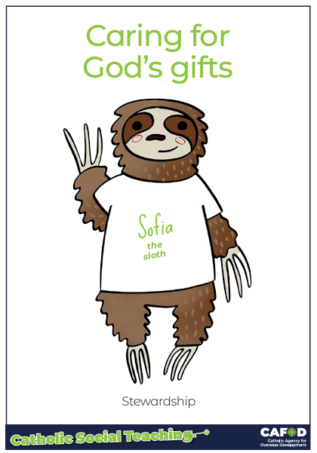
God’s gifts
Stewardship
This means:
Caring for all people
Caring for the world
.
Notes:
For teachers:
This gives a brief overview of CST which includes stewardship. These posters support CST and look more closely at stewardship and how we can be better stewards.
Catholic Social Teaching helps us to know how to treat each other and the world. One principle is ‘stewardship’. Sofia the sloth reminds us about Stewardship – it is about caring for God’s gifts.
This means:
Caring for all people
Caring for the world
Making things fair
Sharing with others
Looking after the poor and those in need
For teacher support for embedding CST throughout the school see:
https://cafod.org.uk/education/primary-teaching-resources/cst-pack-for-children

Slide 4
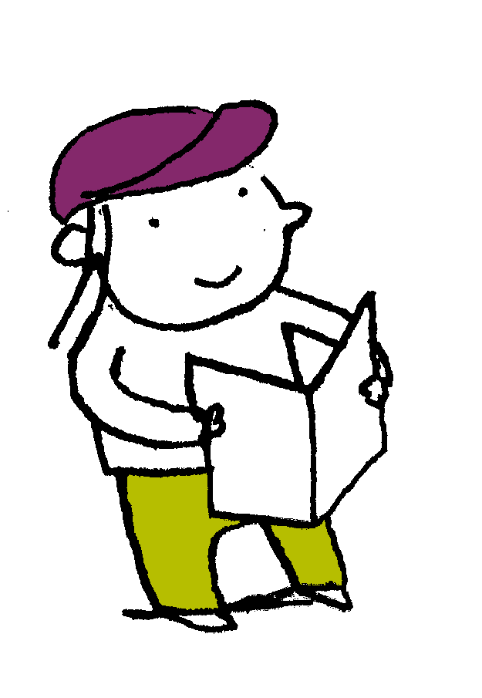
“In the beginning God made the heavens and the earth….God saw everything that he had made and, indeed, it was very good.” Genesis 1: 31
Scripture
Notes:
Read this piece of scripture before discussing the posters.
Optional: light a candle, play some gentle music and invite pupils to reflect on these words of scripture and what they mean. Read them from the Bible to demonstrate its importance and tell pupils that these words come from Genesis, the first book of the Bible.

Slide 5
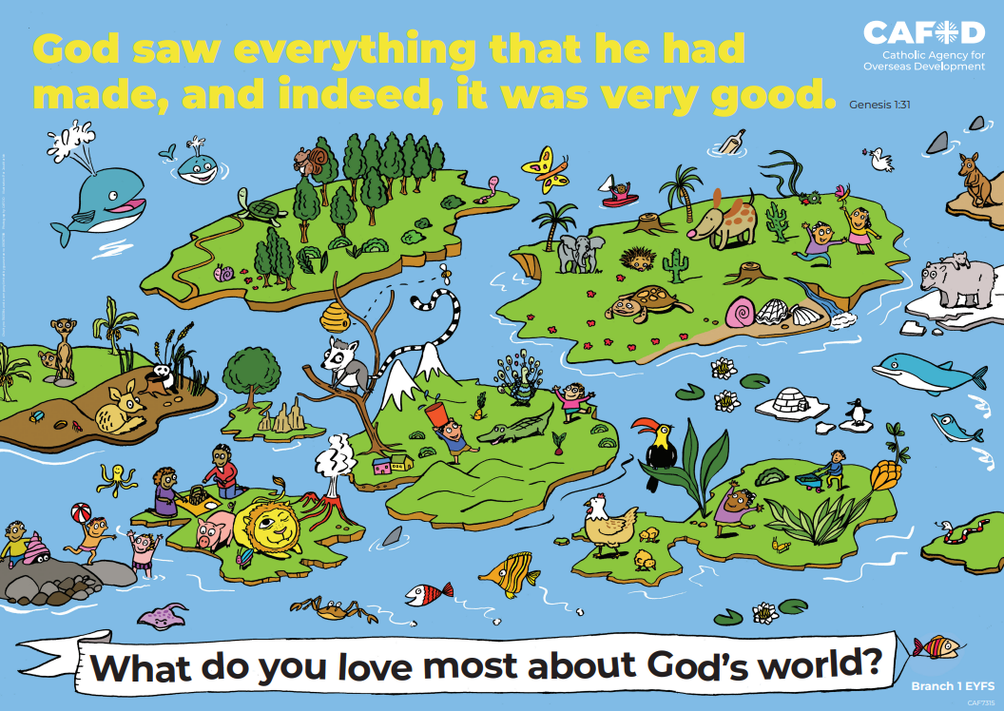
God’s world
Key words:
God me family loved
creation
Key questions:
What do you love most about God’s world?
What is good?
Notes:
Explain that you will be looking at this poster. Read through the key words you will be exploring and the key question(s) you will be answering. Ask pupils if they can recognise how this poster links to the words from the Bible they have just heard.
Other key words: dignity, stewardship

Slide 6
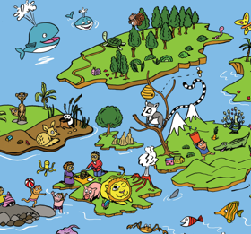
God’s world
I wonder….
What did God create?
Use the poster to help you.
Notes:
Look at the poster – Ask pupils questions such as:
What did God make? At first, encourage pupils to think about the bigger parts of creation: the land and sea, mountains, hills, rivers, desert…
Pupils might mention things from the poster like a lion, raccoon, squirrel, turtle, octopus, whale…

Slide 7
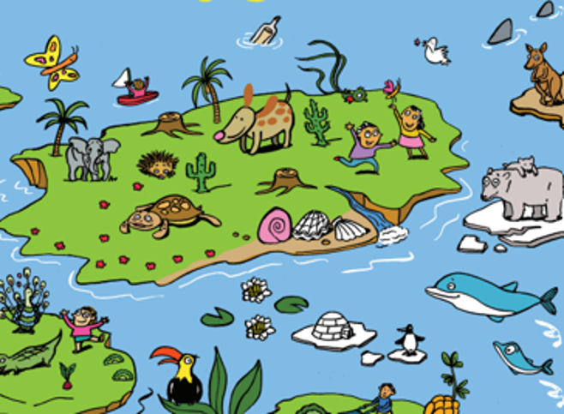
God’s world
What plants and animals can you see? We need them. We care for them.
Notes:
Suggested questions:
What plants can you see here (or remember from the previous slide)? (Tees, evergreen, palm trees, desert plants/cacti…)
What animals can you see? (butterflies, dove, toucan, penguin, kangaroo, turtle, reindeer, peacock, turtle, elephant, polar bears, crocodile, hedgehog,…)
Why do you think God was happy with what he made? (There are beautiful, interesting, fun, special things)

Slide 8
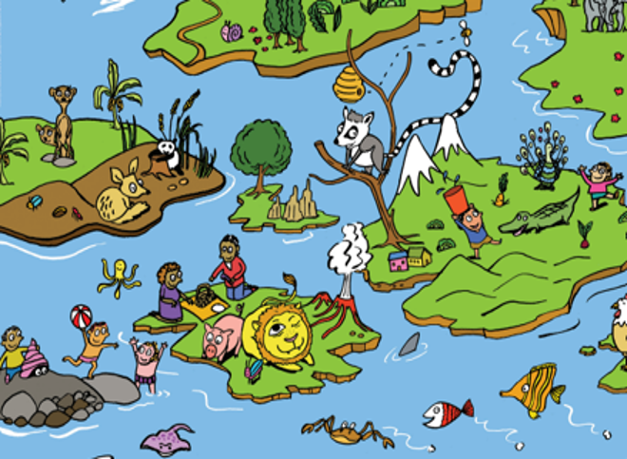
God’s world
What people can you see? God loves us. We are all special.
Notes:
Suggested questions:
What are the people doing? (playing, working, making food…)
How are they treating each other (kind, caring, helping, loving, working together…)

Slide 9
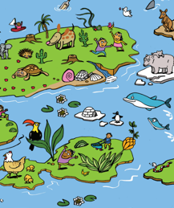
God’s world
What else can you see that God created?
I wonder….
Could anything else be added to the picture?
Notes:
Suggested questions:
Who/what might you add to the pictures? (For example: you, your family, friends, your pets, …)
Why do you think God was happy with what he made? (There are beautiful, interesting, fun, special things)

Slide 10
Stewardship
Key words:
God me family loved
creation
Key questions:
What do you love most about God’s world?
What is good?
Notes:
Review learning

Slide 11
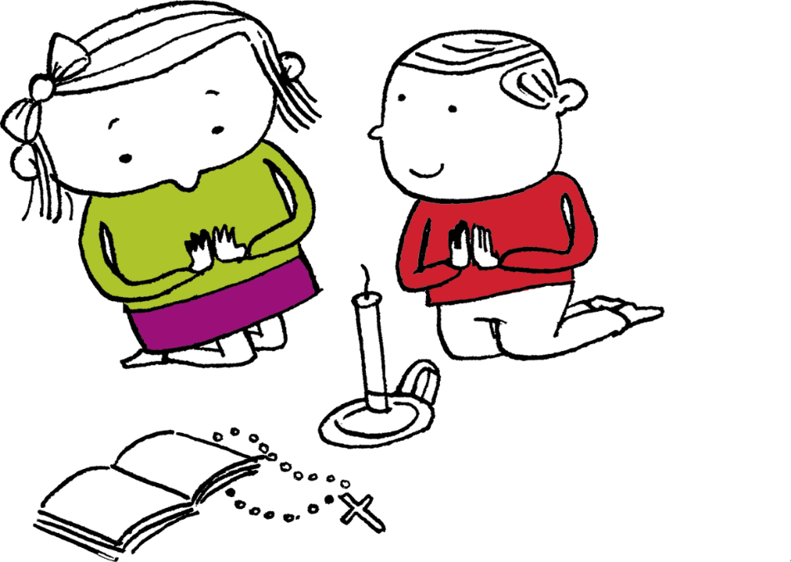
Let us pray
Thank you, God our father, For making the world. Thank you for all the good things and everything we love. Help us to take care of the world and other people. Amen

Slide 12
Order the RE CAFOD poster set

