Slide 1
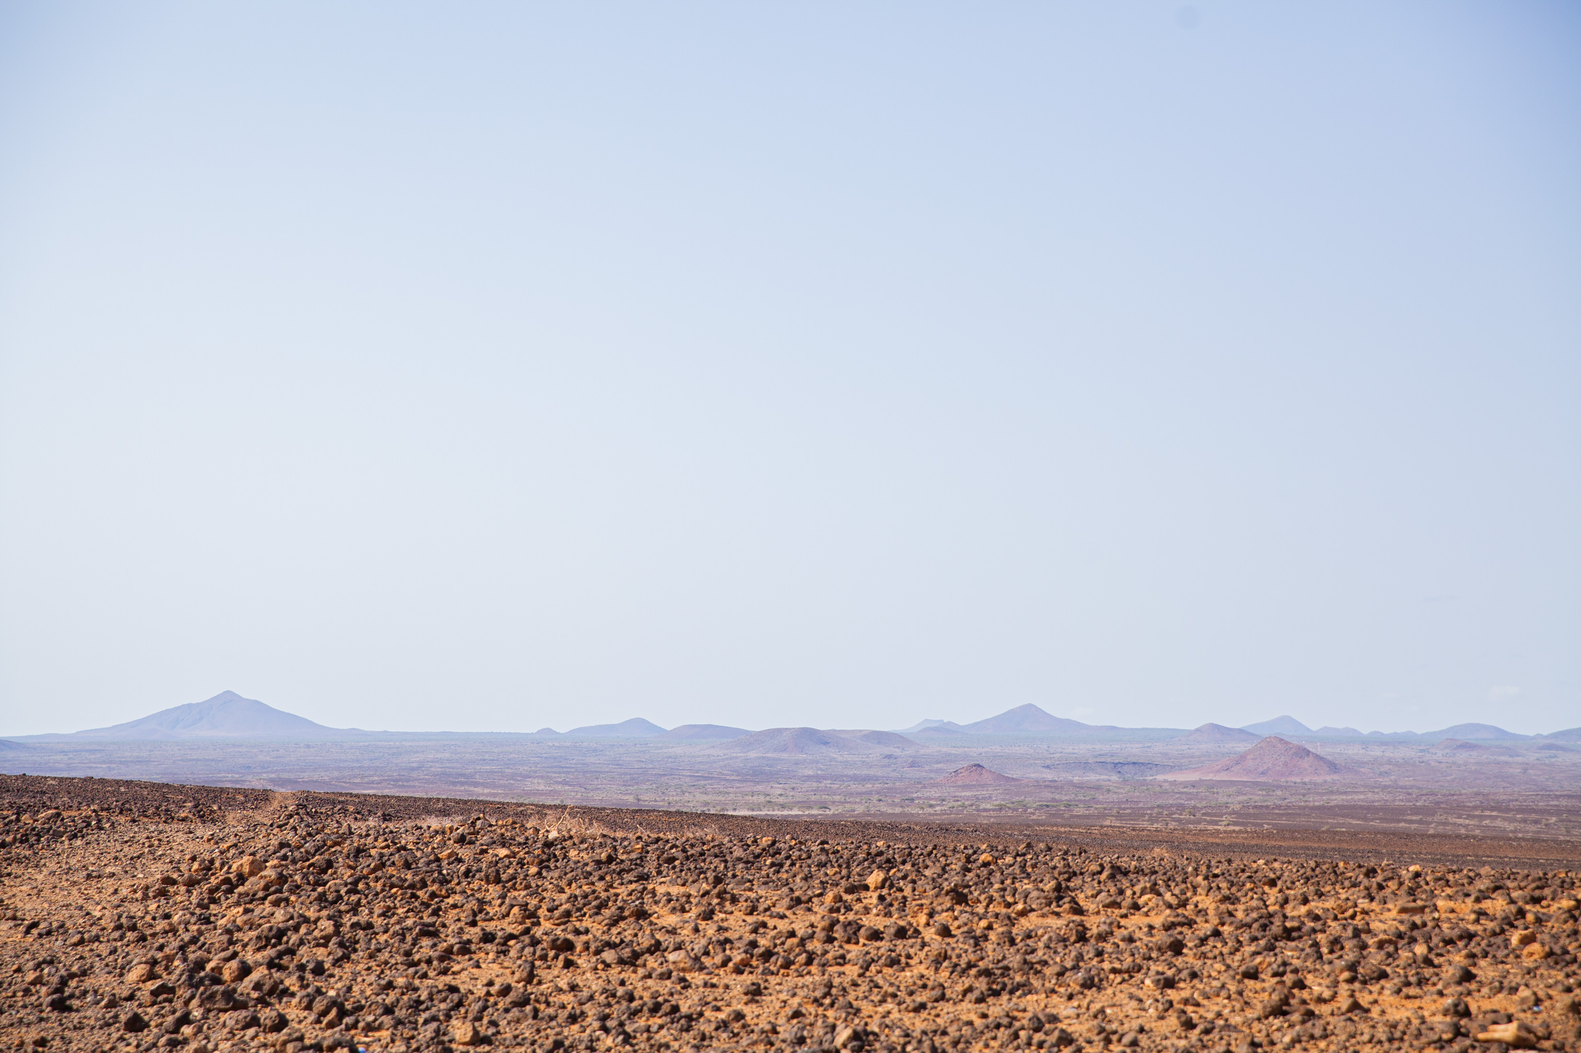
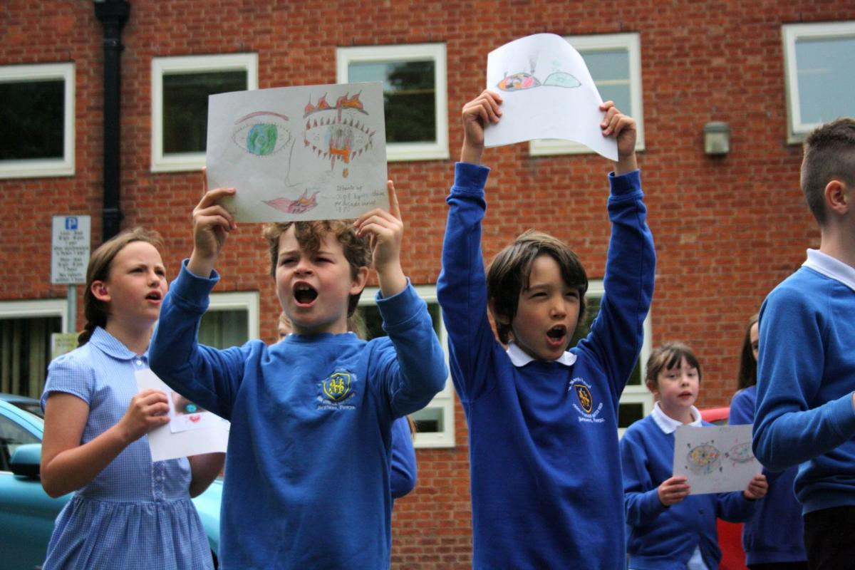
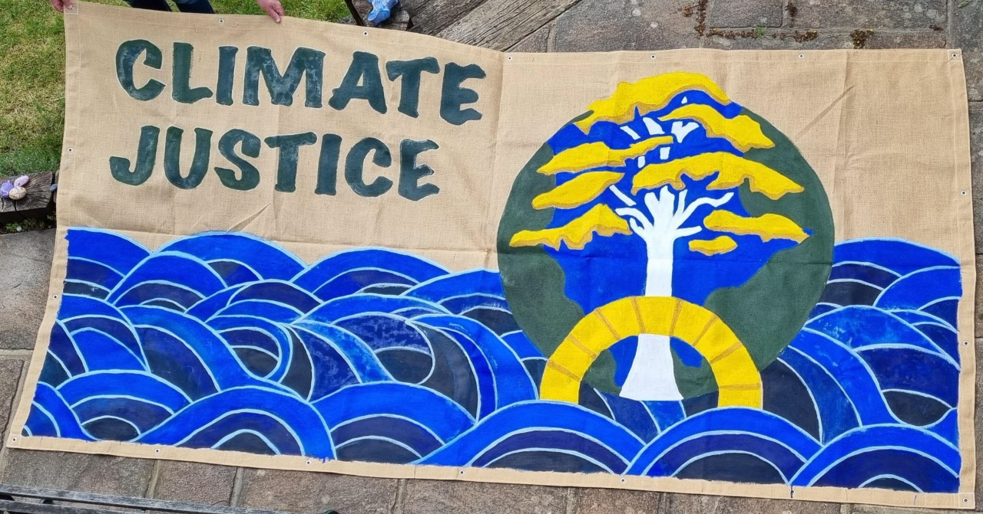
Get creative for climate justice!

Slide 2
Save the planet

Slide 3
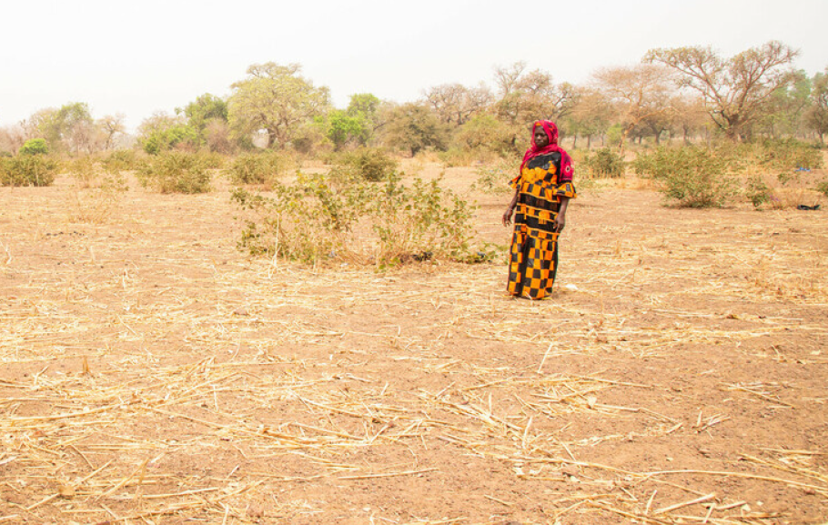
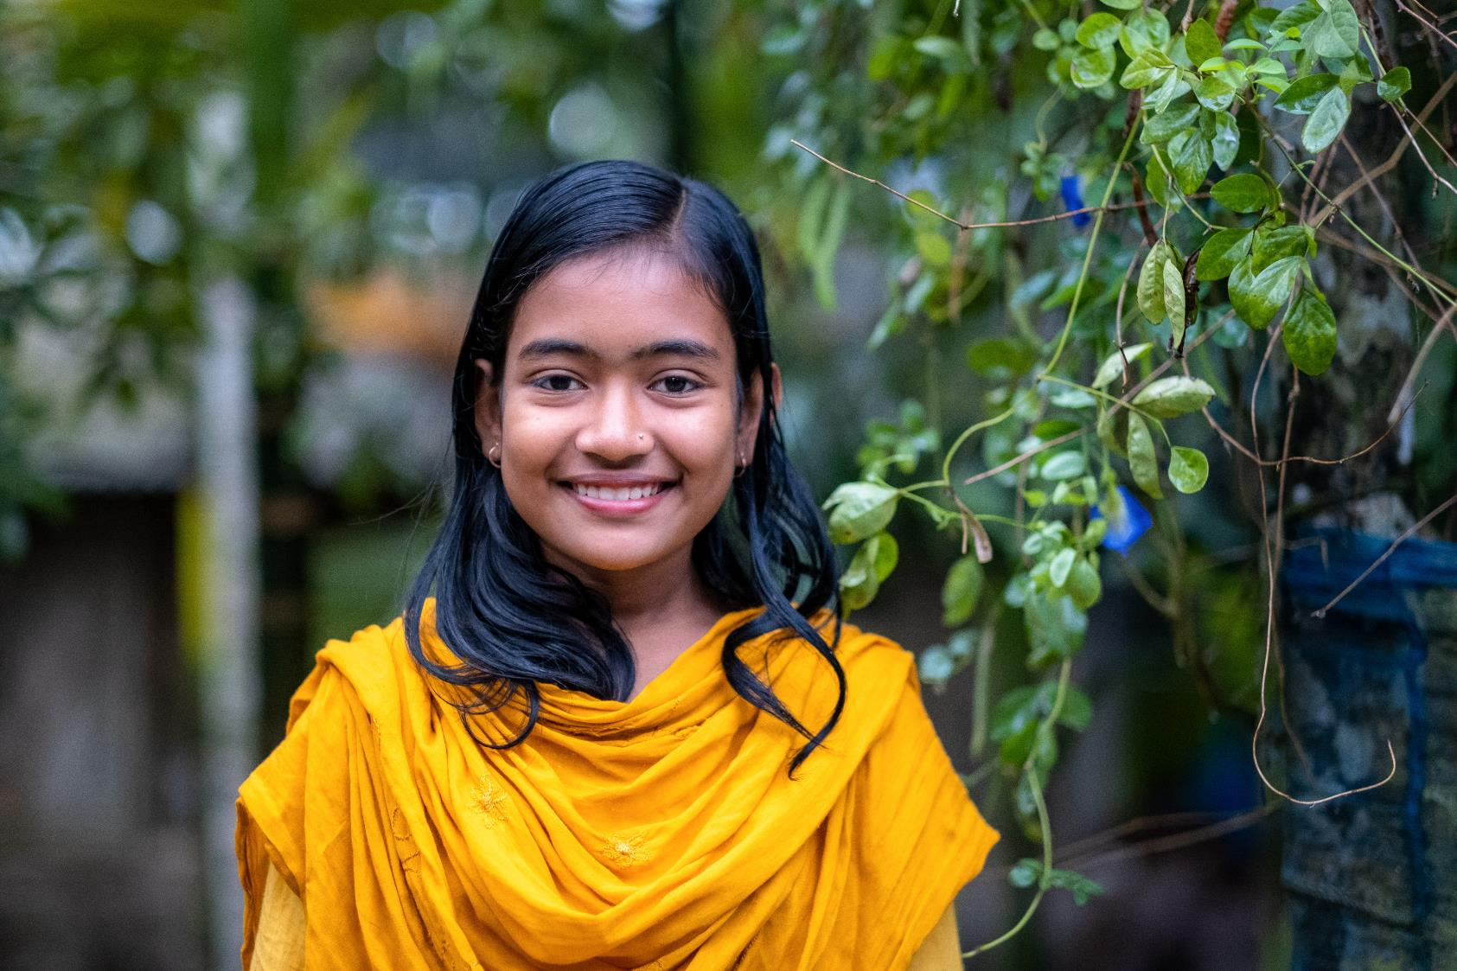
Our global neighbours
Notes:
Photos:
Burkina Faso, Gery Berbot/Oxfam
Bangladesh, Amit Rudro

Slide 4
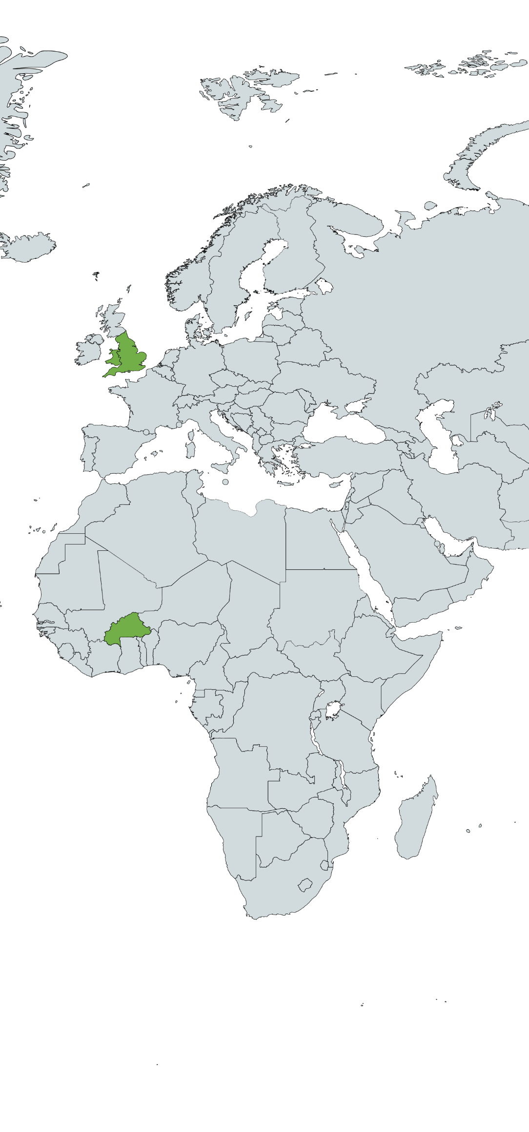
Burkina Faso

Slide 5

Bangladesh

Slide 6
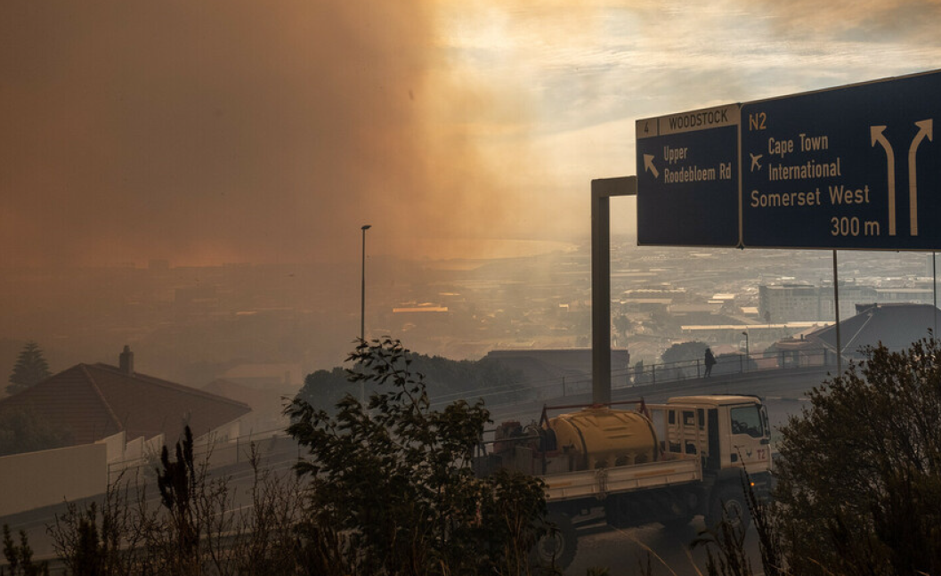
Climate justice
Notes:
Photo:
Tommy Trenchard/Oxfam

Slide 7
Climate justice
or
Climate change

Slide 8
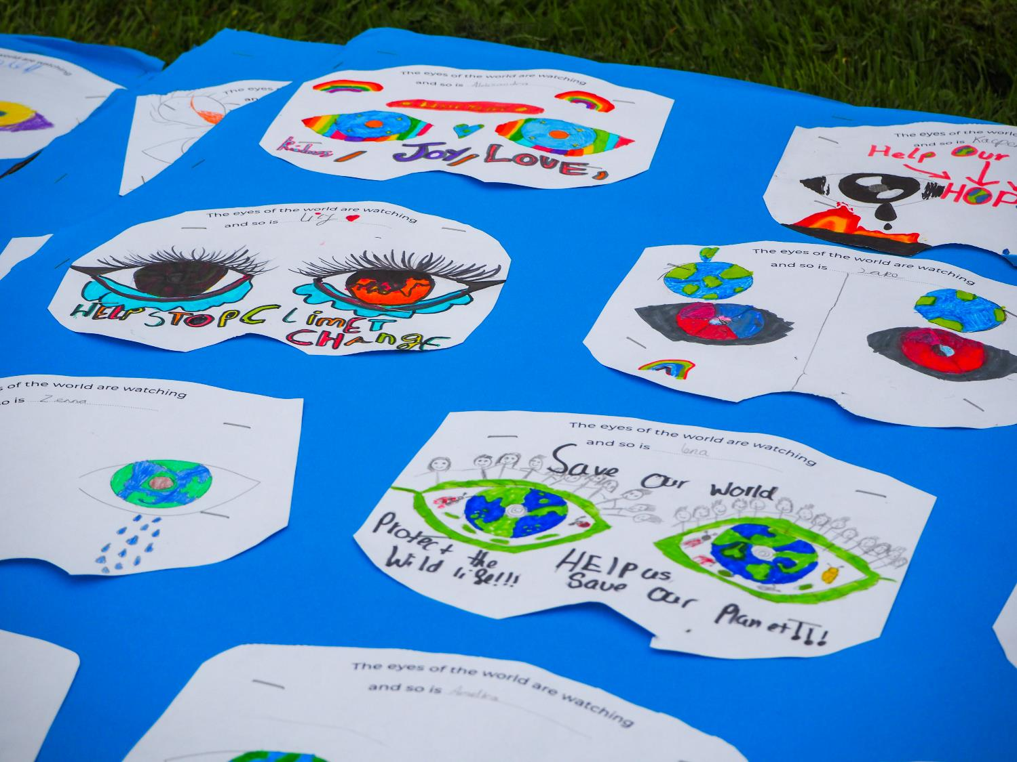
Get creative!
Notes:
Photos:
Robert Barkley Academy
Annie Bungeroth

Slide 9
Creator God,
Your world is a wonderful and beautiful place,
full of variety, full of wonder, full of life.
Teach us to care for the earth and
help us to build a world that is filled with your goodness.
Amen.

