Slide 1
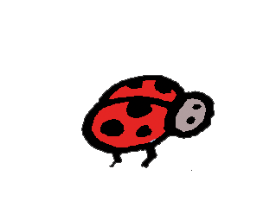
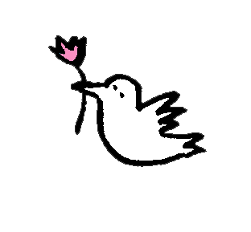
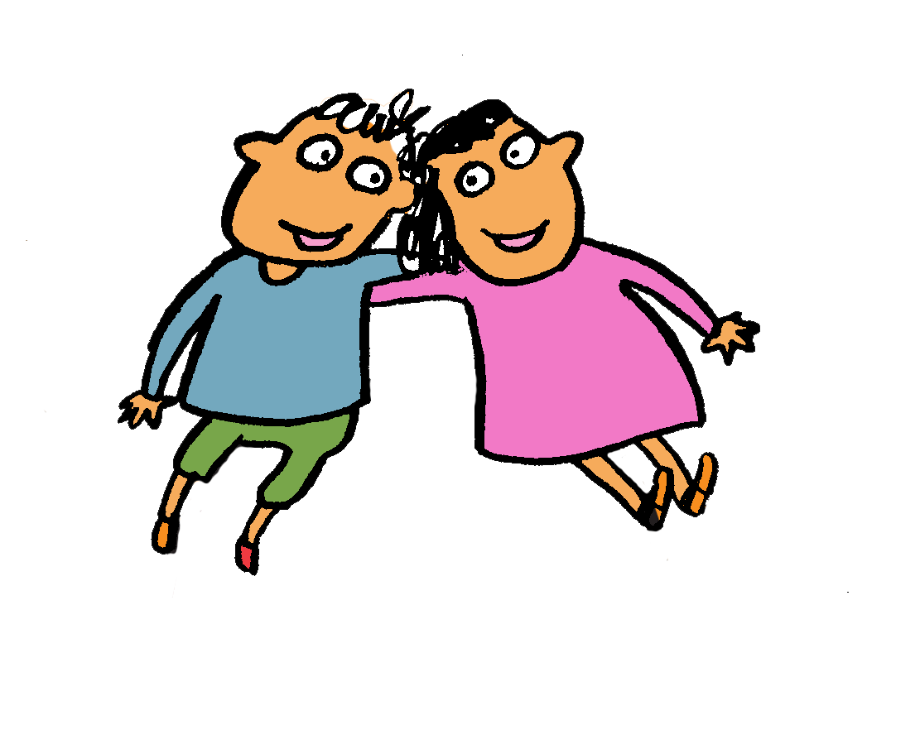
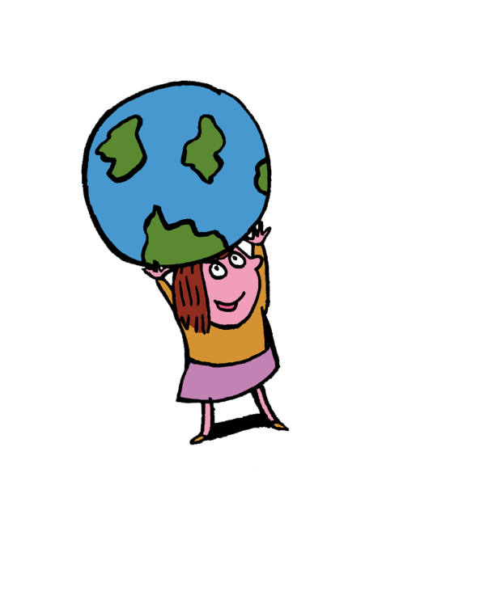
Year 1 Neighbours

Slide 2
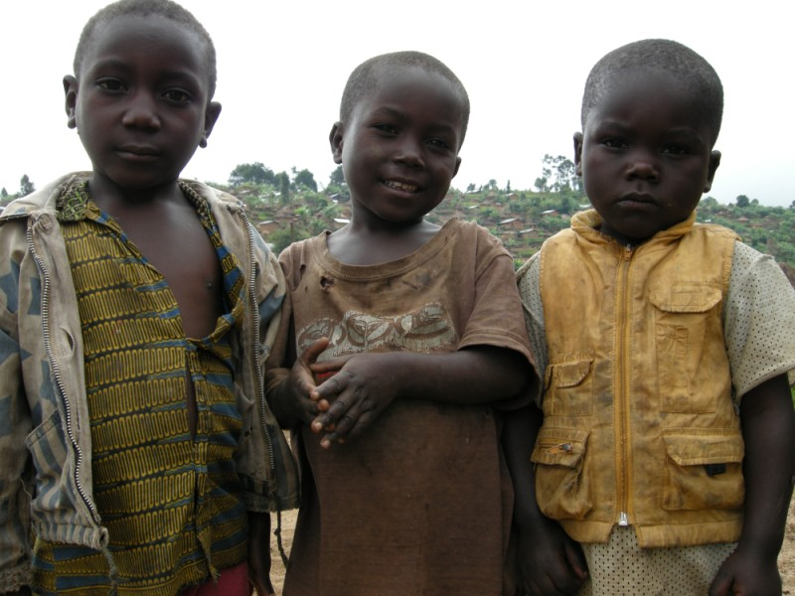
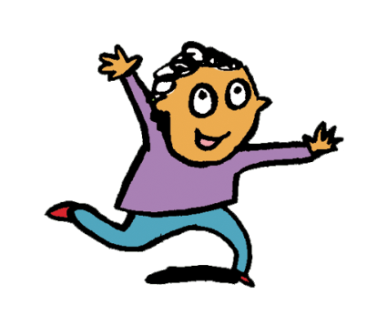
We live in the Democratic Republic of Congo.
It is a country in Africa.
We are neighbours.
Notes:
COUNTRY: Congo Democratic Republic LOCATION: Kanyabayonga
Children outside Kanyabayonga Parish

Slide 3
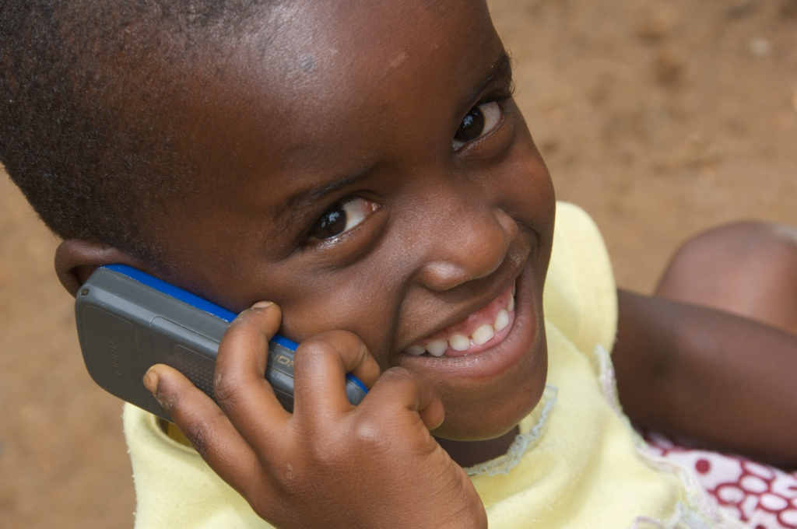
This is Benita.
She lives in Rwanda, in Africa. She is chatting on the phone.
Do you like talking on the phone?
Notes:
Discuss – do you like talking to your friends and neighbours on the phone?
COUNTRY: Rwanda LOCATION: Ruyenzi
Benita, 4yrs, using a mobile phone.

Slide 4
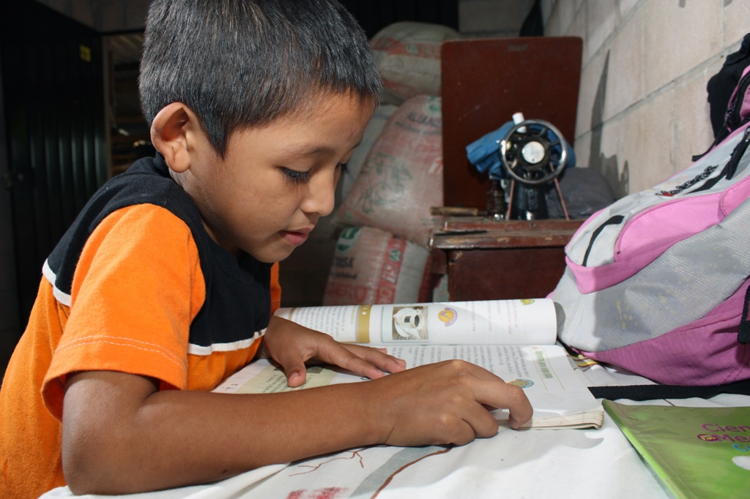
Walter lives in El Salvador.
He is doing homework.
What do you think he is learning about?
Notes:
Discuss what Walter could be learning - Maybe he is learning about his neighbours around the world too!
COUNTRY: El Salvador LOCATION: Puentecitos, Guaymango municipality, Ahuachapán department
Fidel Ramos Gonzalez's youngest son Walter Ovidio, 6yrs doing his homework.

Slide 5
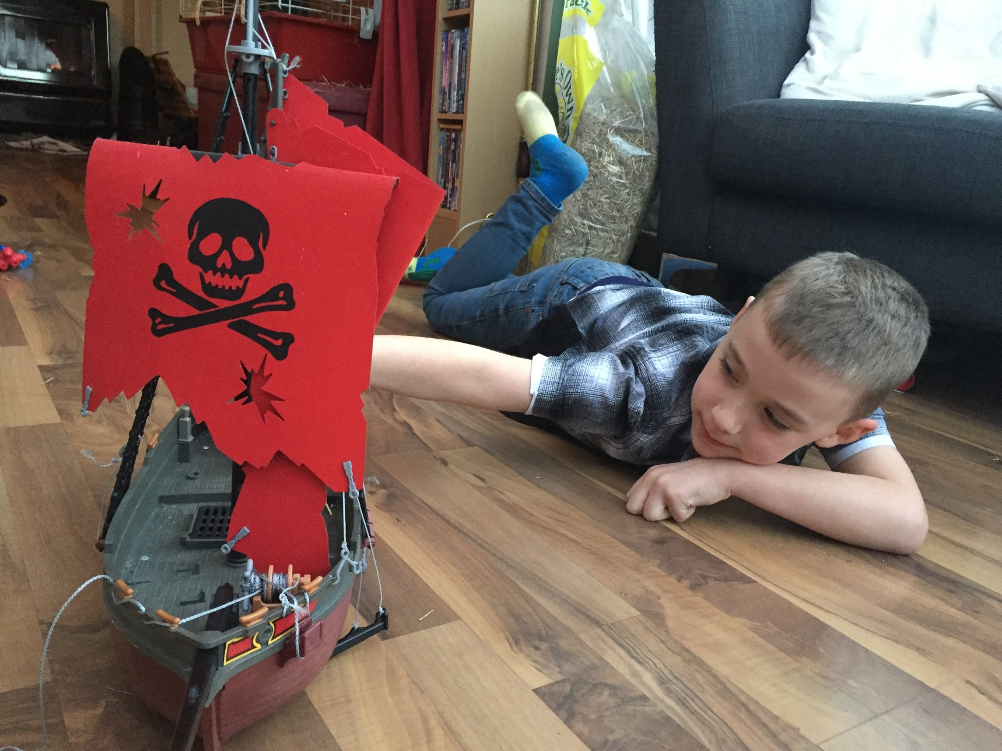
This is Aidan.
He is 6. He lives in the UK.
Aidan likes learning about neighbours near and far.
Notes:
COUNTRY: United Kingdom
Aidan, 7yrs, from Somerset.
Photo credit: David Brinn | CAFOD (2018)

Slide 6
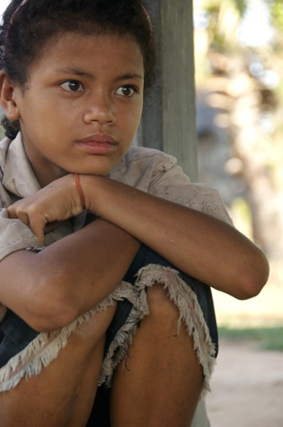
Reun lives in Cambodia.
It is a country in Asia.
He is thinking.
Maybe he is thinking about neighbours around the world, just like you!
Notes:
COUNTRY: Cambodia LOCATION: Samrong Village, Seam Reap
Reun Rak, 10yrs, Ean Poise's nephew. The family is supported by Banteay Srei.

Slide 7
Some neighbours live close to us.
Some neighbours live far away, like the children you have learnt about today.

Slide 8
Tell someone at home about the neighbours around the world you have met today.

Slide 9
Photographs by: Laura Donkin, Annie Bungeroth, Claudia Torres, Kate Stanworth Illustrations: Per Karlen

