Slide 1

cafod.org.uk
Notes:
This presentation is for anyone (CAFOD staff or volunteers or supporters or others) who wants to introduce and encourage groups in parishes, schools or other Catholic communities in England and Wales to take up the livesimply award challenge.
The livesimply Award is an opportunity for a Catholic parish, community or school to live out the livesimply principles of living more simply more sustainable and more in solidarity with poor communities.

Slide 2
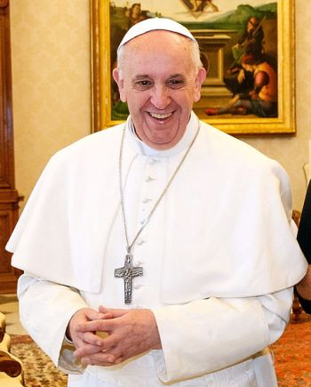

Pope Francis inspires us to livesimply
In Laudato Si’ Pope Francis invites us all to “work with generosity and tenderness in protecting this world which God has entrusted to us”.
Notes:
Pope Francis in his document Laudato Si’: Care of our Common Home, he asks everyone to work to protect the earth our common home.
This challenge can be addressed by the livesimply award.

Slide 3

Our challenge
“All Catholics are called to act…Catholics of richer lands must play their part to help development. They should be in the forefront of those who fight to build a better world, based on justice and equality.”
Pope Paul VI, On the development of peoples, para. 81
Notes:
The livesimply principles were first developed out of another Pope’s contribution to Catholic Social Teaching. Pope Paul VI wrote On the development of peoples in 1967.

Slide 4
Key message from On the Development of Peoples
God calls us to look hard at our lifestyles and to choose to live SIMPLY, SUTAINABLY and in SOLIDARITY with those who live in poverty.
In this way we can help create a world in which human dignity is respected and everyone can reach their full potential. This would be true progress, worth more than economic growth alone.
Notes:
We asked some theologians from this country to reread Populorum Progressio and to focus on what the key message was…they felt it was this….
Live simply was not just a CAFOD initiative….
Popolorum Progressio, on the Development of Peoples a key piece of Catholic Social teaching written by Pope Paul VI in 1967 was not just about economics but about wholistic development.
And out of this grew the Livesimply principles which led to the livesimply campaign movement and network. And out of this grew the livesimply Award.

Slide 5
Why should Catholic parishes and schools do the livesimply award?
To support Pope Francis in his call to protect the planet and recognise our global interconnectedness
Recognition for the work the parish or school is doing already
Breaking down barriers and working together on a common endeavour
To achieve more of an impact collectively
To show leadership in the Catholic community
Notes:
There are many reasons to undertake the livesimply award.
Taking up Pope Francis’ challenge to work for justice peace and caring for creation.
Recognising all the work our communities are doing.
Bringing the parish or school community together.
Achieving more by working together and showing leadership in the Catholic community.

Slide 6
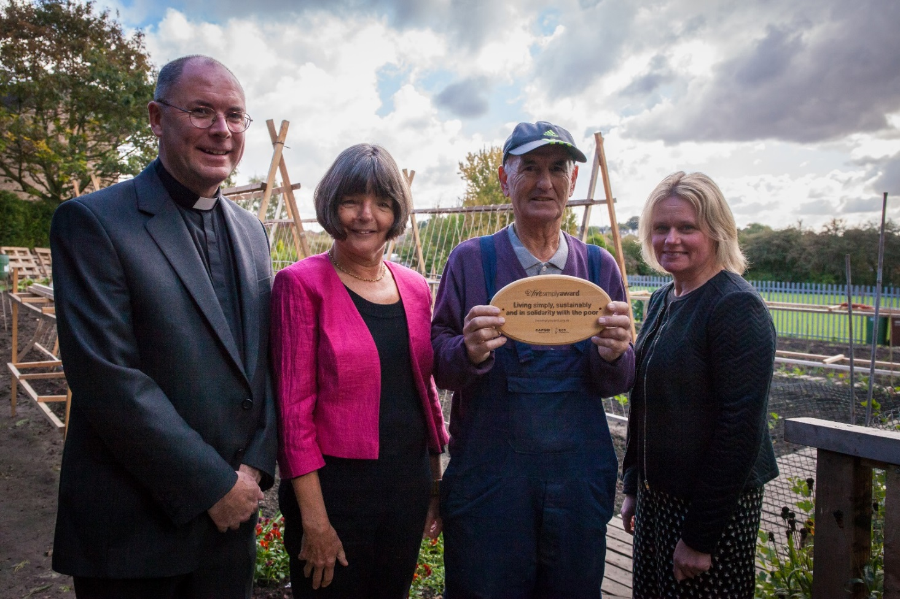
St Benedict’s parish in Leeds with their livesimply plaque
Notes:
And St Benedict’s Garforth in the Leeds diocese, like so many livesimply parishes, have internalised the key principles living more simply, sustainably and in solidarity with poor communities.
Trish in the pink jacket is the coordinator. She has also given talks and supported other parishes nearby in their livesimply challenges and she has become a livesimply assessor.

Slide 7
Who is organizing the livesimply award?
CAFOD
Supported by the livesimply network which includes the National Justice and Peace Network (NJPN) and a number of religious congregations.
A parallel award to Eco-church award for Protestant churches organised by the Christian Environmental organisations A Rocha and supported by Tearfund and Christian Aid.
Notes:
The livesimply award was created and is administered by CAFOD as a contribution to Catholic parishes and schools in England and Wales.
It is supported by the Justice and Peace Movement and many religious congregations. Protestant churches have a parallel scheme call Eco-church. In Scotland and Ireland, the parallel award is Eco-congregation.

Slide 8
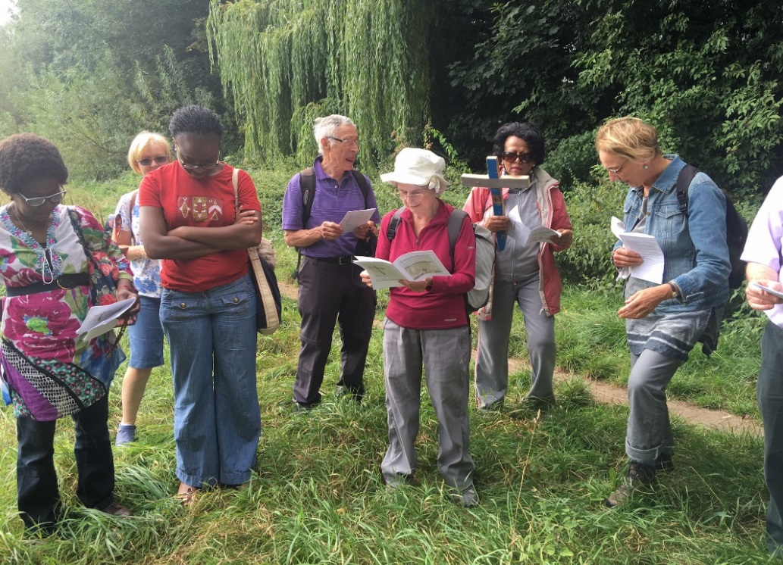
Potential benefits for your community
Nurture for our spiritual lives
Strengthen friendships
Support for taking practical steps
Help to play our part in big issues
Connections with wider community
Notes:
Working together on the livesimply award can bring parishes and school communities together.
It can nurture for our spiritual lives, strengthen for the bonds of friendship, support those taking practical steps and help us to play our part in tackling the big issues while making connections with the wider community.

Slide 9
Four simple steps
If in a parish, get the support of your parish priest. In a school, ask your headteacher to support. Sign up as a livesimply organiser. Set up a livesimply group.
Do a self-assessment to help create a livesimply action plan - three significant actions and six supporting ones. Register by sending CAFOD your action plan.
Put your plan into action!
Apply for the Award by contacting CAFOD when you are ready for assessment.
Notes:
There are four simple steps.
First, get your leader to support.
Then self-assess and put together a plan. When CAFOD receives the plan you receive a livesimply registration certificate.
Put your plan into action.
When you have done it, contact CAFOD to arrange an assessment visit. Two livesimply assessors will visit you to find out what you have accomplished.

Slide 10
1. Sign up
Start by visiting cafod.org.uk/livesimply
Get inspired by a film of other livesimply communities
Sign up and download the livesimply action plan form
Join the livesimply e-group and CAFOD campaign update to receive information
Use some of the livesimply resources including a livesimply talk and PowerPoint
Order copies of the livesimply guide and livesimply prayer to enthuse others in your community
Notes:
https://cafod.org.uk/Campaign/How-to-campaign/Livesimply-award
The livesimply page of the CAFOD website has a number of resources to use.
You can also sign up and join the livesimply e-group. You will receive monthly email updates, but you can also use the e-group for support and information from the rest of the group.
Make sure to watch the video of other livesimply communities and think about using and adapting the short talk and PowerPoint to involve the rest of your community.
Order copies of the livesimply guide and prayer cards.

Slide 11
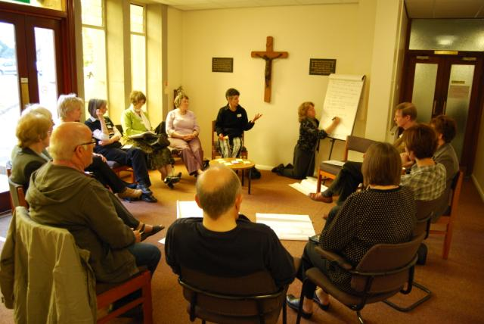
2. Self-assessment and registration
Reflection and worship
Practical
Reaching out
Notes:
Start by undertaking a self assessment. Get a group of your community together to brainstorm all that you are already doing to live simply, sustainably and in solidarity with poor communities.
You may discover that you are already doing some excellent things that could help you qualify for your award.
Look at how you already organise your reflection and worship.
What practical actions do you do every year?
How does your community reach out to its members and the wider community?

Slide 12
3. Develop your action plan
Of the 100 livesimply ideas, which five does your parish already do?
Which three significant actions under each heading do you think it might undertake?
Notes:
Make sure to download and use the 100 livesimply ideas from cafod.org.uk/livesimply
Hand out photocopies of the downloaded 100 livesimply ideas.

Slide 13
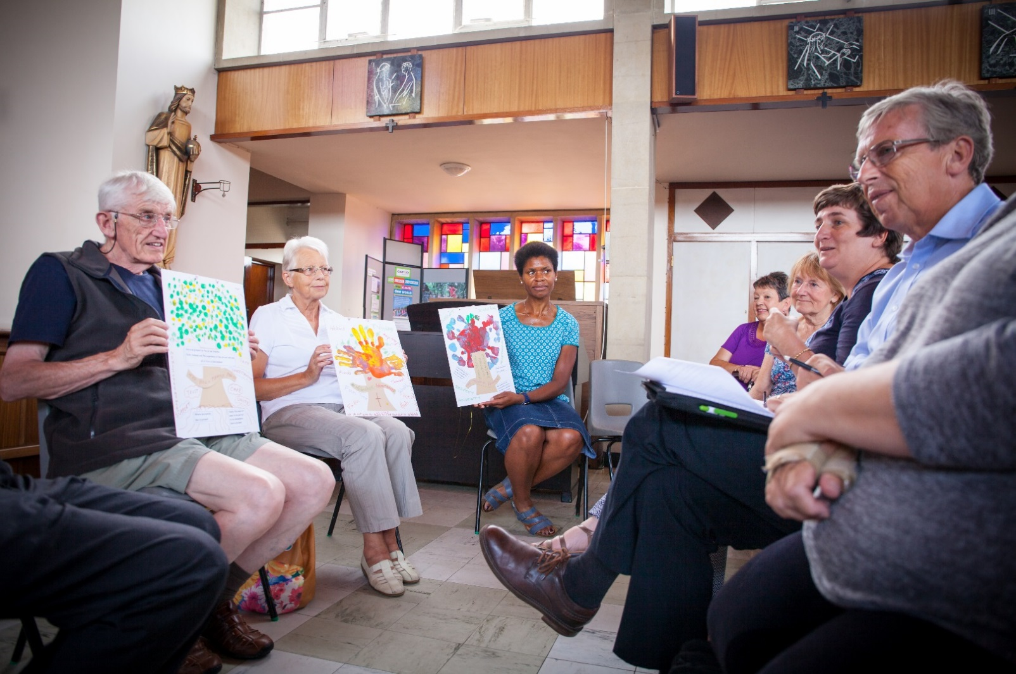
4. Assessment
Notes:
When you have done what you said you would in your action plan, contact CAFOD to organise two livesimply assessors to visit your parish. They will listen to all that you have accomplished.
This is a good moment to begin to plan your livesimply celebration.

Slide 14
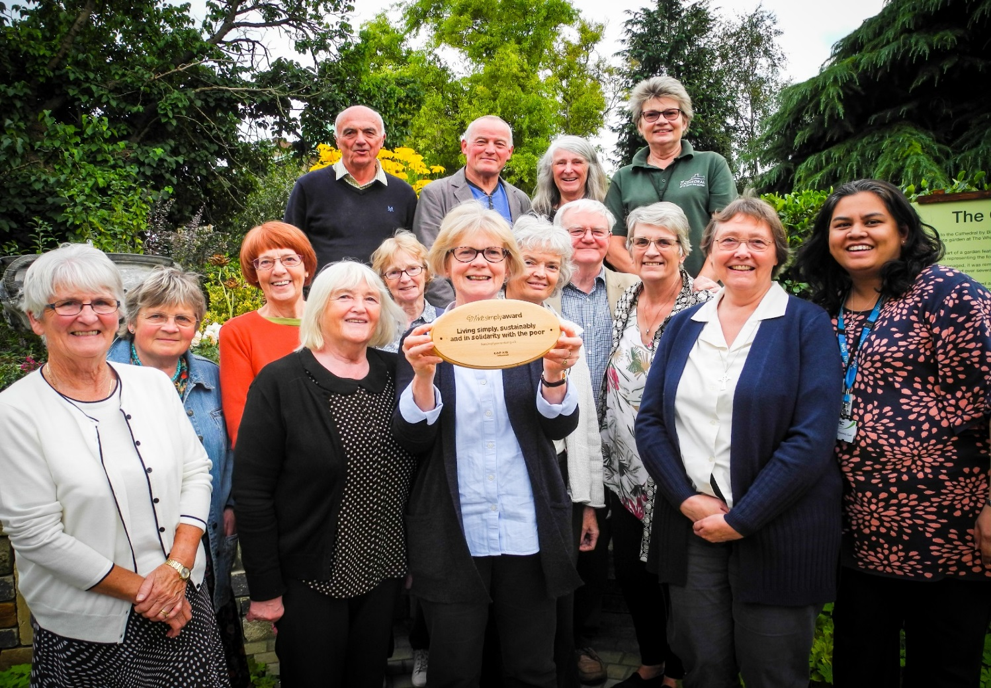
In Cathedrals…
Notes:
Here are representatives from many of the groups that came together to work on the livesimply award at St John the Evangelist Cathedral, Norwich. This is the second livesimply award cathedral.

Slide 15
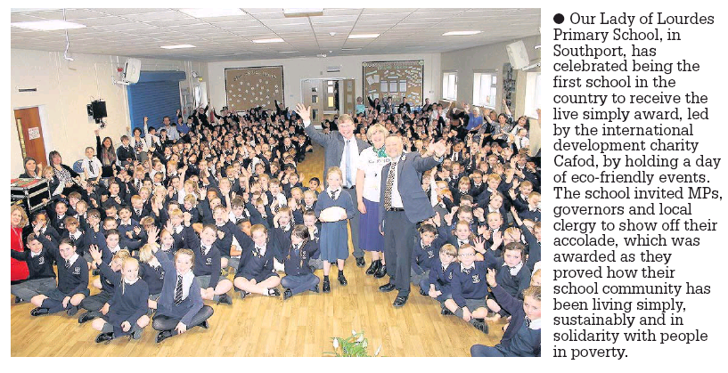
In Schools…
Notes:
Our Lady of Lourdes primary school in Southport is the first school to receive the livesimply award.

Slide 16
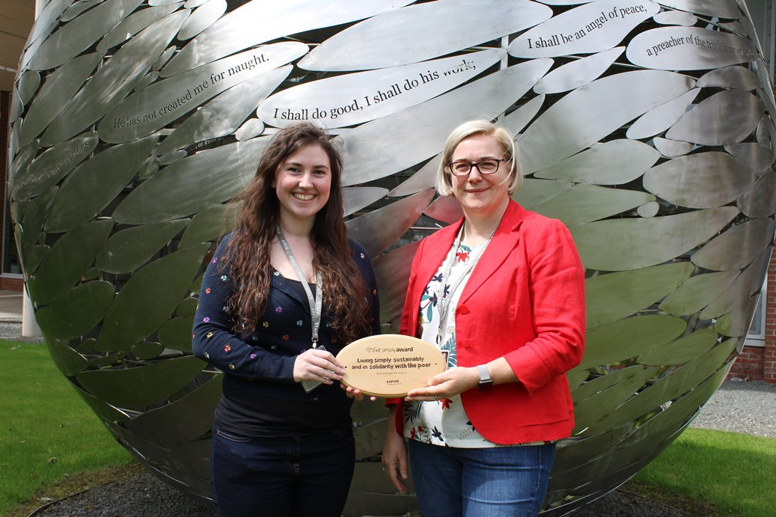
Newman University Birmingham
Notes:
Charlotte Bray as part of her CAFOD Step into the Gap programme worked through the Chaplaincy of Newman University but with involvement of the whole university to gain a livesimply award.

Slide 17
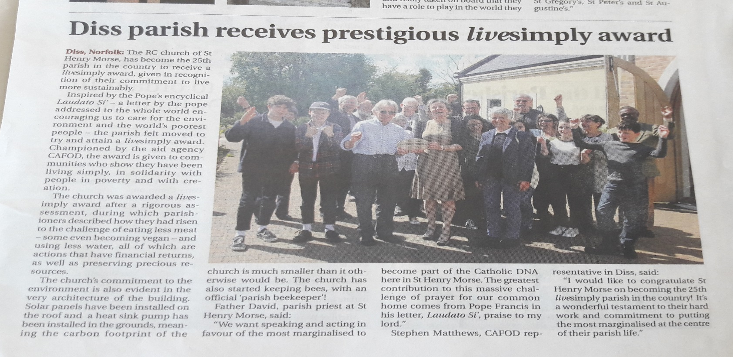
In parishes…
Notes:
St Henry Morse parish in Diss, Norfork was the 25 livesimply awardee.
They received press coverage both locally, in the diocese of East Anglia, and in the national Catholic press which inspired many others.

Slide 18
Livesimply award progress so far
Over 250 parishes or schools are now signed up
Over 70 parishes, schools and a university now have the award
Over 150 parishes and schools are now registered as livesimply which means over 80 communities are actively working on the award!
A number of parishes and communities and school are waiting to be assessed.
Notes:
There a lots of parishes and schools now signed up and lots of livesimply organising happening.

Slide 19
Breakdown of 73 Awards
56 Catholic Parishes including three cathedrals: Brentwood, Norwich (East Anglia) and Middlesbrough
12 Catholic Primary Schools
2 Catholic Secondary Schools
1 Catholic Special School
1 University – Newman in Birmingham
1 Catholic Organisation Knights of St Columba Council 92, Southend-on-Sea

Slide 20
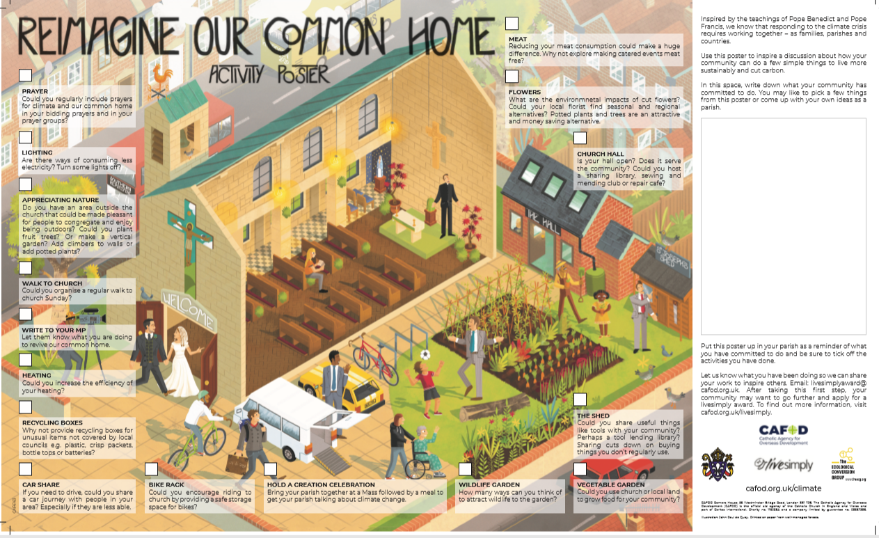
Livesimply Parish Activity

Slide 21
THANK YOU

