Slide 1
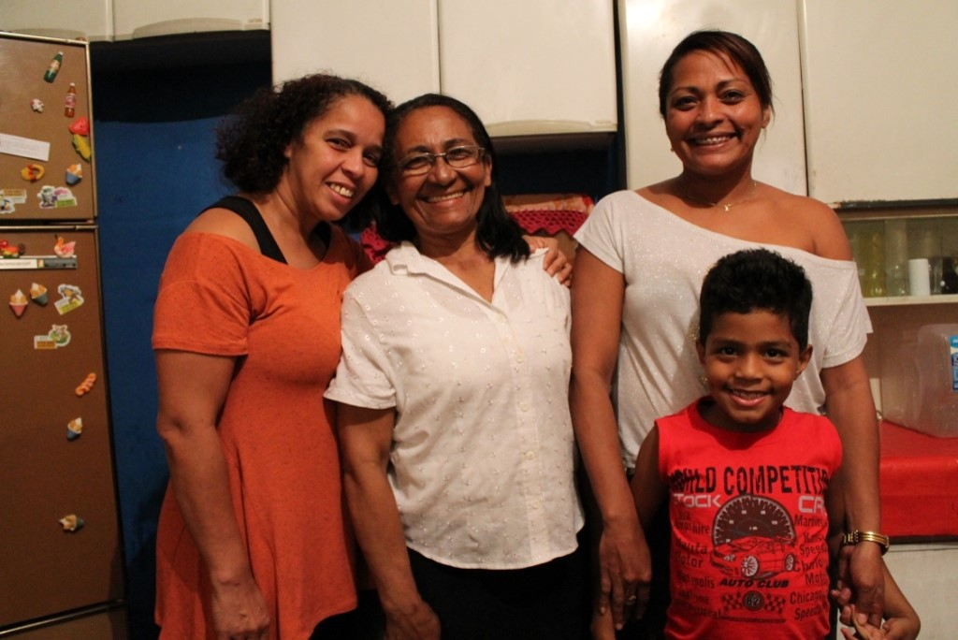
God’s love
Notes:
Prayer 1: God’s love
This picture shows: a family who live in a favela in São Paulo
Location: São Paulo, Brazil
Picture credit: Shea Bradley/CAFOD

Slide 2
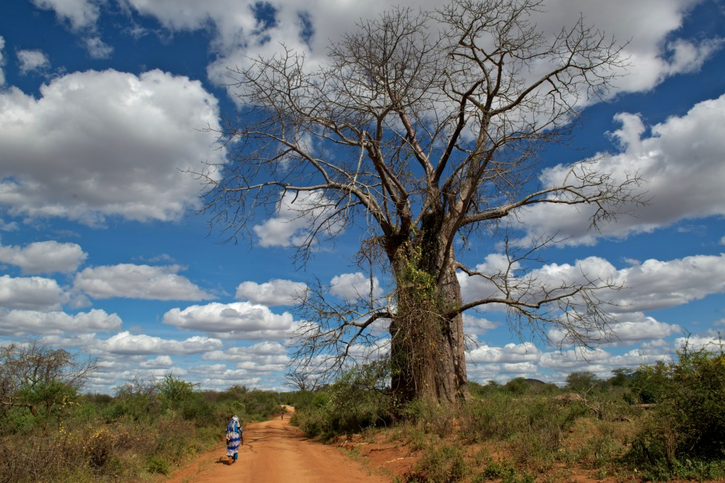
God’s love
Notes:
Prayer 1: God’s love
This picture shows: a baobab tree
Location: Ikanga, Diocese of Kitui, Kenya
Picture credit: Annie Bungeroth/CAFOD

Slide 3
God’s love
Notes:
Prayer 1: God’s love
This picture shows: a water droplet on a leaf
Location: Kenema, Eastern Province, Sierra Leone
Picture credit: Simon Rawles/CAFOD

Slide 4
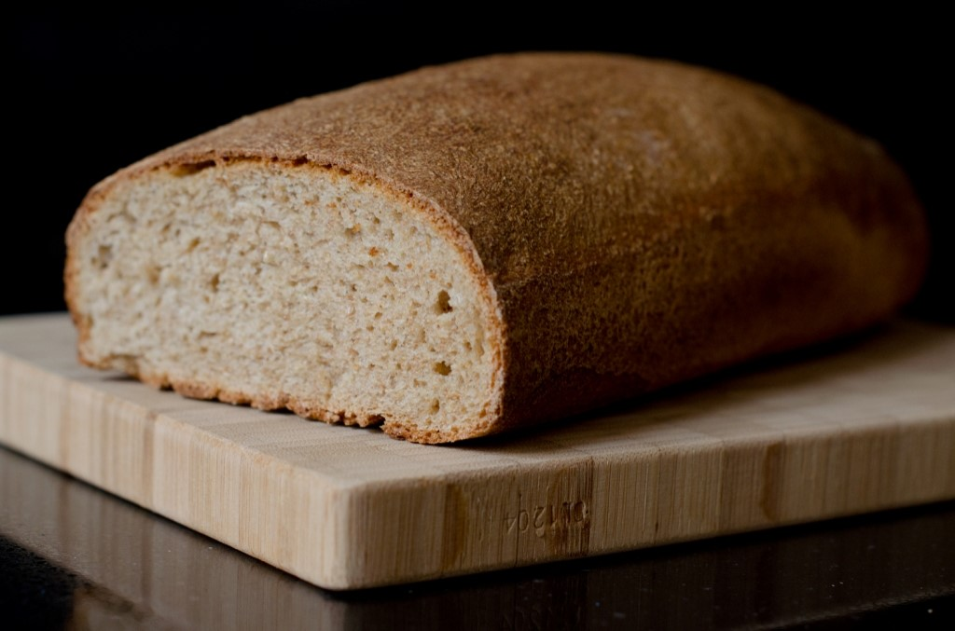
God’s love
Notes:
Prayer 1: God’s love
This picture shows: a loaf of bread
Picture credit: gvdvarst/freeimages.com

Slide 5
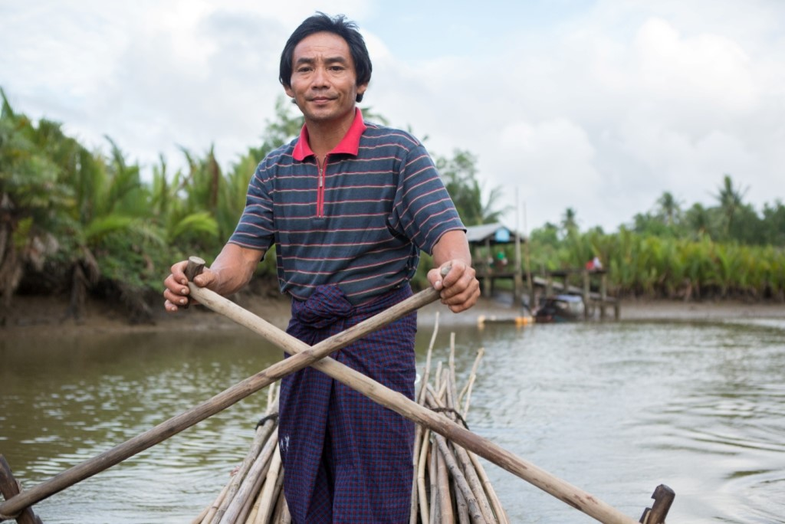
U Win Myi
Notes:
Prayer 2: Sing like no one is listening
This picture shows: U Win Myi, a fisherman
Location: Myanmar
Picture credit: Ben White/CAFOD

Slide 6
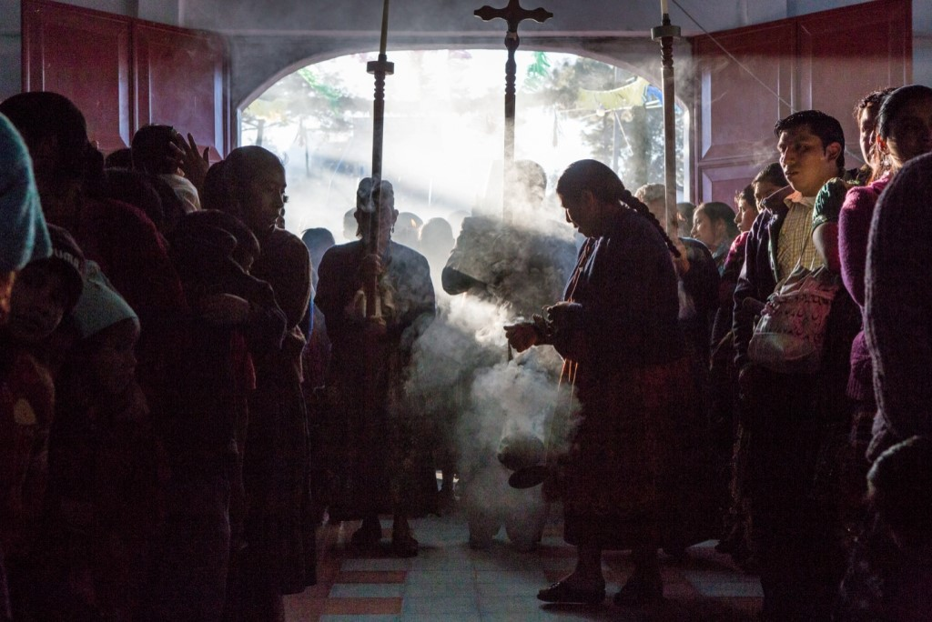
Incense, Guatemala
Notes:
Prayer 3: Sacred scent
This picture shows: a religious ceremony with incense
Location: Parish of Santa Maria Chiquimula, Guatemala
Picture credit: Nikola Ivanovski/CAFOD

Slide 7
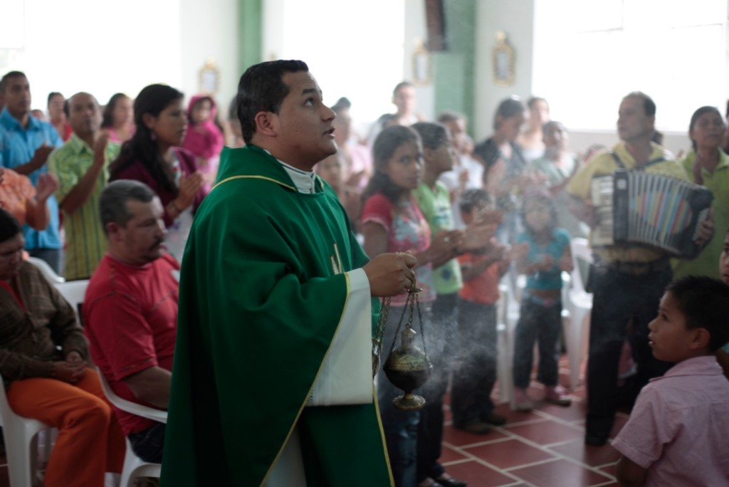
Incense, Colombia
Notes:
Prayer 3: Sacred scent
This picture shows: a priest with incense at Mass
Location: Miraflores, Chontaduro, Colombia
Picture credit: Paul Smith/CAFOD

Slide 8
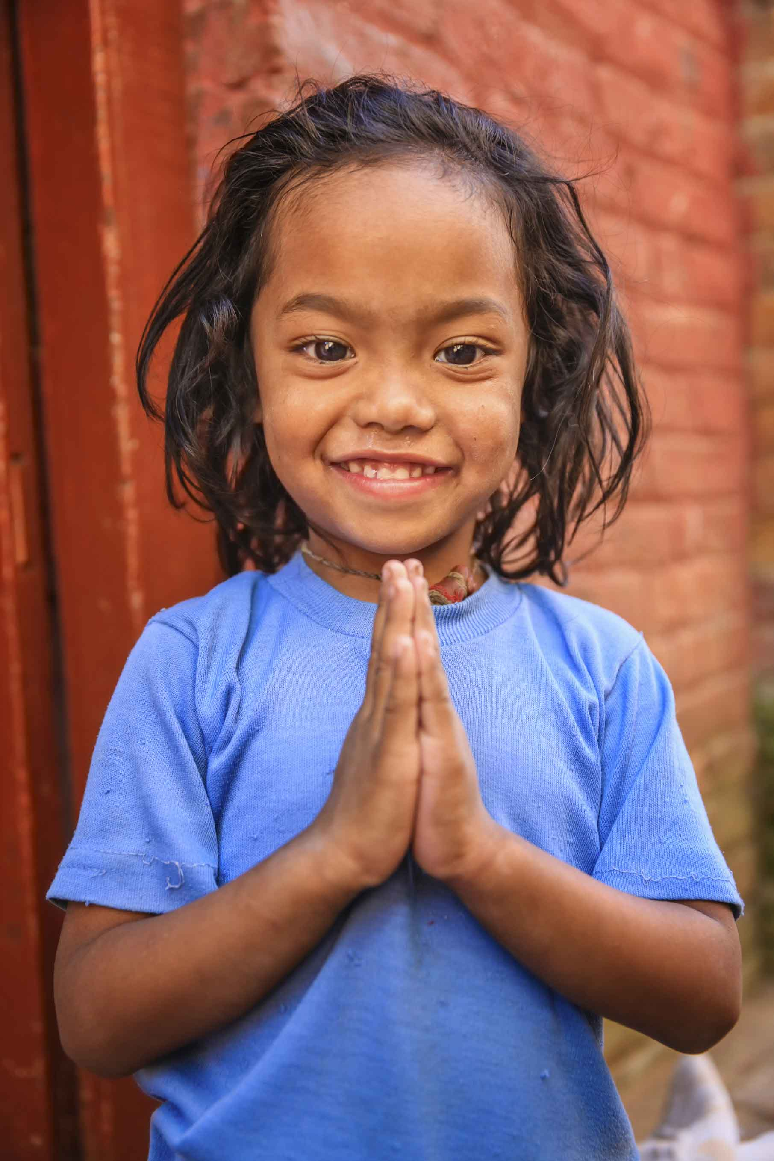
Peace be with you
Notes:
Prayer 4: Peaceful posture
This picture shows: a girl making the namaste greeting
Location: Nepal
Picture credit: Bartosz Hadyniak/ istockimages.com

Slide 9
Sunflower seeds
Notes:
Prayer 5: God’s seeds
This picture shows: a sunflower
Location: King Henry Walk Garden, London
Picture credit: Louise Norton/CAFOD

Slide 10
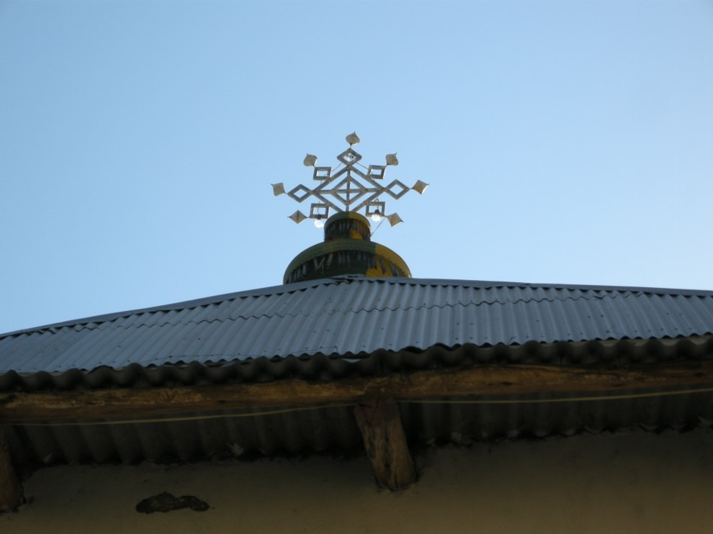
East
Notes:
Prayer 6: North, South, East, West
This picture shows: a cross on top of an Orthodox church
Location: Biera village, Adigrat, Tigray, North Ethiopia
Picture credit: Ataklti Mulu/CAFOD

Slide 11
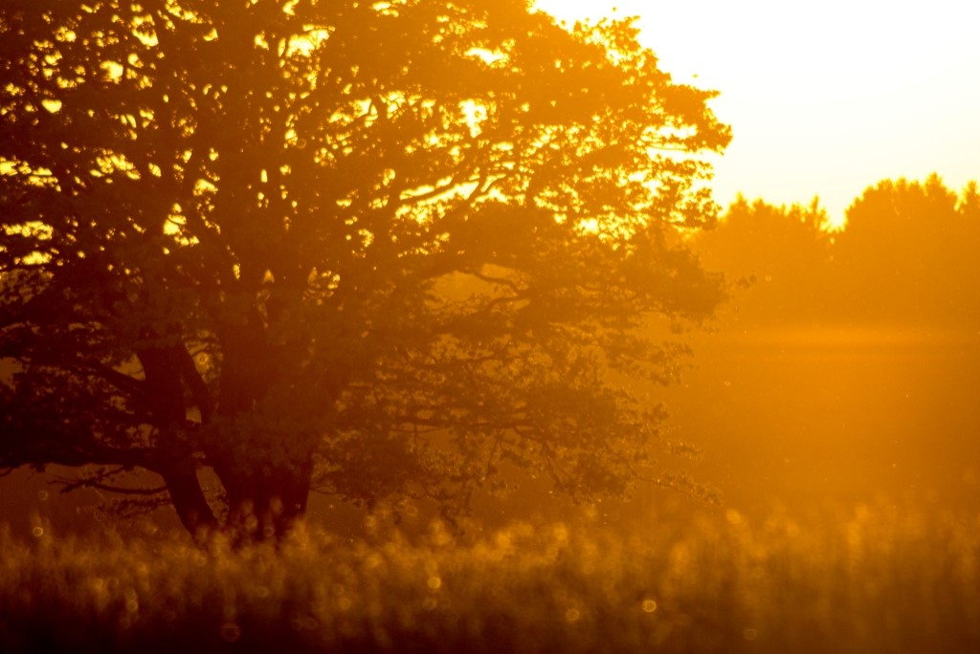
South
Notes:
Prayer 6: North, South, East, West
This picture shows: old oak in fields, sunset
Picture credit: krappweis/freeimages.com

Slide 12
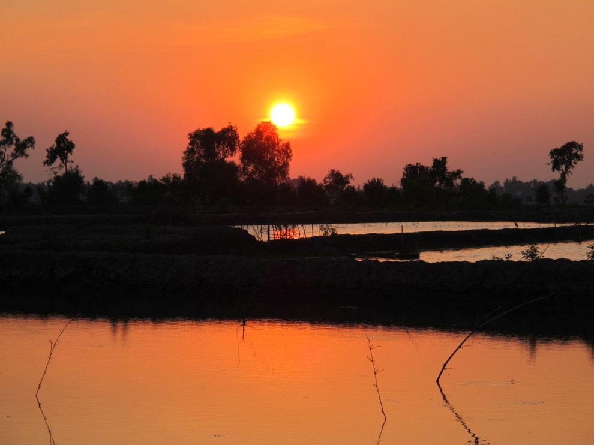
West
Notes:
Prayer 6: North, South, East, West
This picture shows: sunset over river Ganges delta
Location: Mongla District, Bangladesh
Picture credit: Chris Bain/CAFOD

Slide 13
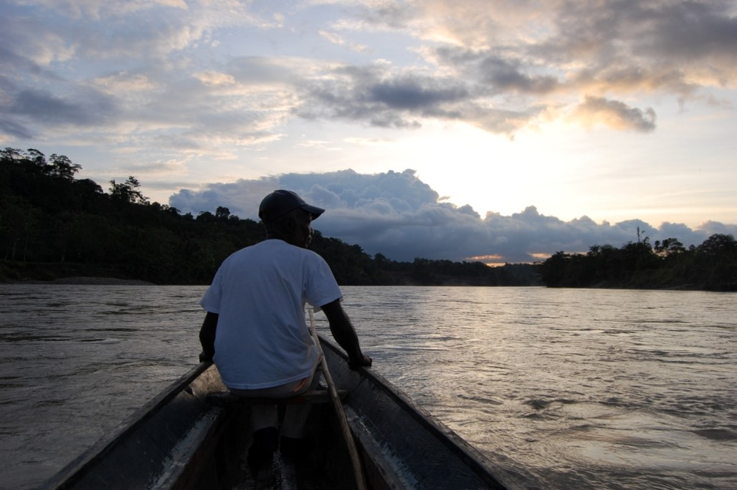
North
Notes:
Prayer 6: North, South, East, West
This picture shows: river boats are the principal mode of transport in Chocó, Colombia
Location: Chocó, Colombia
Picture credit: Barbara Davies/CAFOD

Slide 14
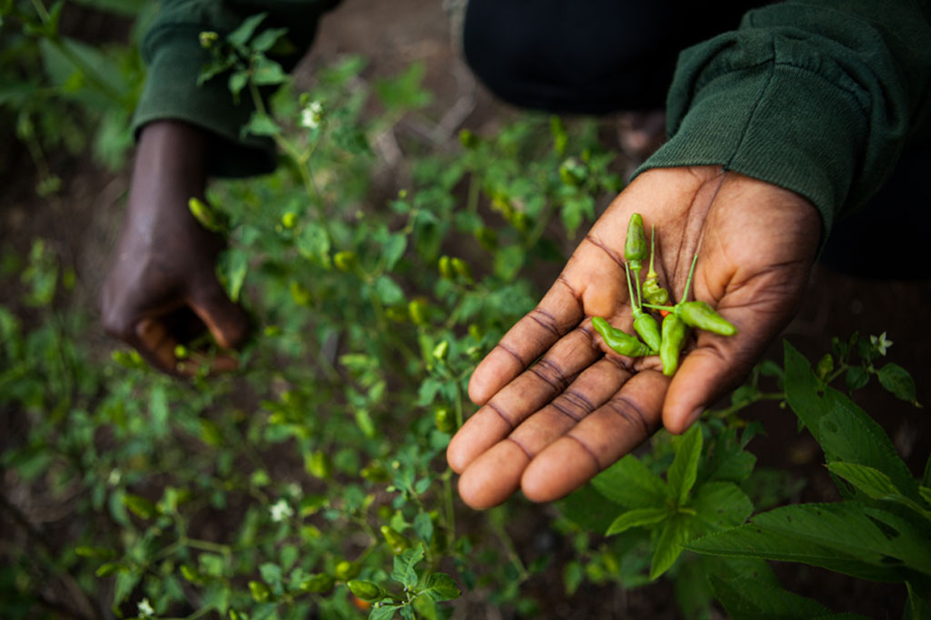
Earth
Notes:
Prayer 6: North, South, East, West
This picture shows: under-ripe chillies
Location: Kenema, Sierra Leone
Picture credit: Simon Rawles/CAFOD

Slide 15
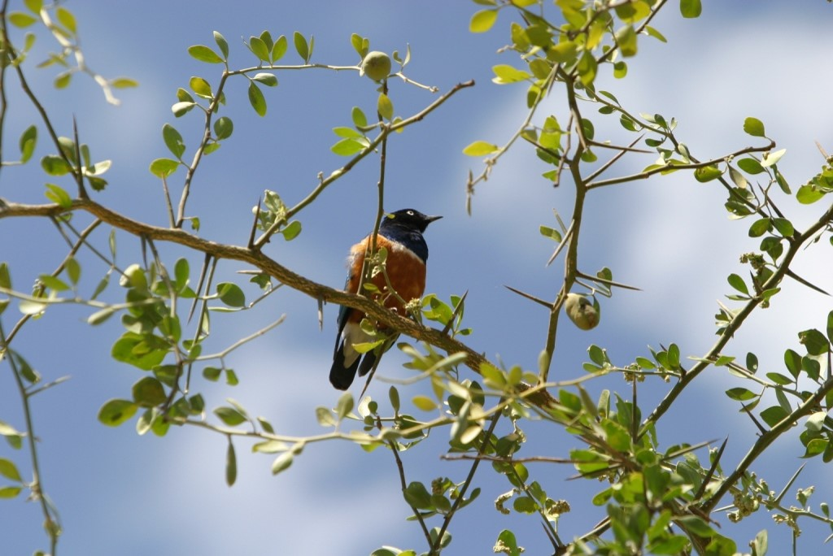
Sky
Notes:
Prayer 6: North, South, East, West
This picture shows: a superb starling (Lamprotornis superbus) perching in a thorn tree
Location: Tanzania
Picture credit: Shea Bradley/CAFOD

Slide 16
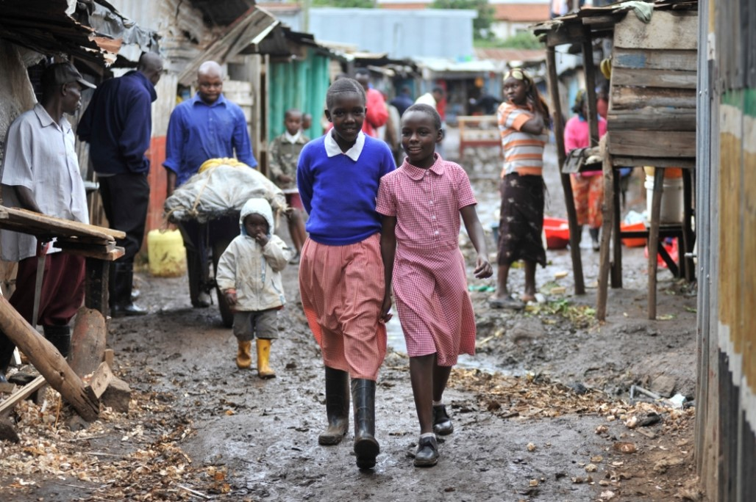
Kibera. Kenya
Notes:
Prayer 7: We are one
This picture shows: Lucky and Faith walking in the streets of Kibera
Location: Kibera, Nairobi, Kenya
Picture credit: Riccardo Gangale/CAFOD

Slide 17
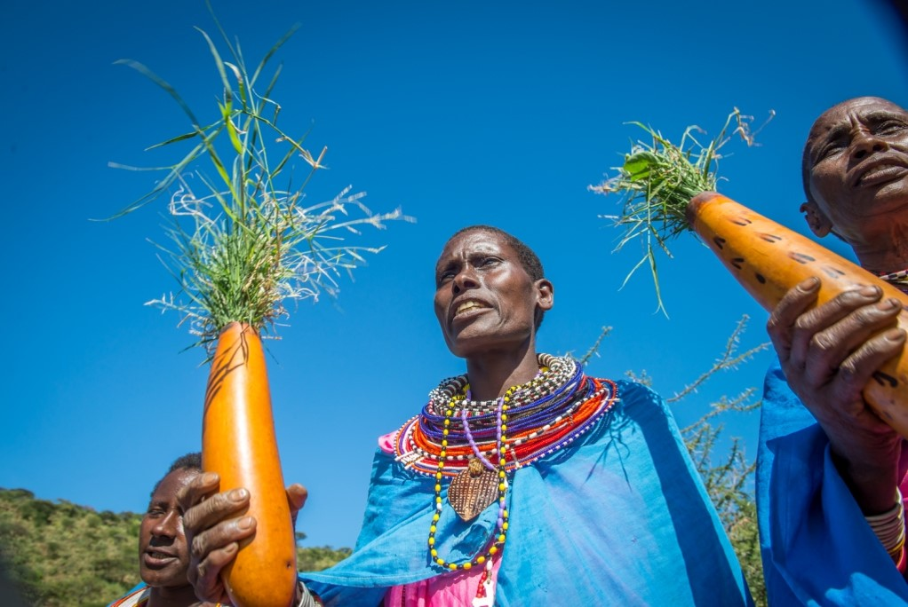
Sinteyo
Notes:
Prayer 8: Kenyan beads
This picture shows: Sinteyo and her Masaai community praying for rain
Location: Kenya
Picture credit: Annie Bungeroth/CAFOD

Slide 18
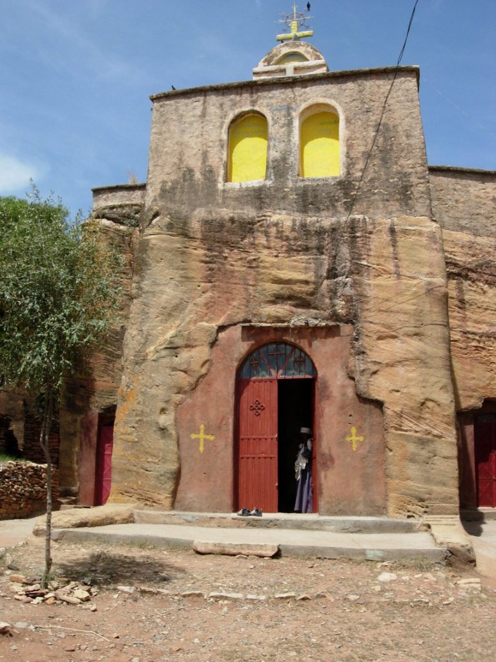
Ethiopia
Notes:
Prayer 9: Ethiopian elilta
This picture shows: The church façade, Adigrat Diocese Catholic Secretariat
Location: Tigray, Ethiopia
Picture credit: Araya Welde Hawrya/CAFOD
This picture shows: a deacon in St George’s church. He serves the church, sings songs, collects contributions and assists the priest in running the church. At the church there are many deacons who come from various monasteries.
Location: Addis Ababa, Ethiopia
Picture credit: Ashenafi Gudeta/CAFOD

Slide 19
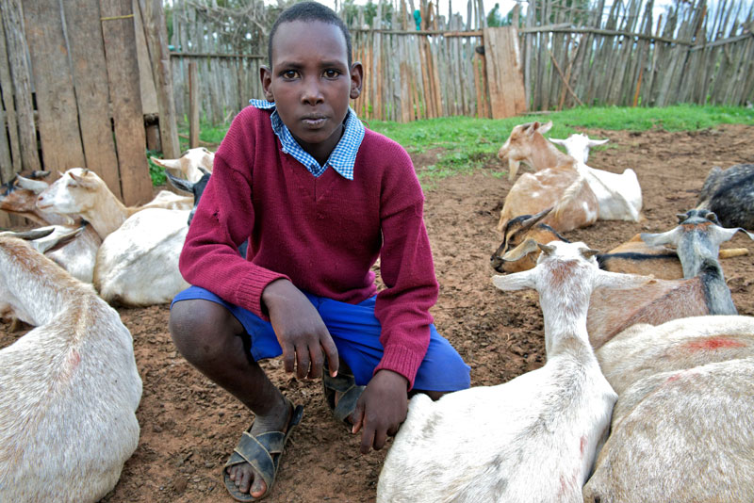
David
Notes:
Prayer 10: What I love
This picture shows: David, a young person from Maralal in Kenya. It is his job to look after his family's goats.
Picture credit: Annie Bungeroth/CAFOD

