Slide 1
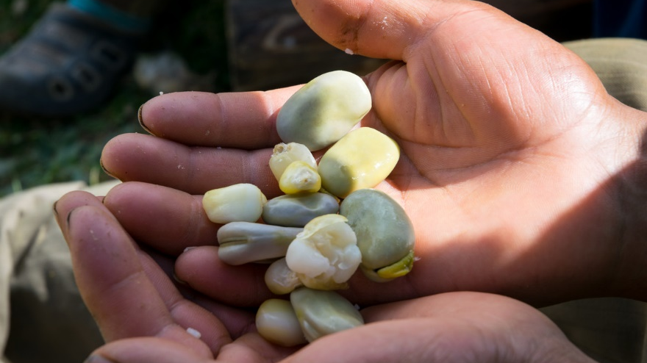
A place at the table
God our Father,
thank you for the abundance of your creation,
and the generosity of your gifts.
We are sorry that so many people in our world
are excluded from the feast prepared by you
for all to share.
May your Spirit lead us to seek change,
so that hunger and poverty are no longer a scar
and a scandal in our world.
May your Spirit guide us as we seek change,
so everyone has enough food to flourish
and a place at the table you spread for all. Amen.
“On this mountain, for all peoples,
the Lord is preparing
a banquet of rich food.”
Isaiah 25:6

Slide 2
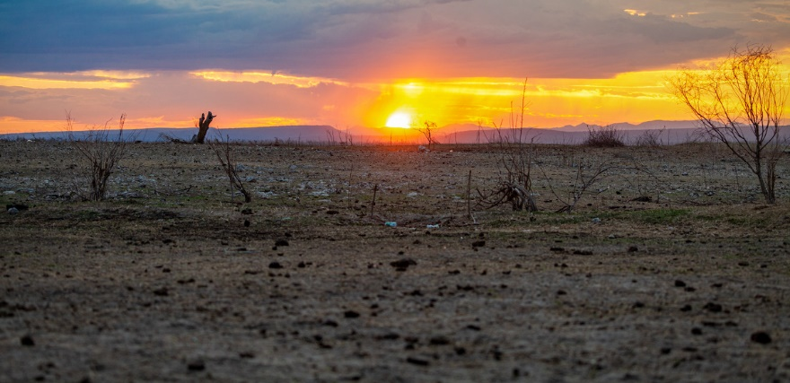
Lord Jesus, bread of life,
You fed the hungry people
and you ask us to do the same.
In dry lands, the harvest has failed,
and our sisters and brothers are hungry.
Move the hearts of all people
to share with generous love
the food that you have given us,
and to care for the Earth
that you have entrusted to us.
Amen
Notes:
Picture credit: CAFOD

