Slide 1




Nursery Our World

Slide 2

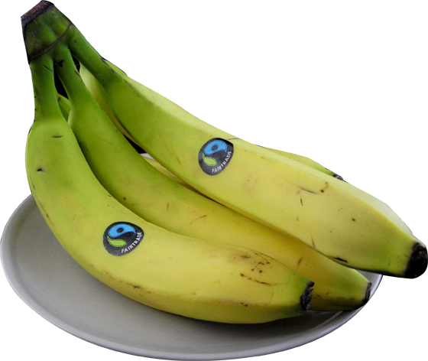
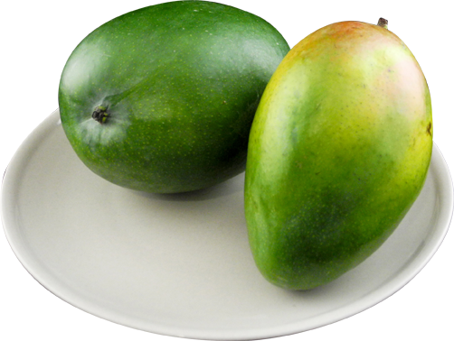


Slide 3
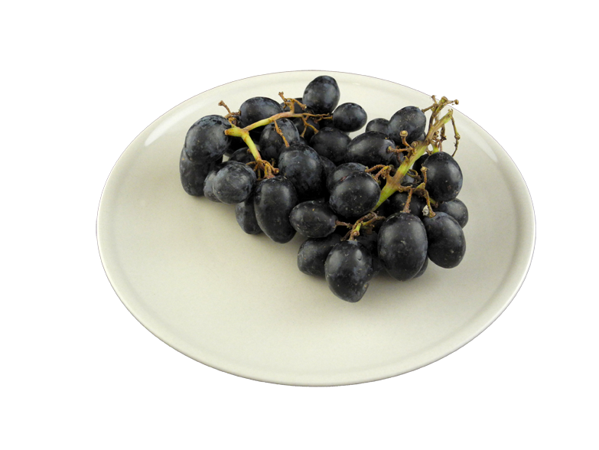
You will need:
1 Fairtrade mango,
1 Fairtrade banana,
Fairtrade grapes,
and a splash of
Fairtrade fruit juice.

Slide 4
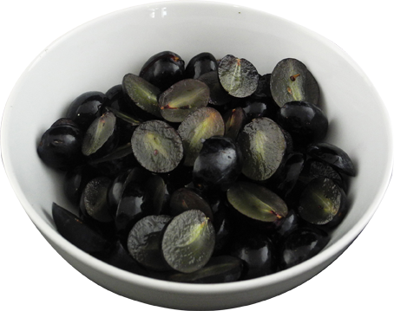
1. Cut the
grapes in
half and place
them in a bowl.
Notes:
Wash the grapes, cut them in half and place them in a bowl.

Slide 5
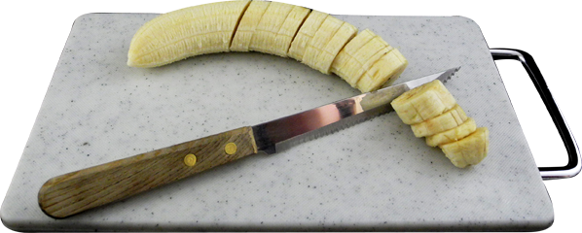
2. Peel and
chop the banana into slices and add
it to the bowl.
Notes:
2. Peel and chop the banana into slices and add it to the bowl.

Slide 6
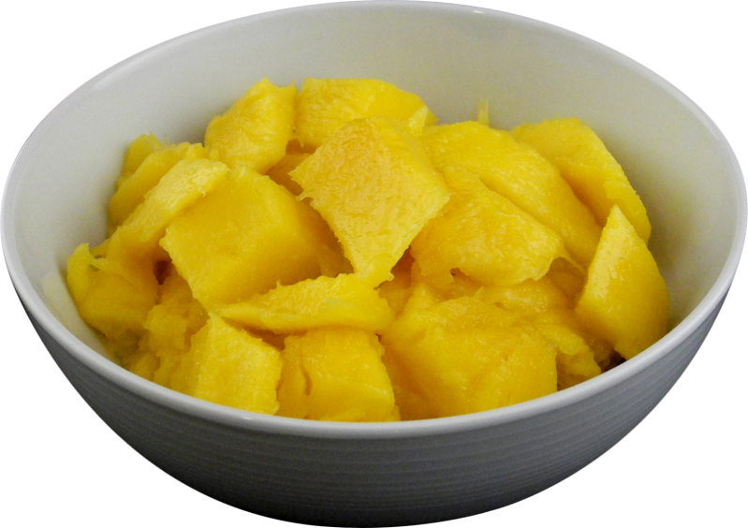
3. Peel and
chop the mango
and add it to
the bowl.
Notes:
3. Next peel and chop the mango and add it to the bowl (you may need a grown up to help you).

Slide 7

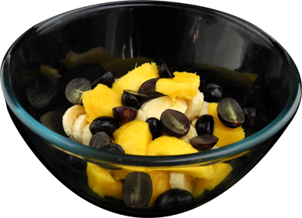
4. Finally add a splash of fruit juice to the
bowl and stir.
Yummy!
Notes:
4. Finally add a tiny splash of fruit juice to the bowl and stir. Yummy!

Slide 8
You will need:
1 Fairtrade banana,
a squeeze of
Fairtrade honey,
ice cold milk,
and ice cubes.
Scrummy Fairtrade Banana and Honey Smoothie

Slide 9
1. Peel and chop the banana.
2. Put all the ingredients
into a blender
and BLITZ!

Slide 10

3. Pour into
a tall glass
and enjoy.

Slide 11
For more delicious fairtrade recipes check out the
Fairtrade Foundation website.
www.fairtrade.org.uk
or make some of your own!

