Slide 2
Question 1

Slide 3
CAFOD stands for…
A. Catholic Aid for Overseas Development
B. Catholic Agency for Overseas Development
C. Catholic Fund for Overseas Development
D. Catholics for Overseas Development

Slide 4
CAFOD stands for…
A. Catholic Aid for Overseas Development
B. Catholic Agency for Overseas Development
C. Catholic Fund for Overseas Development
D. Catholics for Overseas Development

Slide 5
Until 2000, CAFOD stood for Catholic Fund for Overseas Development.
But, over the years, CAFOD moved from solely raising and distributing money to support projects, to being more of an agency.
As an agency, CAFOD doesn’t just raise and distribute money. An agency:
empowers local people
works alongside local people - people help themselves
shares skills, time and people
tackles the causes of poverty
Notes:
Until 2000, CAFOD stood for Catholic Fund for Overseas Development. But, over the years, CAFOD moved from solely raising and distributing money to support projects, to being more of an agency.
An agency doesn’t just raise and distribute money, but:
approaches development as a process that empowers local people and changes unjust structures – working alongside local people, finding out what they want to do, helping to support them
shares skills, time and people as well as funds
builds local capacity – gives control to locals, so people help themselves
supports programmes rather than projects – ie. broader, varied work, not just individual projects, but potential several projects may make up a programme – more holistic
seeks to tackle the causes of poverty, not just trying to mop up what has already happened.
CAFOD did not suddenly do all of this in 2000, but had been adapting to this way of working for the years leading up to the change in acronym.

Slide 6
Notes:
The ‘O’ represents the Caritas International, flaming cross symbol.
Caritas International is the global network of Catholic agencies to which CAFOD belongs.

Slide 7
Question 2

Slide 8
How many countries does CAFOD work in?
A. 400 programmes in 40 countries
B. 50 programmes
in 30 countries
C. 250 programmes
in 25 countries
D. 100 programmes
in 15 countries
Notes:
This figure changes! Please check our website for the latest figures.

Slide 9
How many countries does CAFOD work in?
A. 400 programmes in 40 countries
B. 50 programmes
in 30 countries
C. 250 programmes
in 25 countries
D. 100 programmes
in 15 countries
Notes:
This figure changes! Please check our website for the latest figures.

Slide 10
CAFOD works in:
Asia
Africa
Latin America
Middle East
In recent years we have supported sister agencies in Europe to deal with the refugee crisis.
Notes:
CAFOD cannot work all over the world, but as you can see, we do work in many countries worldwide: in Asia and the Middle East, across Africa and in Latin America.
In recent years we have also been supporting sister agencies in Europe to help deal with the Refugee crisis there.

Slide 11
Question 3

Slide 12
From whom does CAFOD raise its money?
A. Catholics in England and Wales
B. Governments
C. Other organisations
D. Catholics in the UK

Slide 13
From whom does CAFOD raise its money?
A. Catholics in England & Wales
B. Governments
C. Other organisations
D. Catholics in the UK

Slide 14
The Catholic community of England and Wales give approximately two thirds of CAFOD’s total income.
We get a small amount from governments – both our own and other countries’ governments – to carry out development/relief work.
Other institutions and agencies can give funding when CAFOD is best placed to deliver a piece of work, such as Islamic Relief or another Catholic development agency.
Notes:
A bit of a trick question! CAFOD raises the majority of its money from the Catholic Community of England and Wales (approx. 2/3 of our total income) comes from individuals and communities in England and Wales.
We get a small amount from governments – both our own and other countries’ governments – to carry out development/relief work.
We also get some from other institutions and agencies – when CAFOD is best placed to deliver a piece of work, another agency (such as Islamic Relief or another Catholic development agency) may give us a fixed amount of money to carry out that piece of work.
Of course, not just Catholics give to CAFOD, but it tends to be Catholics as we are the Catholic Agency. Because of the way the Catholic community is divided up across the UK, both Scotland and Ireland have their own “Bishops’ Conferences”, and have development agencies called SCIAF in Scotland and Trocaire in Ireland.

Slide 15
Question 4

Slide 16
When and how did CAFOD start?
A. 1960 – emergency in Dominica
B. 1965 – idea from the Bishops
C. 1966 – to celebrate the World Cup
D. 1967 – in response to Populorum Progressio

Slide 17
When and how did CAFOD start?
A. 1960 – emergency in Dominica
B. 1965 – idea from the Bishops
C. 1966 – to celebrate the World Cup
D. 1967 – in response to Populorum Progressio
Notes:
This isn’t strictly true! The first “Family Fast Day” was held in 1960. A group of Catholic lay women from the Catholic Women’s League (CWL) and the Union of Catholic Mothers (UCM) heard about children dying because of a lack of even the most basic healthcare on the Caribbean island of Dominica.
They persuaded the National Board of Catholic Women to support them and organised the first Fast Day, wanting people in England and Wales to fast/give up one meal on one day in Lent and give the money to the people of Dominica.
Their target was to raise £500, but it actually raised over £6,000 which in today equates to about £100,000.
The group of women realised that they weren’t able to process all of this by themselves and needed a charity to deal with it. They approached the Bishops of England and Wales and in 1962 the Bishops established CAFOD as the official Catholic organisation for overseas development and humanitarian relief.

Slide 19
Question 5

Slide 20
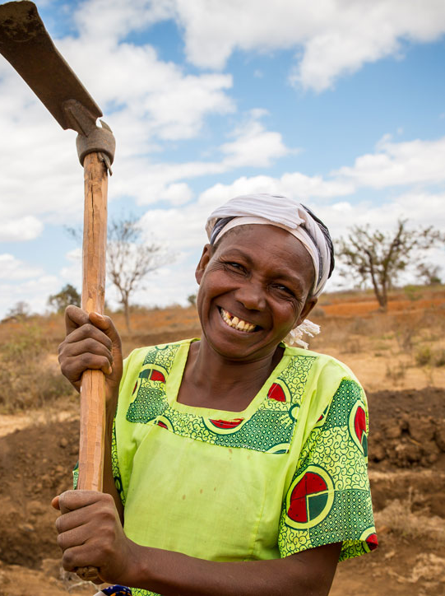
How does CAFOD use its funding?
A. to promote long-term development
B. to respond to emergencies
C. to raise awareness
D. to speak out on behalf of poor communities

Slide 21
How does CAFOD use its funding?
A. to promote long-term development
B. to respond to emergencies
C. to raise awareness
D. to speak out on behalf of poor communities

