Slide 1
A sharing Church
Acts 4:32-37

Slide 2
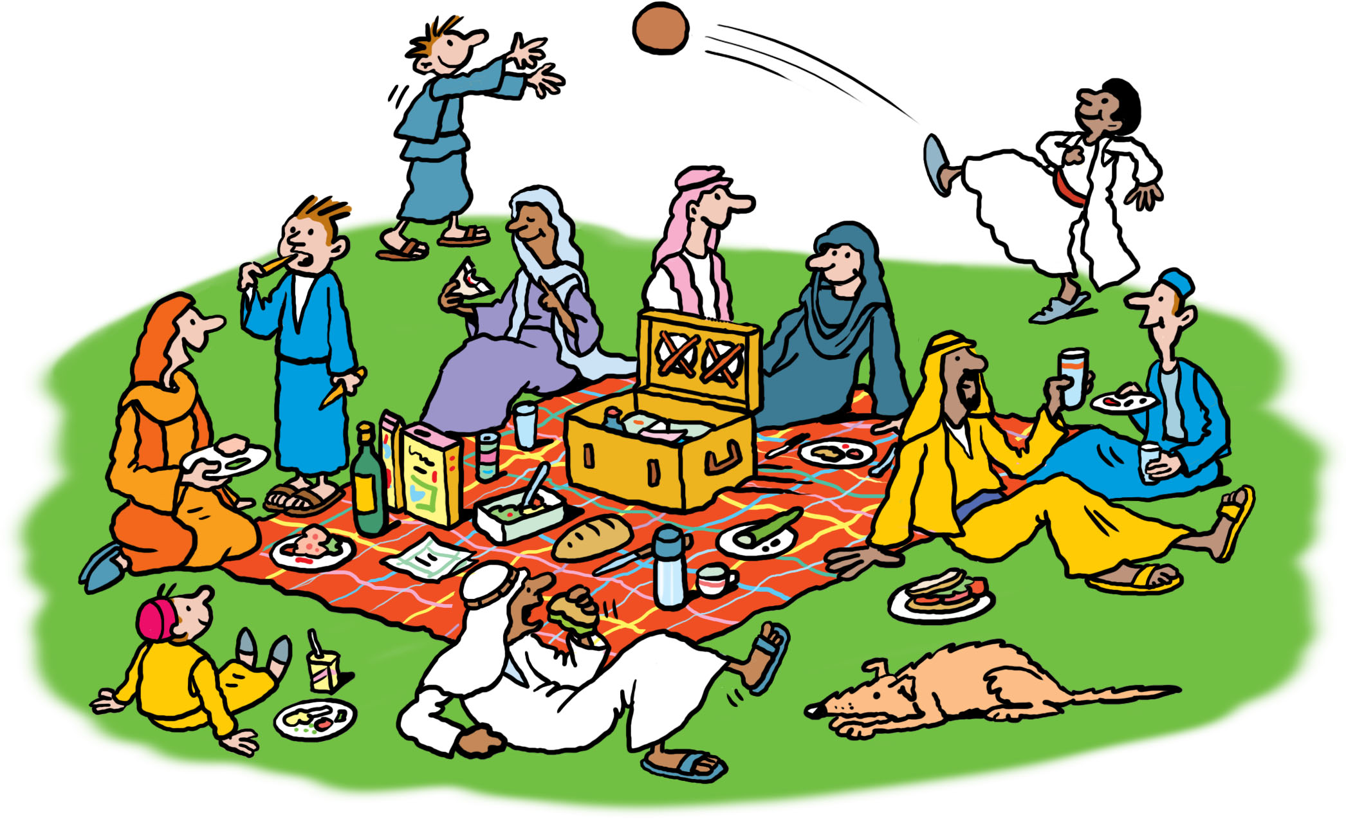
All the believers were one in heart
and mind…
they
shared
everything
they had.

Slide 3
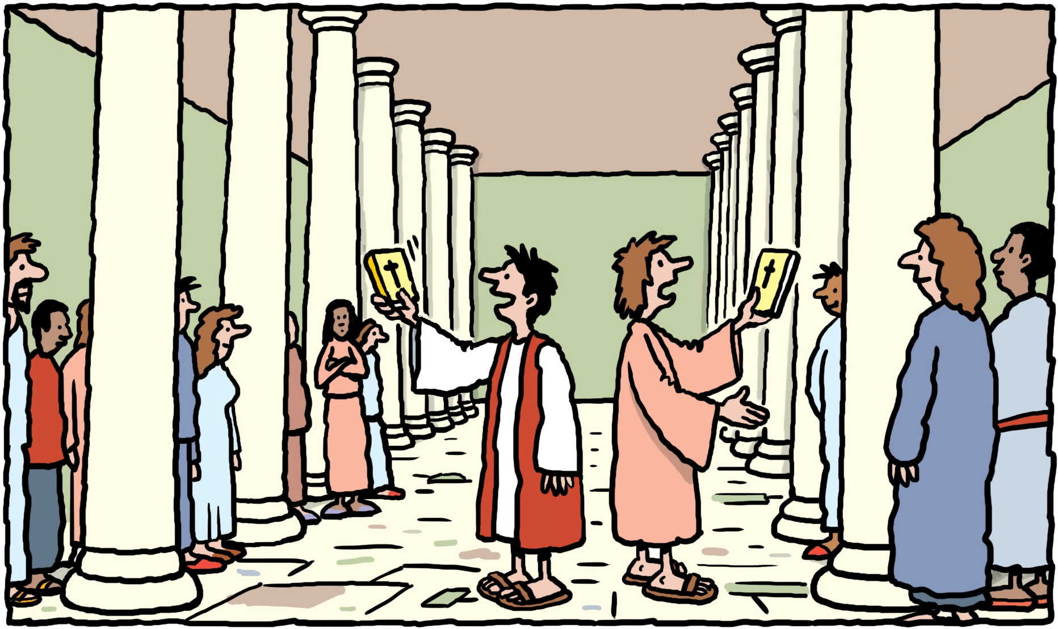
With great power
the apostles continued to testify
to the
resurrection
of the
Lord Jesus,
and much grace was upon them all.

Slide 4
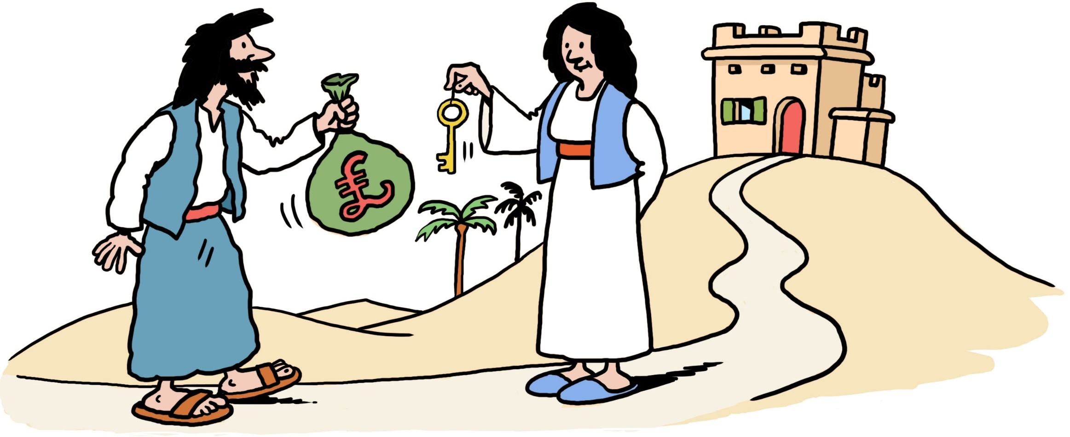
There were no needy persons among them,
for
from time to time
those who owned
lands or houses
sold them,

Slide 5
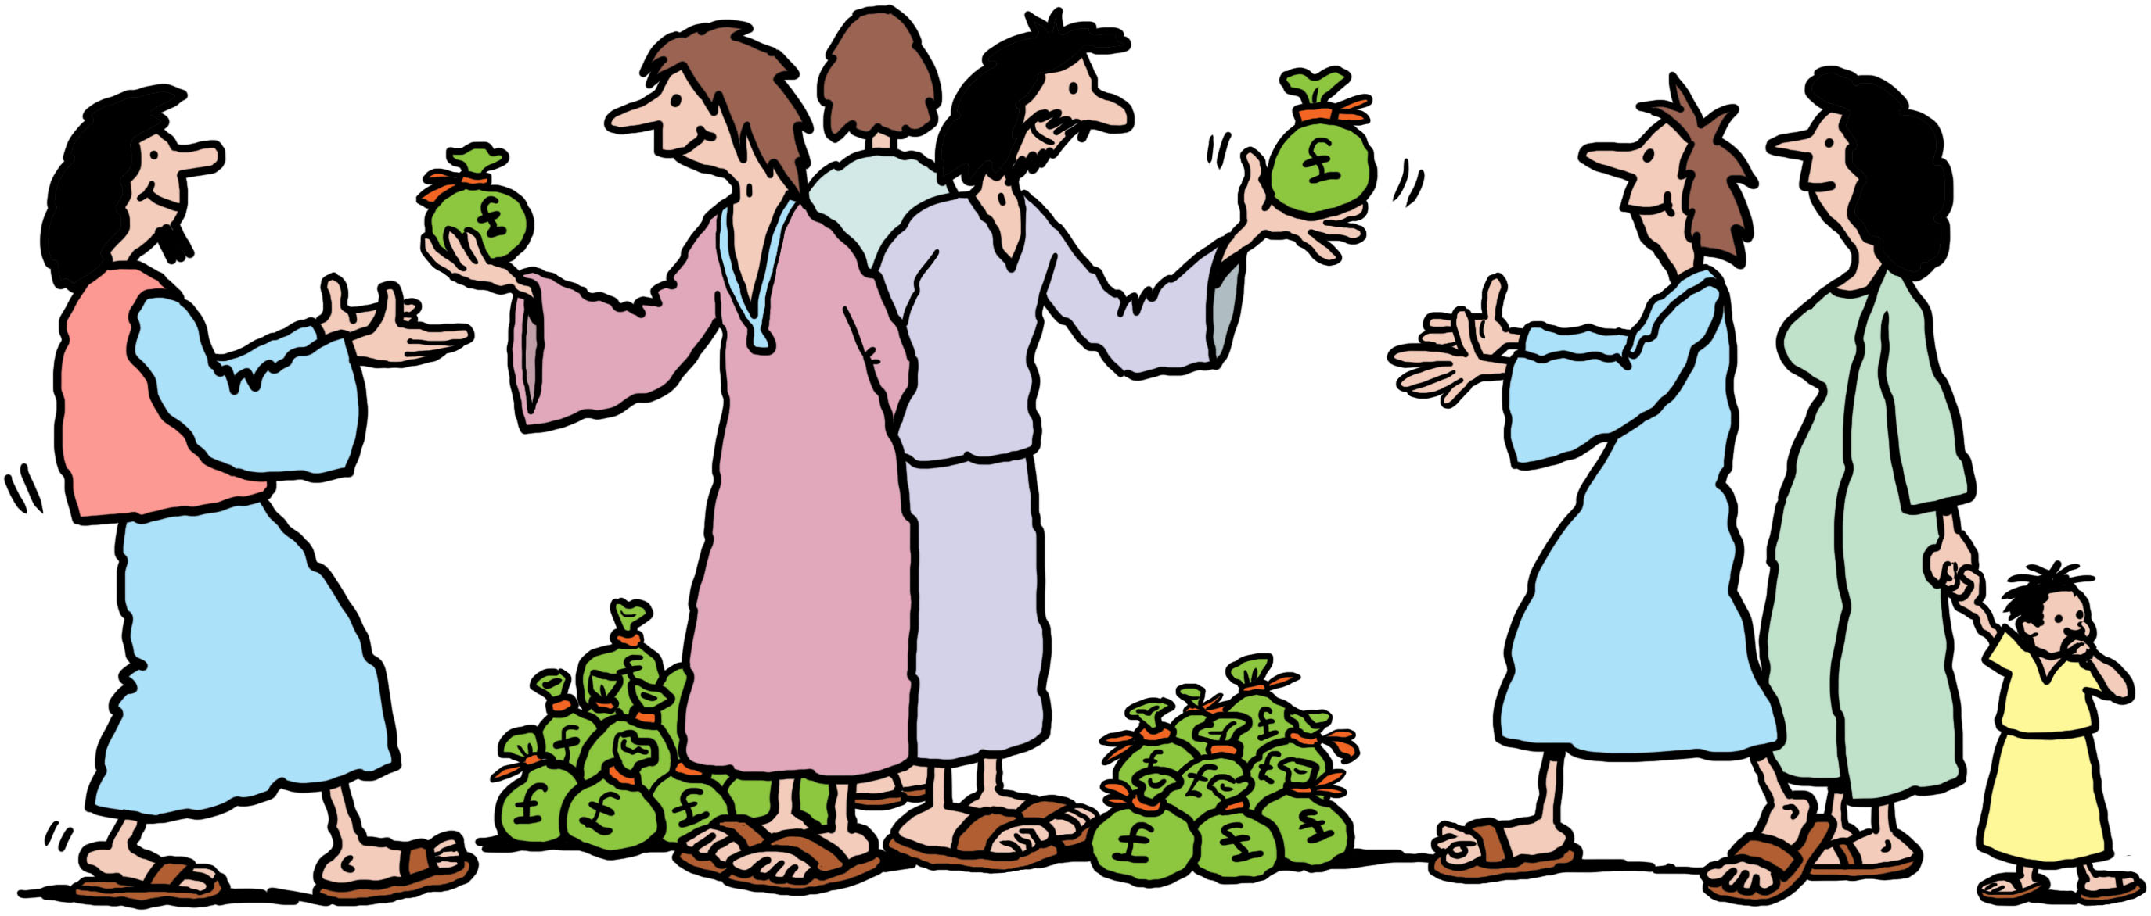
brought the money from the sales
and put it at the apostles’ feet,
and
to all who had need.
it was distributed

Slide 6
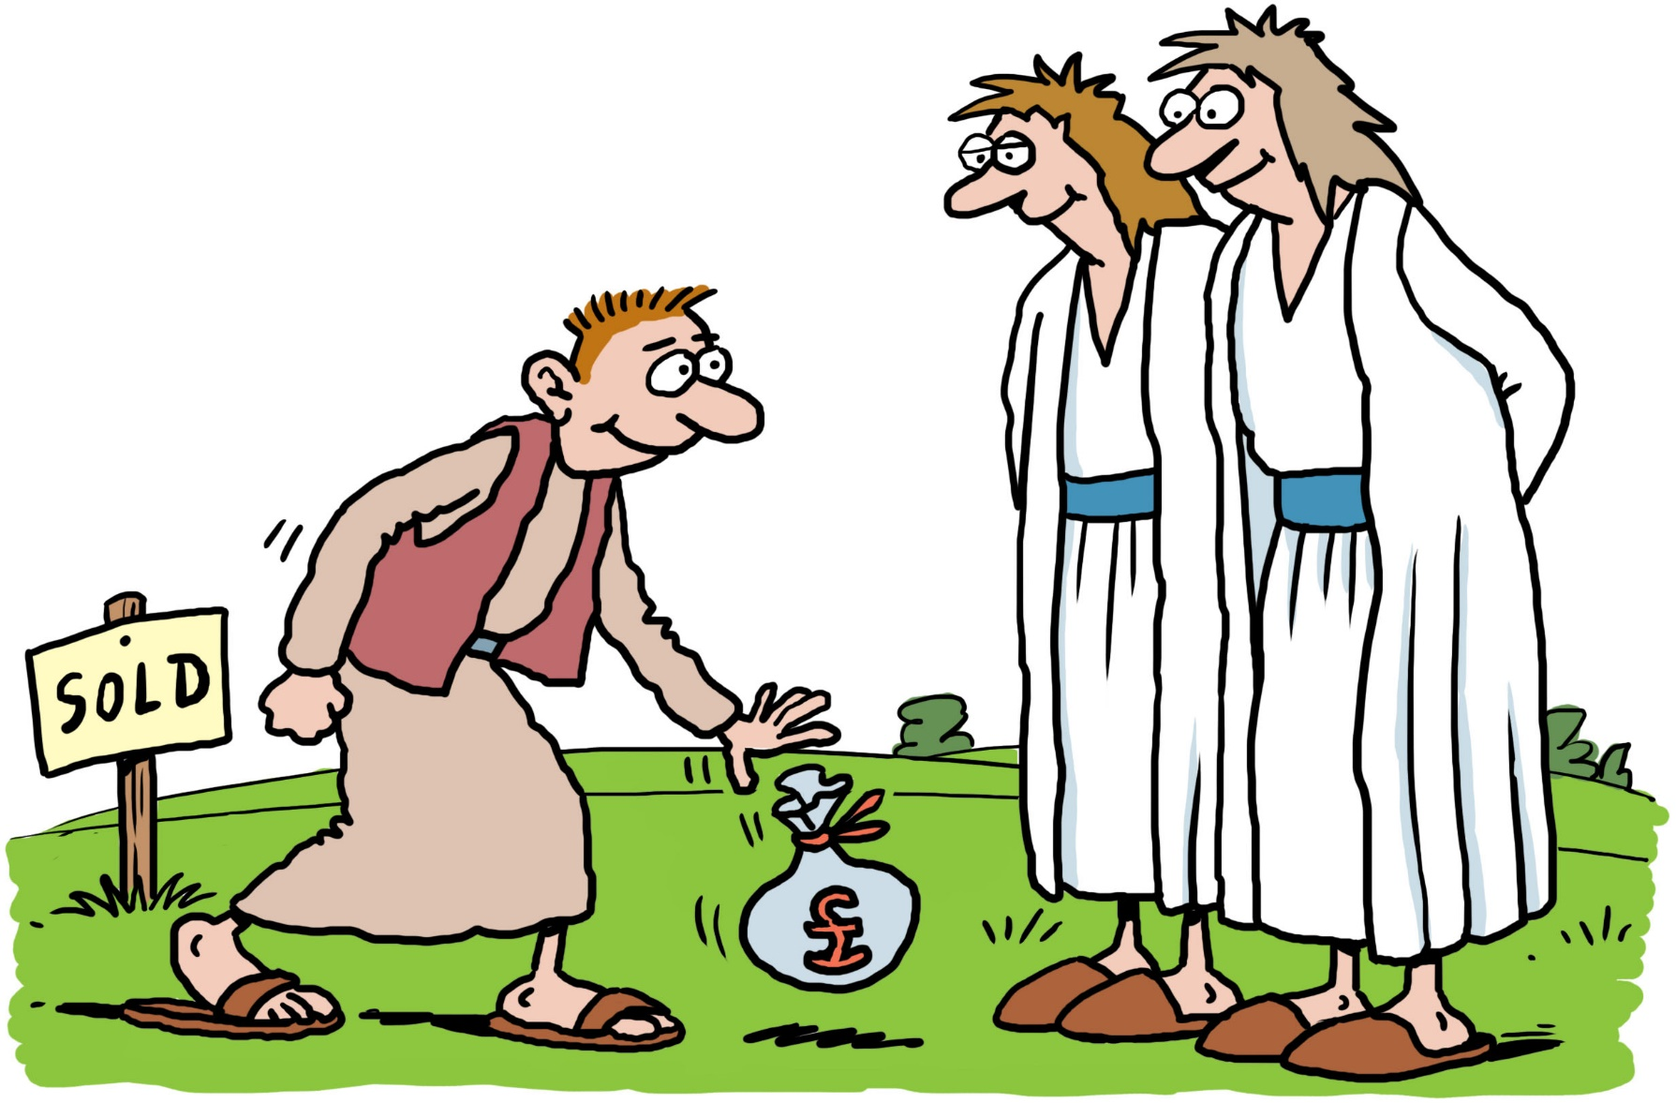
Joseph,
a Levite from Cyprus, whom the apostles called
Barnabus
(which means Son of Encouragement),
sold a field he owned,
brought the money
and put it at the
apostles’ feet.

Slide 7
Illustrations by Ellis Nadler

