Slide 1

Notes:
Thank you for your prayerful and generous support. As part of the CAFOD and Caritas family, you are already there in this emergency.
Image credit: Withheld for security reasons

Slide 2

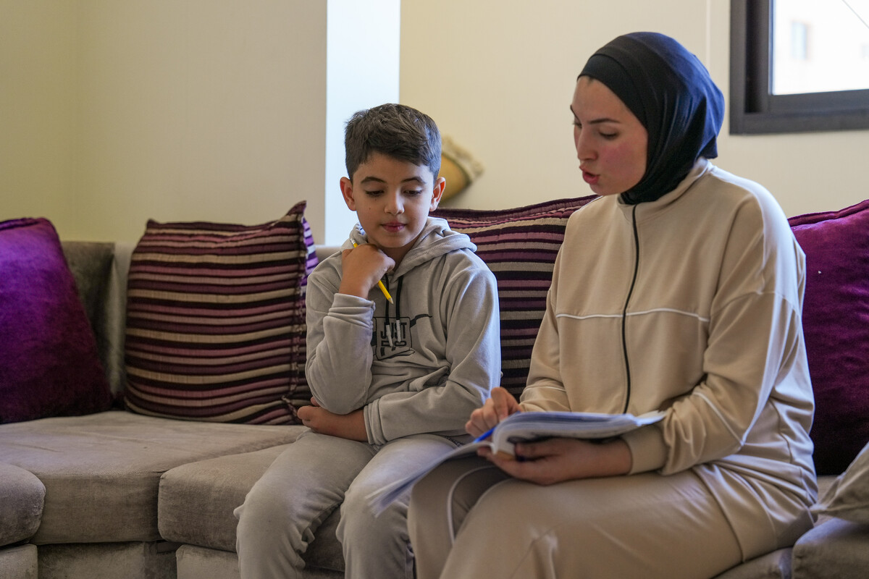
Zein’s story
Zein* is 8 years old and had to leave his home in southern Lebanon because of the war.
He is staying at a camp for displaced people in North Lebanon.
Zein is feeling homesick. His family only brought essential items with them so he’s also missing his toys and being able to draw.
‘‘What I want most is to go back home and for the war to stop. I love my home, and I just want to return, sleep there, and feel safe and comfortable. No one understands the value of home until they leave it’’
Zein (8), Lebanon
Zein* and his sister Jinane* doing schoolwork together.
Notes:
Image credit: DEC. CAFOD use psuedonyms for the security of our partners.

Slide 3

Watch Zein’s story
Notes:
Zein's Story | CAFOD - YouTube

Slide 4
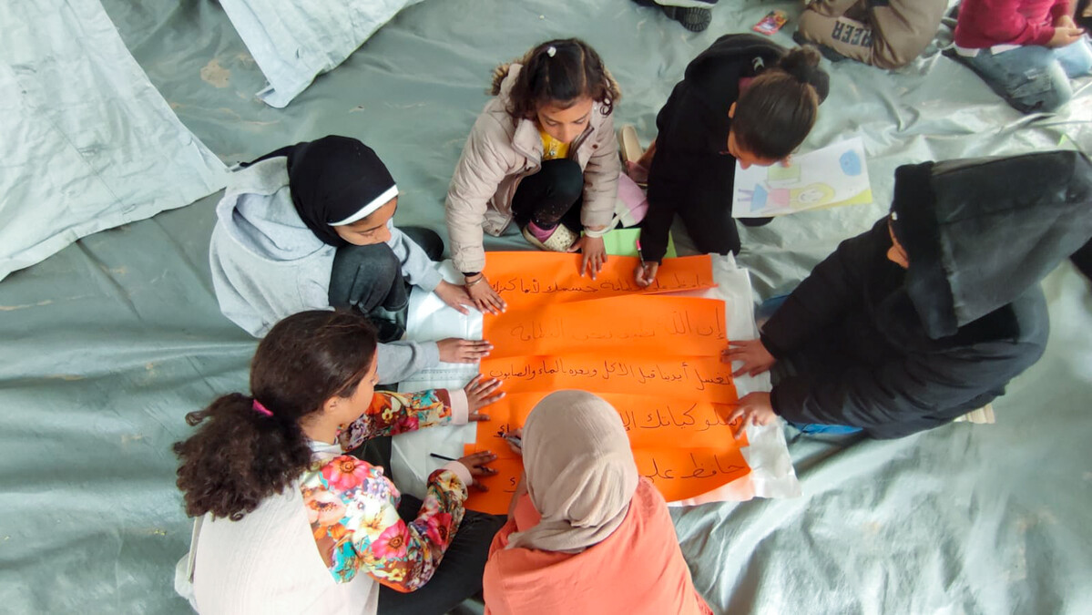
Let us pray
God of love​
We pray for peace in our world, and an end to war.​
Instead of hatred, let there be love.​
Shelter your children and protect us.​
Guide us and keep us from harm,​
So we can build a world of love and live our lives in peace.​
Amen.​
Children’s groups in Gaza
Notes:
Image credit: Caritas Jerusalem

