Slide 1
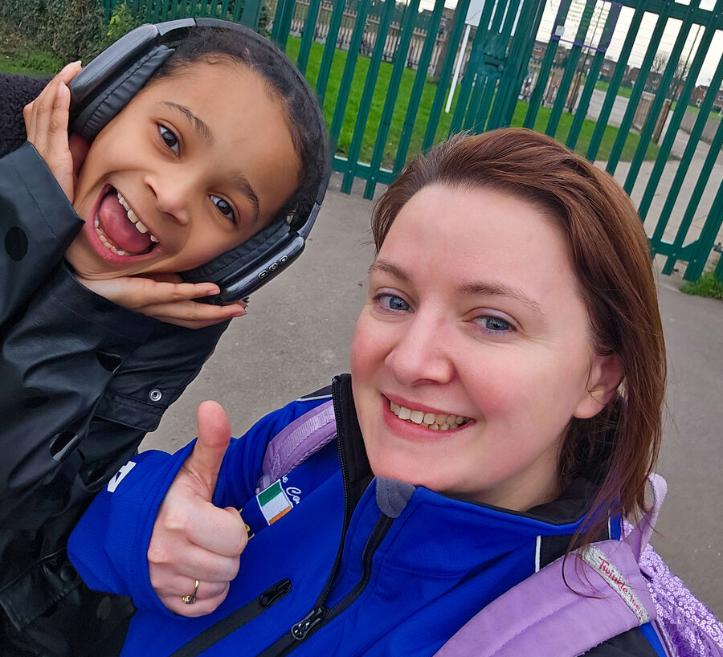
How will you try to be like Jesus, sharing the good news that God loves us all?
Gospel Celebration of the Word
Notes:
Children’s liturgy: Third Sunday of Advent (Year A)
Preparation of the worship space
Colour: purple or rose/pink
Props: coloured pens and pencils
Song suggestions
Give me joy in my heart (722, Laudate)
Welcome
Today we listen to Jesus say that he came to heal people who are sick and bring good news to people who are poor. We are going to think about how we can be that good news and help to build a better world for all people to live in.
CAFOD supporters
Photo credit: CAFOD

Slide 2
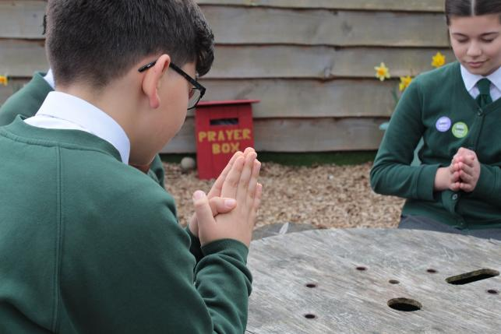

God of hope, You sent your Son Jesus to bring good news to people who are poor. Help us to be that good news, so that together we can work towards a better world where all of us have all that we need. Amen.
Gather
Notes:
St Francis Xavier's RC Primary School, Herefordshire
Photo credit: Vicky Ahmed

Slide 3

Gospel: Matthew 11: 2-11
John the Baptist heard in prison about the things that Christ was doing and he sent some of his disciples to him.
“Tell us,” they asked Jesus, “are you the one John said was going to come, or should we expect someone else?”
Jesus answered, “Go back and tell John what you are hearing and seeing: the blind can see, the lame can walk, those who suffer from dreaded skin diseases are made clean, the deaf hear, the dead are brought back to life, and the Good News is preached to the poor. How happy are those who have no doubts about me!”
Word

Slide 4
While John’s disciples were leaving, Jesus spoke about him to the crowds: “When you went out to John in the desert, what did you expect to see? A blade of grass bending in the wind?
"What did you go out to see? A man dressed up in fancy clothes? People who dress like that live in palaces!
"Tell me, what did you go out to see? A prophet? Yes indeed, but you saw much more than a prophet. For John is the one of whom the scripture says: ‘God said, I will send my messenger ahead of you to open the way for you.’
"I assure you that John the Baptist is greater than anyone who has ever lived. But the one who is least in the Kingdom of heaven is greater than John.”

Slide 5
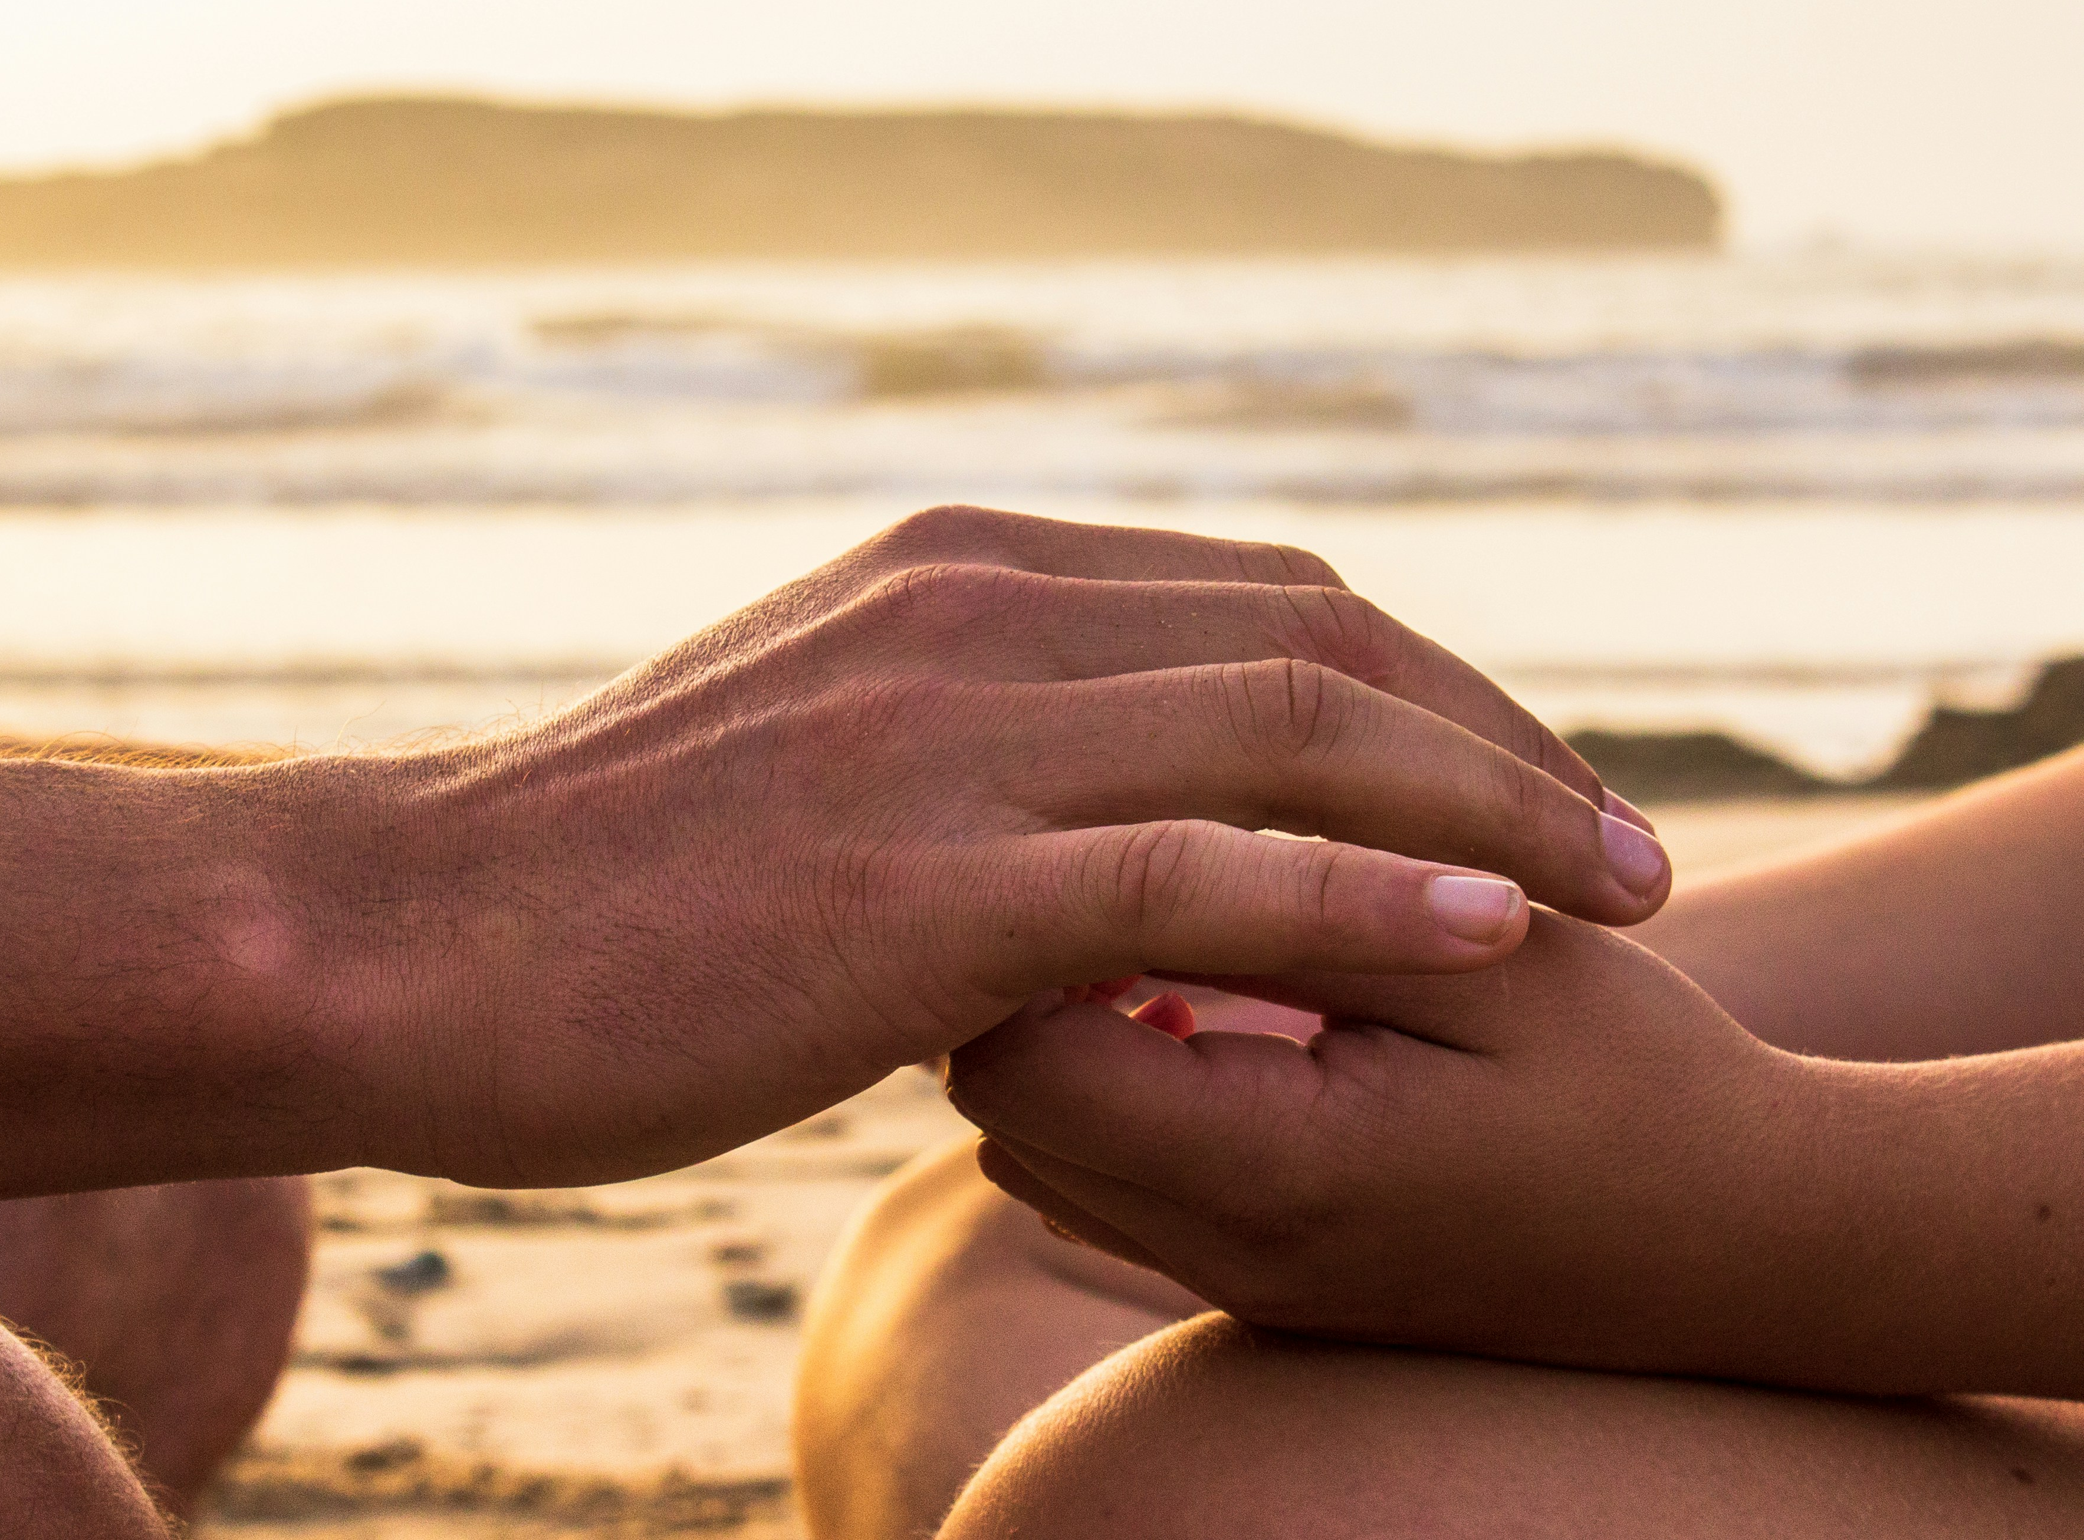

What do you remember from the Gospel reading?
John the Baptist, who we heard about last week, wants to make sure Jesus is really the special person that he has been waiting for, so he sends some friends to check.
Jesus answers them by telling them that he is the one who has come to heal those who are sick and bring good news to the people who are poor.
This answer tells John that Jesus really is the person for whom he has been waiting.
Respond
Notes:
Comfort
Photo credit: Louis Hansel on Unsplash

Slide 6
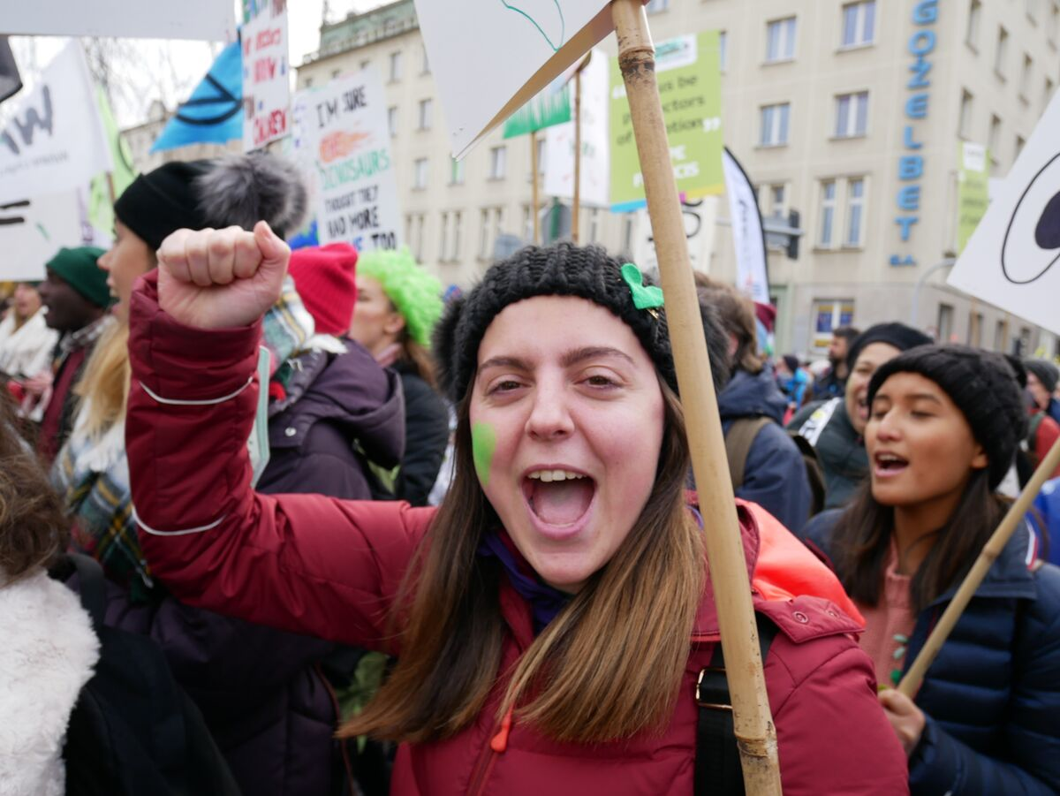
We are all part of one family, God’s family, and God asks us to love each other and care for each other.
But what does it actually mean to bring good news to people who are poor?
What can we really do to help those people, either our friends, family or people in other countries, whom we have never met?
Harriet from Wales campaigns for those people around the world affected by climate change
How can we help people who are sick or who have hurt themselves? People who are hungry or thirsty? People who are poor?
Notes:
Harriet from Wales campaigning
Photo credit: Rosie Heaton

Slide 7
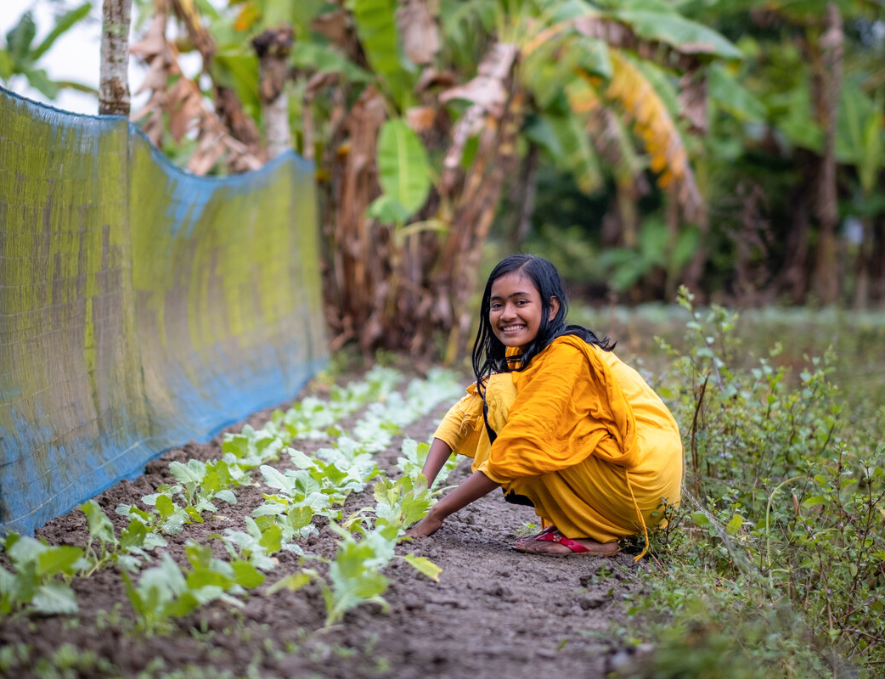
CAFOD works alongside people who are poor all around the world.
When there is an emergency, like an earthquake or a flood, this can mean giving people food or shelter, but more often it means helping them to help themselves.
For example, giving people seeds, tools and training means that they can grow enough food for their families and enough to share with others.
This is very good news!
With CAFOD's help, Dristy in Bangladesh has learned how to grow crops that survive floods
Notes:
Dristy in her garden, Bangladesh
Photo credit: Amit Rudro

Slide 8
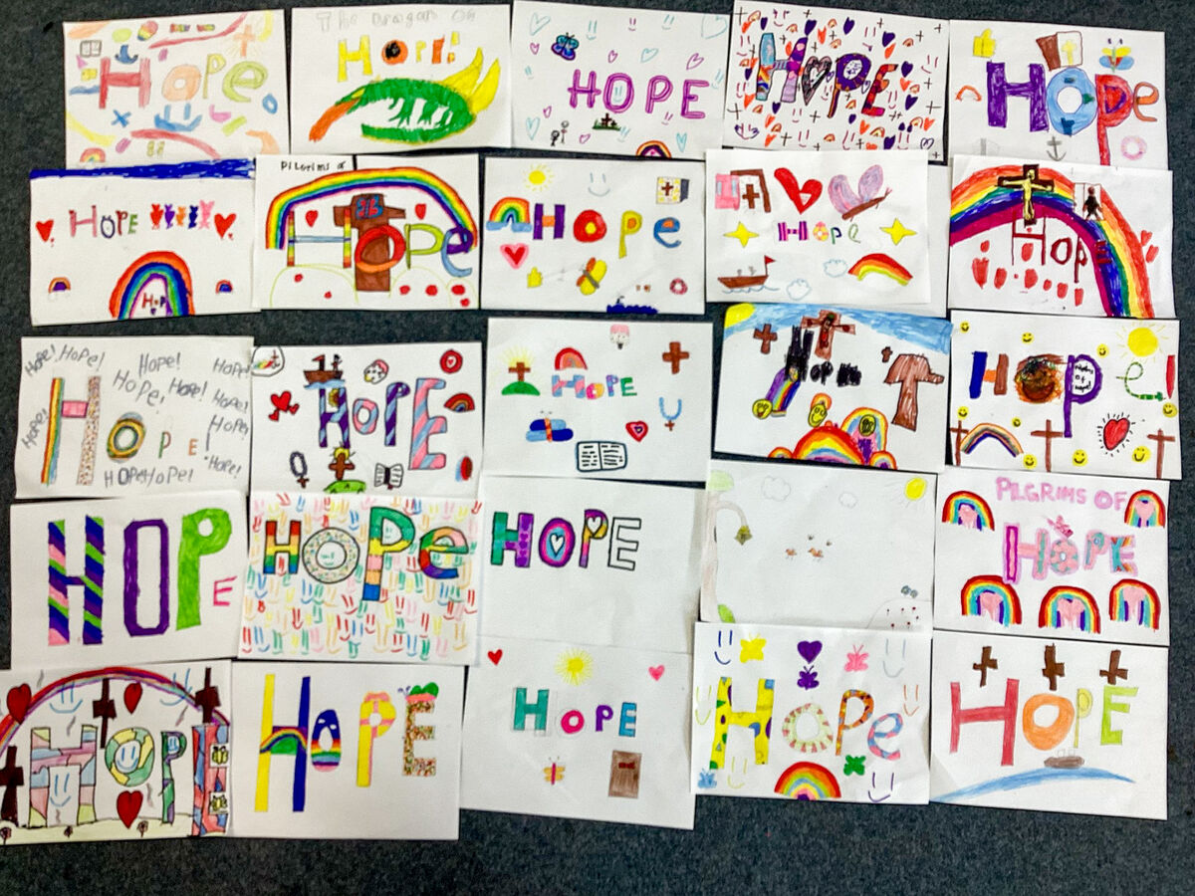

At the beginning of the Jubilee Year, Pope Francis asked us to be signs of hope to one another, especially to people in any kind of need.
Throughout the Jubilee Year, so many people have been doing what they can to answer this call - praying, walking, fundraising and campaigning to build a better world.
This is also really good news!
Notes:
Collage of Hope
Photo credit: CAFOD

Slide 9
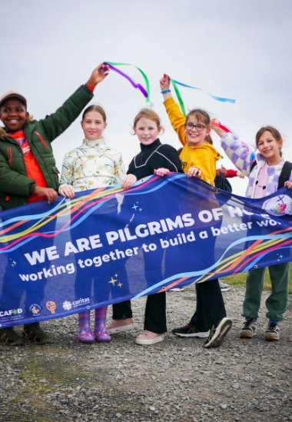
The Jubilee Year comes to an end soon, but the work of putting our faith into action and working together with our sisters and brothers to create a fairer and more loving world will continue.
We can all play our part in changing the world for the better.
How will you try to be like Jesus, helping others, being a sign of hope, sharing the good news that God loves us all?
Notes:
Somerset school children making their Jubilee pledge
Photo credit: CAFOD Clifton

Slide 10
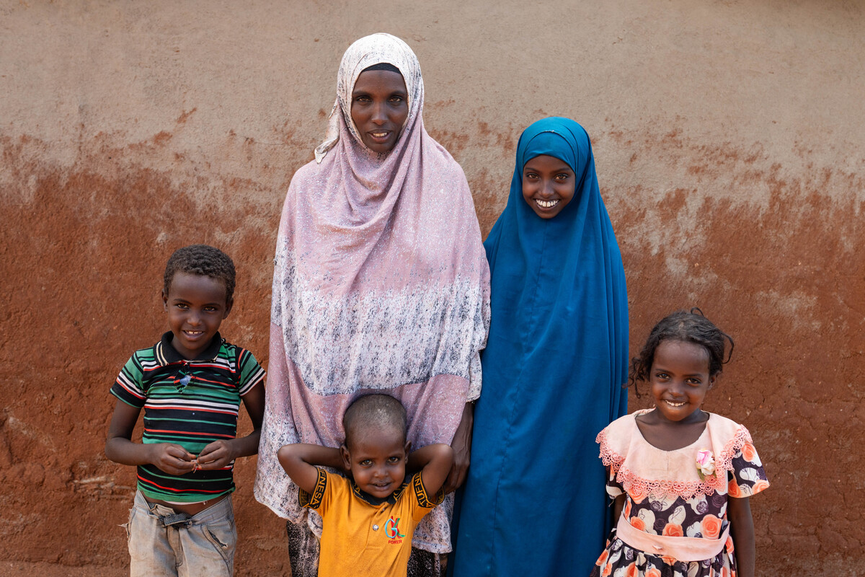
Chirri, in blue, lives in Kenya with her mother and father, brothers and sisters.
Severe drought in Kenya has meant water is scarce, with not enough for people, crops or livestock. As animals died, people struggled to make a living.
"There was no rain for years,” says Chirri. “We had to get water far away. We started our journey at seven and came back at ten. I got tired and thirsty. The sun was way too hot.”
Notes:
Kerra, Chirri and the family, Marsabit, Kenya
Photo credit: Joe Newman

Slide 11
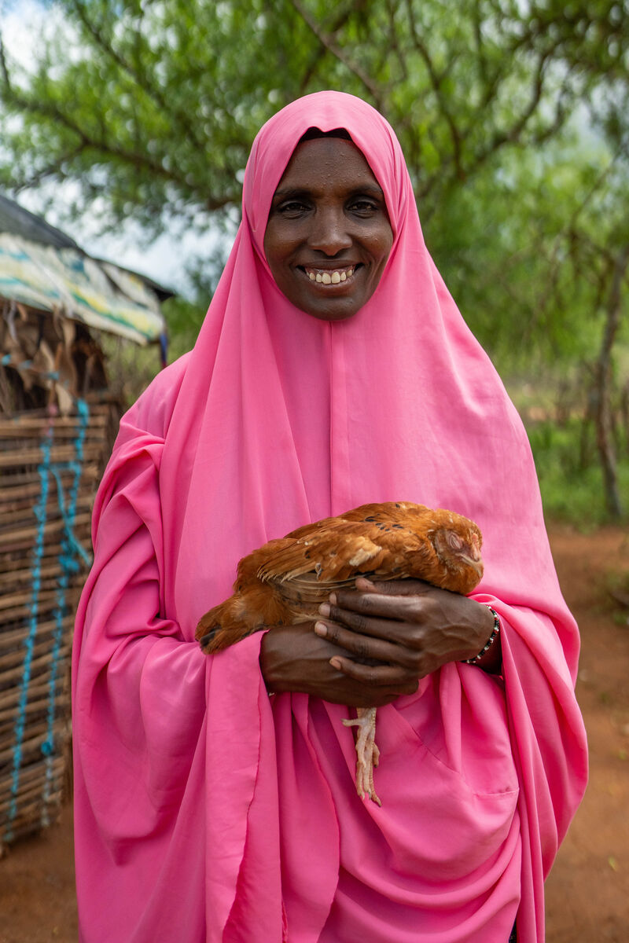
Because children like you have been praying, walking, fundraising and campaigning to build a better world, CAFOD can support people like Kerra to change their lives for the better.
With CAFOD's help, Kerra was given chickens, which need less water to survive. She learned how to rear them to help her make a living. She can sell the eggs, or a chicken, earning the money to buy food, clothes, soap and books for school.
Notes:
Kerra and one of her chickens, Marsabit, Kenya
Photo credit: Joe Newman

Slide 12
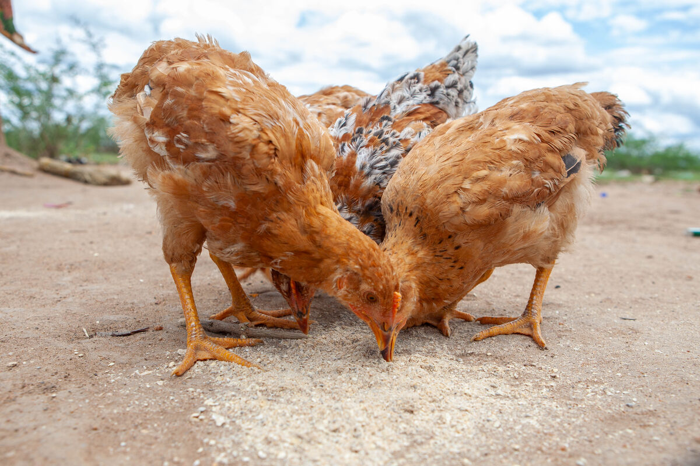
Chirri enjoys helping out with the chickens. When her mum is away, Chirri looks after them and feeds them.
“My mum taught me how. I like it when they all start jumping about and I like seeing them lay eggs. I like eating the eggs too – fried for breakfast!”
Notes:
The chickens of Marsabit, Kenya
Photo credit: Joe Newman

Slide 13
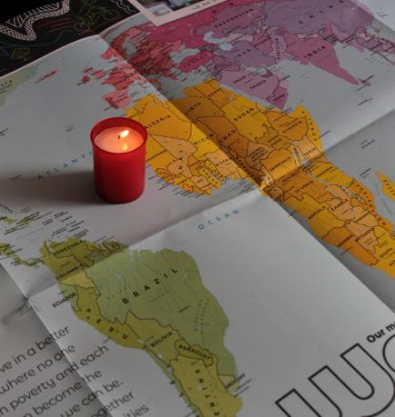
Let us pray
We pray for our brothers and sisters around the world who are living in poverty:
that we may listen to them, learn from them, and support them as they work to make a better life for themselves and their families.
Lord in your mercy…
We pray for our parish, family and friends:
that we may grow in faith and in love for one another and share the good news through our actions.
Lord in your mercy…

Slide 14
Let us pray
In this Jubilee Year:
we pray that we may be signs of hope in our world, in all that we do and how we treat each other.
Lord in your mercy…
Generous God, we thank you for all the good things you have given us.
Help us to follow the example of Jesus, to care for others and to share the good news through our actions.
Amen.

Slide 15
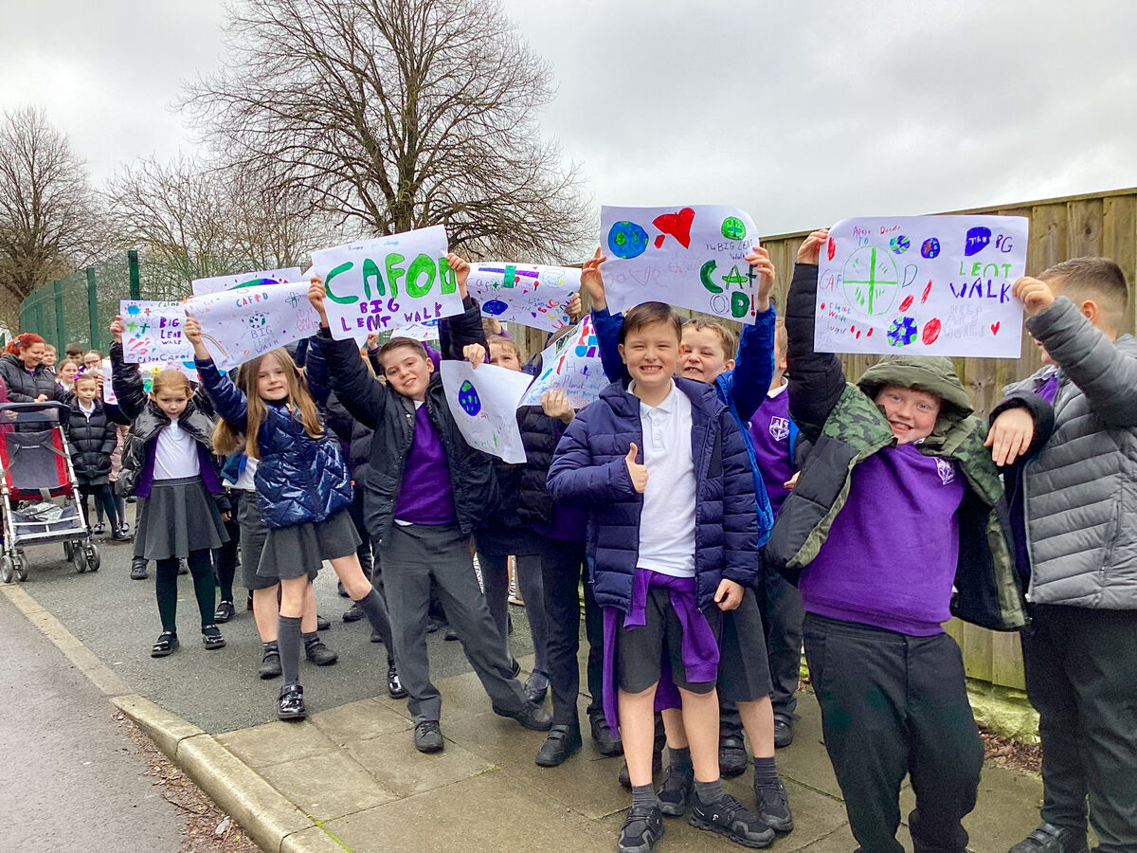

How will you try to be like Jesus this week, sharing the good news that God loves us all?
Send
Notes:
Supporting CAFOD
Photo credit: CAFOD

Slide 16
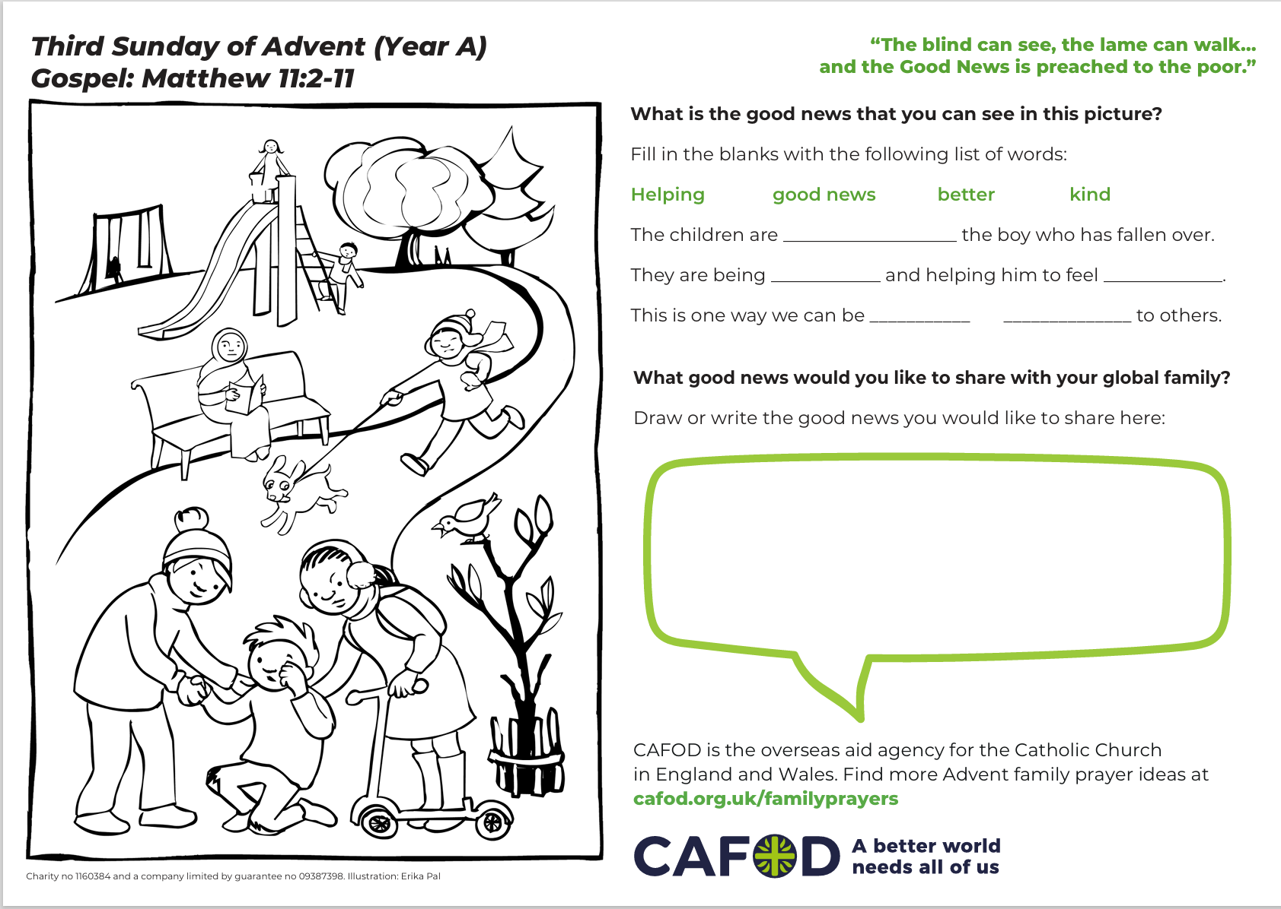
Activity suggestions
Download the illustration
Share the accompanying activity sheet with the children. Invite them to colour in the illustration of the children helping someone and to think of other ways we can help others, both here and overseas. Encourage them to do the other activities on the sheet either now or at home later.
Sometimes we hear more stories of doom and gloom than of good news. Encourage the children to think about good news and something positive they can share. Gather these good news stories on sticky-notes or pieces of paper. They could be personal e.g. “My team won the football match yesterday” or more general: “God loves me and God loves everybody.”
Remind the children to share all that they have heard and thought about in the liturgy today with people at home. Encourage them to do at least one thing in the next week that could be a sign of hope or good news to someone in need.
Notes:
Illustration: Erika Pal

Slide 17



Get involved with CAFOD this term
Join us!
Prepare...
Advent resources
Jubilee Celebration Day!
Join our Advent assembly!
Download the Advent calendar

Slide 18
