Slide 1


A selection of prayers
Prayer for a summer of hope
A coronavirus prayer
For the world’s people
A prayer to the Holy Spirit
For the poor and the earth
For refugees
For justice
For peace
A Marian prayer
For the oppressed
For the hungry
For those who mourn
Click on each prayer in presentation mode to move directly to the correct slide

Slide 2

Prayer for a Summer of Hope
Lord of all hopefulness,
fill me with a spirit of hope this summer.
Help me not to dwell on the things I will miss,
but treasure each day as a gift from you
and embrace every opportunity to share hope with others.
I entrust to you my family, my friends
and all our sisters and brothers around the world
continuing to endure the effects of coronavirus.
Bring new hope and new life to us all,
through Christ our Lord.
Amen

Slide 3

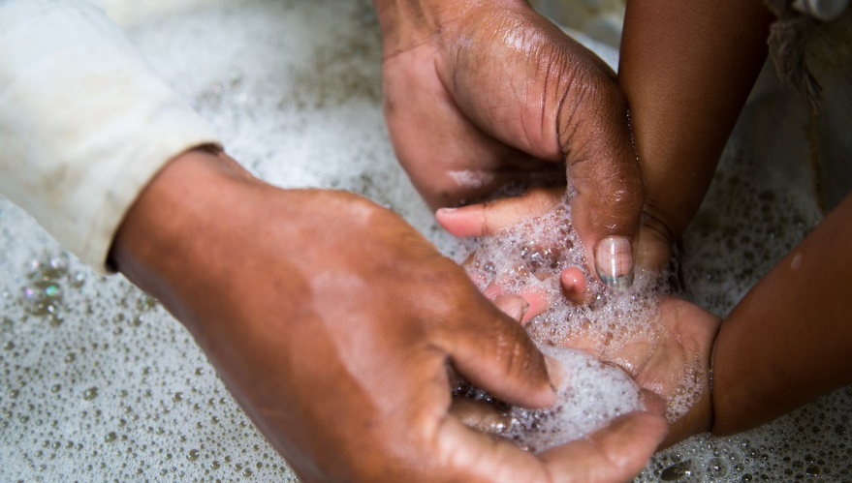
Coronavirus prayer
God of hope, love and mercy,
united in prayer with our global family,
we ask for quick control of the virus that is spreading in our world.
We pray for our sisters and brothers who are affected,
especially those in poor communities without healthcare.
Heal the sick, give eternal life to those who have died
and console families who have lost loved ones.
Help governments and health authorities
to make wise decisions for the good of everyone.
We pray that medicine for the sickness will be quickly found.
Hold us all in your merciful love. Amen.
Based on a prayer from the Bishops of Africa and Madagascar

Slide 4
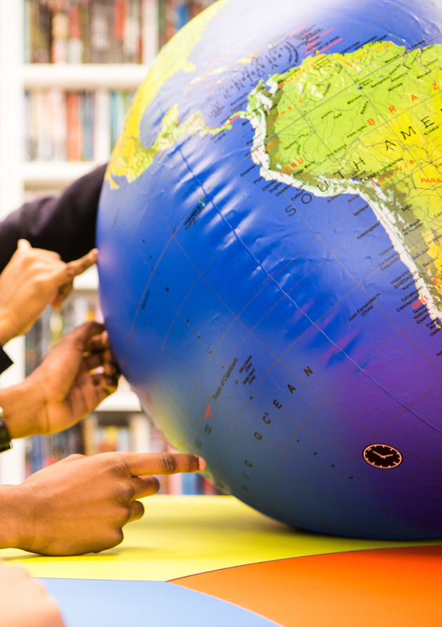

Prayer for the world’s people
Heavenly Father,
You hold the whole world deep in your heart,
sharing our pains and burdens,
delighting in our joys and successes.
We offer you our prayers –
both spoken and unspoken –
and ask you to hear us
as we pray for others around our world.
[Those who wish to, each name a country]
We make these prayers
in the name of the Father,
and the Son and the Holy Spirit. Amen.

Slide 5
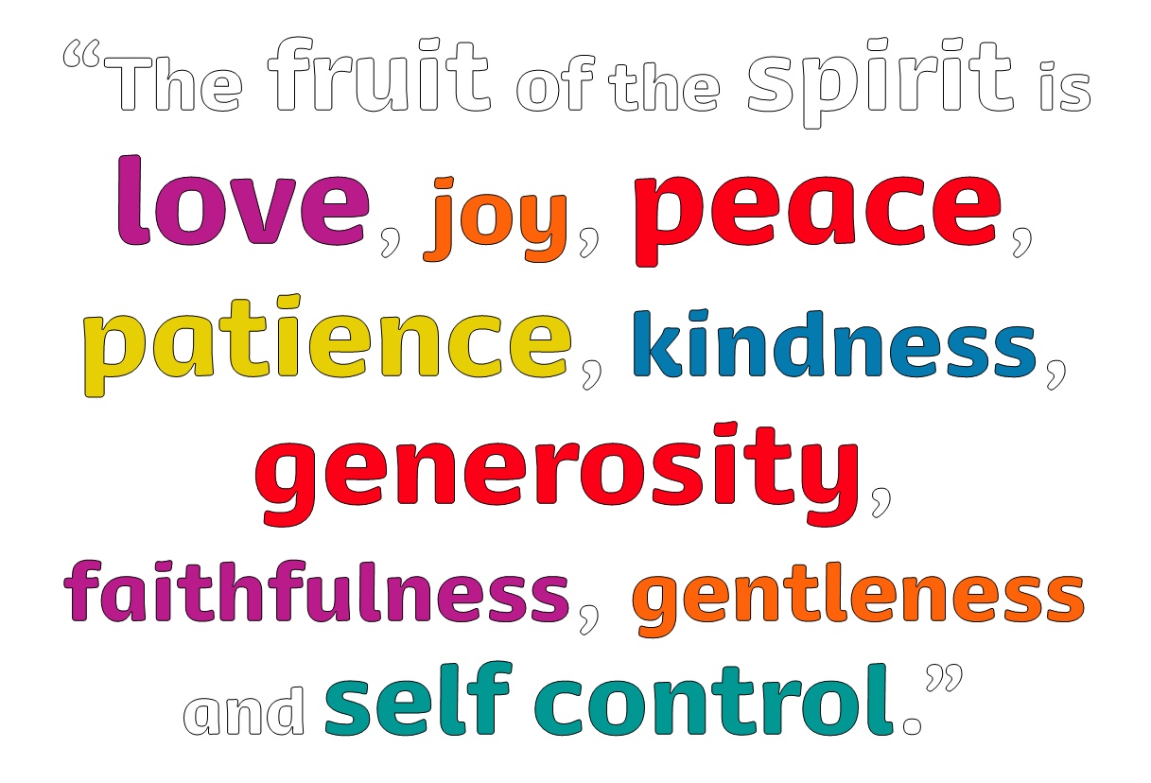

We pray to the Holy Spirit:
That love may fill our hearts so that we are open to others…
Response: Come, Holy Spirit, help us to transform our world
That all your children may find joy in their lives…
That wars may cease, and peace may come…
That all peoples may learn to be patient and tolerant…
That those who suffer may experience kindness…
That generosity may be given to those in need…
That we may be faithful to the Lord’s command
to love all our sisters and brothers…
That vulnerable and forgotten people may
receive gentleness and respect…
That we may be able to put others first to help them in their need…

Slide 6
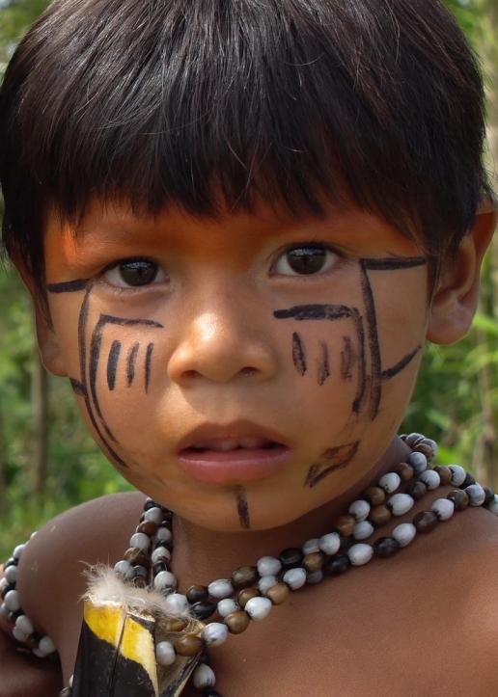
A prayer for the poor and the earth
God of the poor, help us to rescue the abandoned and forgotten of this earth. Touch the hearts of those who look only for gain at the expense of the poor and the earth. Teach us to discover the worth of each thing, to be filled with awe and contemplation, to recognise that we are profoundly united with every creature as we journey towards your infinite light. Encourage us, we pray, in our struggle, for justice, love and peace. AMEN
Pope Francis, Laudato Si’, 2015

Slide 7
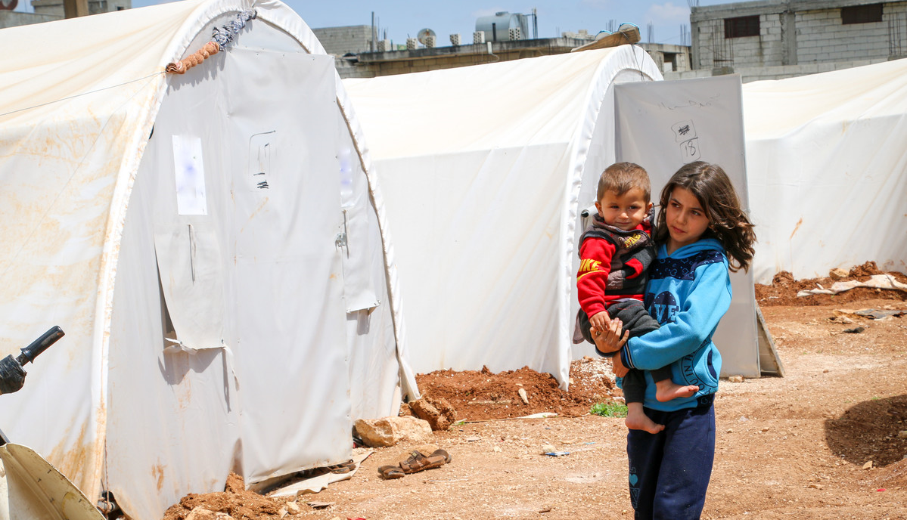
A prayer for refugees
Jesus, friend and brother,
You know what it is like
to be hungry and thirsty.
You know what it feels like
to be a stranger who is made unwelcome.
You know the suffering
of all who have lost everything.
We pray that by welcoming refugees
we may show love for our neighbour
and be closer to you.
Amen.
Tony Singleton/CAFOD

Slide 8

A prayer for justice:
Lord Jesus,
you were angry and indignant
when you saw people hurt by injustice.
We share your anger
with those systems of injustice
and hatred in the world.
Thank you that you offer us
a new way of acting
that overcomes injustice – a way of love.
Help each of us to live out
the determination we share,
so that, with your Holy Spirit,
we might be able
to transform the world around us. Amen
Illustration by Ellis Nadler

Slide 9
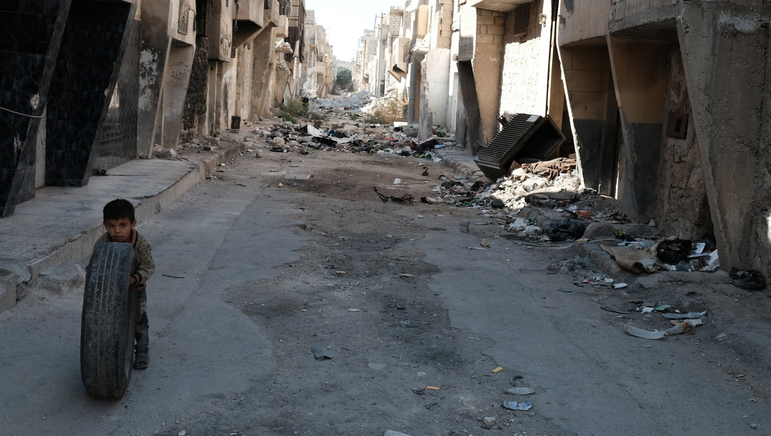
A prayer for peace
We pray for our sisters and brothers around the world
in countries where there is war and violence.
God sent his Son, so that all might have life in abundance.
Lord, give peace to your people throughout the world.
The time will come when there will be no more crying, nor pain, nor war.
Lord, give peace to your people throughout the world.
Jesus, the Prince of Peace, will stand beside us.
Lord, give peace to your people throughout the world.
We pray together for the coming of God’s kingdom of love, justice and peace.
Our Father…

Slide 10
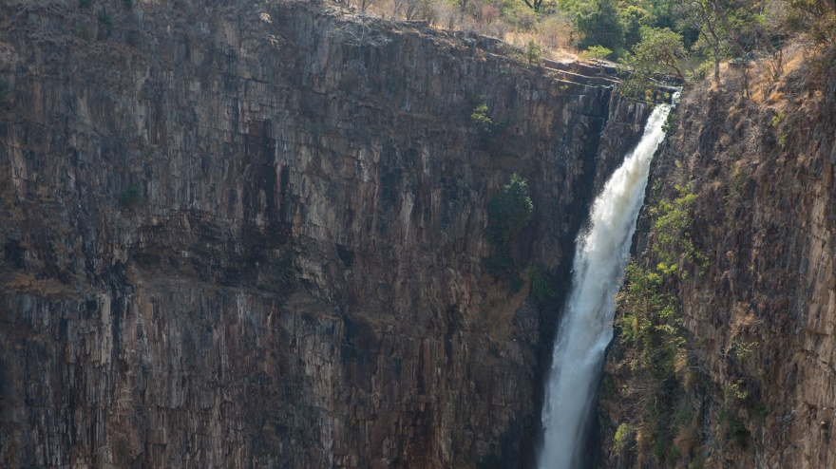
A Marian prayer
Holy Mary, Mother of God,
you have given the world its true light,
Jesus, your Son – the Son of God.
You abandoned yourself completely
to God's call
and became a wellspring
of the goodness which flows from him.
Show us Jesus. Lead us to him.
Teach us to know and love him,
so that we too can become
capable of true love
and be fountains of living water
in the midst of a thirsting world. Amen
Pope Benedict XVI, Deus Caritas Est

Slide 11
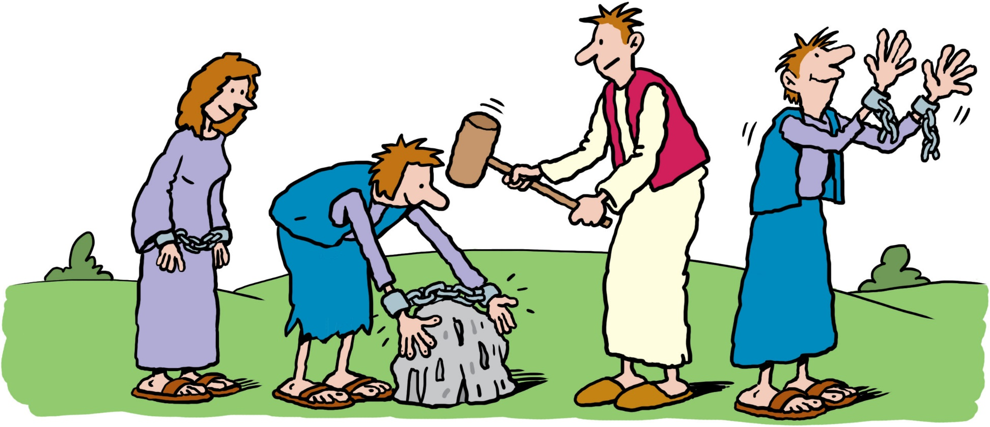
A prayer for the oppressed
Jesus, you knew what it was to be poor and oppressed,
ignored and ridiculed, unjustly accused and unfairly convicted.
Be with everyone whose rights are ignored.
And may we stand with them too.
Embolden us to speak truth to power,
to break the chains of injustice
and to set free the oppressed.
Amen.
“Is not this the kind of fasting
I have chosen: to loose the chains of injustice and
untie the cords of the yoke,
to set the oppressed free…?”
Isaiah 58:6
Illustration by Ellis Nadler

Slide 12
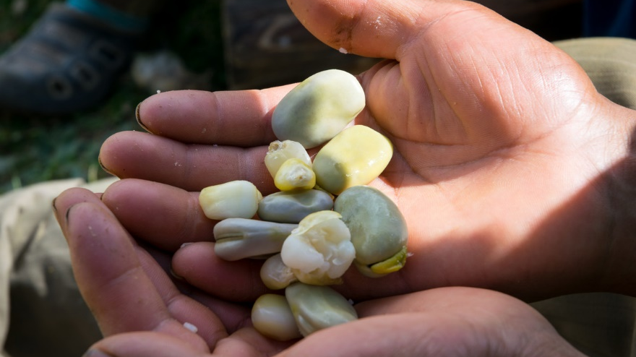
A place at the table
God our Father,
thank you for the abundance of your creation,
and the generosity of your gifts.
We are sorry that so many people in our world
are excluded from the feast prepared by you
for all to share.
May your Spirit lead us to seek change,
so that hunger and poverty are no longer a scar
and a scandal in our world.
May your Spirit guide us as we seek change,
so everyone has enough food to flourish
and a place at the table you spread for all. Amen.
“On this mountain, for all peoples,
the Lord is preparing
a banquet of rich food.”
Isaiah 25:6

Slide 13
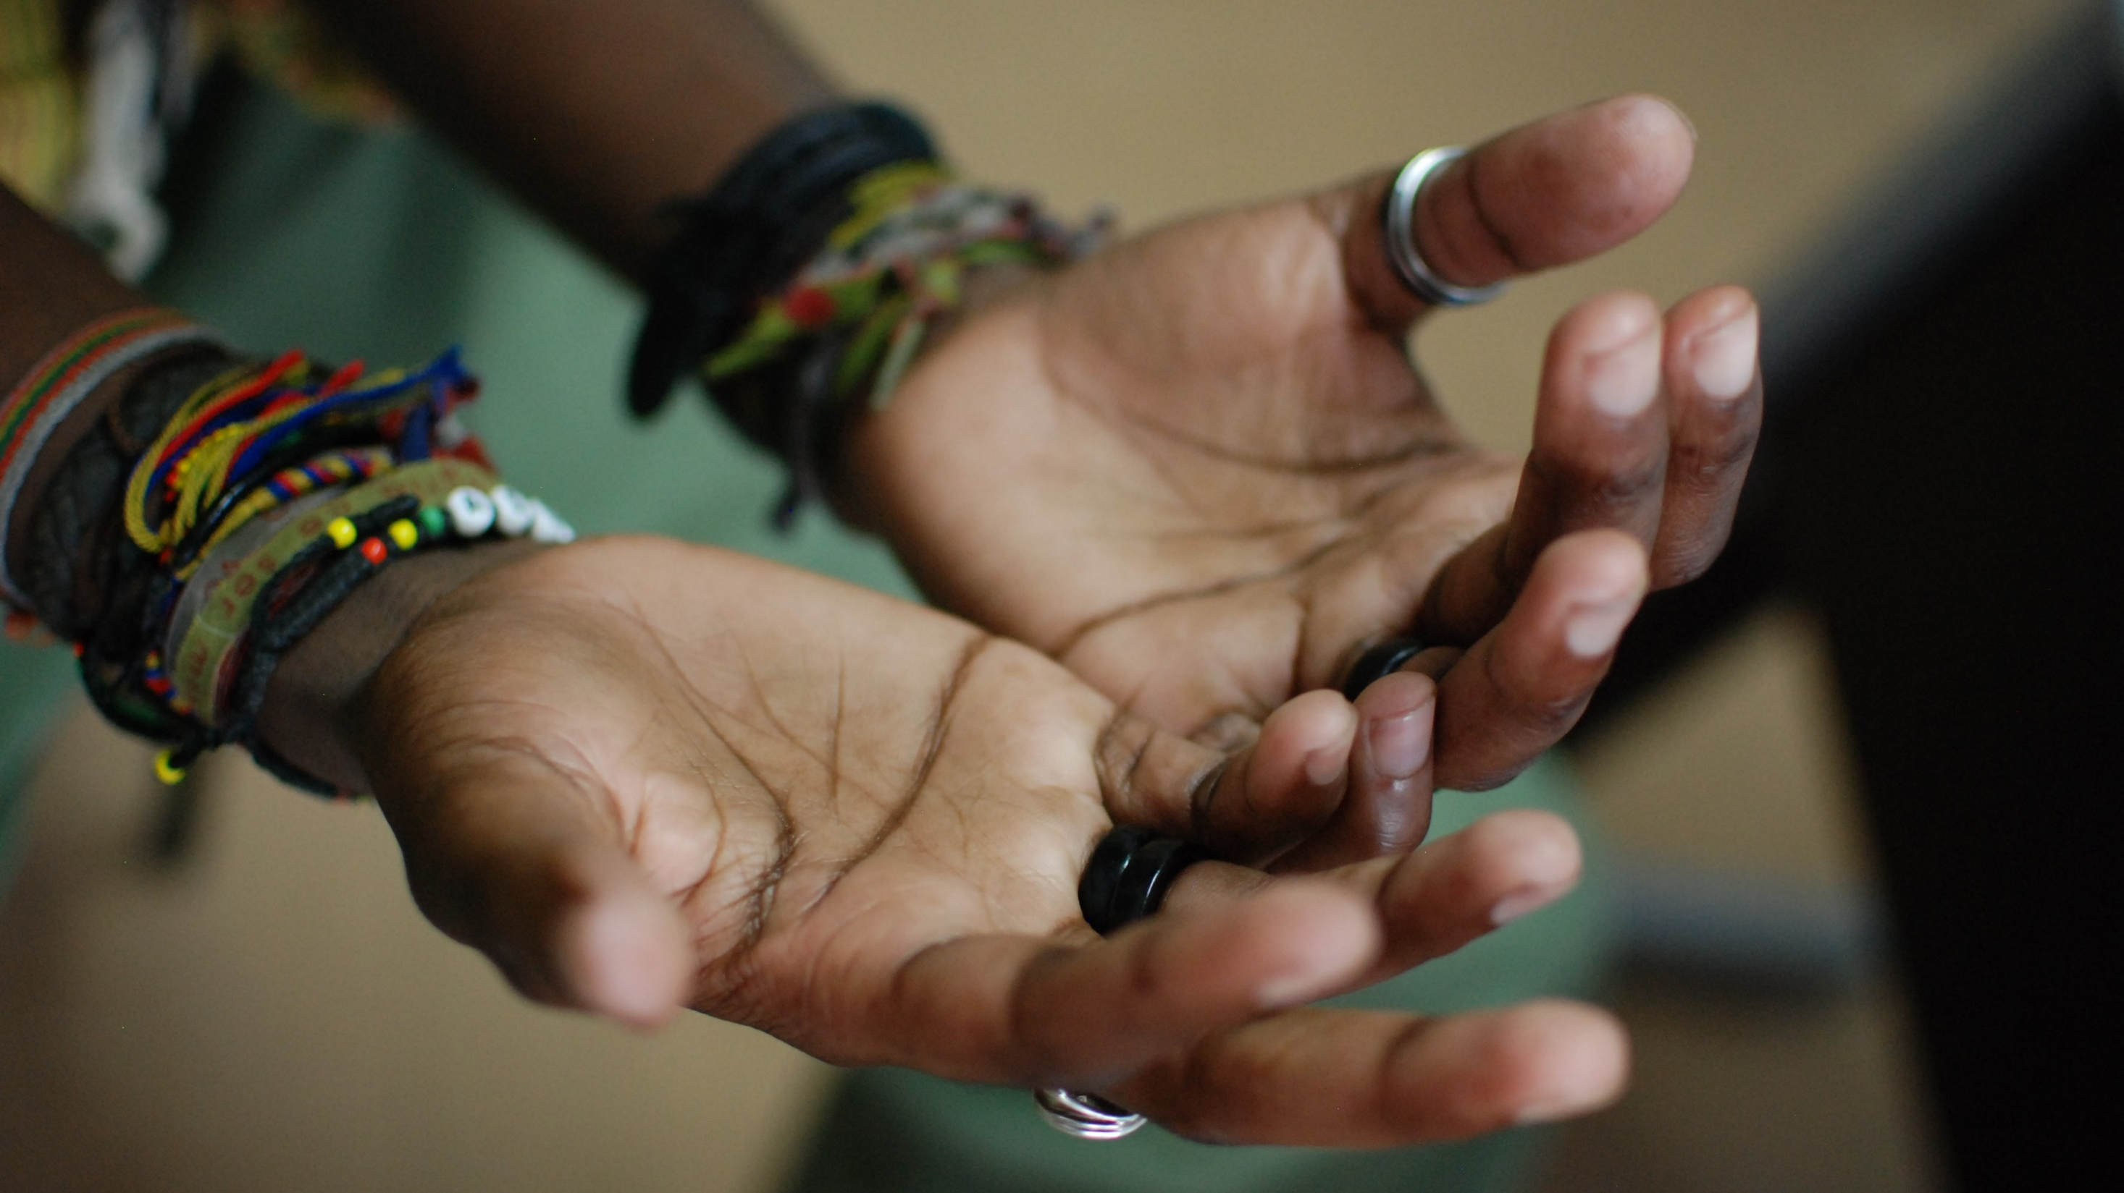
A prayer for those who mourn
Christ Jesus, you understand the pain of loss,
the grief that seems to take air from my lungs.
You are the resurrection and the life. All our hope is in you.
Lord Jesus, may I find a way through the darkness
to the light of your love.
You are the resurrection and the life. All our hope is in you.
Christ Jesus, you wept at the death of your friend, Lazarus.
Now your compassion wipes the tears from our eyes.
May we find comfort in reaching out to others who feel lost and alone.
You are the resurrection and the life. All our hope is in you.

