Slide 1
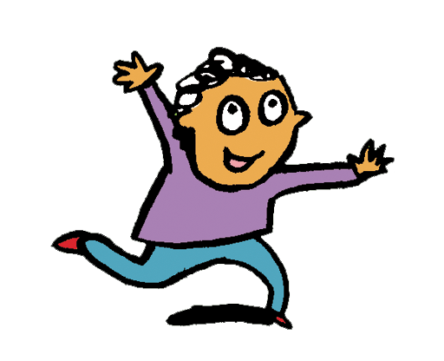
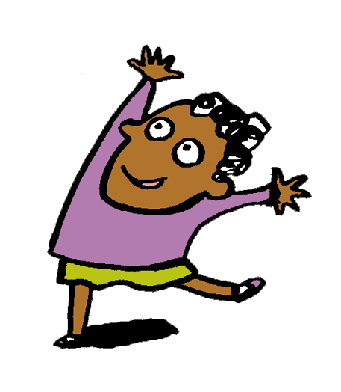
Reception Our World

Slide 2
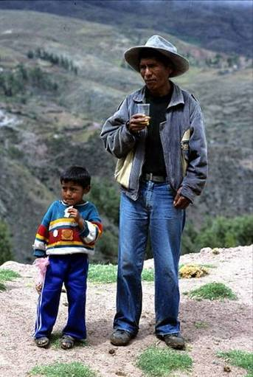
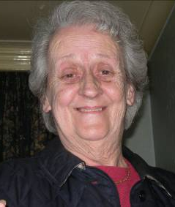
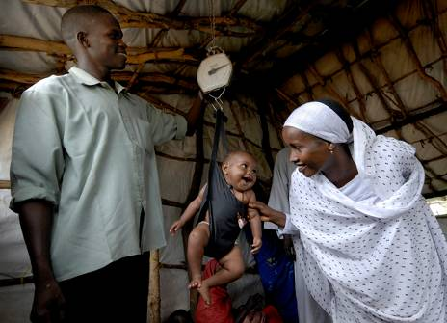
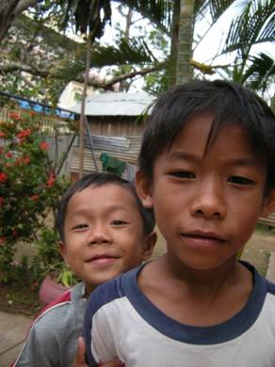
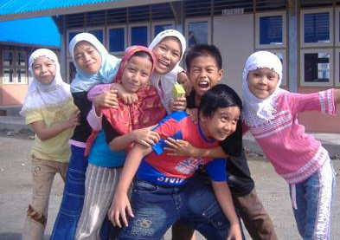
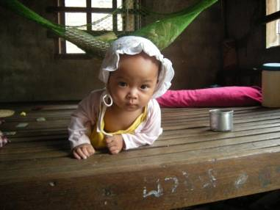
We are all part of God’s GLOBAL Family!

Slide 3
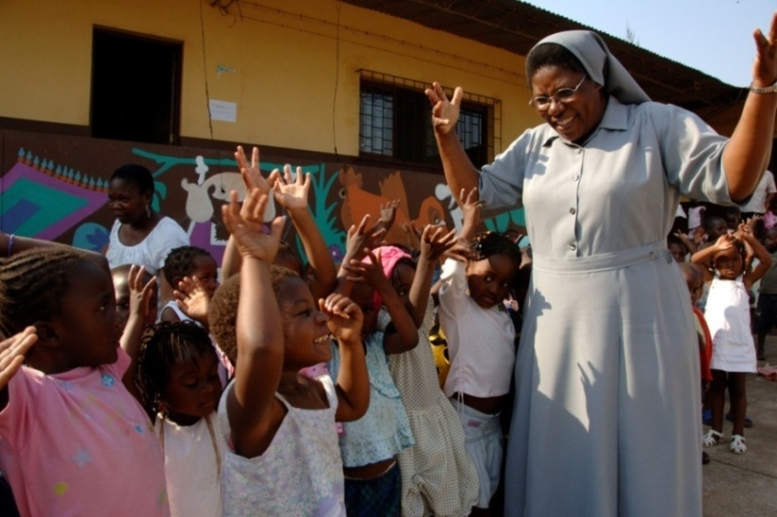
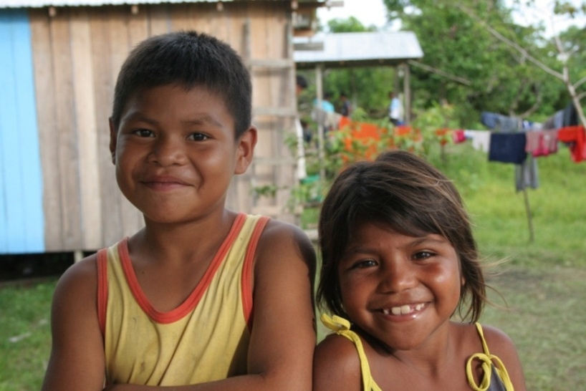
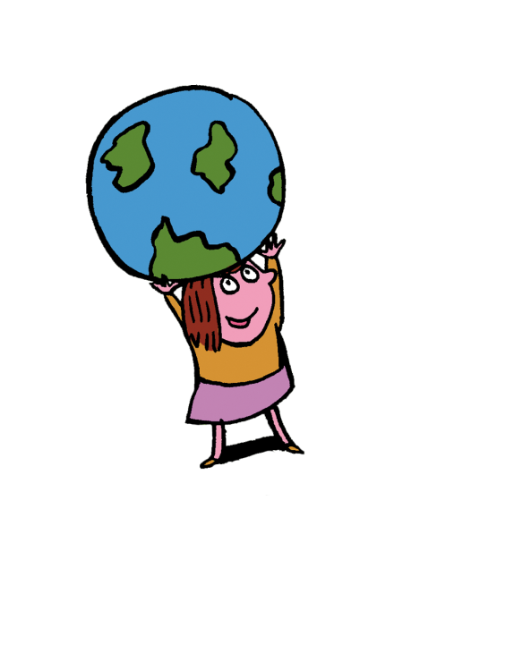
We all share God’s wonderful world.
God made all people equal.
CAFOD works with all people.
Notes:
CAFOD works with all people because God made all people equal.
Mozambique
PHOTOGRAPHER: Annie Bungeroth
Sister Susannah with children from the play school. The resettlement project rehoused 1,777 families from Chamanculo to a higher ground after the floods. The programme introduced homes, trees, plants, fields, electricity supply, wells & 3 schools. These are a kindergarten, primary & "professional" school for learning trades.
Sri Lanka
PHOTOGRAPHER: David Snyder
Young students in one of the older classrooms of the Zahira Muslim College. Caritas Sri Lanka supported the school with both a new classroom building and leadership training for its older students after the tsunami destroyed several buildings on the campus.
Brazil
PHOTOGRAPHER: CAFOD Staff Photographer
CAFOD and partner CIMI Tefé train indigenous participants from the community of Porto Praia how to plan, film and direct films about the issues that are affecting their community, which will be used to lobby local decision makers.

Slide 4
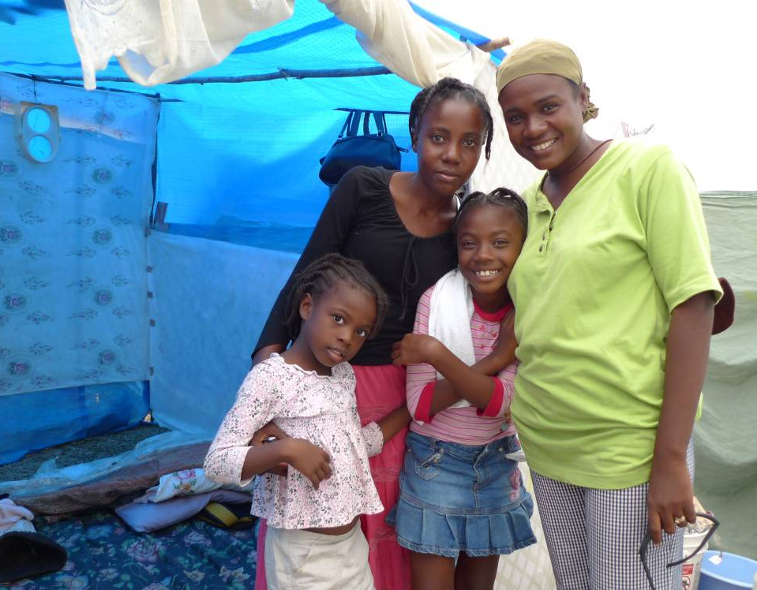
CAFOD is helping Carmen and her family to have the things they need.
Notes:
Carmen and her family live in Haiti. They survived the earthquake in January 2010. CAFOD is working to make sure they have the things they need.
PHOTOGRAPHER: CAFOD Staff Photographer

Slide 5
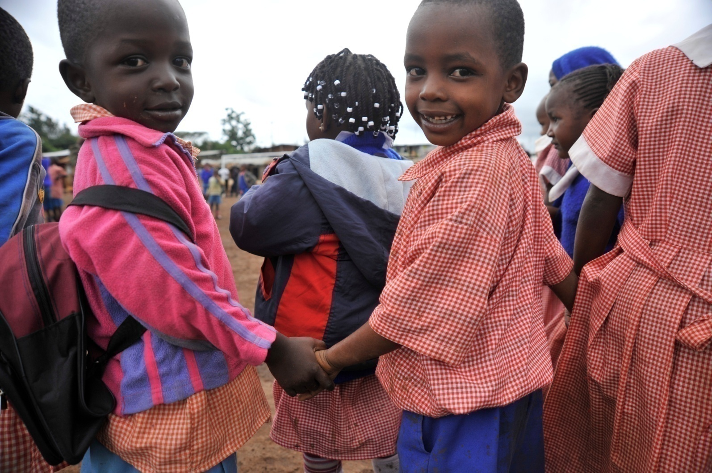
We all share God’s wonderful world.
We should all care for it.
Notes:
Children holding hands at Glory Primary School, Kibera, Nairobi (Kenya). CAFOD funds an after-school Peace Club in Glory Primary School, Laini Saba, where the children do songs, poetry and drama around the issue of peace, as part of our Youth Building Bridges for Peace in Kibera project.
PHOTOGRAPHER: Riccardo Gangale

Slide 6
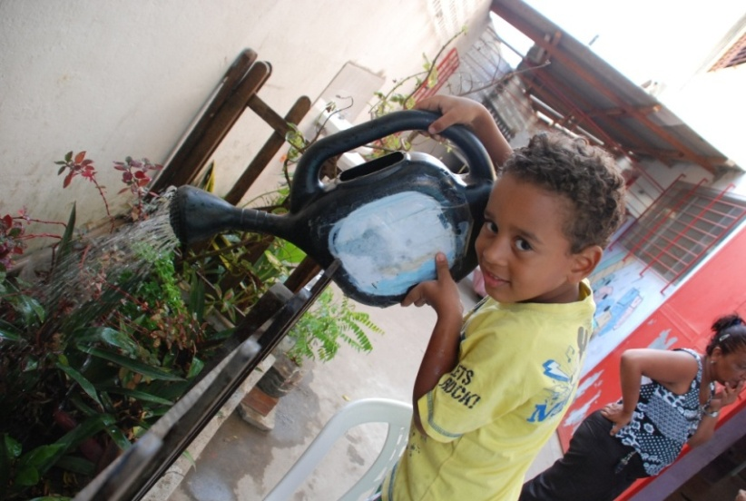
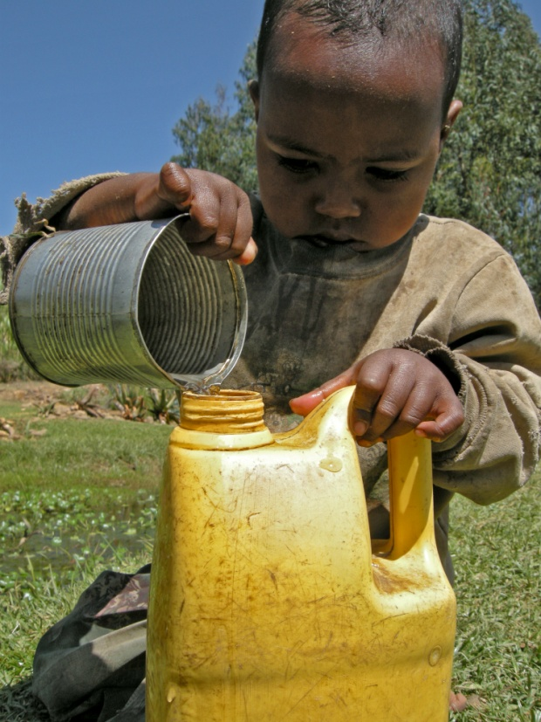
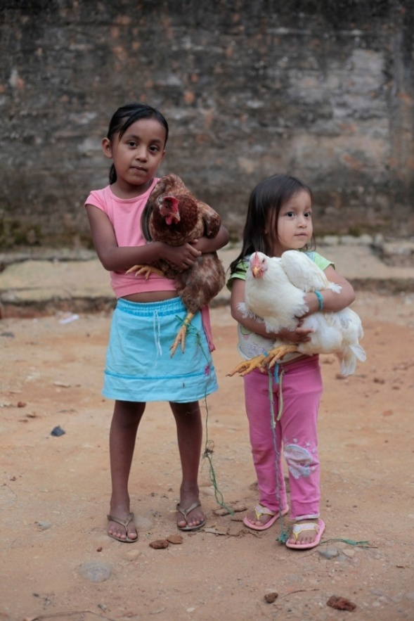
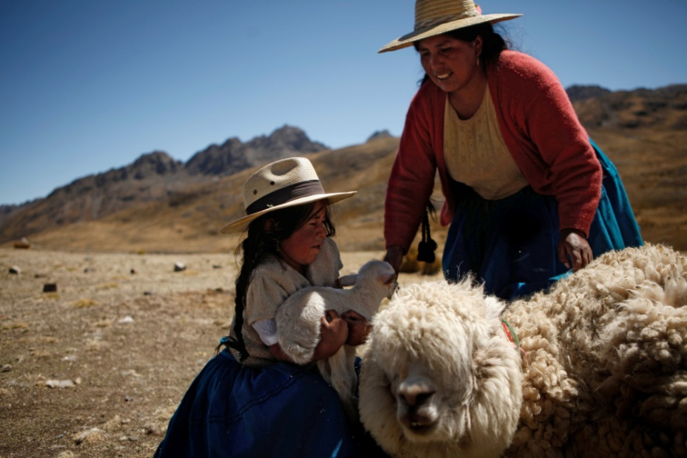
How can we take care of God’s world?
Notes:
Pictures of our brothers and sisters taking care of God’s world:
In Bolivia Aurelia Mamani, 33yrs, and her daughter Daisy, 7yrs, preparing alpaca for shearing. The wool is sold at market in La Paz to earn money to buy rice, sugar and oil, although Aurelia keeps some wool to weave into clothes and blankets.PHOTOGRAPHER: Luis Eduardo Galdieri
Azmera, 4 years old, gets water with her mother in Biera village, North Ethiopia. Photo credit: Ataklti Mulu
Two girls holding chickens in Florencia, Colombia. Photo credit: Paul Smith
In Brazil, children and young people prepare for the Christmas celebrations with workshops in stilt walking, dance, singing, music and costume making. The children will perform a Nativity display for parents and people in the community, using traditional songs, costumes, dances and music from the region. The aim of this is to encourage the local community to celebrate their local culture and take pride in the positive aspects of their community. PHOTOGRAPHER: CAFOD Staff Photographer

Slide 7
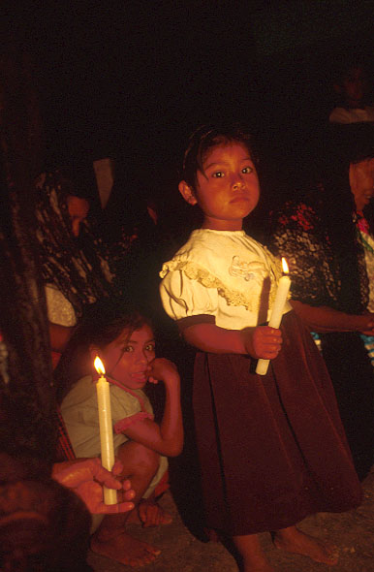
Let’s praise God together
Loving God,
we praise and
thank you for your
wonderful world.
Amen
Notes:
Mexico
PHOTOGRAPHER: Marcella Haddad
Prayers every morning in church of Virgin of Guadelupe during 3 day village fiesta. Indigenous Tseltal Mexicans, from Maya group. Catholics. Livelihoods threatened by coffee price collapse. People suffer discrimination + violence. Fomento educational work includes farming, human rights, health, protecting indigenous culture, women.

Slide 8
Picture credits: Paul Smith, Ataklti Mulu, Luis Eduardo Galdieri, Riccardo Gangale, Annie Bungeroth, David Snyder, Marcella Haddad, Paul Jeffrey, Simon Rawles, Caritas Internationalis, CAFOD.
Illustrations: Per Karlen

