Slide 1
What’s so special about 19 November?
Notes:
Why is November 19 such a special day? Because it is World Toilet Day.

Slide 2
World Toilet Day!

Slide 3
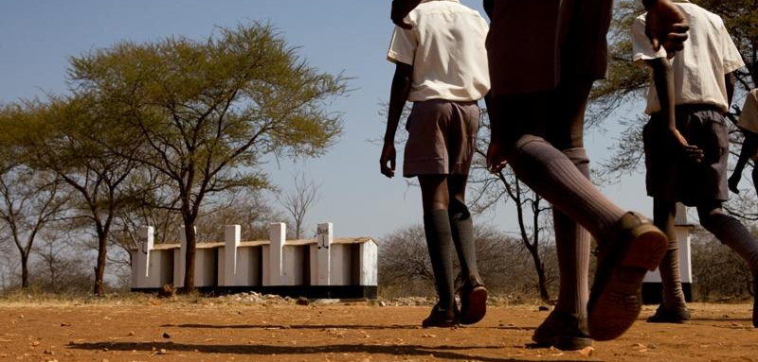
Why do we need World Toilet Day?
Notes:
Raise your hand if you have a bathroom/toilet at home? Raise your hand if you have a mobile phone? Did you know that more people own a mobile phone than a toilet? Think for a moment - how would you manage if you did not have a toilet at home?
1 billion* people in the world do not have a toilet in their house or even outside to use. This means they have to go to the toilet in the bushes or in a field. What do you think the risks may be in doing this? (Waste can get washed into the local rivers, it is unhygienic and can cause diseases, animals can attack you, etc).
*From WHO progress on Sanitation and Drinking Water update 2013

Slide 4
Toilets prevent disease!
Toilets save lives!
Notes:
Our toilets work so hard and are so vitally important. They save lives.
Local experts working with CAFOD have helped people to transform their lives, by supporting them to build toilets in their community.

Slide 5
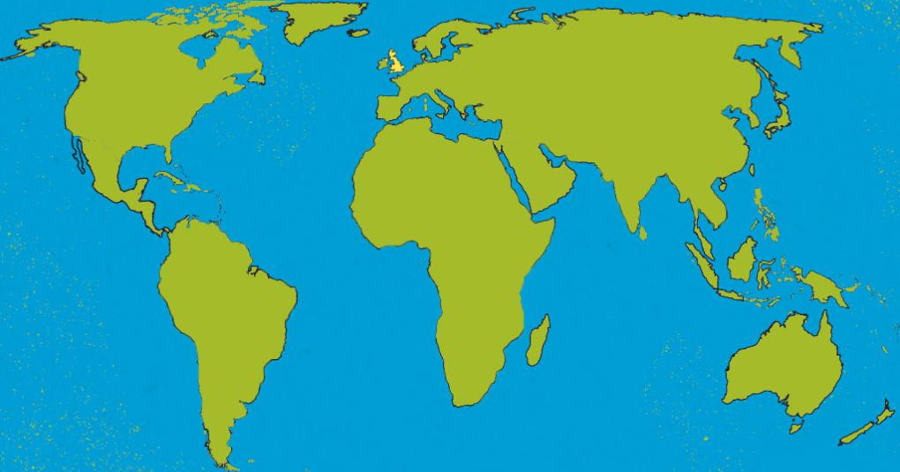
Zimbabwe
Notes:
Ten-year-old Zimisozettu, known as “Zimi”, lives in a remote village in Zimbabwe. Zimbabwe is a beautiful country in Africa. Her community faced the problem of a lack of toilets.

Slide 6
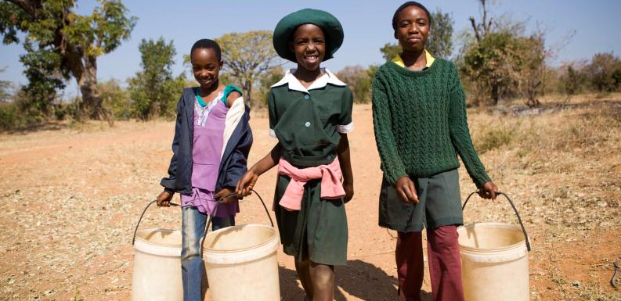
Notes:
Until recently, Zimi and her family didn’t have a toilet in their home. There were also no working toilets at Zimi’s school. That meant that Zimi had to use holes in the ground outside to go to the toilet.

Slide 7
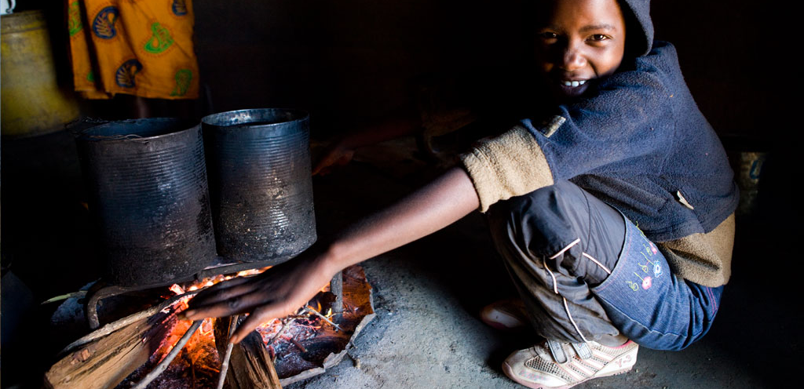
Having toilets in the school
means we are more hygienic. We help out by washing the toilets and keeping them clean. It’s good having toilets and a well near the school. It makes our lives easier.
Notes:
CAFOD has now helped the community to build toilets in Zimi’s home and at the local schools.

Slide 8
“Having good toilets in
school has improved our health - it’s rare for pupils to be off school with stomach problems these days.”
Thando, Zimbabwe
Notes:
This is Thando, he is Zimi’s cousin. Thando goes to the local secondary school.
CAFOD’s partner has also built toilets in Thando’s school.

Slide 9
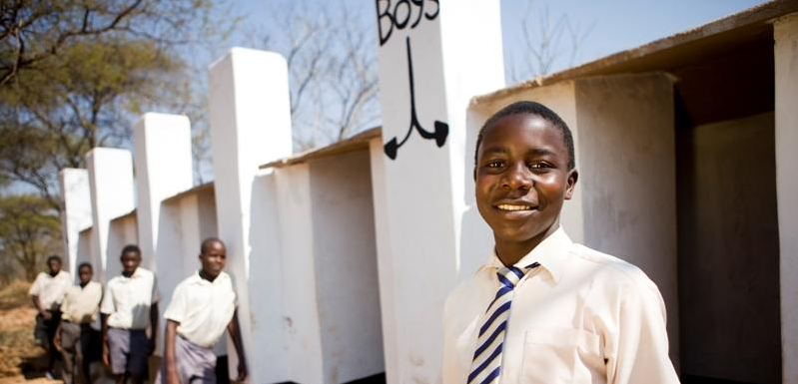
Notes:
The picture shows Thando and his friends outside their school toilets. One of Thando’s teachers says: “The law here says that every school needs a proper toilet. If CAFOD hadn’t come to help, one way or another, our school could have been forced to close. So thank you for constructing our toilets.”
Donations from CAFOD supporters has helped to build 35 toilets in the village so far.

Slide 10
Go potty for toilets!
£85 buys one community toilet!
Notes:
You can build a toilet for a community like Zimi and Thando’s. A community toilet can be bought for £85 through CAFOD World Gifts. Could you raise £85 in your school to buy a toilet?

Slide 11
Let us pray:
Loving God,
we pray for a world of justice
where everyone has access
to a toilet and clean water.
May all our sisters and brothers throughout the world
be able to live in dignity.
We thank you God for creating us all in your image
and making us your children.
Amen
Notes:
cafod.org.uk/schoolsworldgifts
Picture credits: Simon Rawles

