Slide 1
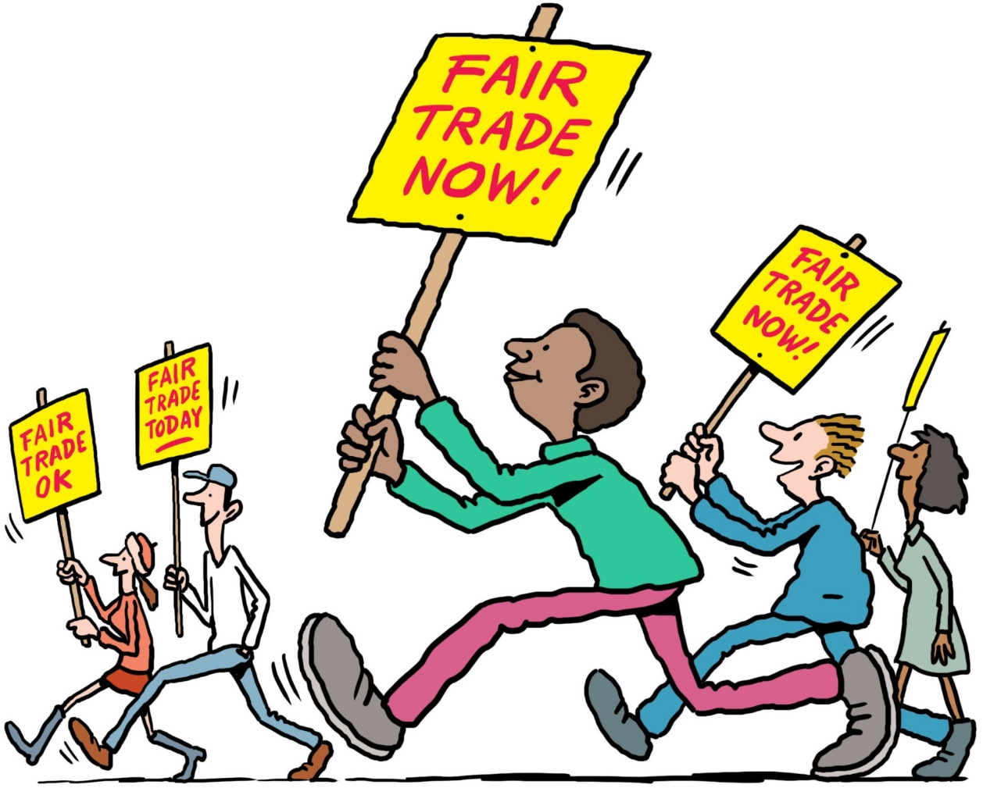
A prayer for justice:
Lord Jesus,
you were angry and indignant
when you saw people hurt by injustice.
We share your anger
with those systems of injustice
and hatred in the world.
Thank you that you offer us
a new way of acting
that overcomes injustice – a way of love.
Help each of us to live out
the determination we share,
so that, with your Holy Spirit,
we might be able
to transform the world around us. Amen
Illustration by Ellis Nadler

