Slide 1
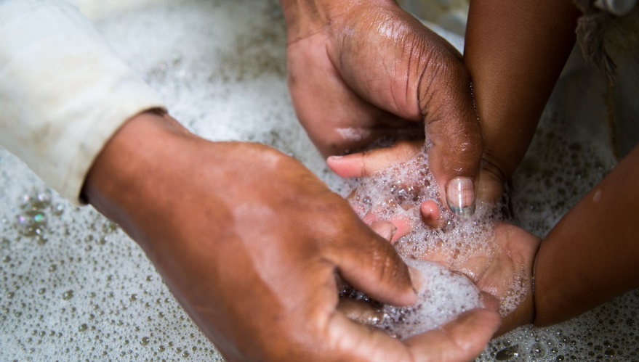
God of hope, love and mercy,
we pray for our sisters and brothers
in India, Brazil and other countries around the world
whose lives are affected by coronavirus.
We remember especially poor communities
struggling to find the healthcare they need.
Heal the sick, give eternal life to those who have died
and console families who have lost loved ones.
Help governments and health authorities
to make wise decisions for the good of everyone.
Hold us all in your merciful love.
Amen.

