Slide 1
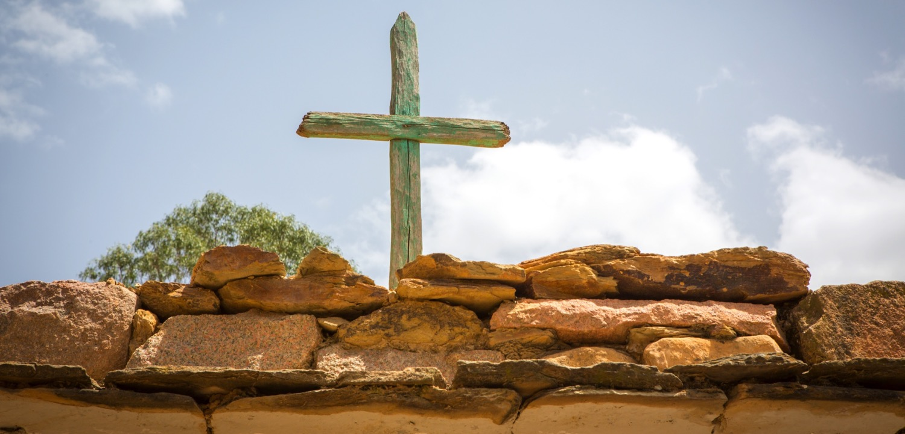
THE WAY OF THE CROSS
Based on teachings of Pope Francis
For young people
Notes:
FOR SETTING UP AND SCRIPT, PLEASE SEE LEADER’S NOTES THAT ACCOMPANY THIS RESOURCE: https://cafod.org.uk/content/download/54537/757608/version/3/Lent%202021%20Stations%20of%20the%20Cross_Secondary_Leaders%20Script.docx
Introduction
Leader: We are here to follow the Way of the Cross. This is a pilgrimage, in which we travel with Jesus along his path to the Crucifixion, stopping to reflect at different stages on the way. Today we will be helped by some powerful messages from Pope Francis. He asks us to think deeply about the harm we are causing our planet and to change the way we live. He places special hope in young people, pointing out how many care about the environment.
Reader 1: He also says we need a new system that does not shut out so many of our sisters and brothers trapped in poverty.
To make our world a better place, we have to act together as one human family. As Pope Francis says: “we are either all saved together or no one is saved.” (Fratelli Tutti 137)

Slide 2
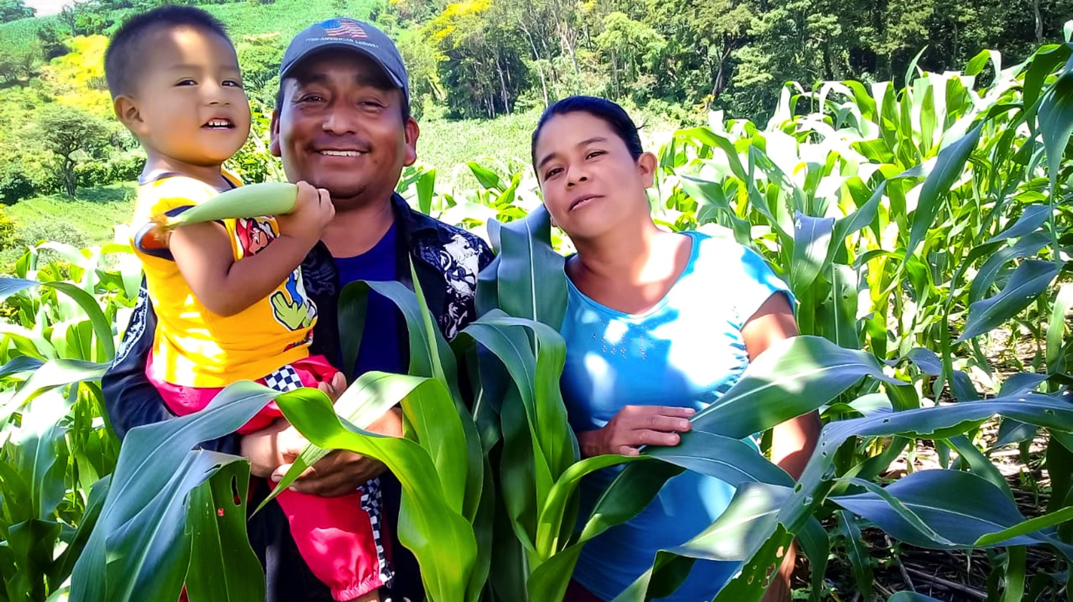
Prayer after each Station
Lord, help us to protect our shared home
and live as one single human family,
full of goodness and beauty. Amen
Notes:
Reader 2: Let’s reflect on these important ideas as we follow our Way of the Cross.
For each Station we have an action and a reflection, then we will repeat this prayer together:
All: Lord, help us to protect our shared home
and to live as one single human family,
full of goodness and beauty.

Slide 3
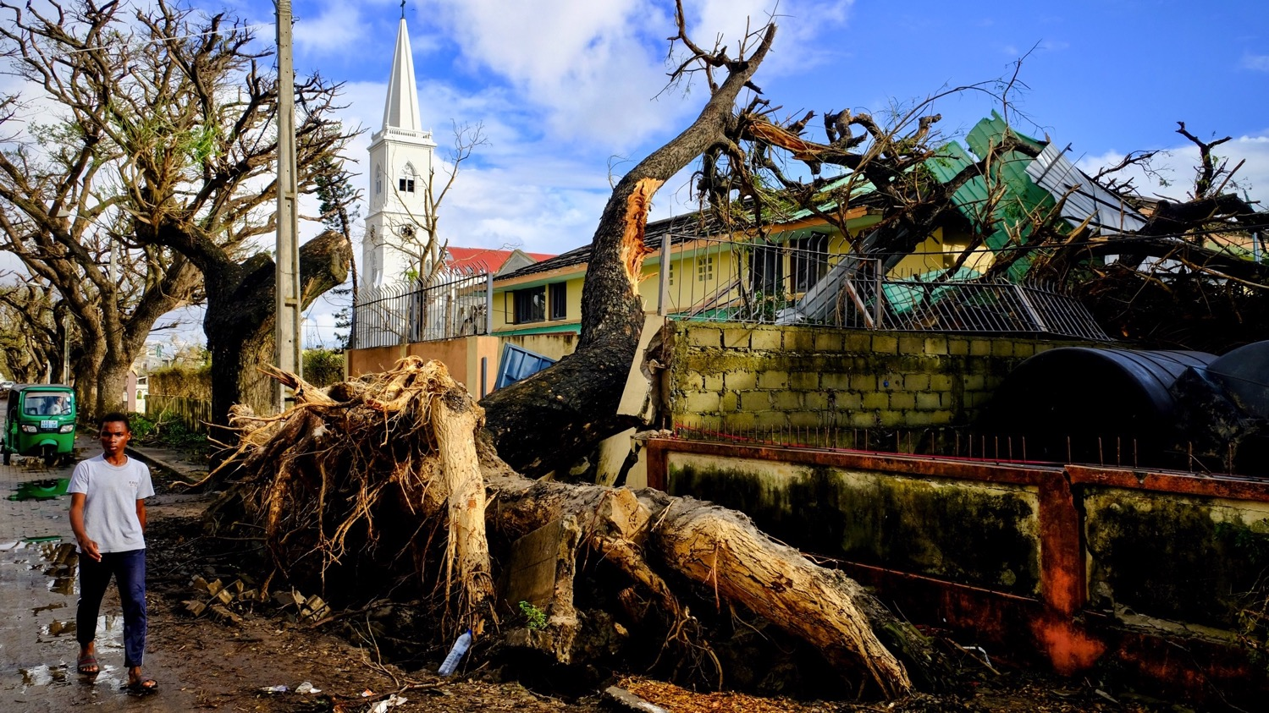
I Jesus is condemned to death
AMAZON PEOPLE’S RIGHTS
Brazil / London
Our earth is crying out to us, because of the harm we have caused her.
Notes:
R1: The first Station: Jesus is condemned to death
Action: Light the candle and open the Bible.
The earth is crying out because of the harm we are causing. (Laudato Si’ #2)
R2: Pilate said to them, ‘Then what should I do with Jesus who is called the Messiah?’ All of them said, ‘Let him be crucified!’
R3: Jesus sets out on his path of suffering at the hands of humankind – our hands. God sent us his only son as a great gift, yet we condemned him to death.
It seems we are making the same mistake with God’s gift of creation. Human beings are polluting the land, the oceans and the air.
R4: May we learn to treat the good things God spreads before us with love and respect.

Slide 4
I Jesus is condemned to death
AMAZON PEOPLE’S RIGHTS
Brazil / London
R: Lord, help us to protect our shared home and live as one single human family,
full of goodness and beauty. Amen
Notes:
All: Lord, help us to protect our shared home
and to live as one single human family,
full of goodness and beauty.

Slide 5
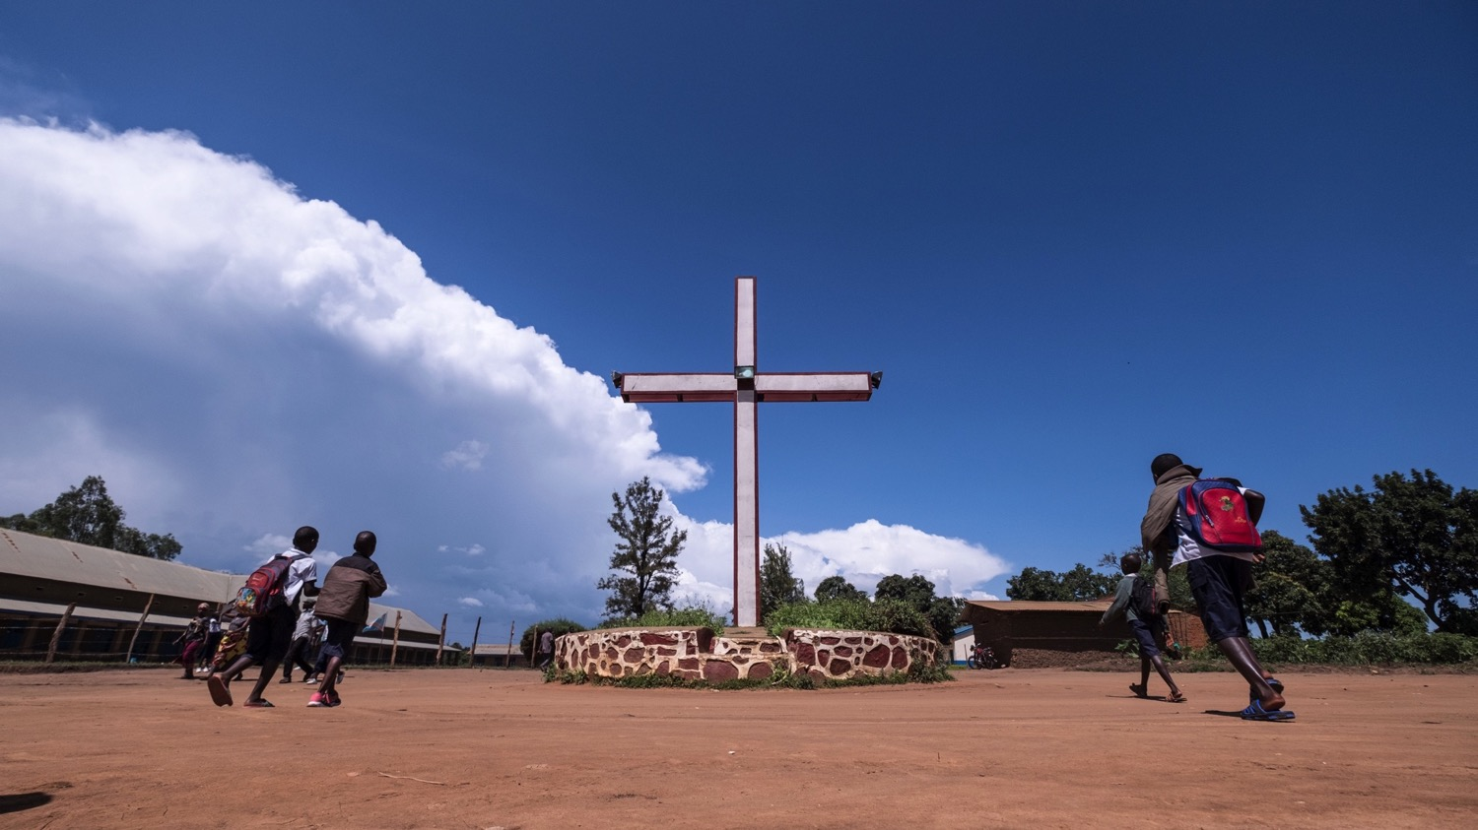
II Jesus carries his cross
The climate crisis is worst for the poor, who have done least to cause it. Like Jesus, they carry the cost of our actions.
Notes:
R1: The second Station: Jesus carries his cross
Action: Place the large wooden cross by this Station, or at the front of the room.
The climate crisis is worst for the poor, yet they have done least to cause it. Like Jesus, they carry the cost of our actions.
R2: “After mocking Jesus, the soldiers stripped him of the robe and put his own clothes on him. Then they led him away to crucify him.” Matthew 27:28-31
R3: Climate change is hitting the poorest hardest. They are bearing the worst of severe weather events like droughts and floods, and have little to fall back on when disaster strikes. Yet greenhouse gas emissions have mostly been caused by richer nations.
We can’t stand by while others suffer for our actions. Let us demand change from our leaders to reduce emissions fast.
R4: We feel sorrow for the times when we have failed to understand how our actions impact others.

Slide 6
II Jesus carries his cross
R: Lord, help us to protect our shared home and live as one single human family,
full of goodness and beauty. Amen
Notes:
All: Lord, help us to protect our shared home
and to live as one single human family,
full of goodness and beauty.

Slide 7
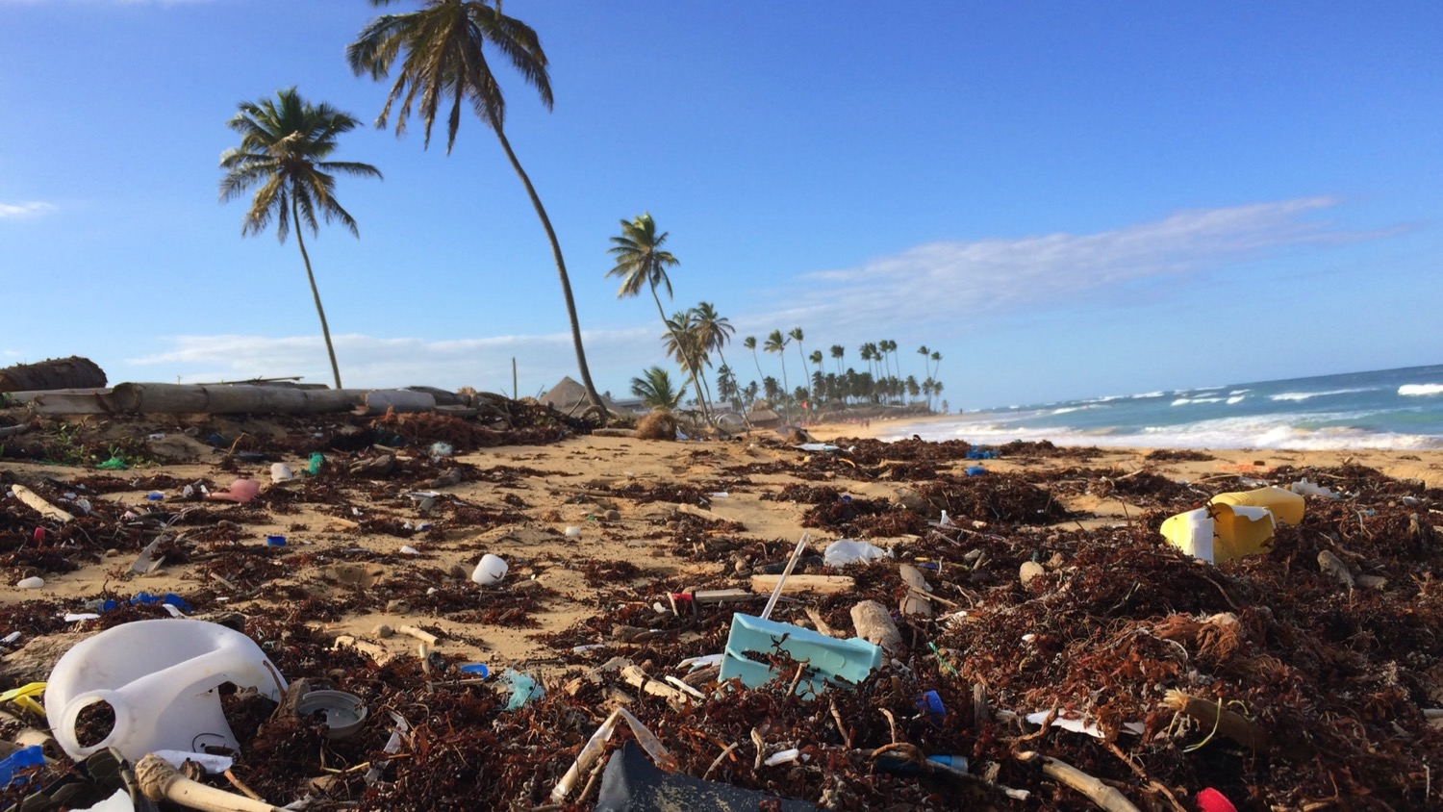
III Jesus falls the first time
“Never have we so hurt and mistreated our common home as we have in the last two hundred years.”
Notes:
R1: The third Station: Jesus falls the first time
Action: Scatter plastic rubbish beneath this image if it is on the wall, or at the front of the room beside the cross. Imagine Jesus falling to the ground.
“Never have we so hurt and mistreated our common home as we have in the last 200 years.” (Laudato Si’ 53)
R2: “He was wounded for our transgressions, crushed for our iniquities; upon him was the punishment that made us whole, and by his bruises we are healed.” Isaiah 53:5
R3: Our world is fragile, entrusted by God to human care. We must be careful with the power we have over it. (Laudato Si’ 78)
R4: May we each do our part to reduce our carbon footprint through our daily actions.

Slide 8
III Jesus falls the first time
R: Lord, help us to protect our shared home and live as one single human family,
full of goodness and beauty. Amen
Notes:
All: Lord, help us to protect our shared home
and to live as one single human family,
full of goodness and beauty.

Slide 9
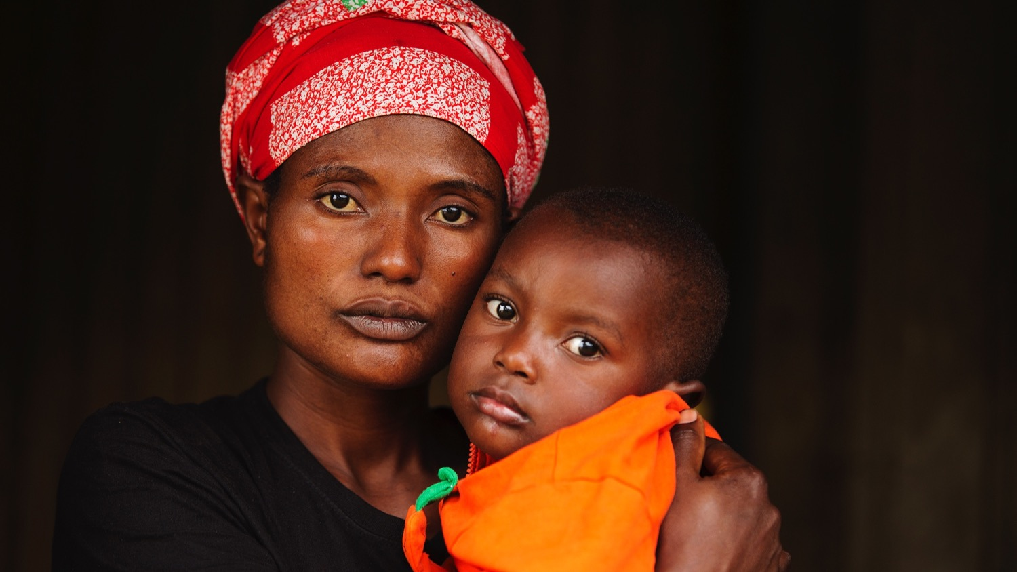
IV Jesus meets his mother
Mary is the Mother and Queen of all Creation, who grieves for the sufferings of the poor and for the creatures of this world.
Notes:
R1: The fourth Station: Jesus meets his mother
Action: pin up a sheet of paper with the word YES written on it – either beside the image or at the front of the room.
Mary is the Mother and Queen of all Creation, who grieves for the sufferings of the poor and for the creatures of this world. (Laudato Si’)
R2: “A sword will pierce your own soul too.” Luke 2:35
R3: Mary grieved for her son at the foot of the Cross, but as Pope Francis says: “she shared his suffering, yet was not overwhelmed by it. She was the woman of strength who uttered her ‘yes’.” (Speech in Panama 2019, quoted in Christus Vivit.)
Mary accepted what God asked of her, despite the risks. She didn’t think twice.
R4: We ask Mary to watch over us, her children, as we try to say yes to all that God asks of us.

Slide 10
IV Jesus meets his mother
R: Hail Mary…
Notes:
All: Hail Mary…

Slide 11
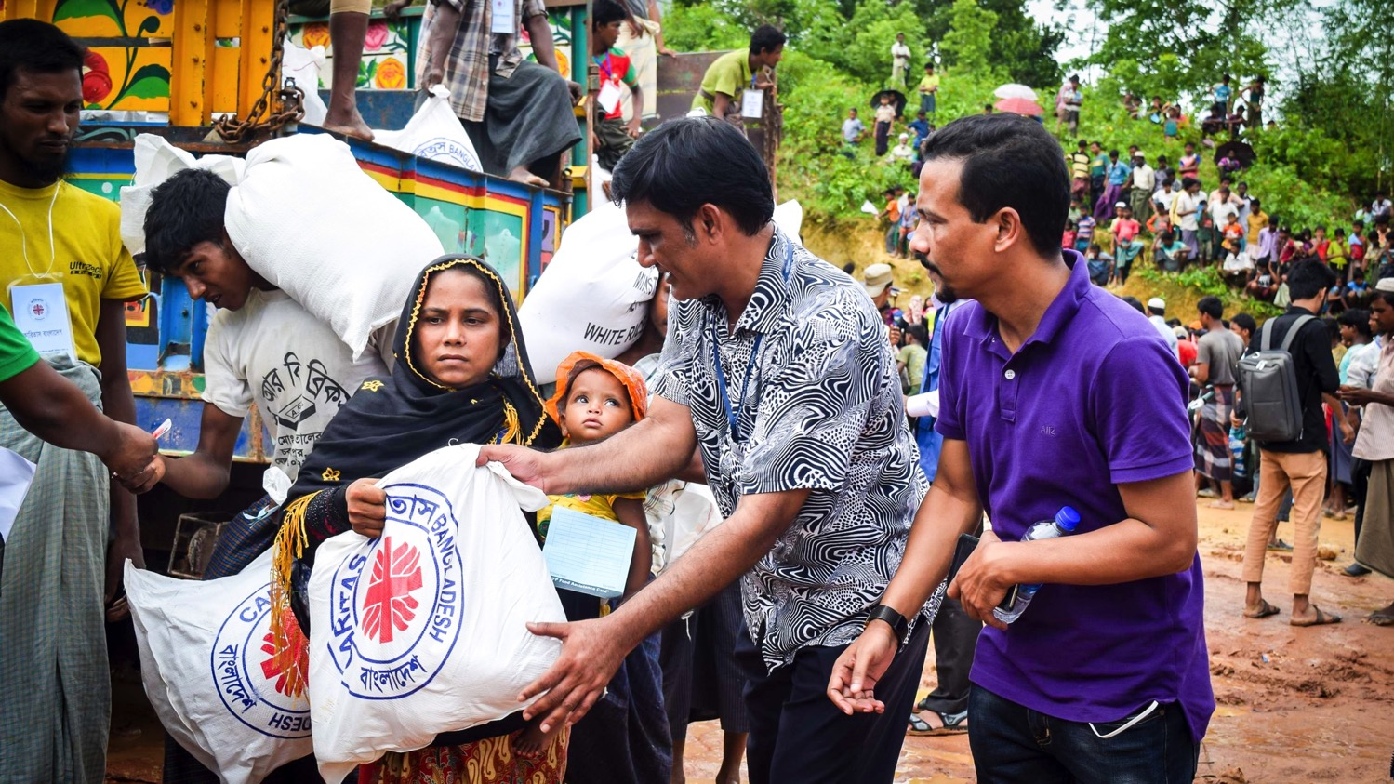
V Simon of Cyrene helps Jesus carry the cross
“God asks everything of us, yet at the same time he offers everything to us.”
Notes:
R1: The fifth Station: Simon of Cyrene helps Jesus carry the cross
Action: One person picks up the wooden cross and holds it high
God asks everything of us, yet at the same time he offers everything to us. (Evangelii Gaudium 12)
R2: “The soldiers compelled a passer-by, who was coming in from the country, to carry his cross.” Mark 15:20-21
R3: Jesus is too weak to carry the great weight of the cross up the hill of Calvary. Simon takes the heavy burden from him, although he must have been afraid to show support for a man condemned to death.
God can put very demanding and challenging tasks in front of us, yet also gives us the joy and courage to meet those challenges.
R4: Let us pray for the strength to help others, even when it seems risky or difficult. Pope Francis gives us this promise: “Our hearts expand as we step out of ourselves and embrace others.” (Fratelli Tutti 89)

Slide 12
V Simon of Cyrene helps Jesus carry the cross
R: Lord, help us to protect our shared home
and live as one single human family,
full of goodness and beauty. Amen
Notes:
All: Lord, help us to protect our shared home
and to live as a single human family, full of goodness and beauty.

Slide 13
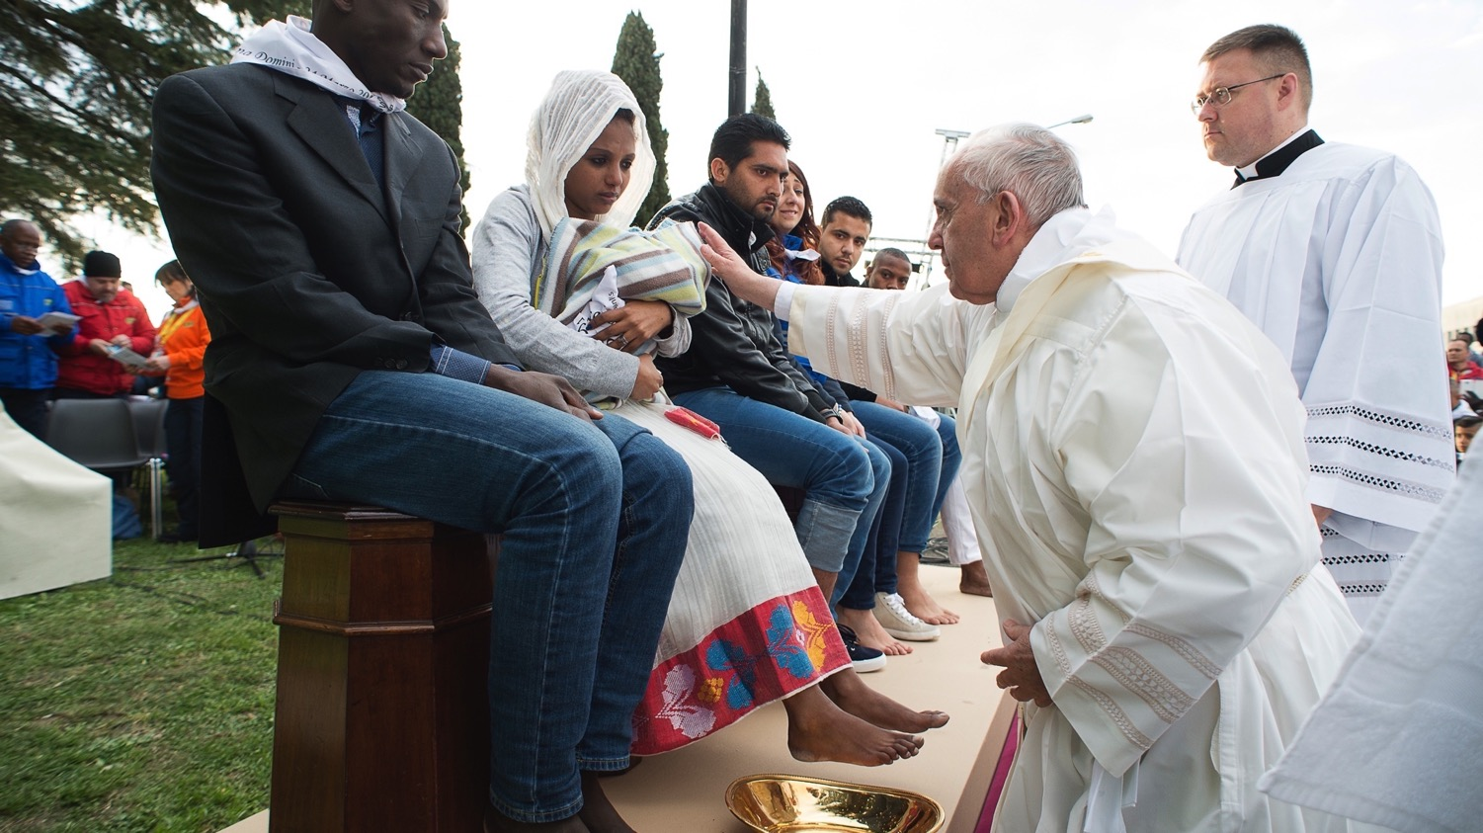
VI Veronica wipes the face of Jesus
Let us not miss out a kind word, a smile, or any small gesture that spreads peace and friendship.
Notes:
R1: The sixth Station: Veronica wipes the face of Jesus
Action: Place a bowl and a cloth beside the Bible and cross.
Let us not miss out a kind word, a smile, or any small gesture which spreads peace and friendship. (Laudato Si’ 230)
R2: ‘Truly I tell you, just as you did it to one of the least of these who are members of my family, you did it to me.’ Matthew 25:37-40
R3: Veronica is another bystander in Jerusalem, who is moved by Jesus’s suffering to step forward and wipe his tired face.
Pope Francis tells us the value of practising simple daily gestures that show we care for one another.
R4: May we reach out to others with everyday acts of love. Let’s live as one single human family.

Slide 14
VI Veronica wipes the face of Jesus
R: Lord, help us to protect our shared home
and live as one single human family,
full of goodness and beauty. Amen
Notes:
All: Lord, help us to protect our shared home
and to live as one single human family,
full of goodness and beauty.

Slide 15
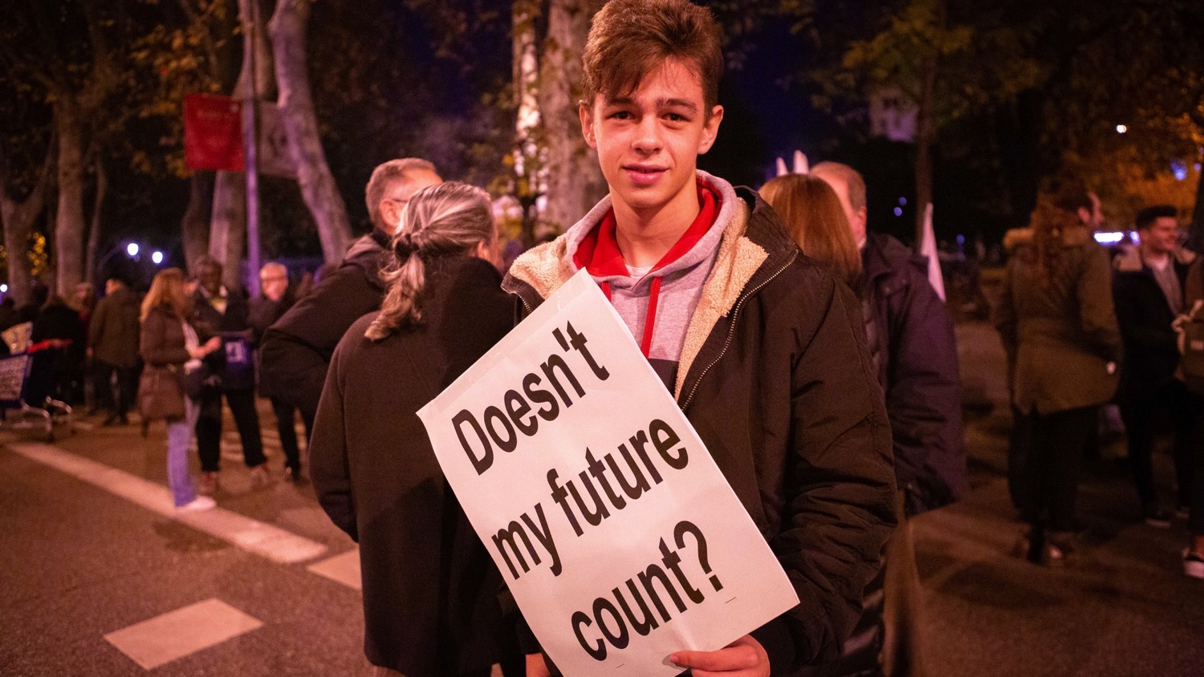
VII Jesus falls the second time
In the throwaway culture, young people themselves end up being discarded.
Notes:
R1: The seventh Station: Jesus falls the second time
Action: Bend to touch the ground and imagine Jesus falling. What must he be feeling now, his second fall in front of the soldiers, the crowd, his mother and friends?
In a throwaway culture, young people themselves end up being discarded. (Christus Vivit 78)
R2: “You have lived on earth in luxury and pleasure; you have fattened your hearts for the day of slaughter.” James 5:5-6
R3: Pope Francis warns of the destruction caused by our throwaway culture, which makes us want more and more without thinking of the cost to others, to the environment, and to our own inner selves.
The emptier our hearts, he says, the more we need things to buy to try and fill the space. We need a better way.
R4: Let us be open to change our lifestyles and live more simply, to find true and lasting satisfaction.

Slide 16
VII Jesus falls the second time
R: Lord, help us to protect our shared home
and live as one single human family,
full of goodness and beauty. Amen
Notes:
All: Lord, help us to protect our shared home
and to live as one single human family,
full of goodness and beauty.

Slide 17
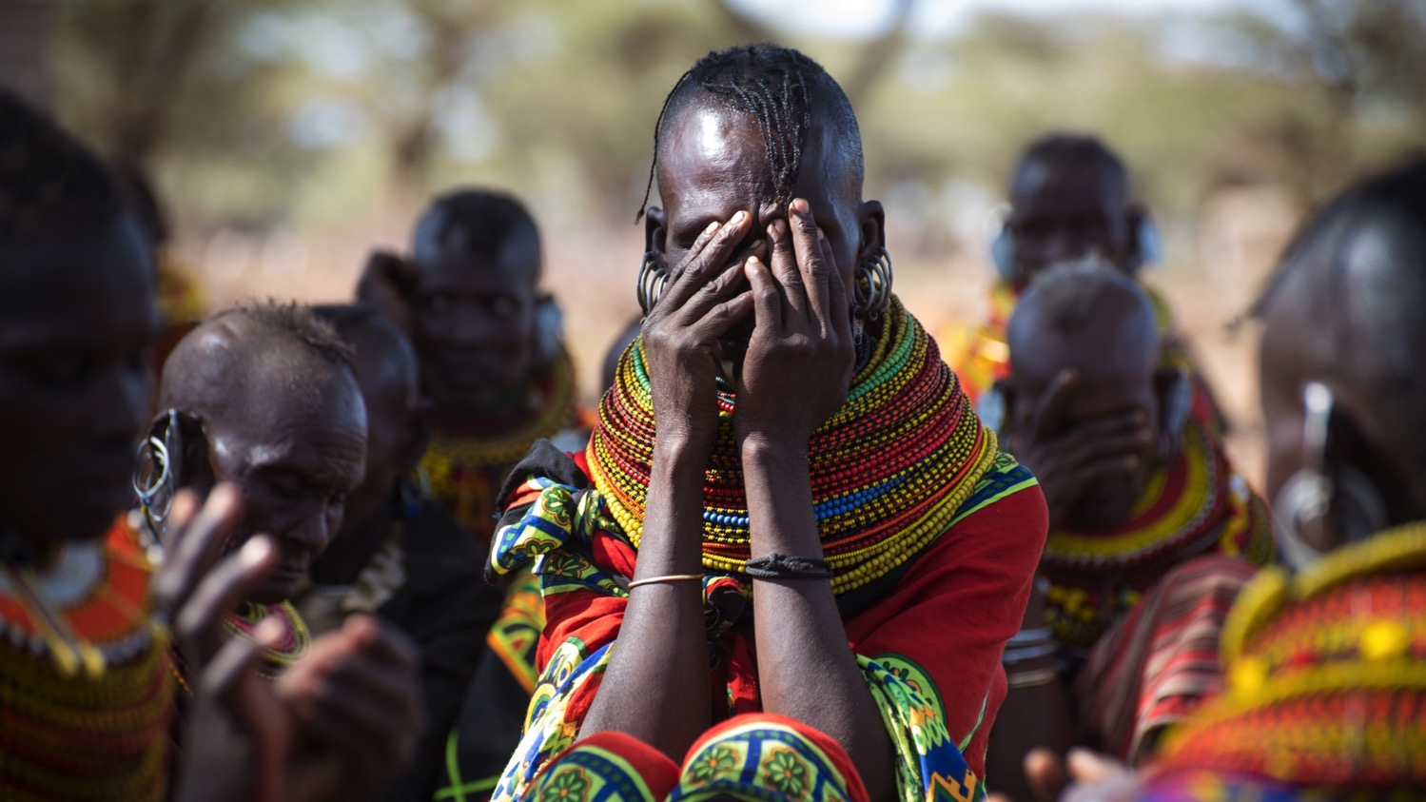
VIII Jesus meets the women of Jerusalem
Dare we turn what is happening to the world into our own personal suffering, and so decide what each of us can do about it?
Notes:
R1: The eighth Station: Jesus meets the women of Jerusalem
Action: share with your neighbour one way, however small, that you could help protect the earth.
Dare we turn what is happening in the world into our own personal suffering, and so discover what we can each do about it? (Laudato Si’ 19)
R2: “Among them were women who were beating their breasts and wailing for him.” Luke 23:28
R3: A group of women in the crowd mourn for Jesus as they follow him on the way to his death. They share in his pain. We too can feel sad and helpless, when we see what is wrong in our world.
R4: May we always believe that we can make a difference, when we act with love.

Slide 18
VIII Jesus meets the women of Jerusalem
R: Lord, help us to protect our shared home and live as one single human family,
full of goodness and beauty. Amen
Notes:
All: Lord, help us to protect our shared home
and to live as one single human family,
full of goodness and beauty.

Slide 19
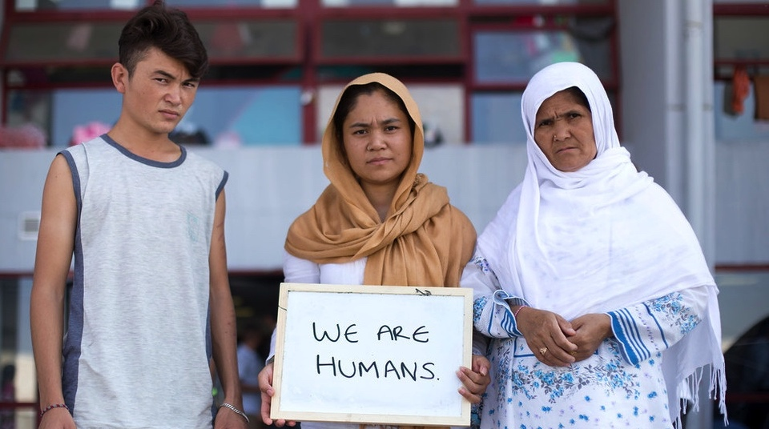
IX Jesus falls the third time
Billions of people, the excluded, frequently remain at the bottom of the pile.
Notes:
R1: The ninth Station: Jesus falls the third time
Action: Bend down and touch the ground. By now Jesus can barely walk. Yet he gets up again.
Billions of people, the excluded, frequently remain at the bottom of the pile. (Laudato Si’ 49)
R2: “Take my yoke upon you, and learn from me; for I am gentle and lowly in heart, and you will find rest for your souls. For my yoke is easy and my burden light.” Matthew 11:28-30
R3: Humanity, it seems, has disappointed God’s expectations. But Jesus, who knows how it feels to struggle and to fall, always holds out his hand to offer us hope. As Pope Francis says, “No one is useless and no one is expendable.” (Fratelli Tutti 215)
R4: May we always include those who are left out, or feel worthless. No one should be cut off from the love and care they need to live a happy life.

Slide 20
IX Jesus falls the third time
R: Lord, help us to protect our shared home
and live as one single human family,
full of goodness and beauty. Amen
Notes:
All: Lord, help us to protect our shared home
and to live as one single human family,
full of goodness and beauty.

Slide 21
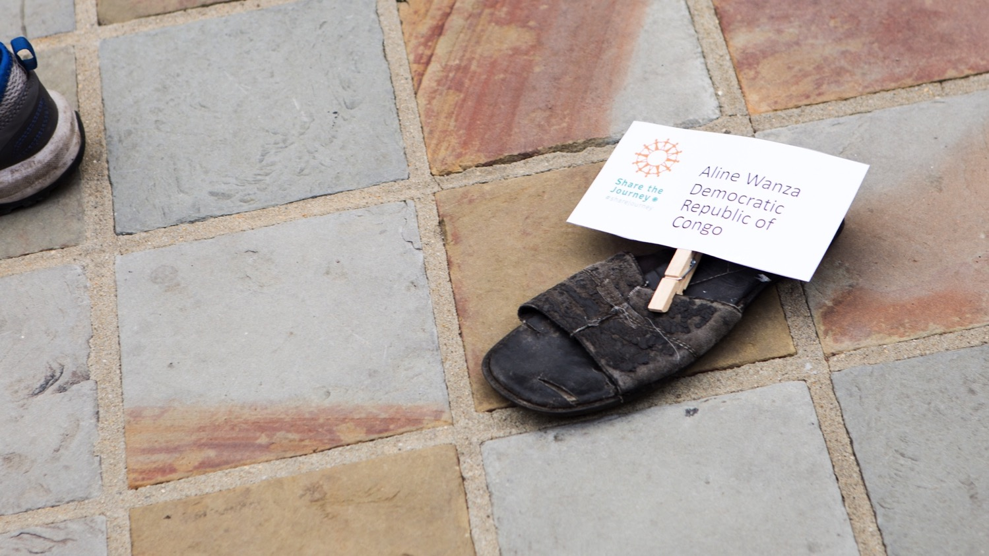
X Jesus is stripped of his clothes
“Not to share our wealth with the poor is to rob them and take away their livelihood.”
Notes:
R1: The tenth Station: Jesus is stripped of his clothes
Action: Think of a time when you felt someone else unfairly got more than you.
“Not to share our wealth with the poor is to rob them and take away their livelihood.” (St John Chrysostom, quoted in Fratelli Tutti 119)
R2: “The soldiers took his clothes and divided them into four parts, one for each soldier.” John 19:23
R3: These soldiers seem heartless, yet how poor must these men be, who scramble over the simple clothes of a wandering prophet.
The earth is a shared inheritance, says Pope Francis, whose fruits are meant to be shared by everyone. (Laudato Si’ 93)
R4: May we never be content with a world where the rich few enjoy so much, at the expense of the poor. Let’s not take more than our fair share of the earth’s resources.

Slide 22
X Jesus is stripped of his clothes
R: Lord, help us to protect our shared home
and live as one single human family,
full of goodness and beauty. Amen
Notes:
All: Lord, help us to protect our shared home
and to live as one single human family,
full of goodness and beauty.

Slide 23
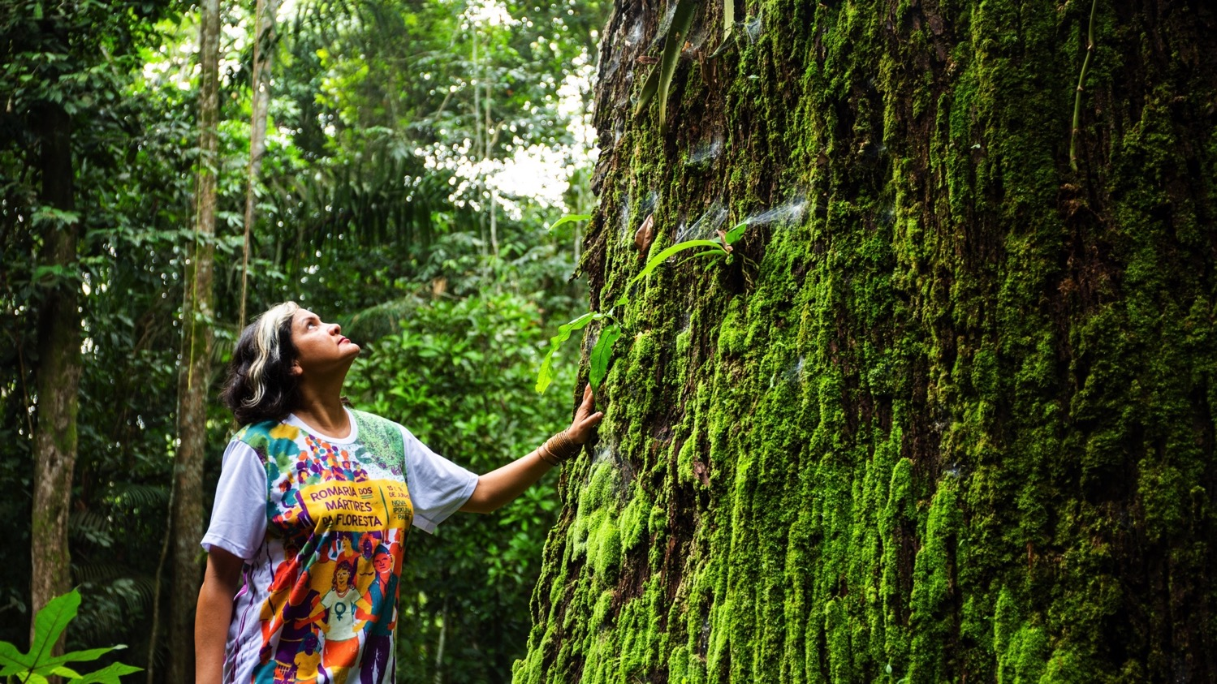
XI Jesus is nailed to the cross
“Let me say this once more: God never tires of forgiving us.”
Notes:
R1: The eleventh Station: Jesus is nailed to the cross
Action: Take the hammer and bang it against the block of wood three times, slowly.
Let me say this once more: God never tires of forgiving us. (Evangelii Gaudium 3)
R2: “When they came to the place that is called The Skull, they crucified Jesus there with the criminals, one on his right and one on his left.” Luke 23:33-34
R3: One of the thieves is sorry for what he has done and sees the goodness in Jesus. We may not always have done our best to care for each other and for the earth, but it’s never too late to change.
R4: May we always turn back to God whenever we are lost. He never tires of forgiving us.

Slide 24
XI Jesus is nailed to the cross
R: Lord, help us to protect our shared home
and live as one single human family,
full of goodness and beauty. Amen
Notes:
All: Lord, help us to protect our shared home
and to live as one single human family,
full of goodness and beauty.

Slide 25
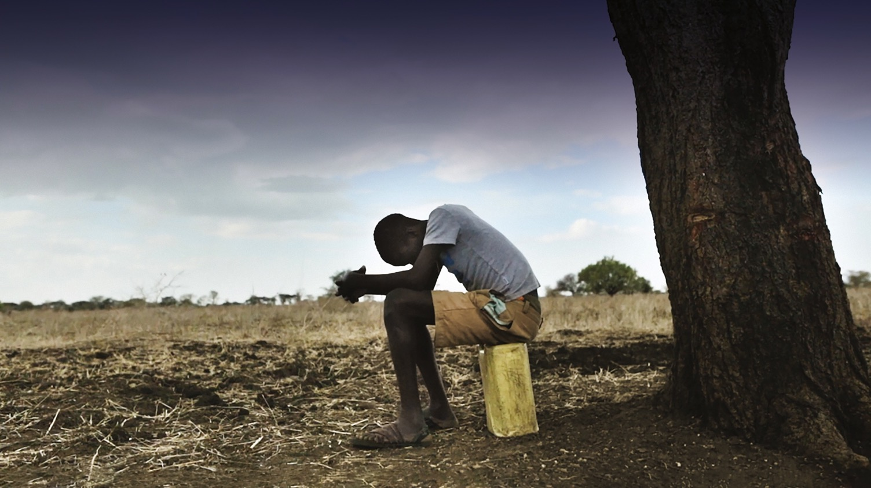
XII Jesus dies on the cross
“The Creator does not abandon us. He never forsakes his loving plan, or repents of having created us.”
Notes:
R1: The twelfth Station: Jesus dies on the cross
Action: Blow out the candle, extinguish the lights if appropriate, shut the Bible.
The Creator does not abandon us. He never forsakes his loving plan, or repents of having created us. (Laudato Si’ 13)
R2: “Jesus cried out with a loud voice, ‘Eloi, Eloi, lama sabachthani?’ which means, ‘My God, My God, why have you forsaken me?’… Then Jesus gave a loud cry and breathed his last.” Mark 15:34, 37
R3: When we think of everything that is wrong in the world – poverty, injustice, climate change – we can feel despair.
Yet as Pope Francis tells us, God never regrets having created us.
R4: May we keep faith even in the darkest times, and know that God loves and values each of us.

Slide 26
XII Jesus dies on the cross
R: Lord, help us to protect our shared home
and live as one single human family,
full of goodness and beauty. Amen
Notes:
All: Lord, help us to protect our shared home
and to live as one single human family,
full of goodness and beauty.

Slide 27
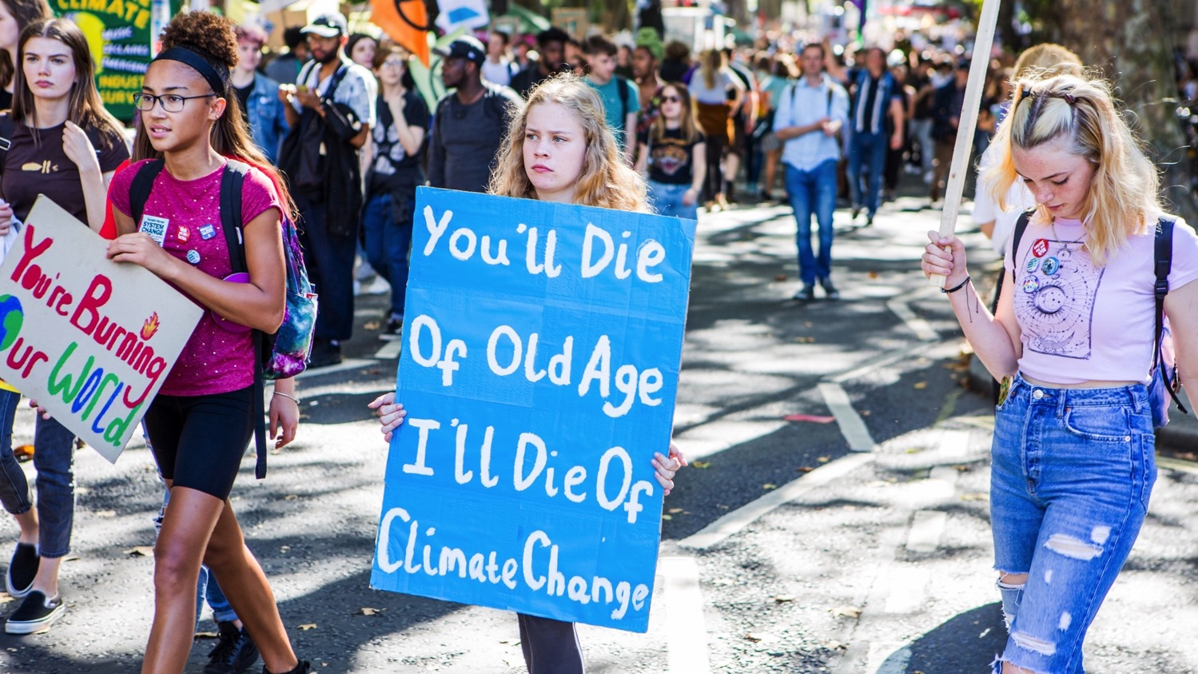
XIII Jesus is taken down from the cross
“Your young hearts want to build a better world... You are the ones who hold the future!”
Notes:
R1: The thirteenth Station: Jesus is taken down from the cross
Action: With the lights still out, remove the large cross that was placed during Station 2. Lay it to one side on the ground.
Please, do not leave it to others to be protagonists of change. You are the ones who hold the future! (Christus Vivit)
R2: “Joseph of Arimathea, who was a disciple of Jesus, though a secret one because of his fear of the Jews, asked Pilate to let him take away the body of Jesus.” John 19:38
R3: Joseph is afraid, but his love for Jesus makes him act anyway. We must do what we know is right, even when it is difficult.
R4: May we always work for the good of all and stand up against injustice.

Slide 28
XIII Jesus is taken down from the cross
R: Lord, help us to protect our shared home
and live as one single human family,
full of goodness and beauty. Amen
Notes:
All: Lord, help us to protect our shared home
and to live as one single human family,
full of goodness and beauty.

Slide 29
XIV Jesus is laid in the tomb
“We come together to take charge of this home which has been entrusted to us.”
Notes:
R1: The fourteenth Station: Jesus is placed in the tomb
Action: cover the large cross with a cloth.
We come together to take charge of this home which has been entrusted to us. (Laudato Si’ 244)
R2: “Joseph bought a linen cloth, and taking down the body, wrapped it in the linen cloth, and laid it in a tomb that had been hewn out of the rock.” Mark 15:45
R3: While the body of Jesus lies in the tomb, the disciples are full of fear. They hide, and they wait. Yet very soon they must find the courage to go out and change the world. This is our future as young people.
R4: May we overcome our fears and our reluctance and play our part in making the world a better place.

Slide 30
XIV Jesus is laid in the tomb
R: Lord, help us to protect our shared home and live as one single human family,
full of goodness and beauty. Amen
Notes:
All: Lord, help us to protect our shared home
and to live as one single human family,
full of goodness and beauty.

Slide 31
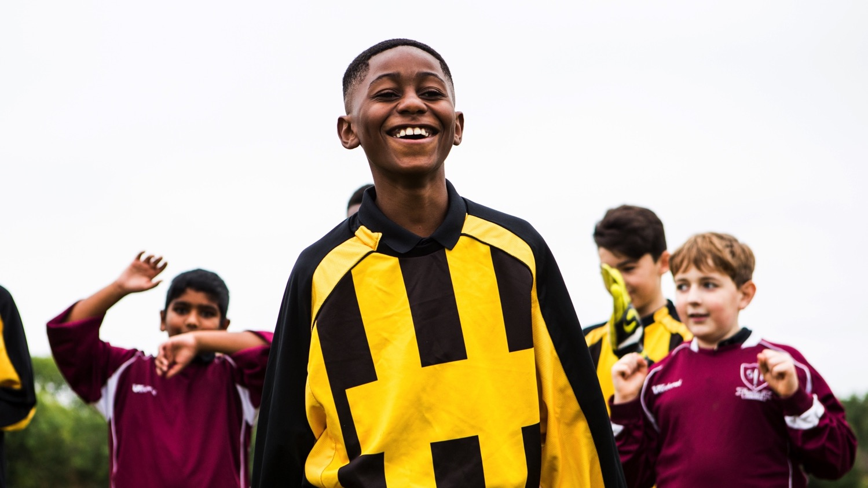
XV Jesus is risen
“Give yourselves over to the best of life! Open the door of the cage, go out and fly!”
Notes:
R1: The fifteenth Station: Jesus rises from the dead
Action: Turn the lights back on. Relight candle/s. Play some joyful music.
Give yourselves over to the best of life! Open the door of the cage, go out and fly! (Christus Vivit 143)
R2: “Why do you look for the living among the dead? He is not here, but has risen.” Luke 24:5
R3: Pope Francis is full of hope for young people. He urges us to take risks, to be bold, to follow our dreams.
“My joyful hope,” he says, “is to see you keep running the race before you, outstripping all those who are slow or fearful.”
Following Jesus along this Way of the Cross to his resurrection shows us that we too can rise and be the best of ourselves.
Nothing can prevent us from being open to what is good, true and beautiful.
R4: May we always live as one single human family, caring for the earth and for our sisters and brothers.
May we never forget the grace of God at work deep in our hearts. (Laudato Si’ 205)

Slide 32
Closing prayer
O God, Trinity of love,
grant that we Christians may live the Gospel,
discovering Christ in each human being
recognising him crucified
in the sufferings of the abandoned
and forgotten of our world,
and risen in each brother or sister
who makes a new start.
Come, Holy Spirit, show us your beauty,
reflected in all the peoples of the earth,
so that we may discover anew
that all are important and all are necessary,
different faces of the one humanity
that God so loves. Amen
Prayer by Pope Francis
from Fratelli Tutti
Notes:
R1: We say together the closing prayer, by Pope Francis.

Slide 33
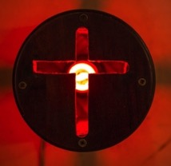
Pope Francis’ teachings taken from:
Evangelii Gaudium 2013
Laudato Si’ 2015
Christus Vivit 2019
Fratelli Tutti 2020
Photos: Joost Baastmeijer/Caritas; Caritas Bangladesh; Simon Murphy; l’Osservatore Romano; Bill Oxford; David Mutua; Tommy Trenchard; Natalia Tsoukala/Caritas; Solidarity Service Association CVX; Dustan Woodhouse

