Slide 1
Year 1 Neighbours

Slide 2
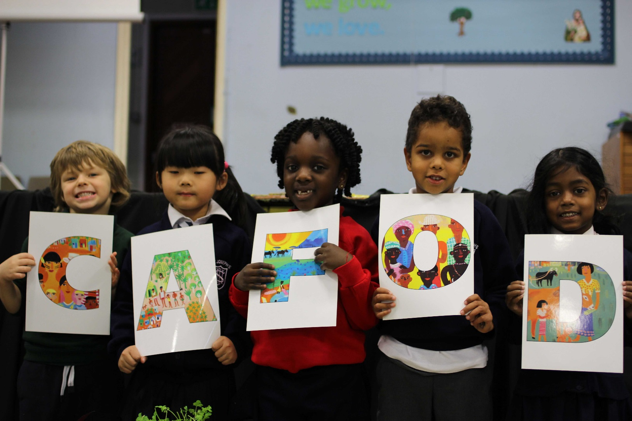
Helping our neighbours.
How does CAFOD help?

Slide 3
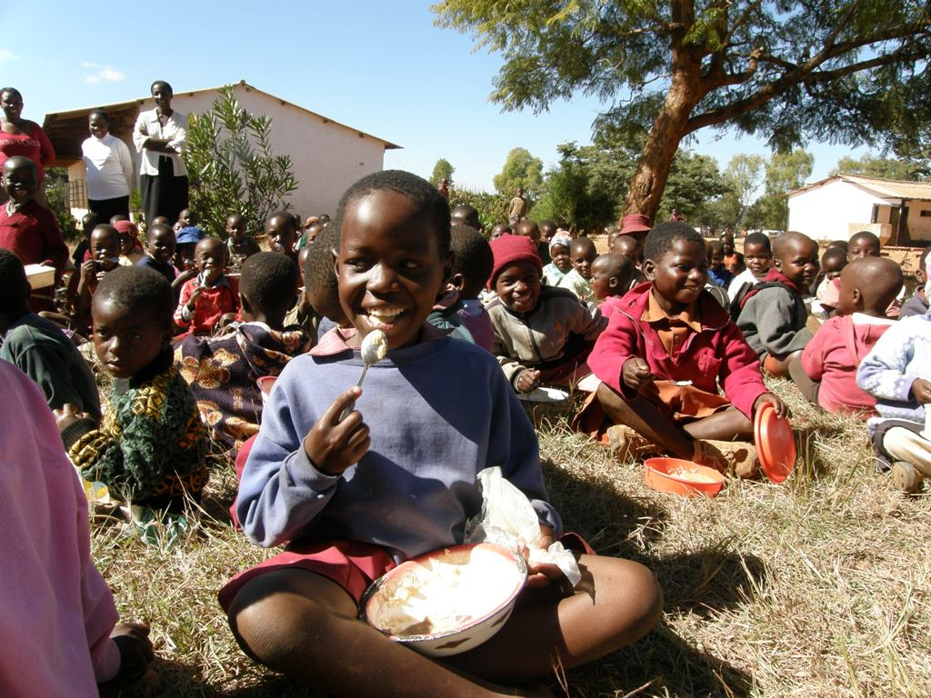
CAFOD helps our neighbours around the world to …
… have
enough food
Notes:
Lunchtime at the Dhirihori Primary School. CAFOD's partner Caritas Zimbabwe responded to the need for humanitarian food aid, as children were fainting in class as families have struggled to find food for their children. The children eat a high-protein porridge made of maize meal. PHOTOGRAPHER: Nana Anto-Awuakye

Slide 4
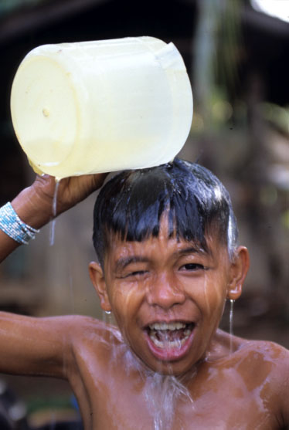
… have clean water
Notes:
Philippines - Christian Joy, 9 is the son of small farmer Jul Yap who also works for JPIP. JPIP, one of CAFOD’s partners, greatly helps the family and their community. They now have piped water, solar powered electricity, organic farming, improved harvests, fewer debts, a motorbike and a cellphone. They now have water nearby so Christian takes a bath more often.
PHOTOGRAPHER: Annie Bungeroth

Slide 5
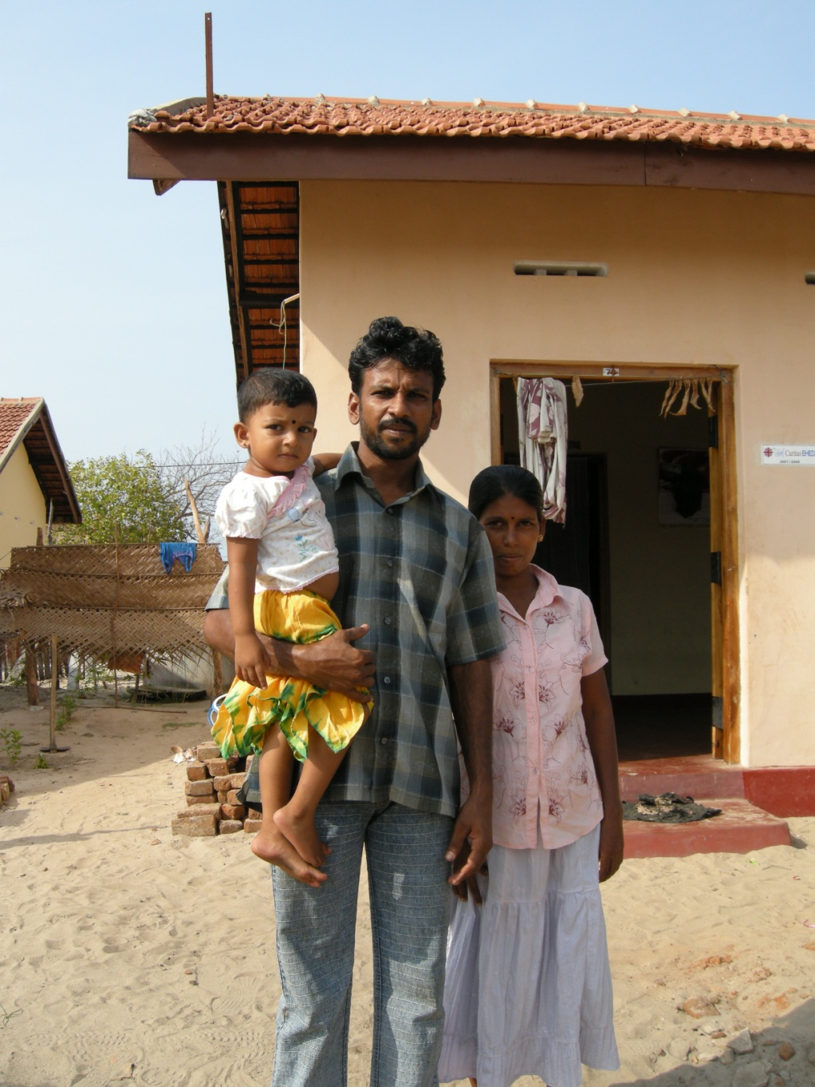
… have a home
Notes:
Sri Lanka
PHOTOGRAPHER: Lucy Morris
New house for tsunami-affected household constructed with CAFOD funds (Disasters Emergency Committee).

Slide 6
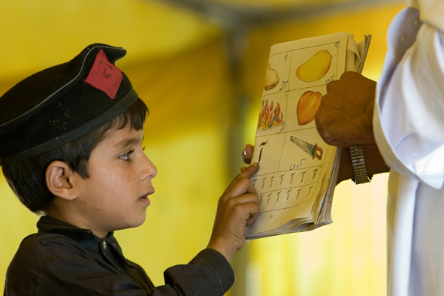
… go to school
Notes:
COUNTRY: Pakistan
Student at Government Primary School Nakka Beesan works on his reading lesson with his teacher. He attends classes inside a tent provided by CRS (one of CAFOD’s partners) as his school collapsed in the 8/10/2005 earthquake, killing two students. CRS also provided each student with study materials to help them get back to school.
PHOTOGRAPHER: Jim Stipe

Slide 7
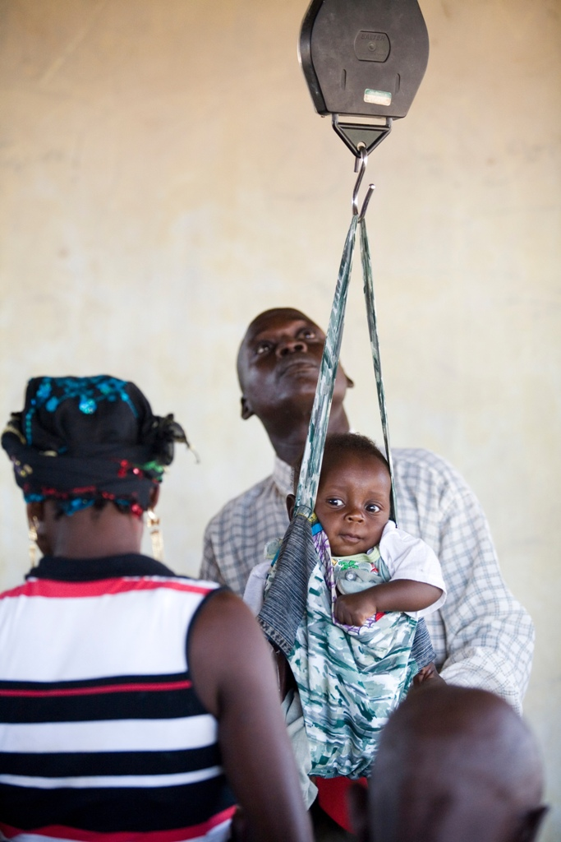
… go to a doctor if they are unwell
Notes:
COUNTRY: Nigeria
LOCATION: Yakoko, Zing Local Authority, Taraba State, North East Nigeria
CAPTION: The clinic keeps a check on the weight of the babies that come here to monitor any weight loss which could indicate illness
PHOTOGRAPHER: Simon Rawles

Slide 8
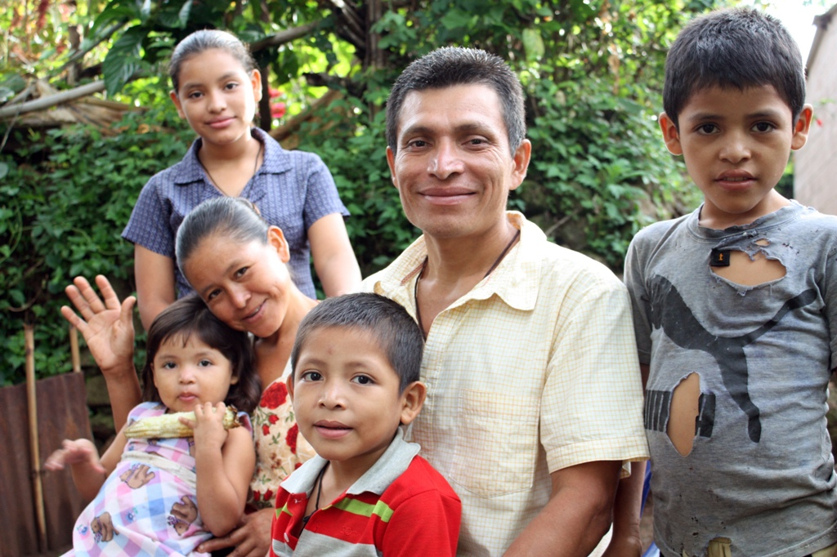
CAFOD works with neighbours all around the world to make sure they have what they need.
Notes:
CAFOD works with neighbours around the world no matter who they are or what they believe, to make sure they have what they need.
Photo:
COUNTRY:El Salvador
Ramos Laguan family including Fidel Ramos Gonzalez, his wife Julia de Jesus Laguan, and their children Sarita, 15yrs, Marisol, 13yrs, Ronaldo Adrian, 9yrs, Walter Ovidio, 6yrs and Raquel Guadalupe, 4yrs.
PHOTOGRAPHER: Claudia Torres

Slide 9
Photographs by: Claudia Torres, Simon Rawles, Jim Stipe, Lucy Morris, Annie Bungeroth, Nana Anto-Awuakye. Illustration: Per Karlen

