Slide 1
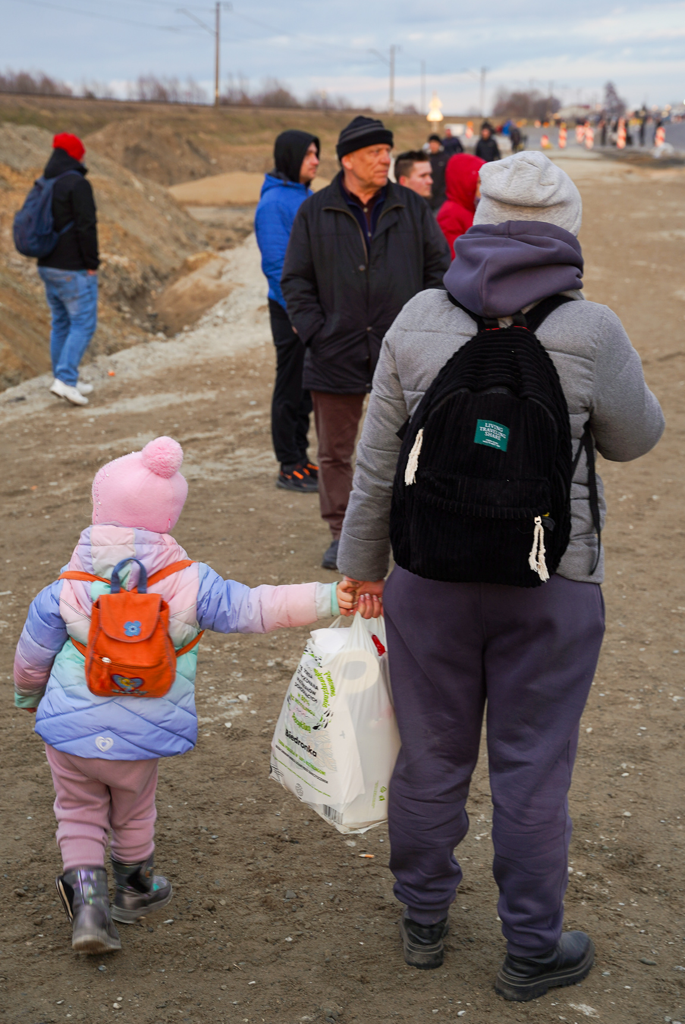


Slide 2
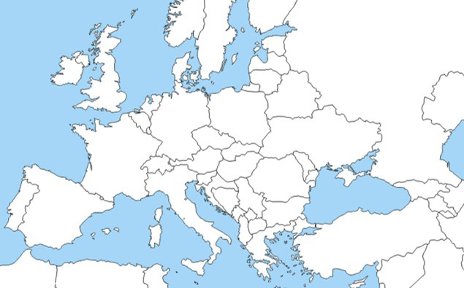
What has happened?
On 24 February, the president of Russia, Vladimir Putin, sent Russian soldiers to invade Ukraine.
There has been bombing and fighting across the country.
Many people have had to leave their homes.
Many have fled to other countries.
Russia
Ukraine

Slide 3
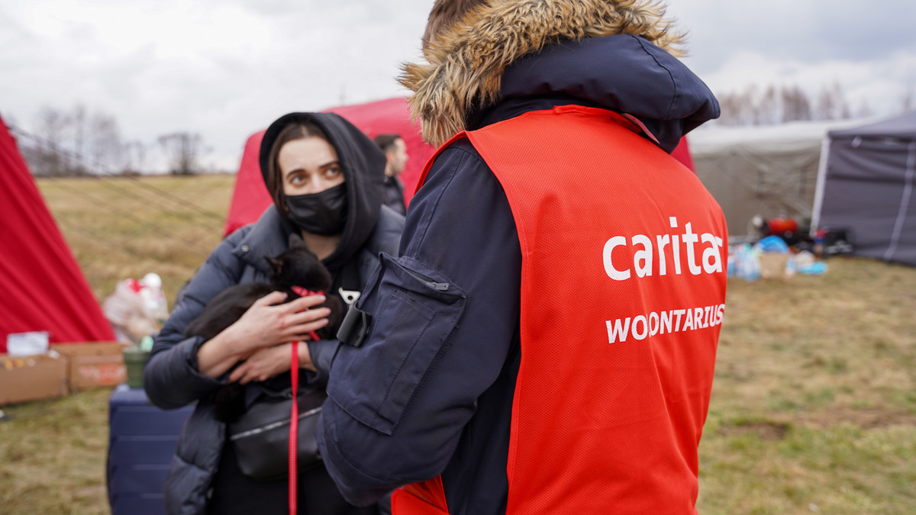
CAFOD is part of a global family
CAFOD is part of a family of Catholic charities around the world – Caritas. When an emergency happens, Caritas is already there.
We are supporting our Caritas sisters and brothers to reach the communities most in need in Ukraine, and in neighbouring countries.
Notes:
Credit: Caritas Poland

Slide 4
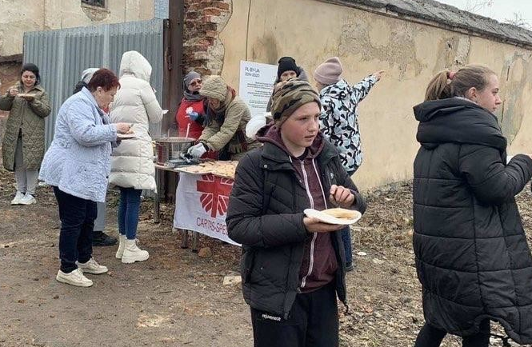
What is being done?
Volunteers from Caritas are already reaching families in need, especially women and children.
Other Caritas agencies are supporting people who have fled Ukraine, who need food, water, shelter and help to continue their journeys.
Notes:
Credit: Caritas Spes

Slide 5
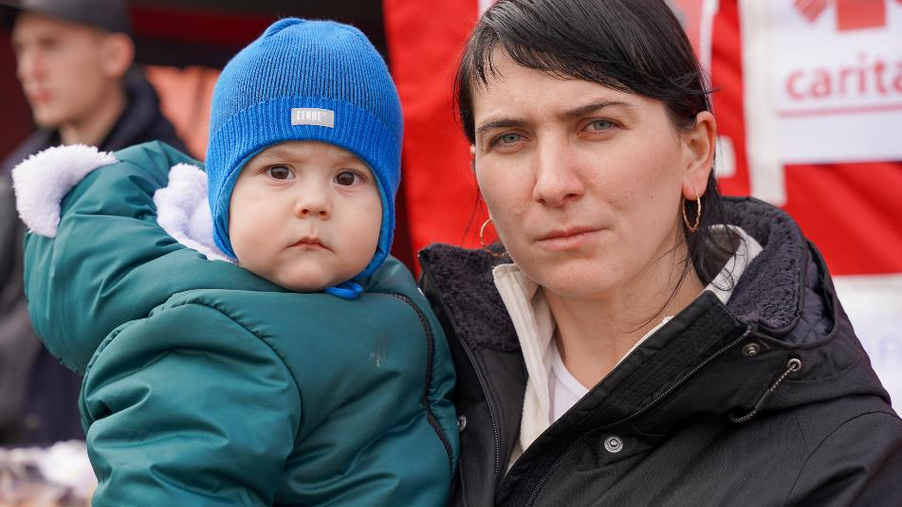
Appeal
CAFOD has also launched an appeal, to reach even more people.

Slide 6
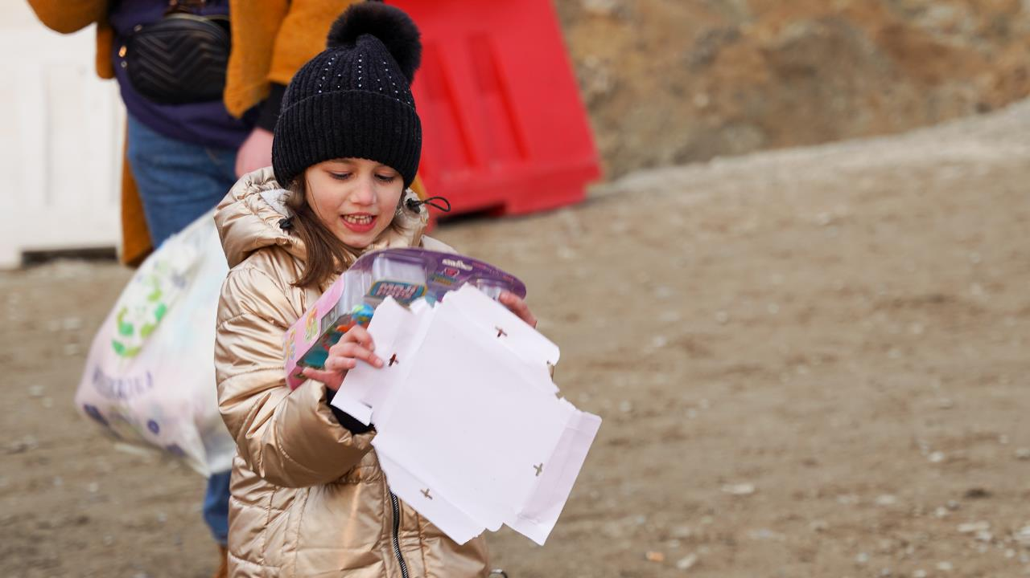
Appeal
£10 could provide one person with essential hygiene supplies for a month.
£20 could provide emergency food for one person for a month.
£50 could provide blankets for ten people to keep them warm.

Slide 7
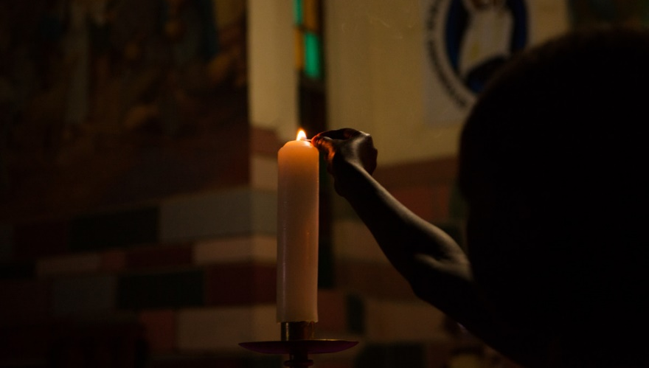

A prayer for Ukraine
Loving God,
We pray for the people of Ukraine,
for all those suffering or afraid,
that you will be close to them and protect them.
We pray for world leaders,
for compassion, strength and wisdom to guide their choices.
We pray for the world, that in this moment of crisis,
we may reach out in solidarity to our sisters and brothers in need.
May we walk in your ways, so that peace and justice
become a reality for the people of Ukraine
and for all the world.
Amen.

Slide 8
Thank you

