Slide 1
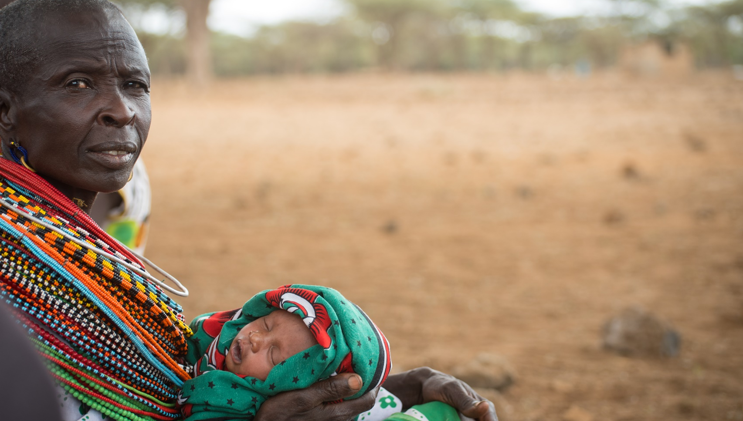

“The Body of Christ,
broken in the sacred liturgy,
can be seen,
through charity and sharing,
in the faces and persons
of the most vulnerable of
our brothers and sisters.”
Pope Francis
Notes:
This image could either be used as a slide to project during an assembly or liturgy, or printed for use as an A4 or A3 poster.
Pope Francis spoke these words as part of his message on World Day of the Poor 2017.
The photograph was taken in 2017 in Northern Kenya, where mothers and babies were attending a mobile nutrition health clinic run by our partner, Caritas Isiolo, and funded through the CAFOD East Africa Crisis Appeal.
Question for reflection:
Where do I see the face of Christ?

Slide 2
Lord Jesus,
as we receive you in the Blessed Sacrament,
inspire us also to recognise you
in our sisters and brothers.
May we too become bread for the world,
nourishing all who hunger
for compassion and mercy,
justice and peace.
Amen.

