Slide 1

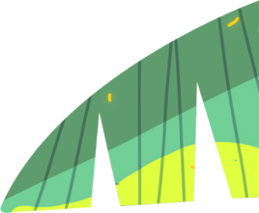
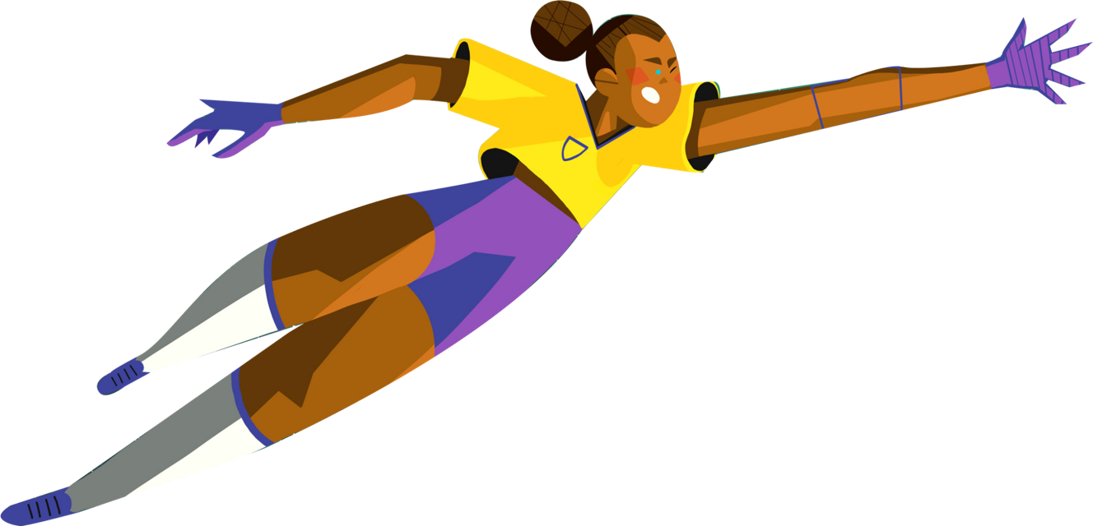
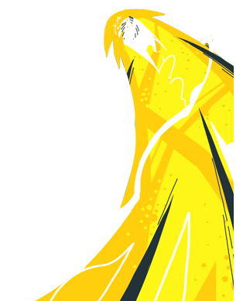


LENT 2020
DEFEND THE DEFENDERS
Protecting the Amazon
with our human rights defenders
Notes:
So this week’s theme links the Amazon, human rights defenders and football. How? Well more than a football pitch of the Amazon is lost every minute and CAFOD supports land rights defenders (who defend people's rights to life, safe homes, and safe work).
These slides were originally prepared for an assembly, but hopefully they’ll provide you with a useful source of information, and you can use these images if you want to inform others and are able to (you could even do an online assembly with some friends or at home with your family).
The Amazon rainforest is under threat. This Lent, we are looking at how we can help defend its people, because their land and homes are being lost.
Their way of life is on the line as they try to defend the Amazon.

Slide 2
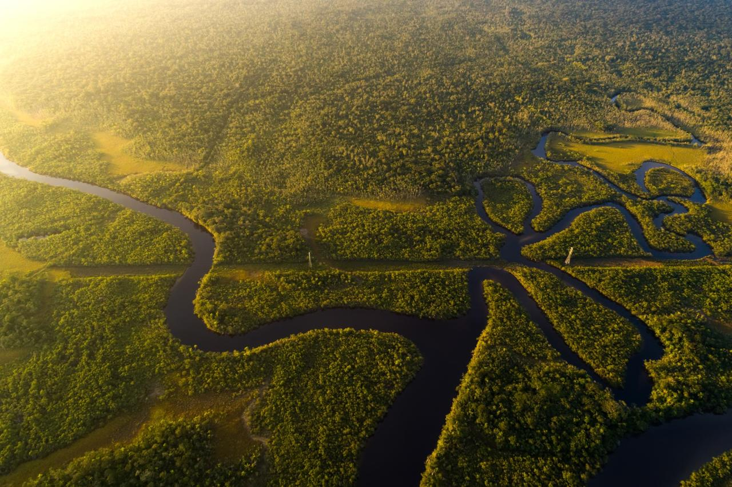
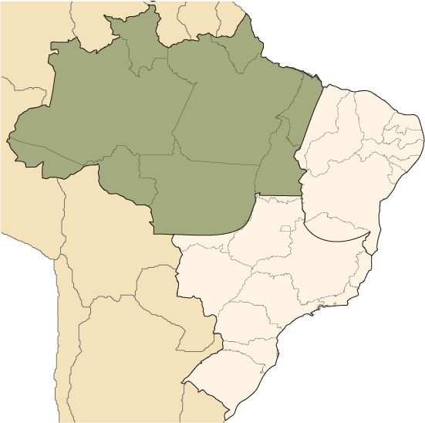

DEFENDING THE AMAZON
Notes:
The Amazon is a vast region that spans nine countries.* See if you can guess what they are! If you scroll down below, you’ll be able to find the answers. The health of the Amazon and the health of the planet are linked.
If we destroyed the Amazon rainforest it would affect all life on earth.
*(Brazil, Bolivia, Peru, Ecuador, Colombia, Venezuela, Guyana, Suriname and French Guiana).

Slide 3
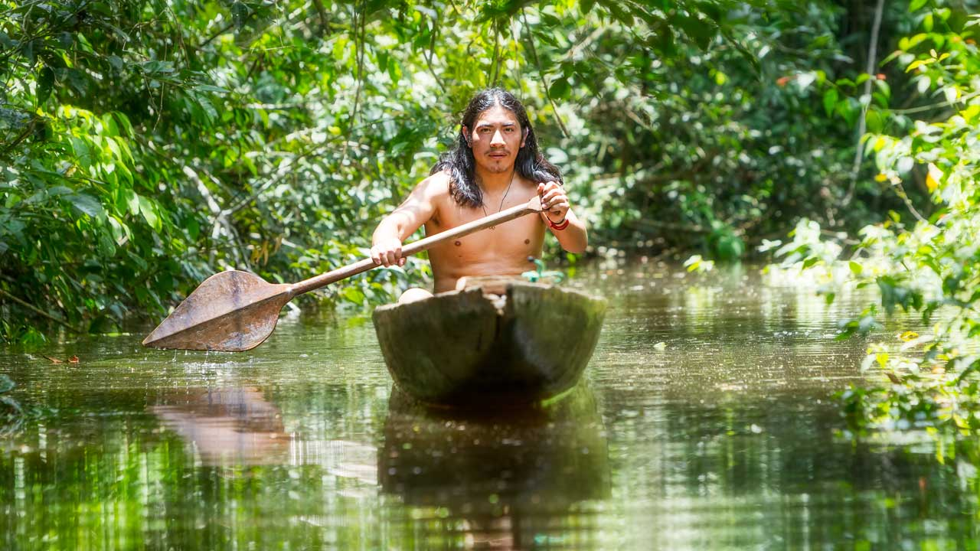
A WAY OF LIFE IS BEING DESTROYED
Notes:
Living in the Amazon, as well as three million indigenous people, there are also many traditional fishing communities, small farmers and people who live from fruit and nut collecting. They have lived in harmony with the rainforest for thousands of years. Now their way of life, which protects the forest and values the land, is under threat.
These communities are the last line of defence against those who seek to extract resources from the forest. Their rights are being ignored.
People who stand up for their land rights are often threatened and sometimes killed. In the last decade more than 300 people have been killed in conflicts over the use of Amazon land and resources.*
*Source: https://www.hrw.org/news/2019/11/15/brazils-amazon-and-its-defenders-are-under-attack-illegal-loggers

Slide 4
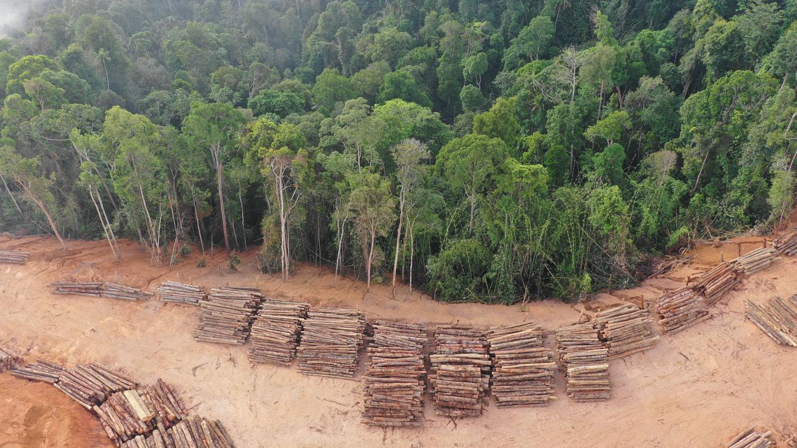
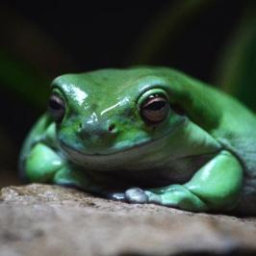
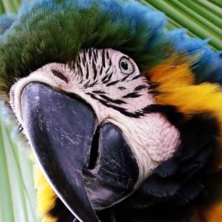
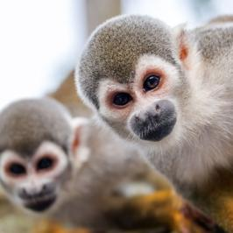
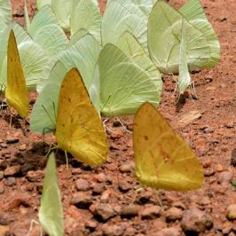
BIODIVERSITY IS BEING LOST
Notes:
The Amazon is also home to over 10 per cent of the world’s species. Many species are under threat.

Slide 5
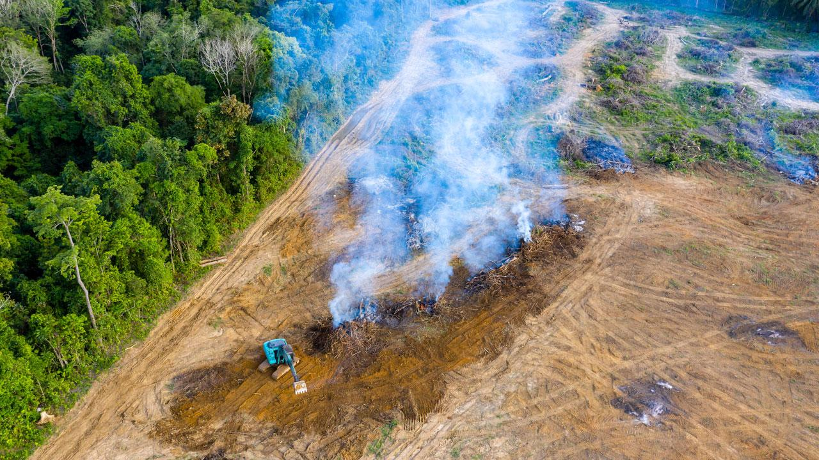
HOMES AND WILDLIFE ARE BEING DESTROYED
Notes:
Even though we know the Amazon is vital for sustaining life, it is still being destroyed. Forest fires have increased due to farmers and loggers clearing land for crops or grazing. Communities are losing their land to mining activity and big farming companies. The mining contaminates land and rivers. The farming leads to large areas being cleared for cattle grazing or single crops.
Destruction of the Amazon would contribute to climate change. The poorest communities, here and around the world, who cannot afford to protect themselves from rising waters or increased natural disasters, would be hit hardest.

Slide 6
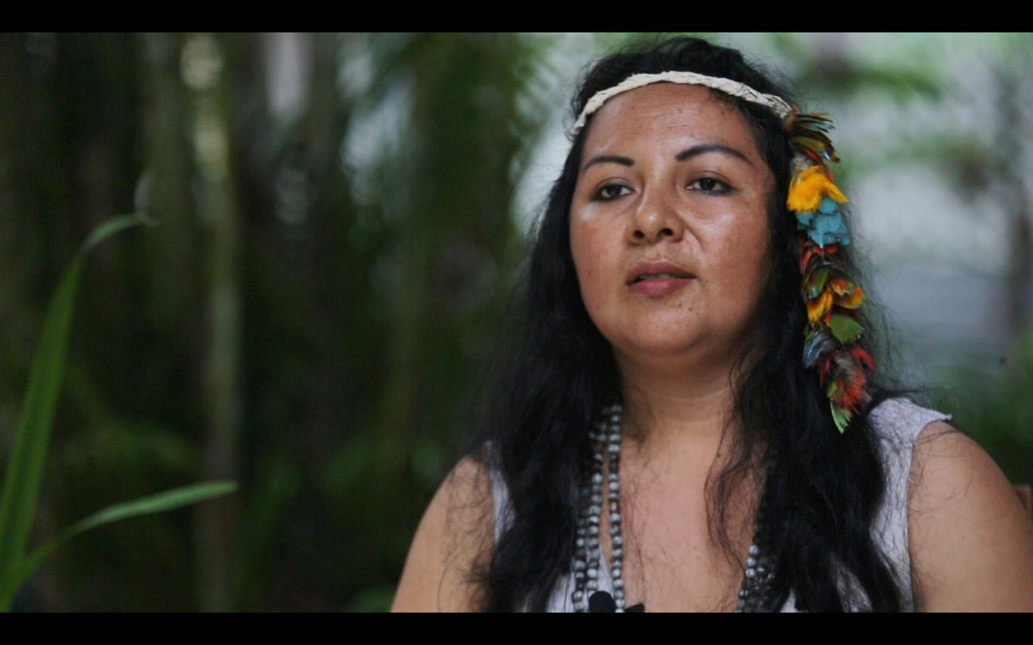
“…if we continue to be crushed and invaded by strangers without even a prior consultation, bit by bit our language, our traditions, our people die.”
Yesica
HUMAN RIGHTS DEFENDERS
Notes:
This is why we need people like Yesica, who stand up for the Amazonian people.
The human rights* of indigenous people around the world are protected by a United Nations declaration. Yesica, like many others, speaks out to ensure these rights are not ignored, standing up to those who seek to extract the forest’s resources.
Yesica says “It is here that the forests, which are a source of life, are preserved… But if we continue to be crushed and invaded by strangers without even a prior consultation, bit by bit our language, our traditions, our people die.”
*The United Nations Declaration on the Rights of Indigenous Peoples (UNDRIP) enshrines Indigenous peoples’ rights, including their rights to their lands and resources and to free, prior and informed consent for land use. Indigenous communities are struggling to have these rights respected. By defending the defenders we can help the indigenous communities to keep their land and sustain a way of life that protects the forest as well as their homes, customs and future.

Slide 7
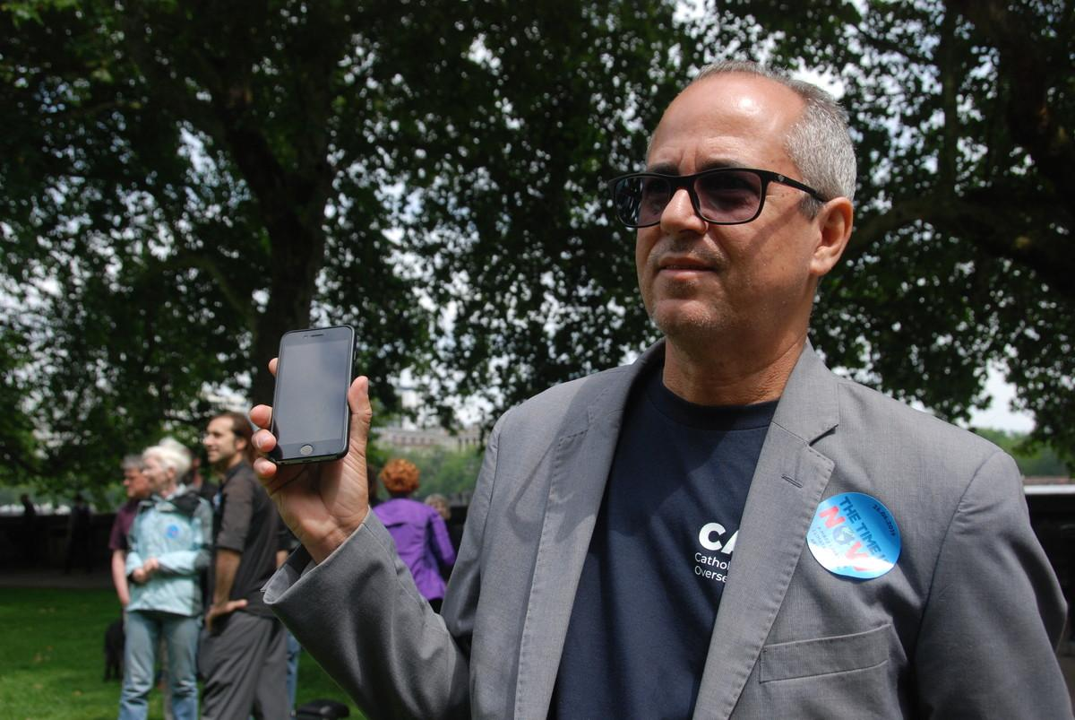
Jose Batista Afonso,
one of the lawyers who defends poor landless farmers in the Amazon.
HUMAN RIGHTS DEFENDERS
Notes:
CAFOD stands in solidarity with indigenous people and poor farmers, and funds lawyers who defend their right to land and to have a safe place to live.
It is dangerous work. The lawyers often receive death threats.
Despite that, thanks to their support, more than 80,000 families in the Amazon now have a safe place to build homes, grow food, and make a living.
This is good news! But many other families need their rights to be defended too.
*The United Nations Declaration on the Rights of Indigenous Peoples (UNDRIP) enshrines Indigenous peoples’ rights, including their rights to their lands and resources and to free, prior and informed consent for land use. Indigenous communities are struggling to have these rights respected. By defending the defenders we can help the indigenous communities to keep their land and sustain a way of life that protects the forest as well as their homes, customs and future.

Slide 8
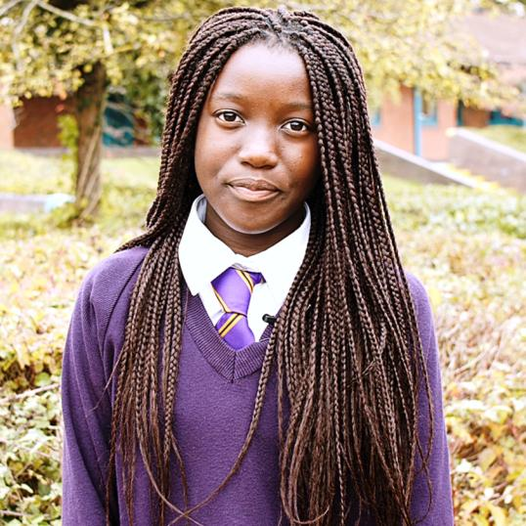
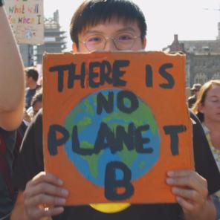
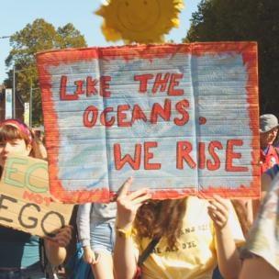
WE ARE RISING UP
Notes:
[At this point we would have shown the CAFOD Lent film featuring Yesica and Hector from the Amazon, but you’ve probably already seen it as it’s linked as part of this week’s theme – if you haven’t yet watched it, please do as it will give you even more insight into this week’s theme]
Young people around the world are rising up, calling everyone to work together to protect the earth, our common home.
As time runs out to stop the worst effects of climate change, it would be an own goal to destroy one of our best defences – the Amazon.
And if we want to protect the Amazon, protecting its people is vital.

Slide 9
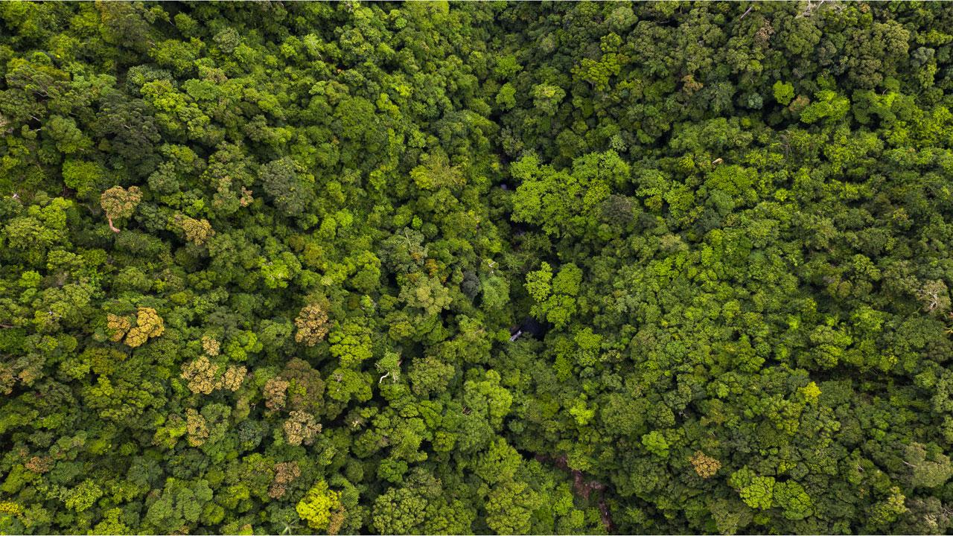

AN AREA BIGGER THAN THE SIZE OF A FOOTBALL PITCH IS LOST EVERY MINUTE
Notes:
An area of Amazon rainforest bigger than the size of a football pitch is lost every minute.
So, this Lent, CAFOD challenged schools to hold football fundraisers to raise money and awareness of what is happening.
Since the school closures and people being separated, fundraising has become far more difficult.
Some schools will have already done your Lent fundraising before closures happened, and if so, THANK YOU!
People in the UK are suffering greatly because of coronavirus, but we are very grateful to have amazing healthcare in this country because of the NHS. In many places where CAFOD works, this will not be the case. So whether you’re still fundraising and raising awareness, or simply remembering and praying for those communities living in the Amazon, thank you.

Slide 10

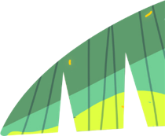

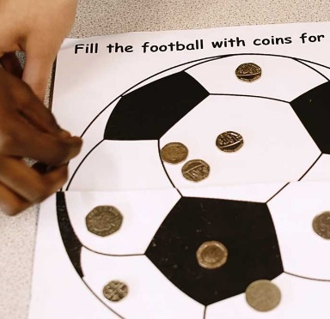
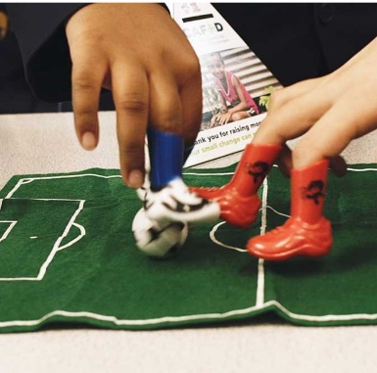
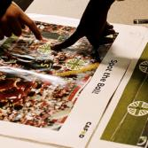
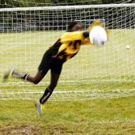
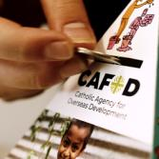
Notes:
Even if you don’t like football, check out the various things to do on the CAFOD home learning page and hopefully you’ll find something that appeals to you. Don’t forget to let us know what you’ve been up to, either by sending us an email to youth@cafod.org.uk or by including #cafod or @cafod on social media.

Slide 11
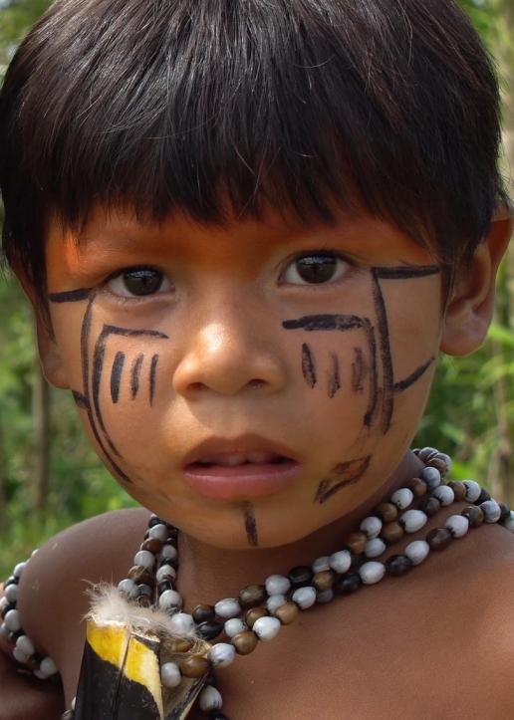
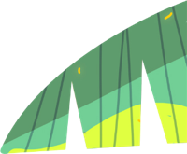





God of the poor, help us to rescue the abandoned and forgotten of this earth. Touch the hearts of those who look only for gain at the expense of the poor and the earth. Teach us to discover the worth of each thing, to be filled with awe and contemplation, to recognise that we are profoundly united with every creature as we journey towards your infinite light. Encourage us, we pray, in our struggle, for justice, love and peace. AMEN Pope Francis
Notes:
Let‘s pray a short prayer written by Pope Francis.
(Prayer written by Pope Francis, Laudato Si’, 2015)

Slide 12
LENT 2020
DEFEND THE DEFENDERS
Protecting the Amazon
with our human rights defenders
Notes:
Thank you for anything you can do to raise awareness, fundraise or campaign with CAFOD. You, and all your families, remain in our prayers at this time.

