Slide 1
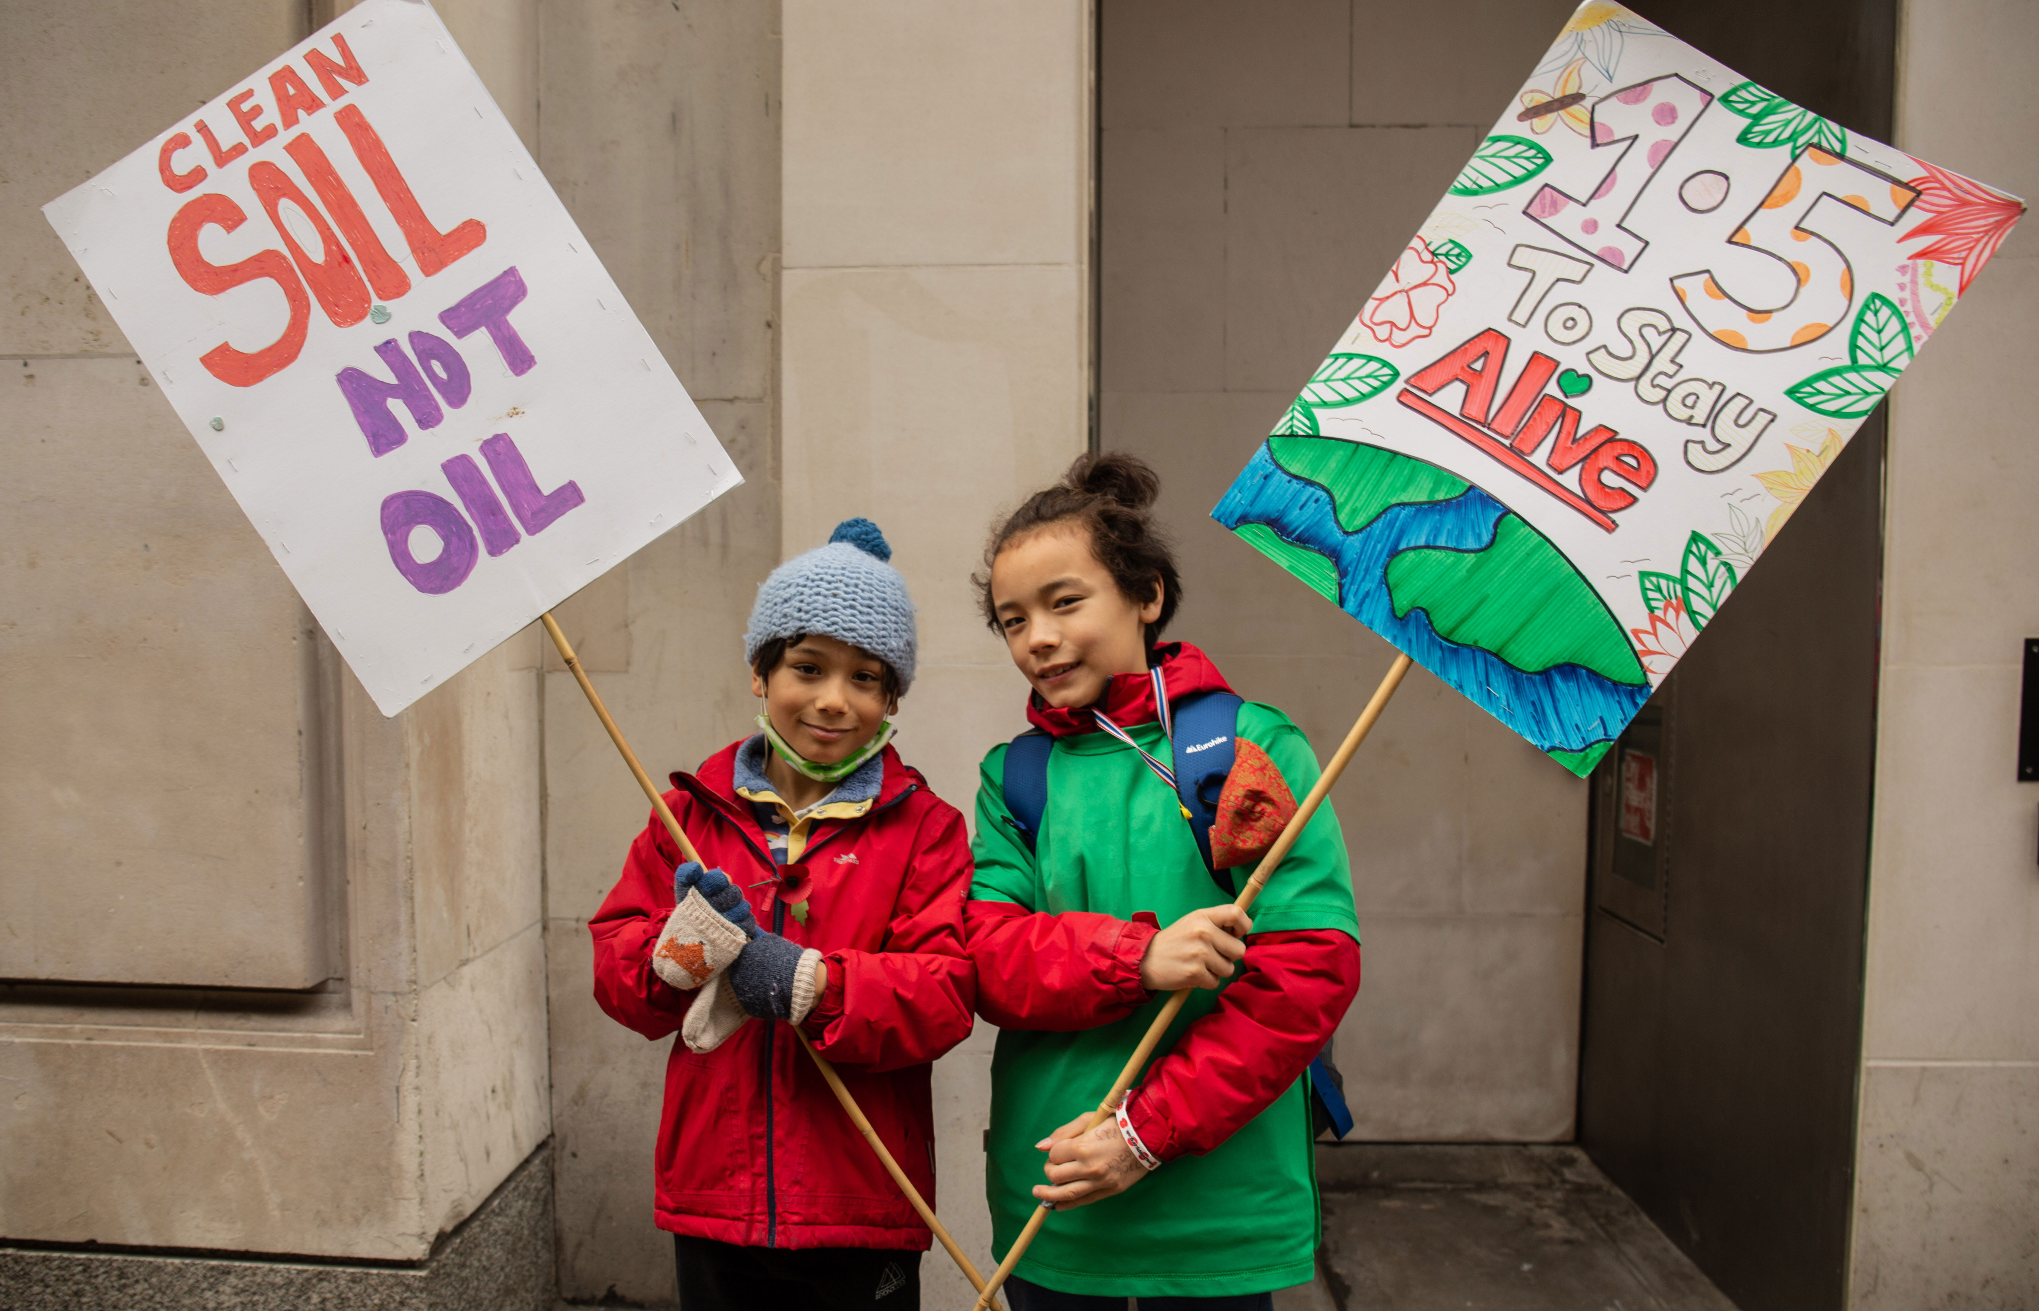
A prayer for after COP26
Loving God
We give thanks for all the people who spoke up for the poorest communities at COP26.
We pray that our collective actions will begin to repair the damage we have caused to our Earth.
Let us continue to urgently work towards good stewardship of your creation and your presence in all living things.
Amen

