Slide 1


A meditation on caring for the Earth, our common home.
Notes:
To play automatically choose Slide Show>Use timings. Then Slide Show>From Beginning and click the sound icon to start the music.
To play music across the slides: Insert>Audio>(Find Antarctic expedition)>Audio/sound tools>Choose start on click, play across all slides and loop until stopped. Pause the slide show to stop the music and images.
Pause the slide show on slide 17 and join together in saying the prayer.
Note: All the photos in this reflection come from the Climate change photopack, which fully explains the background of each photo.
Download the photopack: cafod.org.uk/secondary/climate
Music credit: Antarctic expedition/audionetwork.com

Slide 2
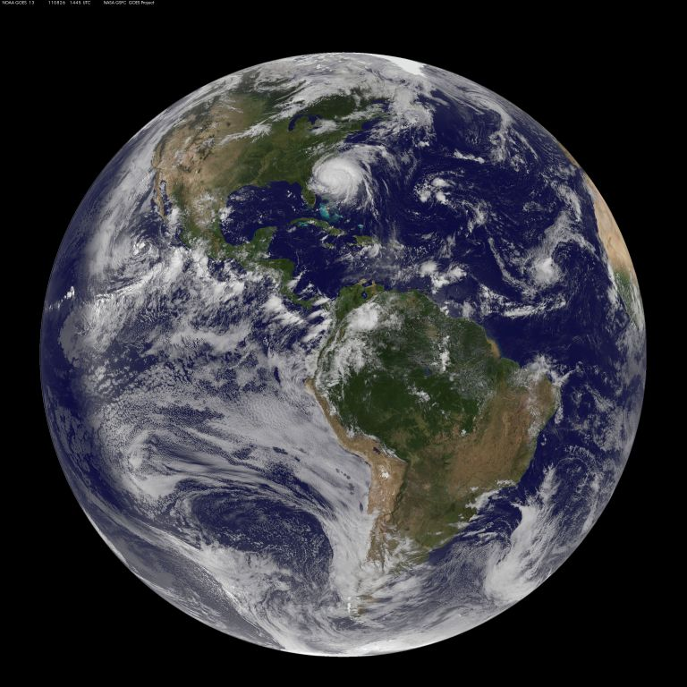
Imagine...
...you are in space, far above the Earth.
How do you feel about the Earth, our common home?
Notes:
Photo credit: Nasa/Wikipedia.

Slide 3
You start to look more closely...
...and turn your attention to four scenes on Earth.

Slide 4
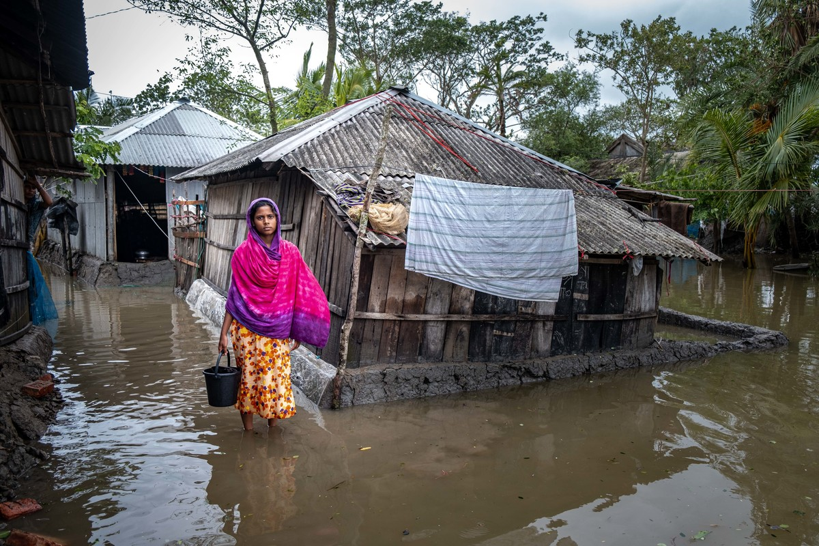
Floods, Bangladesh.
Notes:
Photo credit: Amit Rudro for CRS/Caritas Bangladesh, May 2020

Slide 5
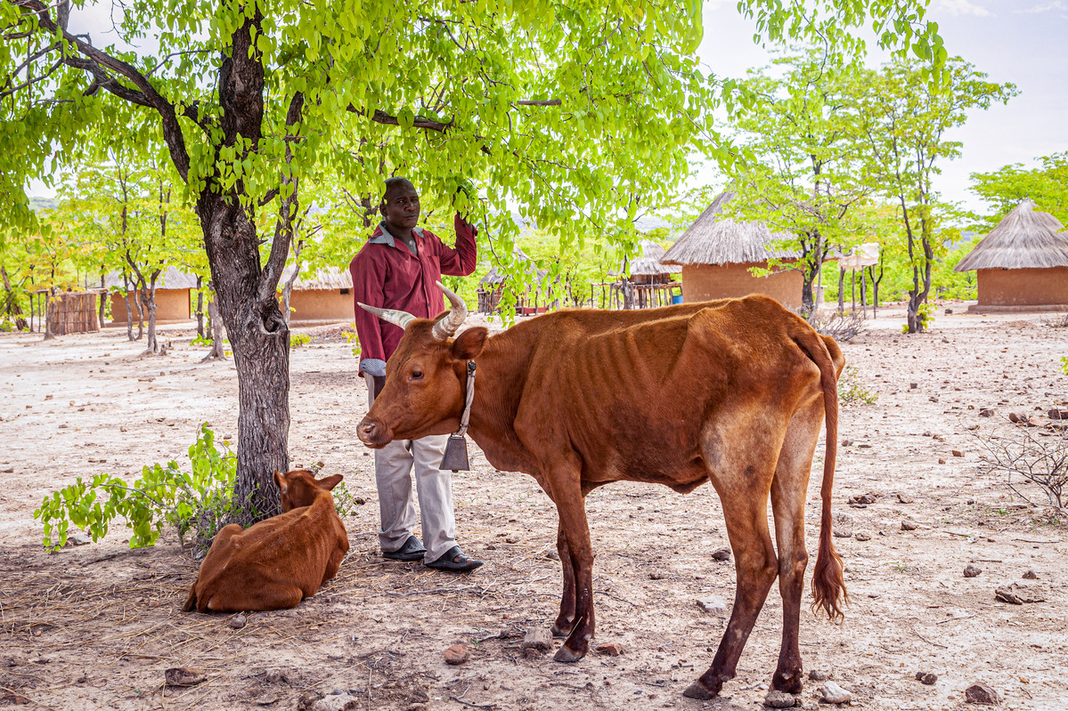
Drought, Zimbabwe.
Notes:
Photo credit: Charmaine Chitate, December 2019

Slide 6
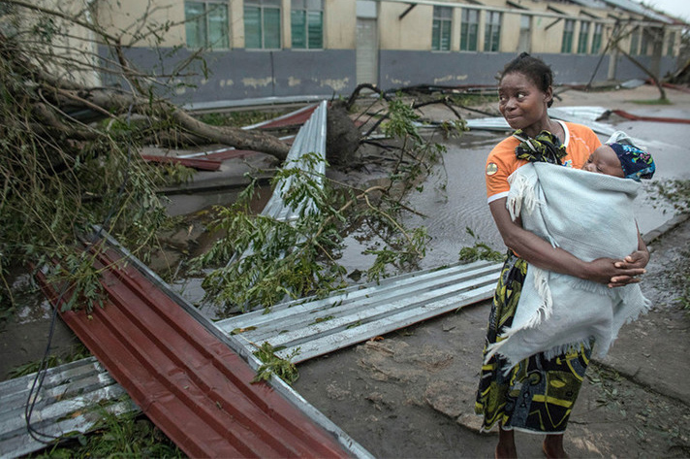
Cyclone, Mozambique.
Notes:
Photo credit: Josh Estey/ CARE/ CAFOD, 2019

Slide 7
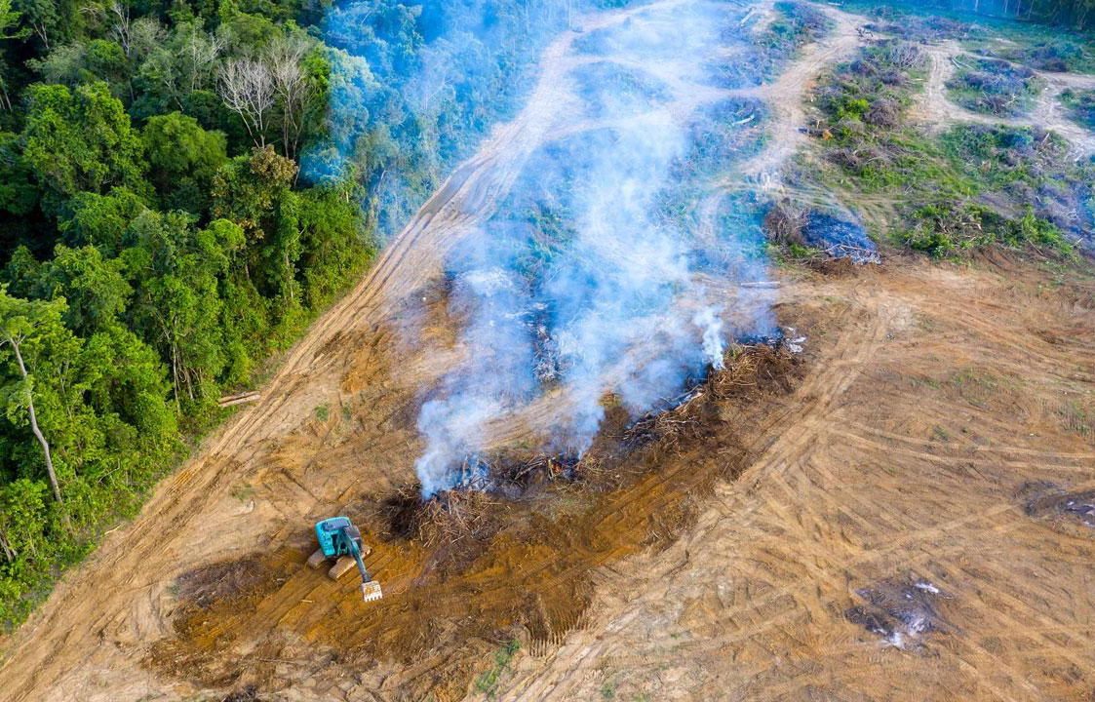
Deforestation, Amazon.

Slide 8
You pause for a moment...
...how do you feel towards the Earth?
How do you feel about the people on Earth?
You turn your attention to four more scenes...

Slide 9
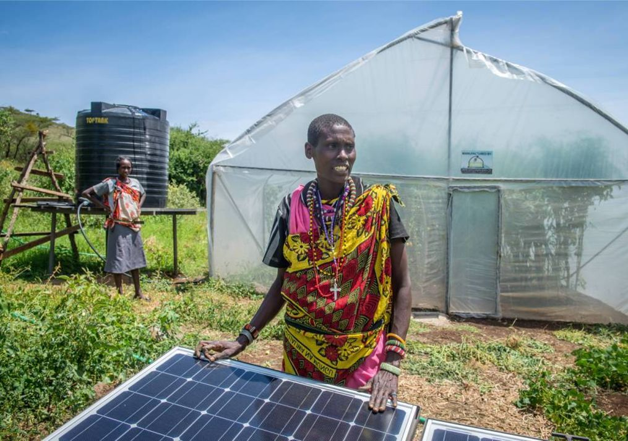
Solar power for irrigation, Kenya.
Notes:
Photo credit: Annie Bungeroth/CAFOD

Slide 10
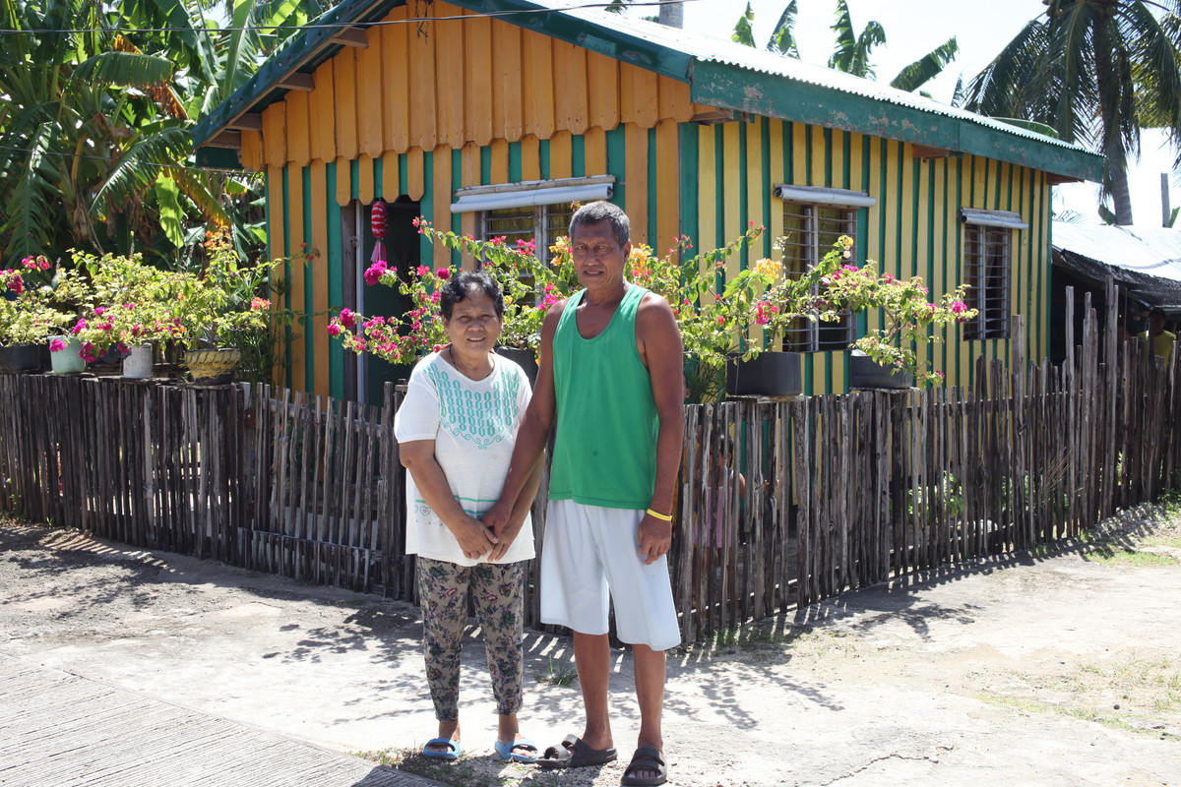
Typhoon-resistant homes, Philippines.
Notes:
Photo credit: CAFOD

Slide 11
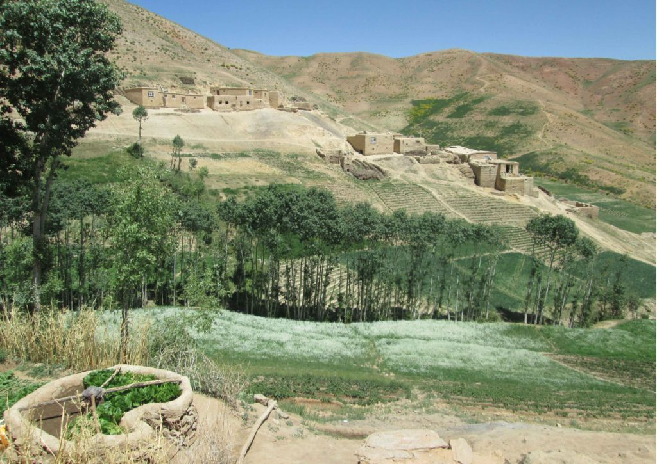
Greening the dry ground, Afghanistan
Notes:
Photo credit: CRS

Slide 12
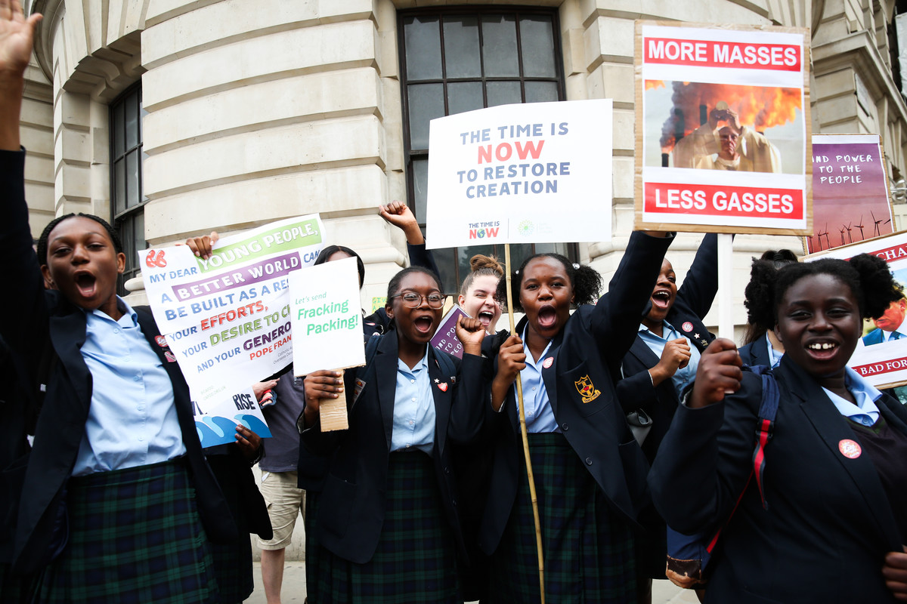
Climate campaigning, UK.
Notes:
Photo credit: Eleanor Church

Slide 13
You pause again...
...how do you feel about the Earth now?
How do you feel about the people on Earth?

Slide 14
“God saw everything that he had made, and indeed it was very good.”
Genesis 1:31
“The Lord God took the man and put him in the garden of Eden to cultivate and take care of it.”
Genesis 2:15
Notes:
Genesis 1:31, 2:15,

Slide 15
“Love the Lord your God with all your heart,
and with all your soul,
and with all your strength,
and with all your mind;
and love your neighbour as yourself.”
Luke 10:27
Who is your neighbour?
Notes:
Luke 10:27

Slide 17
God of all,
you made the earth
and saw that it was good,
but, like robbers,
we have stripped it of its treasure.
Open our eyes, Lord.
Lead us to act as neighbours,
who do not pass by on the other side.
Open our eyes, Lord.
So that together we may care
for all that you have made
and with all creation
sing your praise.
Open our eyes, Lord.
Amen.
Now the earth cries out
and your people hunger and thirst.
Open our eyes, Lord.
Open our eyes to see the pain of your creation
and move us with compassion for your world.
Open our eyes, Lord.
Notes:
Pause the slideshow and join together to say the prayer.
Prayer credit: Catherine Gorman/CAFOD.

