Slide 1
As we leave this place
We leave this place, Lord,
inspired by your Word,
challenged by your example,
empowered by your Spirit.
Give us the strength to be people who
inspire others with your Word,
challenge others with your example
and empower others with your Spirit.
Amen.
Notes:
Prayer: Mo Baldwin / CAFOD
Picture: Elizabeth Porter from FreeImages

Slide 2
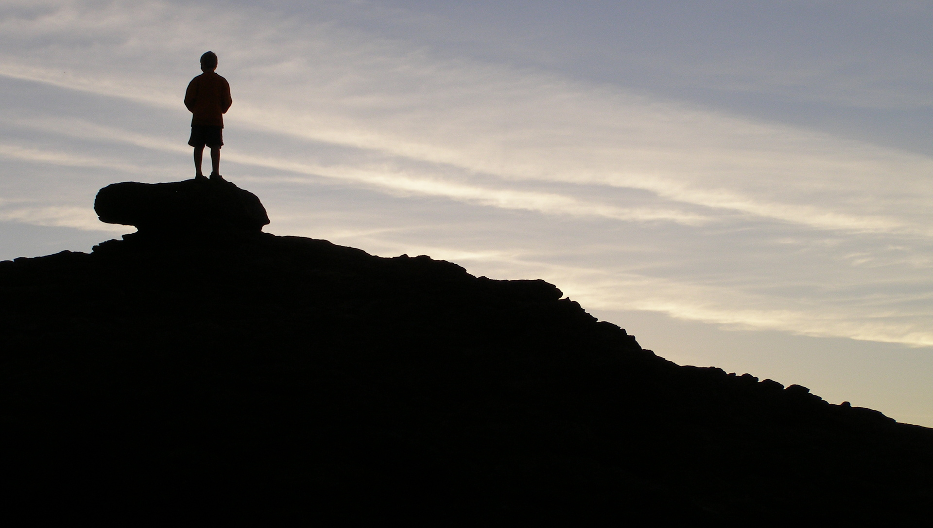
I strive, You inspire.
I intend, You challenge.
I forget, You forgive.
I fail, You love.
Help me, Lord Jesus, to be more like you. Amen.
Notes:
Prayer: Anna Field/CAFOD
Picture: Bryan Wintersteen from FreeImages

Slide 3
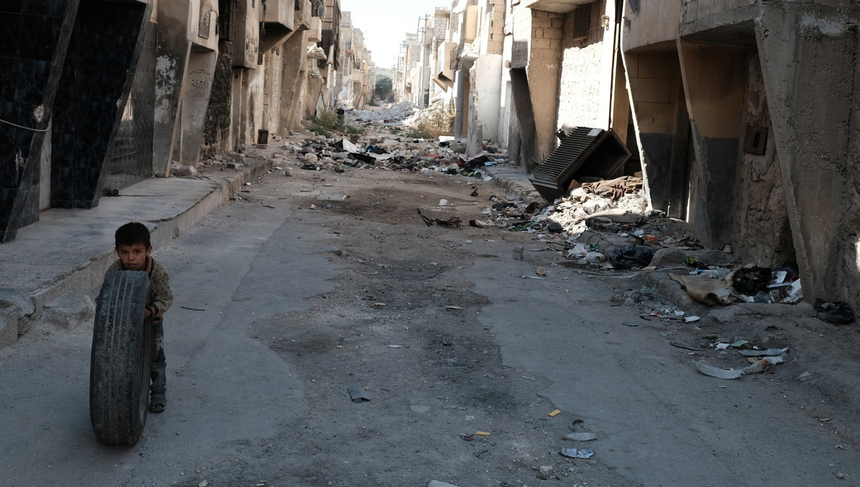
Faith into action
Lord Jesus,
help us to follow your call
and to put faith into action.
Let reflection on your word
lead to action in our world.
Amen.
Notes:
Prayer: Annabel Shilson-Thomas/CAFOD

Slide 4
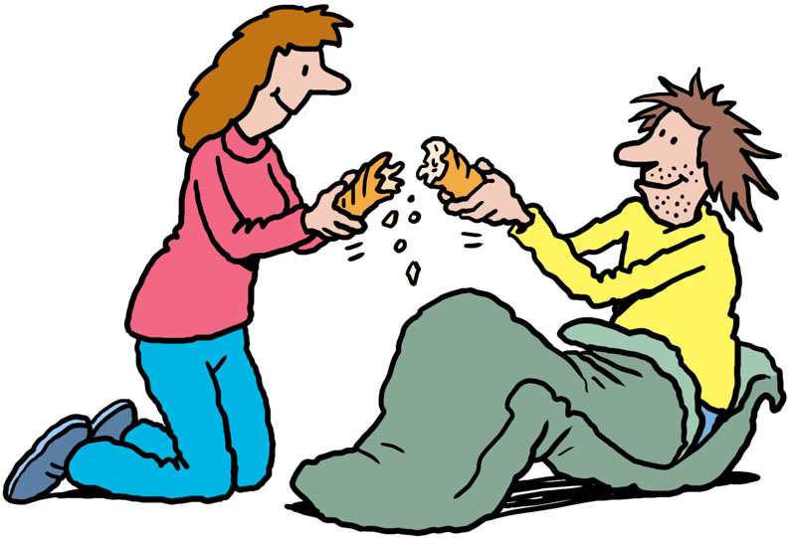
In all we do
In our waiting, in our praying, in our being,
by our actions and our words,
by our choices and decisions
may we make your love known.
In our tears and our anger,
by our sharing and our sheltering,
through our joy and thanksgiving,
may we make your love known.
Illustration by Ellis Nadler
Notes:
Prayer: Linda Jones/CAFOD

Slide 5
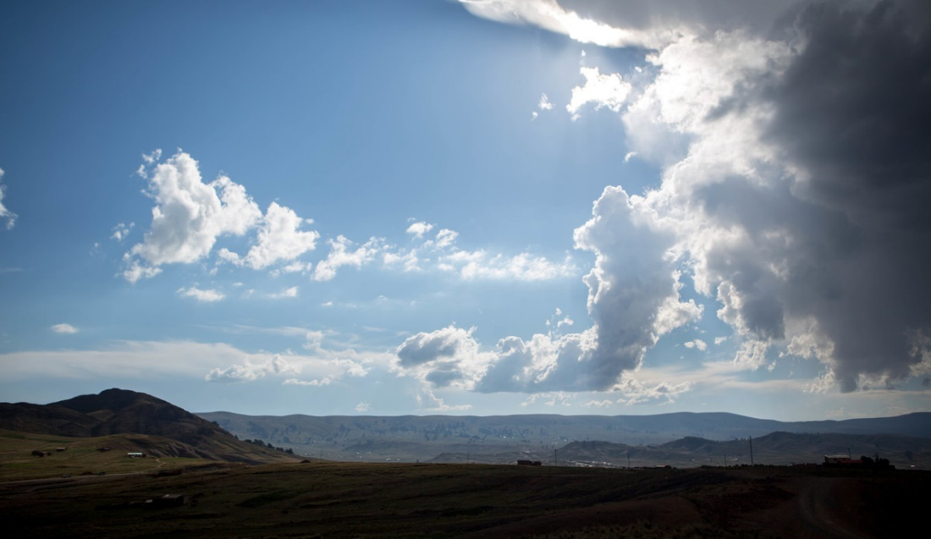
God of all
God of all women and men,
of every time and place,
watch over your people, we ask you.
Encourage us, God of life!
Even when things seem tough and gloomy,
remind us that you are close to us.
Give us the courage to stand up for
what we believe in
and the wisdom to trust
in your guidance and love.
Amen.
Notes:
Prayer: Jonathan Leach/CAFOD
Picture: CAFOD

