Slide 1
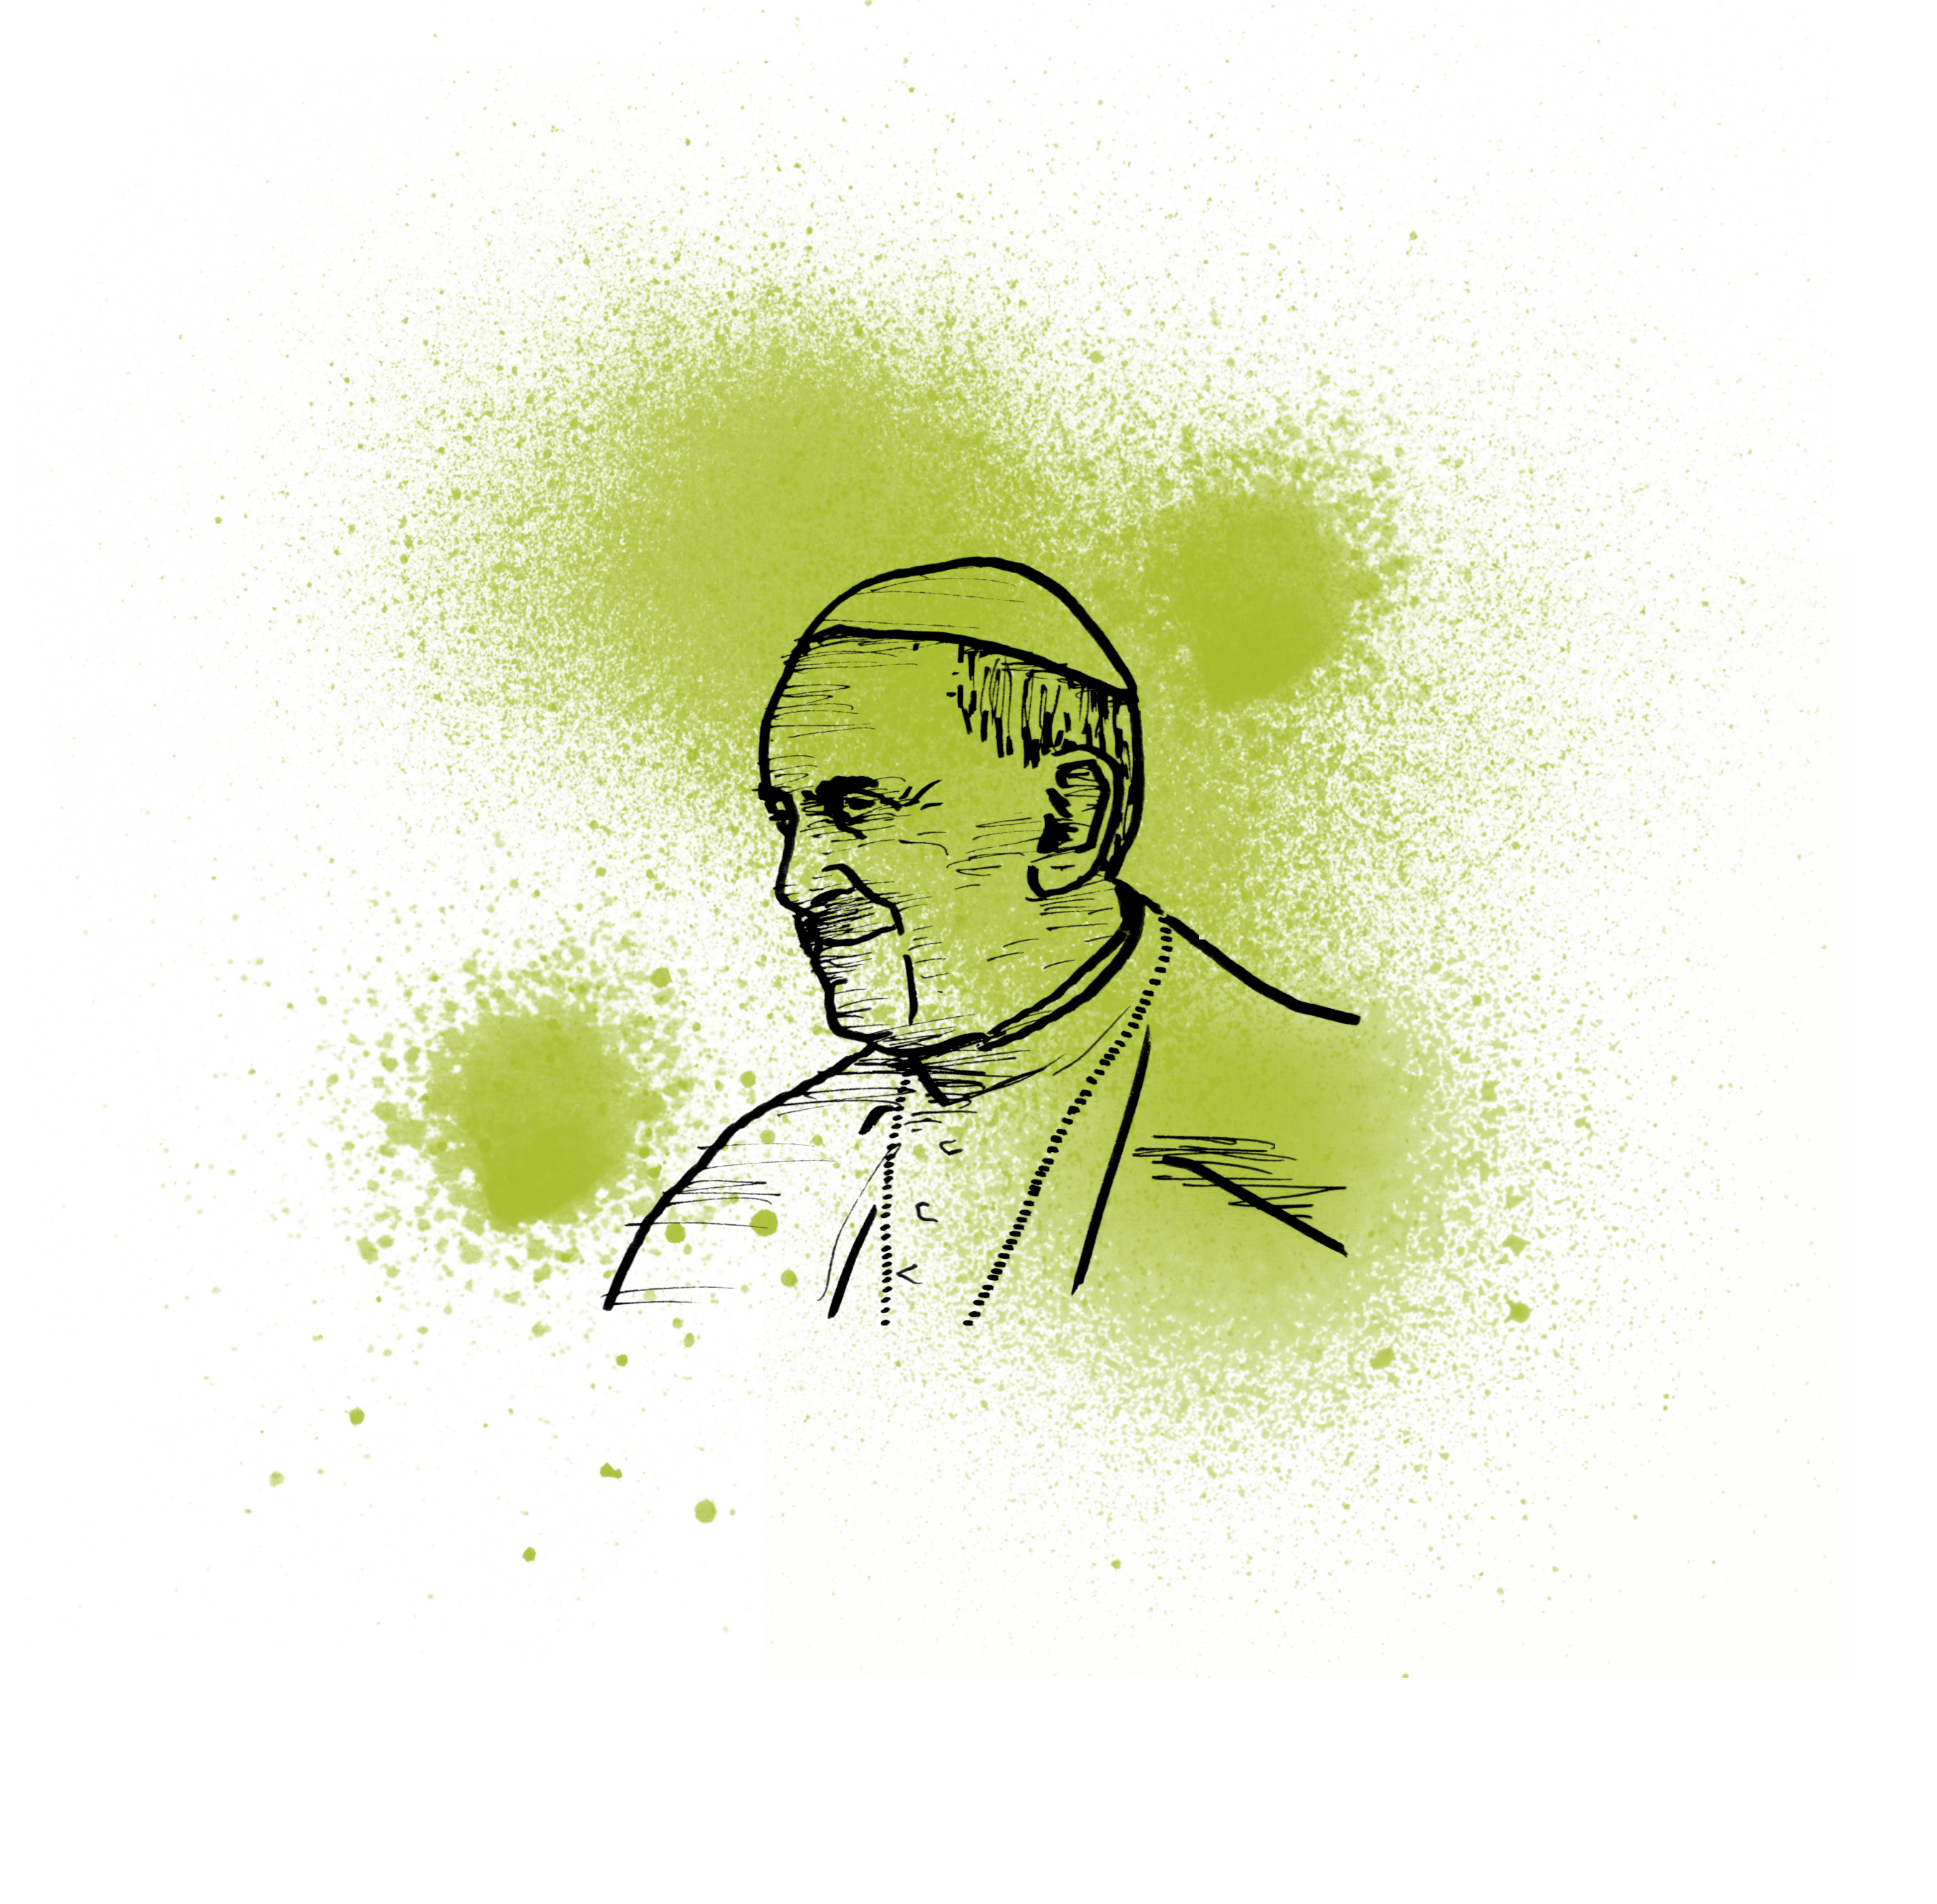
REVOLUTIONARY SERVICE
Challenge
1
GO SOLO
2
JUSTICE NOW!
Every little helps! ­ Change your life to change the world.
Add a meat-free day to your week and reduce your carbon footprint.
Turn off lights and chargers when you are not using them to save energy.
Use Twitter, Facebook or Instagram to share inspiring pictures and quotes.
Live on £1 a day in solidarity with those who don't have enough to eat. Tweet about it to spread the message, tagging @CAFOD.
At the end of each day, reflect on three things you are thankful for. Say a prayer of thanks.
Make friends with someone new.
Other:____________________________
_________________________________
Support those who need God's love and justice today!
Speak up for CAFOD on Lent or Harvest Fast Day to inspire people to support those who live in the greatest poverty across the world.
Volunteer for three hours for a local charity, for example, your local CAFOD office, SVP or your local food bank.
Take up a ministry in your parish.
Lead a short liturgy in your school or parish, praying for an important issue, such as peace.
Other:___________________________
________________________________
You've learned the theory, now put it into action!
“Be revolutionaries, swim against the tide.
Do not be afraid to go and to bring Christ into every area of life, to the fringes of society, even to those who seem farthest away.
The Church needs you, your enthusiasm, your creativity and the joy that is so characteristic of you!”
Pope Francis, World Youth Day, Rio, 2013
Here’s the deal – choose at least one action from each of the four boxes, agree a time limit and maybe a prize with your group. Who can complete the challenge first? Who can change the world? Serve others! Get revolutionary!

Slide 2
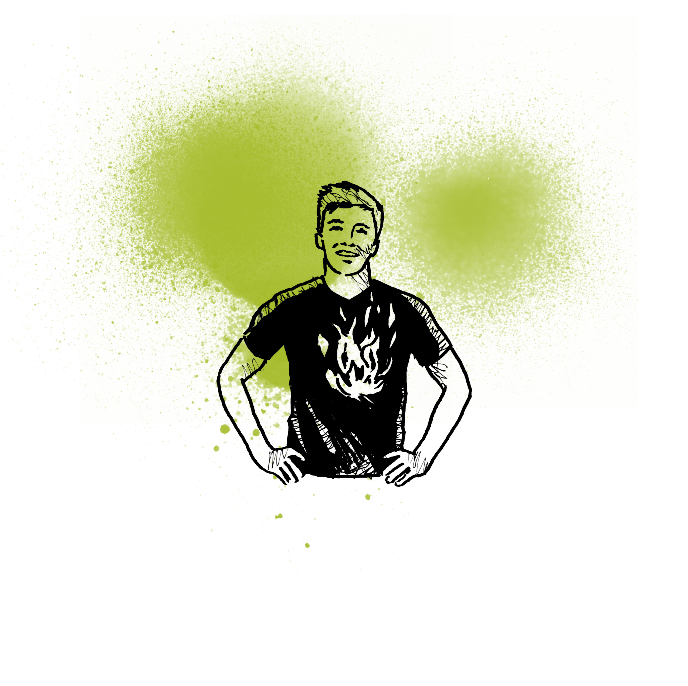
3
CHANGE THE SYSTEM
4
TEAM CHALLENGE
Tackle the root causes of injustice in our world. It's the only long-term way to stop it.
Get involved in CAFOD campaigns.
Go green, organise a ‘Walk to church Sunday’ at your parish.
Inspire the next generation:­ do an assembly in your local primary school. Search 'assembly' at cafod.org.uk/education.
Get creative – make a video or a piece of artwork about justice and share it online or in your parish to inform others.
Invite your MP to your church or school and question them about important justice issues, such as climate change.
Other:___________________________
________________________________
Fight for justice, help others and have fun along the way. Choose one activity to do as a team.
Organise a service day in your parish; perhaps people need help gardening or decorating.
Help run a children's liturgy session ­ cafod.org.uk/childrensliturgy
Organise a themed fundraiser for CAFOD. Brazil-themed party anyone? Get sporty or have a global bake-off.
Help organise a Mass (ask your priest first!) or other service; choose prayers and reflections about justice.
Other:___________________________
________________________________
For hints and tips on all of these email youth@cafod.org.uk
Get support from CAFOD in your area
cafod.org.uk/uk
Picture credit: Mazur/catholicnews.org.uk

