Slide 1



Year 1 Neighbours

Slide 2

The sky above tells
how wonderful God is.
Every day it is there for us to see.

Slide 3
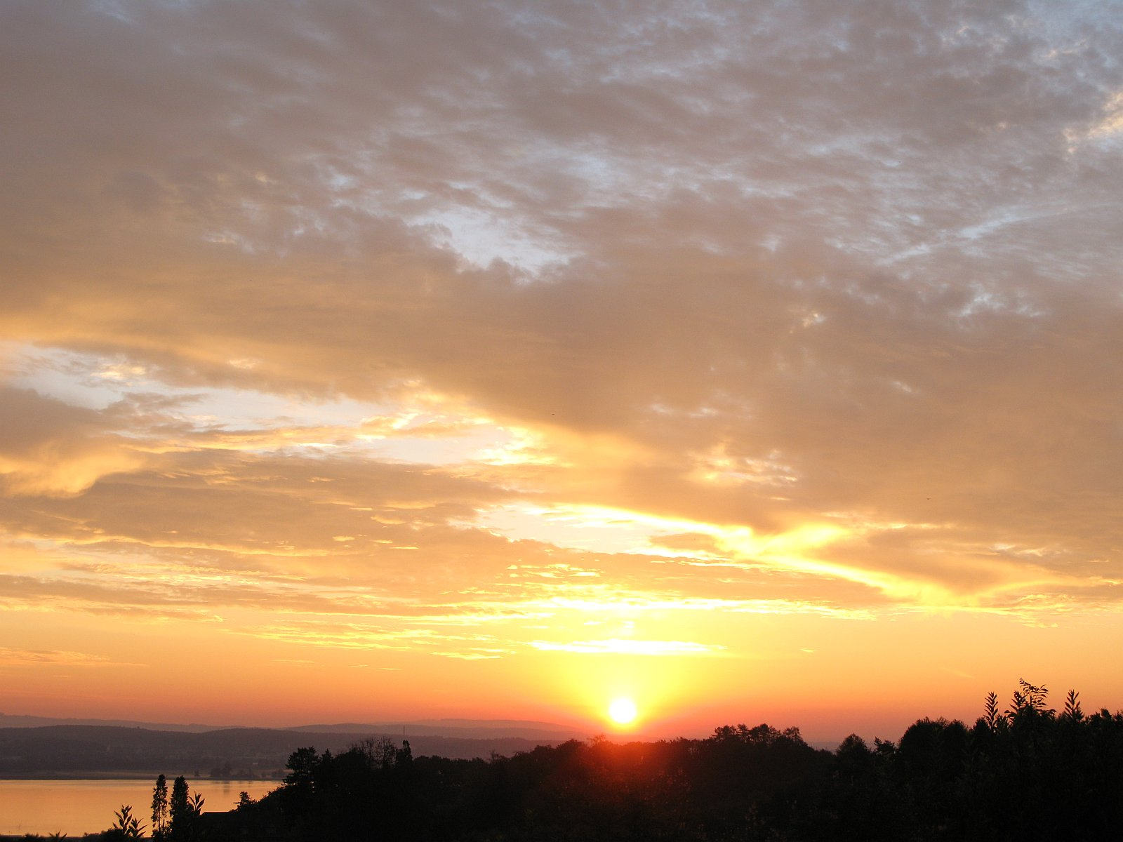
Every morning the golden sun
appears in the sky,
shining on everyone,
bringing light and warmth to all.

Slide 4
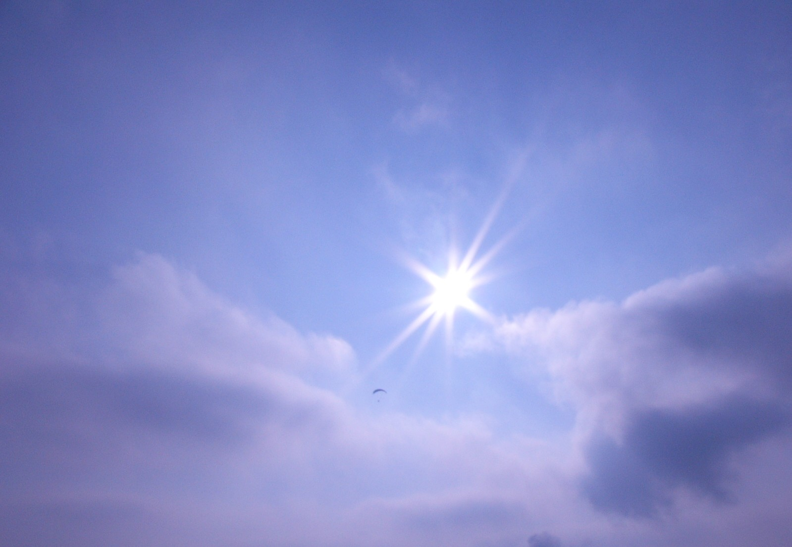
Spreading the message
of God’s love
to neighbours here,
neighbours there,
neighbours everywhere.
Based on Psalm 18: 1-5

