Slide 1
A prayer for our earth
from Pope Francis’ encyclical, Laudato Si’
This prayer is for all who believe in God,
the all-powerful Creator.
Notes:
Picture credit: CAFOD

Slide 2
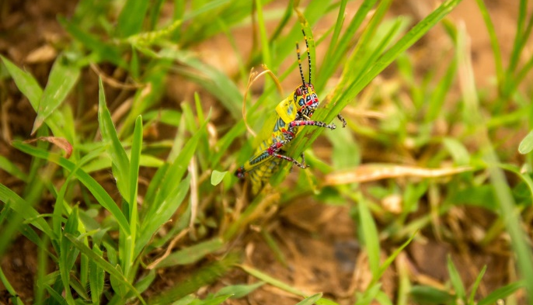
All powerful God,
you are present in the universe
and in the smallest of your creatures.
Notes:
Picture credit: CAFOD

Slide 3
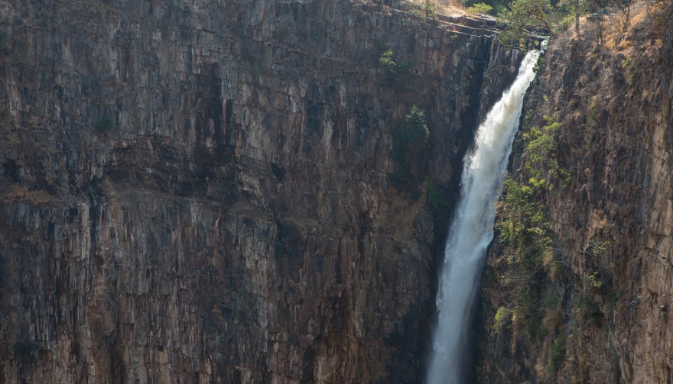
You embrace with your tenderness all that exists.
Pour out upon us the power of your love,
that we may protect life and beauty.
Notes:
Picture credit: CAFOD

Slide 4
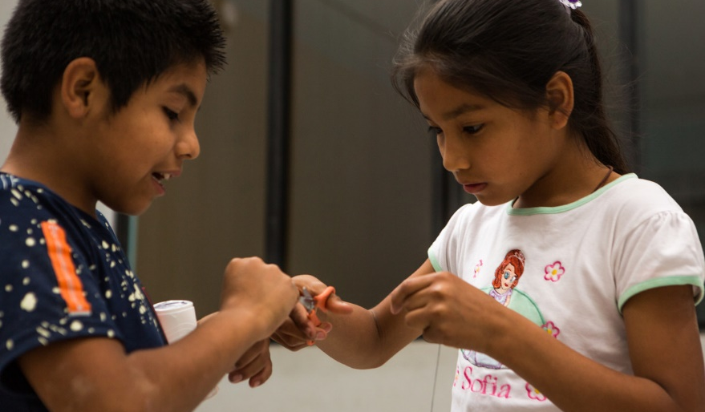
Fill us with your peace,
that we may live as brothers and sisters,
harming no one.
Notes:
Picture credit: CAFOD

Slide 5
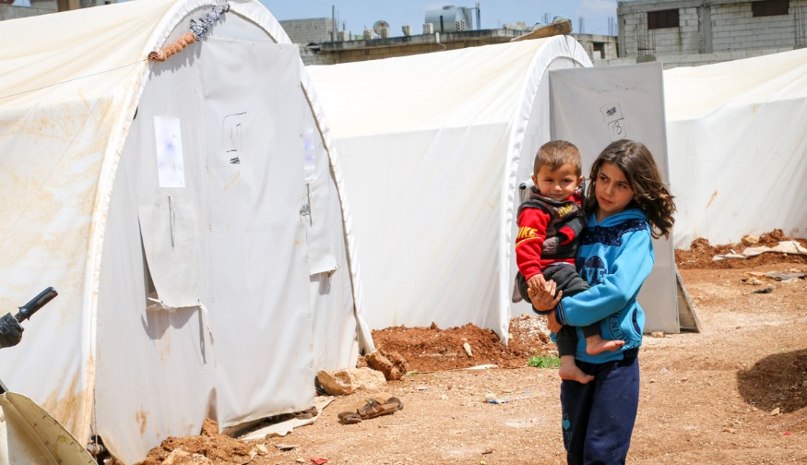
O God of the poor,
help us to rescue the abandoned
and forgotten of this earth,
so precious in your eyes.
Notes:
Picture credit: CAFOD

Slide 6
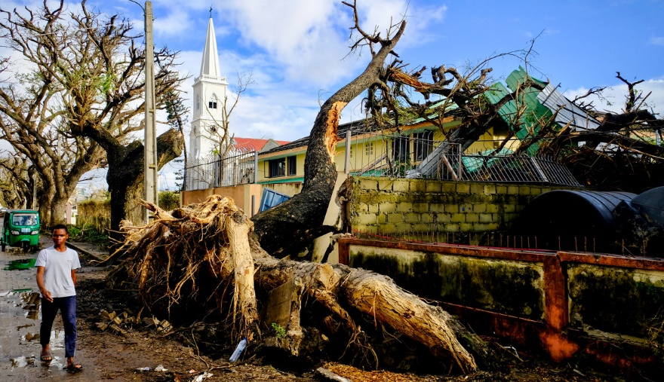
Bring healing to our lives,
that we may protect the world
and not prey on it,
that we may sow beauty,
not pollution and destruction.
Notes:
Picture credit: Joost Bastmeijer/ Caritas Internationalis

Slide 7
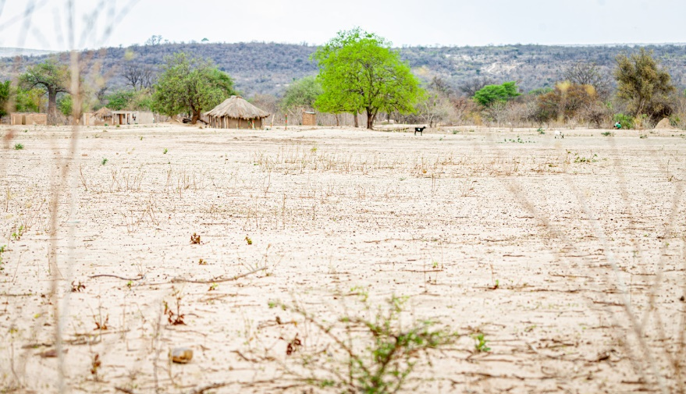
Touch the hearts
of those who look only for gain
at the expense of the poor and the earth.
Notes:
Picture credit: Charmaine Chitate

Slide 8
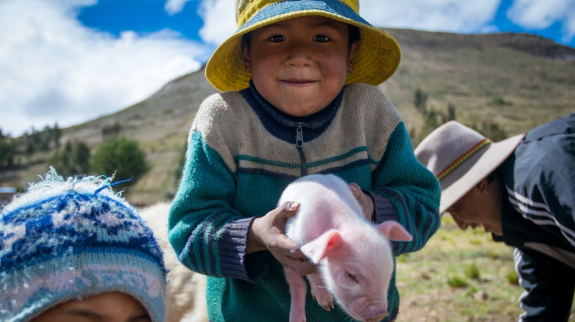
Teach us to discover
the worth of each thing,
to be filled
with awe and contemplation,
to recognise
that we are profoundly united
with every creature
as we journey
towards your infinite light.
Notes:
Picture credit: CAFOD

Slide 9
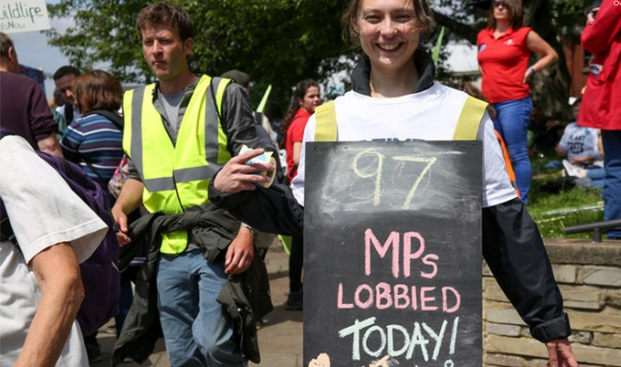
We thank you
for being with us each day.
Encourage us, we pray,
in our struggle,
for justice, love and peace.
Amen.
Notes:
Picture credit: CAFOD

