Slide 1
A game about disaster prevention and relief

Slide 2
AIM
Your team’s aim is to protect the people in a town before a flood.
The team that does this most successfully will be the winners.
HOW?
You will have a map of the town.
In turn, each person chooses an action, like protecting people in one square, or a ‘special action’ like working with local organisations to save more lives.
The flood will hit in just ten minutes.

Slide 3
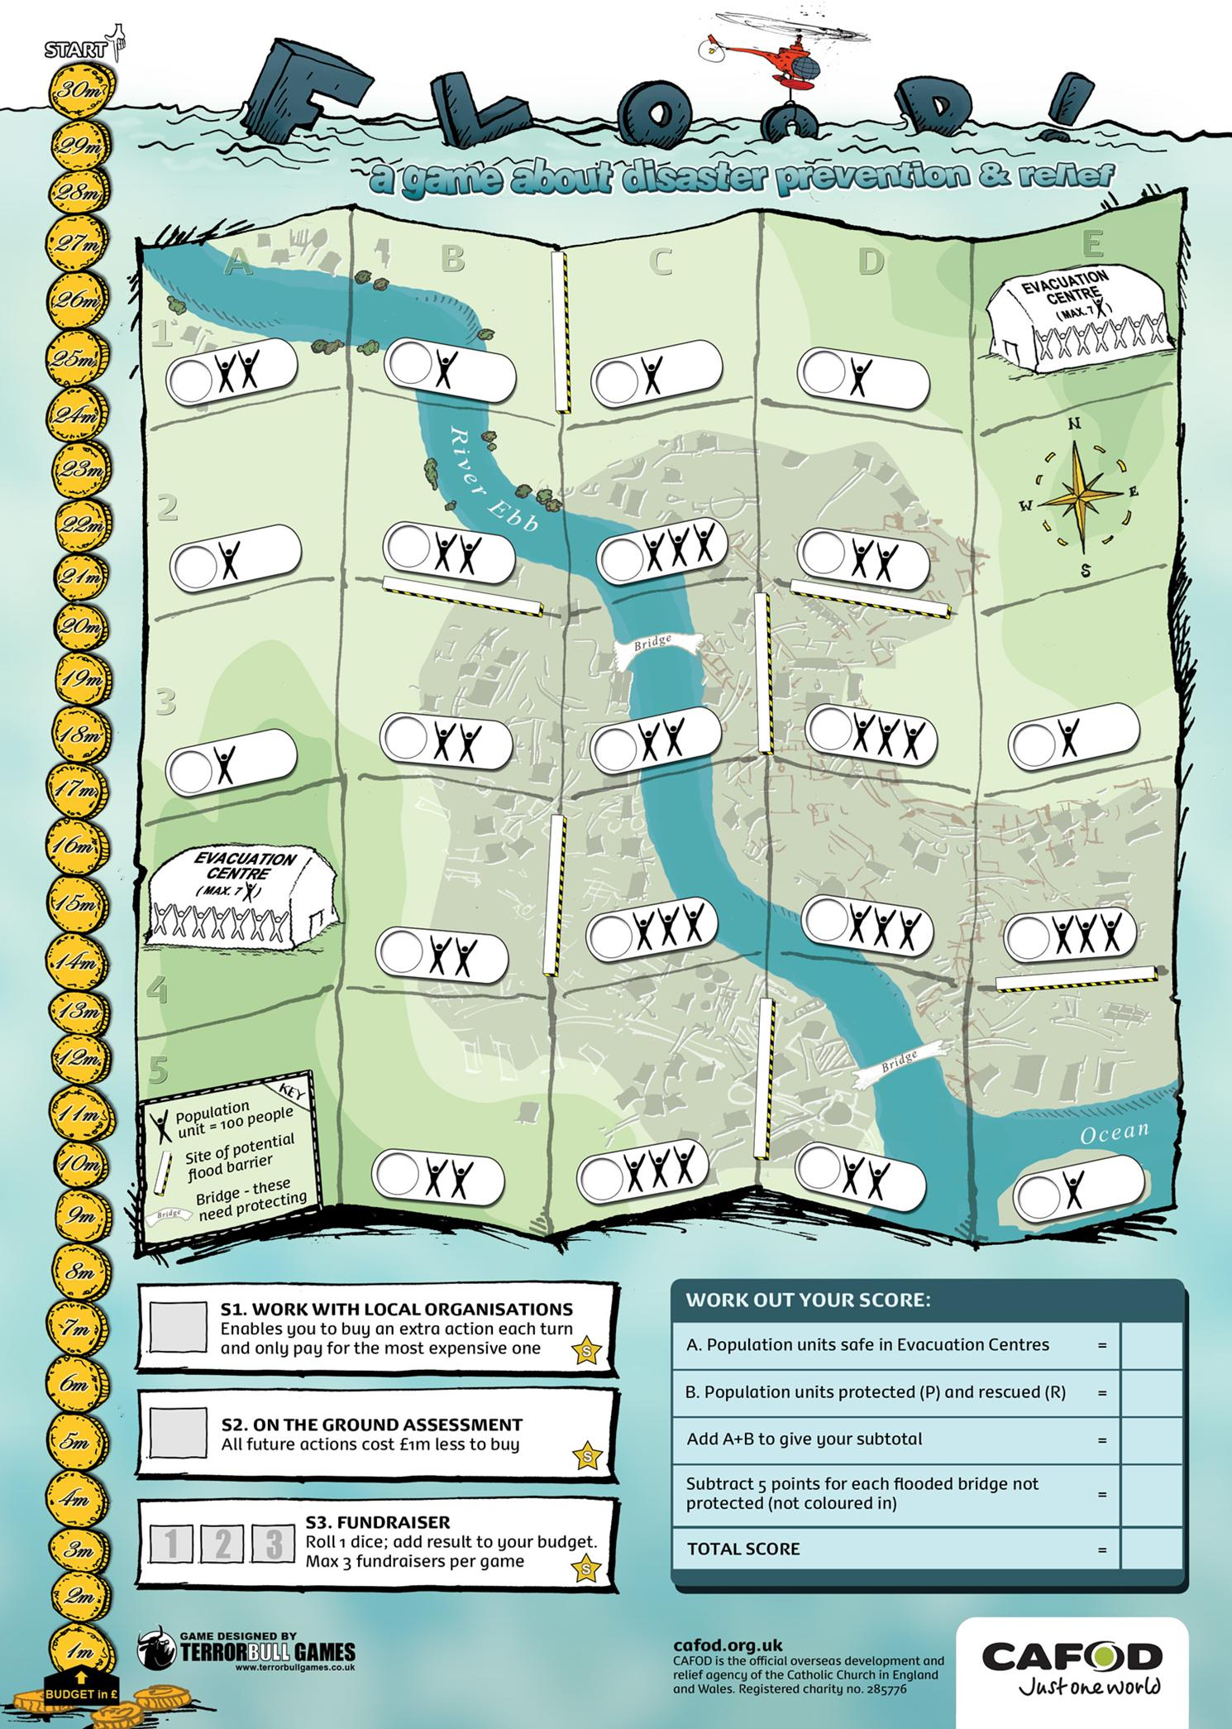
Put paperclip here
People Three people icons = 300 people. Save as many as you can.
Evacuation centre Colour in the people shapes so that you know when it’s full.
Bridge People need structures like bridges, roads and houses to survive. You’ll lose points later if your bridges are destroyed.
River The flood will start on a river square, so protect these.
Special Actions These help you to work better and more quickly. You will save more lives if you use them!

Slide 4
WHAT DO I DO?
IN YOUR TURN:
Choose one action from your clipboard:
EITHER Make a flood barrier or protect a bridge by colouring in.
OR Do a special action and record it on the chart under the map.
OR Pick a square and write P (protected), or E (evacuated) in the circular space.
Pay for your action!
P

Slide 5
STOP WHAT YOU ARE DOING!
The flood has started in square…..
Mark the square with a large “F” for Flood.
If a square floods, you cannot evacuate but you can rescue people. Write R (rescued) in the circular space.
R

Slide 6
FROM NOW ON!
The flood moves like this:
If the flood moves North
F
F
F
If it then moves West
If it then moves South
F
F
F
If it then moves East
F
F
F

Slide 7
AT THE END
(After 15 minutes, or as soon as the first group has flooded its entire map or taken all possible actions.)
Work out your score using the table under the map.
The team that has saved the most people is the winner.
This was just a game. In real emergencies, real lives are lost or saved.
What have you learned about emergencies and the work of an aid agency?

Slide 8
Resources to accompany this presentation can be found at:
cafod.org.uk/secondary/emergencies
Game designed by Terrorbull Games:
terrorbullgames.co.uk

